Slide 1

Seasonal Agriculture Performance Analysis
Tushar
( Netaji Subhas University Of Technology )
AICTE STU ID : STU6a6a3132c25111785344306

Slide 2

PROBLEM STATEMENT
Agricultural activities are influenced by seasonal variations in environmental conditions, farming practices, resource availability and market conditions. As a result, agricultural performance may differ from one season to another. However, raw agricultural data does not clearly explain how agricultural performance changes across seasons or what patterns can be observed in different seasonal conditions. The problem is to analyze the given agricultural dataset and investigate seasonal differences in agricultural performance by identifying meaningful patterns, trends, relationships and variations within the available data.

Slide 3
Project Description
This project analyzes a farm-level agricultural dataset covering 4,000 records across 8 Indian states, 8 crops and 3 growing seasons (Kharif, Rabi and Zaid). It studies how rainfall, temperature, irrigation method and farming practices relate to yield, resource usage and profitability, and compares performance season by season using univariate, bivariate and multivariate analysis. The goal is to move from raw records to clear, evidence-based insights and recommendations about which seasons, crops and irrigation methods perform best.

Slide 4

WHO ARE THE END USERS?
Farmers and farming cooperatives planning crops season-wise
Agricultural extension officers and district agriculture departments
Irrigation planners deciding on drip / sprinkler / flood adoption
Agri-business and supply chain analysts forecasting production
Policy makers designing seasonal subsidy or advisory programs
Students and researchers studying seasonal agricultural trends

Slide 5

Technology Used
  Python 3
Pandas & NumPy - data cleaning and aggregation
Matplotlib & Seaborn - visualization
Google Colab - notebook environment

Slide 6
RESULTS
4,000 farm records
analyzed across
8 states & 3 seasons
Kharif profit margin ~25%
vs. Zaid season
running an overall loss

Slide 7
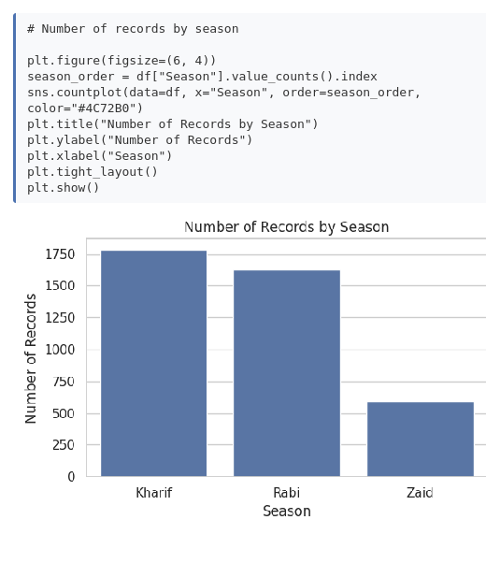
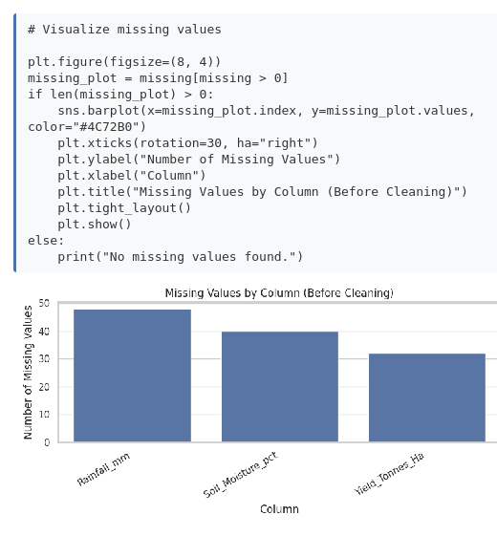
RESULTS
Dataset Overview & Missing Values

Slide 8
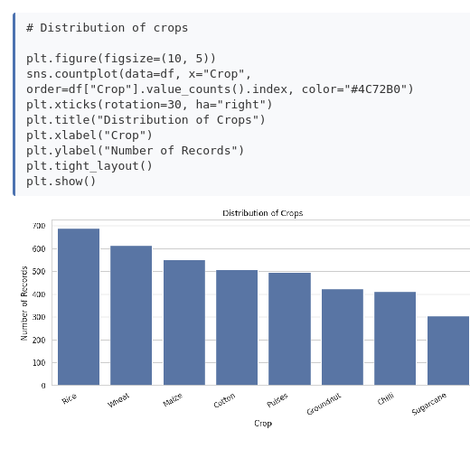
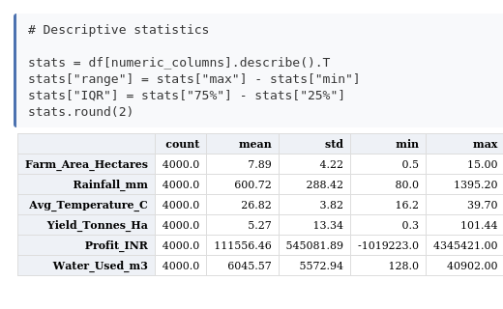
RESULTS
Statistical Analysis & Crop Mix

Slide 9
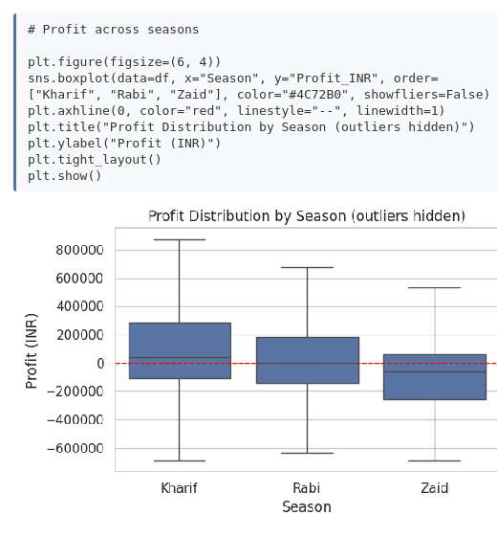
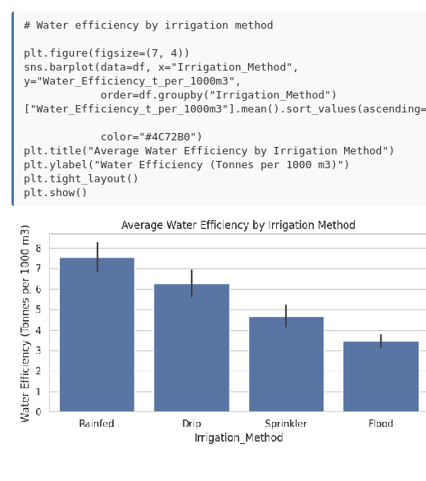
RESULTS
Profit & Irrigation Efficiency by Season

Slide 10
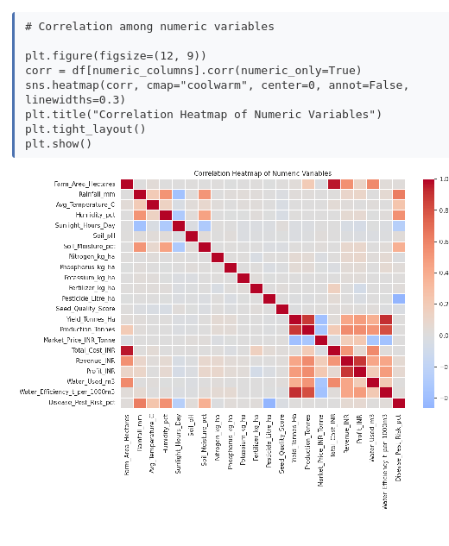
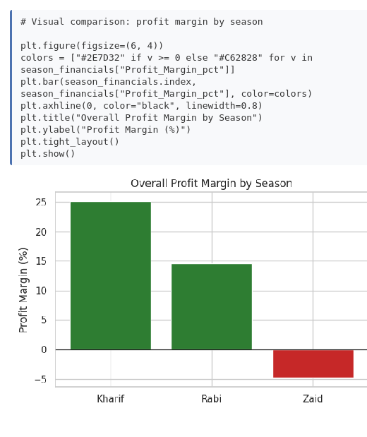
RESULTS
Correlation & Seasonal Profit Margin

Slide 11
Future scope
Extend to district-level
geospatial analysis
using GIS mapping
Add year-over-year data
to study multi-year
seasonal trends

Slide 12
GitHub Link
https://github.com/tushar0993/seasonal-agriculture-performance-analysis

Slide 13

VOIS Course completion certificate
Course name- Data Visualization

Slide 14
Thank you
.

