Slide 1
Sales Performance Analysis of Walmart Stores Using Advanced MySQL Techniques
Task 11: PPT Presentation and Video Submission Name: Tushar Bhatnagar
Batch: 15th September 2024
TEAM- 3

Slide 2

Task 1: Identifying the Top Branch by Sales Growth Rate Walmart wants to identify which branch has exhibited the highest sales growth over time. Analyze the total sales for each branch and compare the growth rate across months to find the top performer.
SQL SYNTAX:
WITH monthly_sales AS (
SELECT Branch, month(Date) AS month, SUM(Total) AS total_sales
FROM walmartsales_dataset
GROUP BY Branch, month),
monthly_growth AS
(SELECT Branch,month,total_sales,
LAG(total_sales) OVER (PARTITION BY Branch ORDER BY month) AS previous_month_sales,
(total_sales - LAG(total_sales) OVER (PARTITION BY Branch ORDER BY month)) / LAG(total_sales) OVER (PARTITION BY Branch ORDER BY month) * 100 AS growth_rate FROM monthly_sales)
SELECT Branch, AVG(growth_rate) AS avg_growth_rate FROM monthly_growth GROUP BY Branch ORDER BY avg_growth_rate DESC
Result
Graph

Slide 3
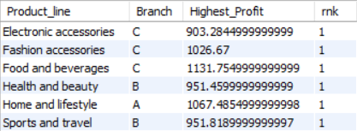
Task 2: Finding the Most Profitable Product Line for Each Branch Walmart needs to determine which product line contributes the highest profit to each branch. The profit margin should be calculated based on the difference between the gross income and cost of goods sold.
SQL SYNTAX:
SELECT Product_line,Branch,
SUM(gross_income) as Highest_Profit,
RANK() OVER (PARTITION BY Product_line ORDER BY SUM(gross_income) desc) as rnk
FROM walmartsales_dataset
GROUP BY Product_line, Branch
ORDER BY rnk
LIMIT 6;
Result
Graph

Slide 4
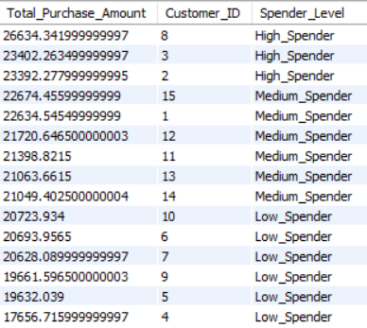
Task 3: Analyzing Customer Segmentation Based on Spending Walmart wants to segment customers based on their average spending behavior. Classify customers into three tiers: High, Medium, and Low spenders based on their total purchase amounts.
SQL SYNTAX:
SELECT SUM(Total) as Total_Purchase_Amount,
Customer_ID,
CASE
WHEN SUM(Total)>23000 THEN 'High_Spender’
WHEN SUM(Total)>21000 THEN 'Medium_Spender’
ELSE 'Low_Spender’
END AS Spender_Level
FROM walmartsales_dataset
GROUP BY Customer_ID
ORDER BY SUM(Total) desc
Result

Slide 5
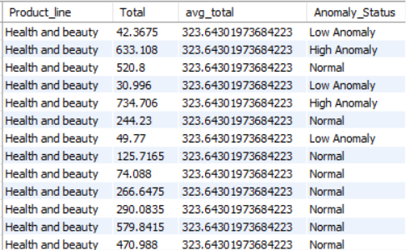
Task 4: Detecting Anomalies in Sales Transactions (6 Marks) Walmart suspects that some transactions have unusually high or low sales compared to the average for the product line. Identify these anomalies.
SQL SYNTAX:
WITH ProductLineStats AS (
SELECT Product_line, AVG(Total) AS avg_total
FROM walmartsales_dataset
GROUP BY Product_line)
SELECT w.Product_line, w.Total, p.avg_total,
CASE
WHEN w.Total > p.avg_total*1.80 THEN 'High Anomaly' WHEN w.Total < p.avg_total*0.20 THEN 'Low Anomaly' ELSE 'Normal'
END AS Anomaly_Status
FROM walmartsales_dataset w
JOIN ProductLineStats p
ON w.Product_line = p.Product_line
Result

Slide 6

Task 5: Most Popular Payment Method by City Walmart needs to determine the most popular payment method in each city to tailor marketing strategies.
SQL SYNTAX:
SELECT count(Payment),
Payment as Popular_Payment_Method,
City
FROM walmartsales_dataset
GROUP BY city, payment
ORDER BY count(payment) desc,
Payment,City
LIMIT 3;
Result

Slide 7
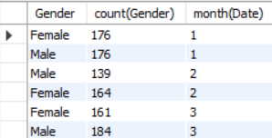
Task 6: Monthly Sales Distribution by Gender Walmart wants to understand the sales distribution between male and female customers on a monthly basis.
SQL SYNTAX:
SELECT Gender,count(Gender),month(Date)
FROM walmartsales_dataset
GROUP BY Gender, month(Date)
ORDER BY month(Date)
Result
Graph

Slide 8
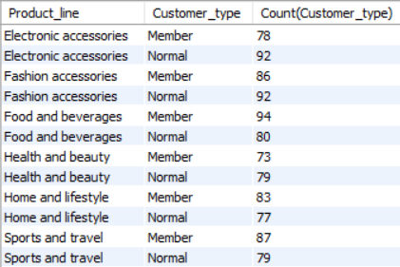
Task 7: Best Product Line by Customer Type Walmart wants to know which product lines are preferred by different customer types(Member vs. Normal).
SQL SYNTAX:
SELECT Product_line,
Customer_type,
Count(Customer_type)
FROM walmartsales_dataset
GROUP BY Product_line,Customer_type
ORDER BY Product_line
Result
Graph

Slide 9
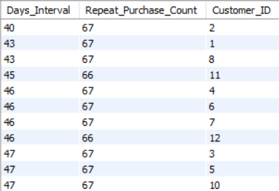
Task 8: Identifying Repeat Customers Walmart needs to identify customers who made repeat purchases within a specific time frame (e.g., within 30 days).
SQL SYNTAX:
SELECT count( distinct Date) as Days_Interval,
count(Invoice_ID) as Repeat_Purchase_Count ,
Customer_ID
FROM walmartsales_dataset
GROUP BY Customer_ID
ORDER BY count(distinct Date) asc
Result

Slide 10
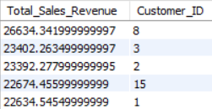
Task 9: Finding Top 5 Customers by Sales Volume Walmart wants to reward its top 5 customers who have generated the most sales Revenue.
SQL SYNTAX:
SELECT SUM(Total) as Total_Sales_Revenue,
Customer_ID
FROM walmartsales_dataset
GROUP BY Customer_ID
ORDER BY SUM(Total) desc
LIMIT 5;
Result
Graph

Slide 11
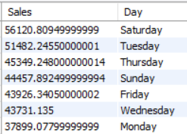
Task 10: Analyzing Sales Trends by Day of the Week Walmart wants to analyze the sales patterns to determine which day of the week brings the highest sales.
SQL SYNTAX:
SELECT SUM(Total) as Sales,
dayname(Date) as Day
FROM walmartsales_dataset
GROUP BY dayname(Date)
ORDER BY SUM(Total) desc
Result
Graph

Slide 12
Analysis & Findings
Branch A has exhibited the highest sales growth over time
Electronic accessories, Fashion accessories, Food and beverages contributes the highest profit to Branch C, Health and beauty & Sports and travel contributes the highest profit to Branch B and Home and lifestyle contributes the highest profit to Branch A
We find customers 8,3,2 as high spenders, customers 15,1,12,11,13,14 as medium spenders and customers 10,6,7,9,5,4 as low spenders
We detected anomalies based on whether the transaction amount was higher or lower by 80% of the average of product line.
We found Ewallet as popular payment method for cities Yangon & Mandalay and cash as popular payment method for city Naypyitaw
We found equal distribution between male and female customers in first month, then more female customers than males in second month and then more male customers than female in third month
we found for product line Food and beverages,Home and lifestyle & Sports and travel, customer type members preferred more than normal customers. Similarly for product line Electronic accessories,Fashion accessories & Health and beauty, normal customer type preferred more than members.
We found customers 2,1,8,11,4,6,7 has made most number of repeat purchases within a shorter timeframe
We find customers 8,3,2,15,1 as top 5 customers by sales volume
We find Saturday as day of the week which brings the highest sales

Slide 13
Video Submission Link
https://drive.google.com/file/d/1PkeZJlnkgqfbMwwmSod143eCCZbhriyp/view?usp=sharing

