Slide 1
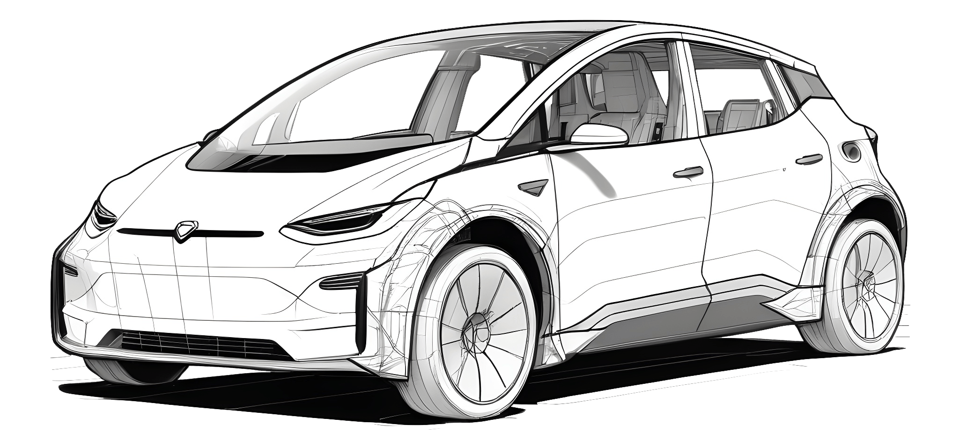
SMART RIDE CONNECT
Ride Smarter, Travel Together
Presented By:
Amey Rupune (250245920011)
Rujula Deshmukh (250245920021)
Tushar Kale (250245920037)
Sujata Yeole (250245920098)

Slide 2
INTRODUCTION
Smart Ride Connect is an innovative web-based platform that bridges the gap between drivers with available car seats and passengers seeking convenient and affordable travel options. Designed to make commuting smarter and more efficient, the application allows drivers to publish ride details such as departure location, destination, time, seat availability, and fare. Passengers can search for rides that match their preferences and request bookings directly through the platform. With real-time matching, secure communication, GPS-based route tracking, and post-trip ratings, Smart Ride Connect ensures a safe, reliable, and eco-friendly ride-sharing experience. Advanced Encryption Standard (AES) is used to safeguard user data, making the platform secure and trustworthy for everyday travel.

Slide 3
PROBLEM DEFINITION
Daily commuting leads to traffic congestion, high fuel costs, and empty vehicle seats.
Many people travel the same routes but have no safe way to connect for shared rides.
Current ride-sharing platforms lack features, safety, or transparency.
There is a need for a user-friendly system for ride-sharing.
Drivers should be able to offer rides; passengers should easily find and book them.
Important features include communication, ride tracking, and user ratings.
Smart Ride Connect solves this by offering a secure, efficient, and web-based carpooling platform.
It benefits both drivers and passengers and supports eco-friendly travel.

Slide 4
GOALS AND OBJECTIVES
Goals
To develop a secure and user-friendly web-based ride-sharing platform.
To connect drivers with available seats to passengers seeking travel options.
To promote cost-effective, efficient, and eco-friendly commuting.
Objectives
To allow drivers to publish ride details including route, date, time, seats, and pricing.
To implement a real-time ride matching and booking confirmation system.
To provide a post-trip rating and review mechanism for transparency and trust.

Slide 5
SCOPE OF THE PROJECT
Build a web-based ride-sharing platform.
Drivers can post rides with route, date, time, seats, and price.
Passengers can search and request rides based on their needs.
System matches rides and confirms bookings.
Chat option for driver and passenger before the ride.
Users can rate and review after the ride.

Slide 6
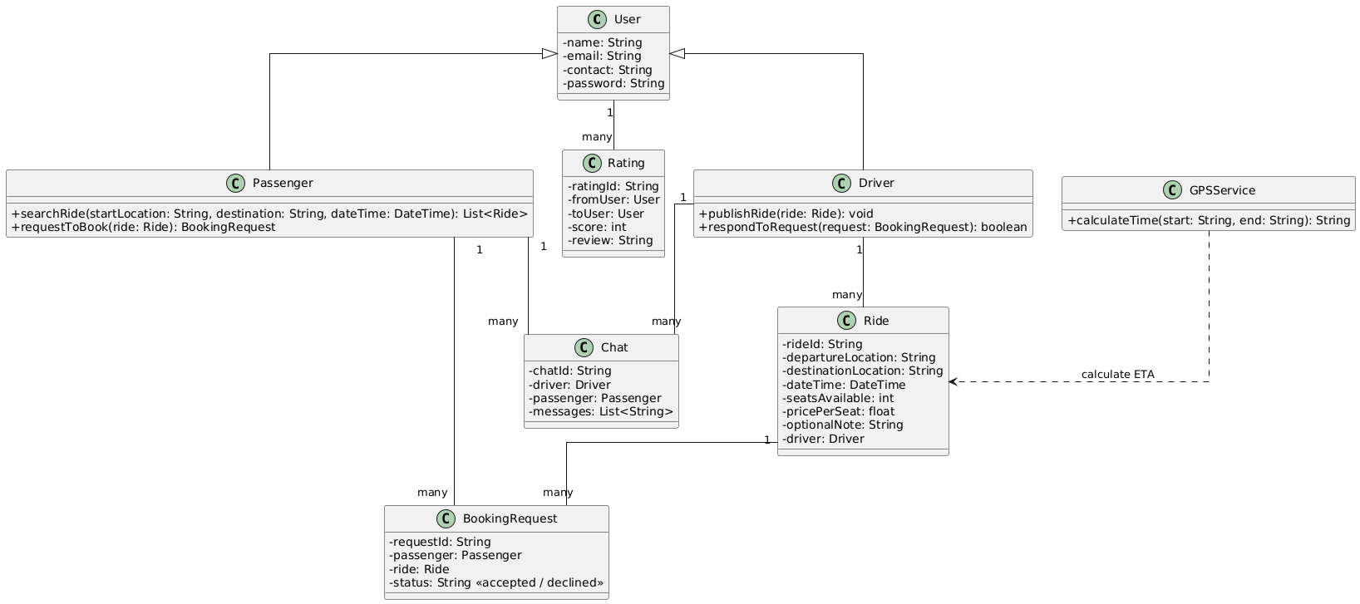
ER Diagram

Slide 7
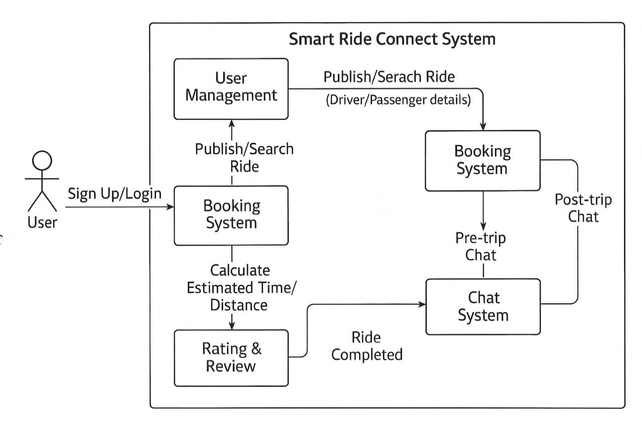
DFD
(Driver/Passenger)

Slide 8
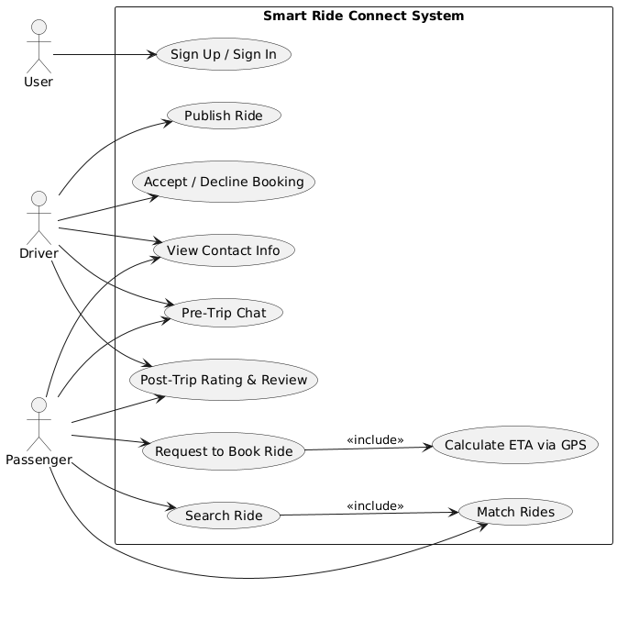
Use-Case Diagram

Slide 9
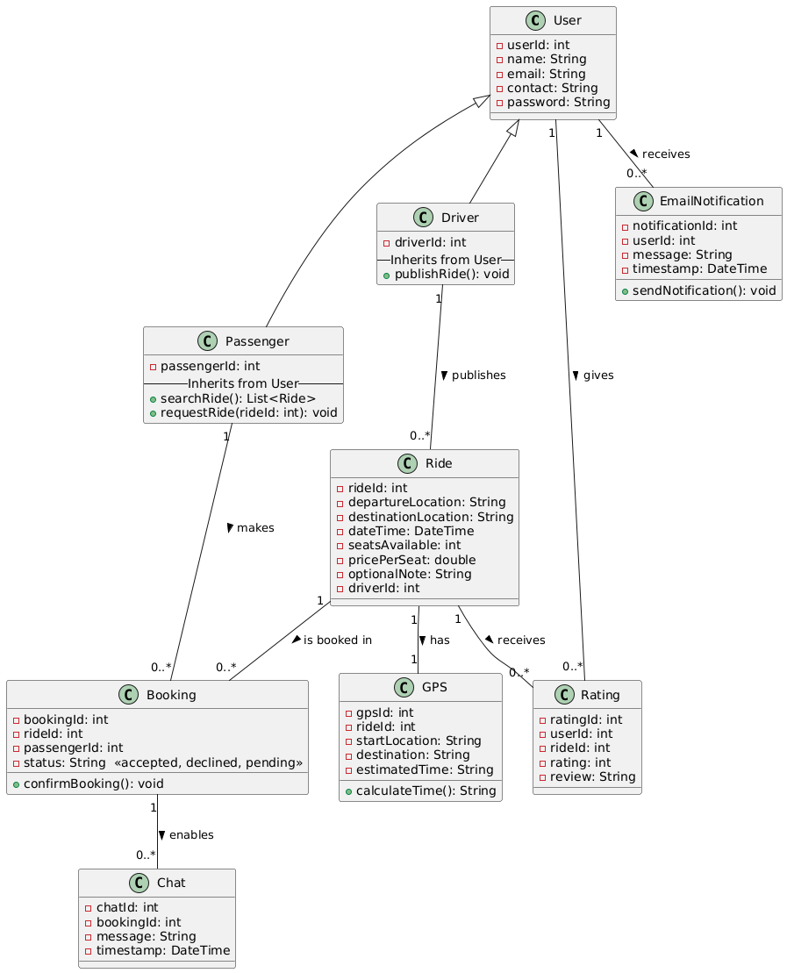
Class Diagram

Slide 10
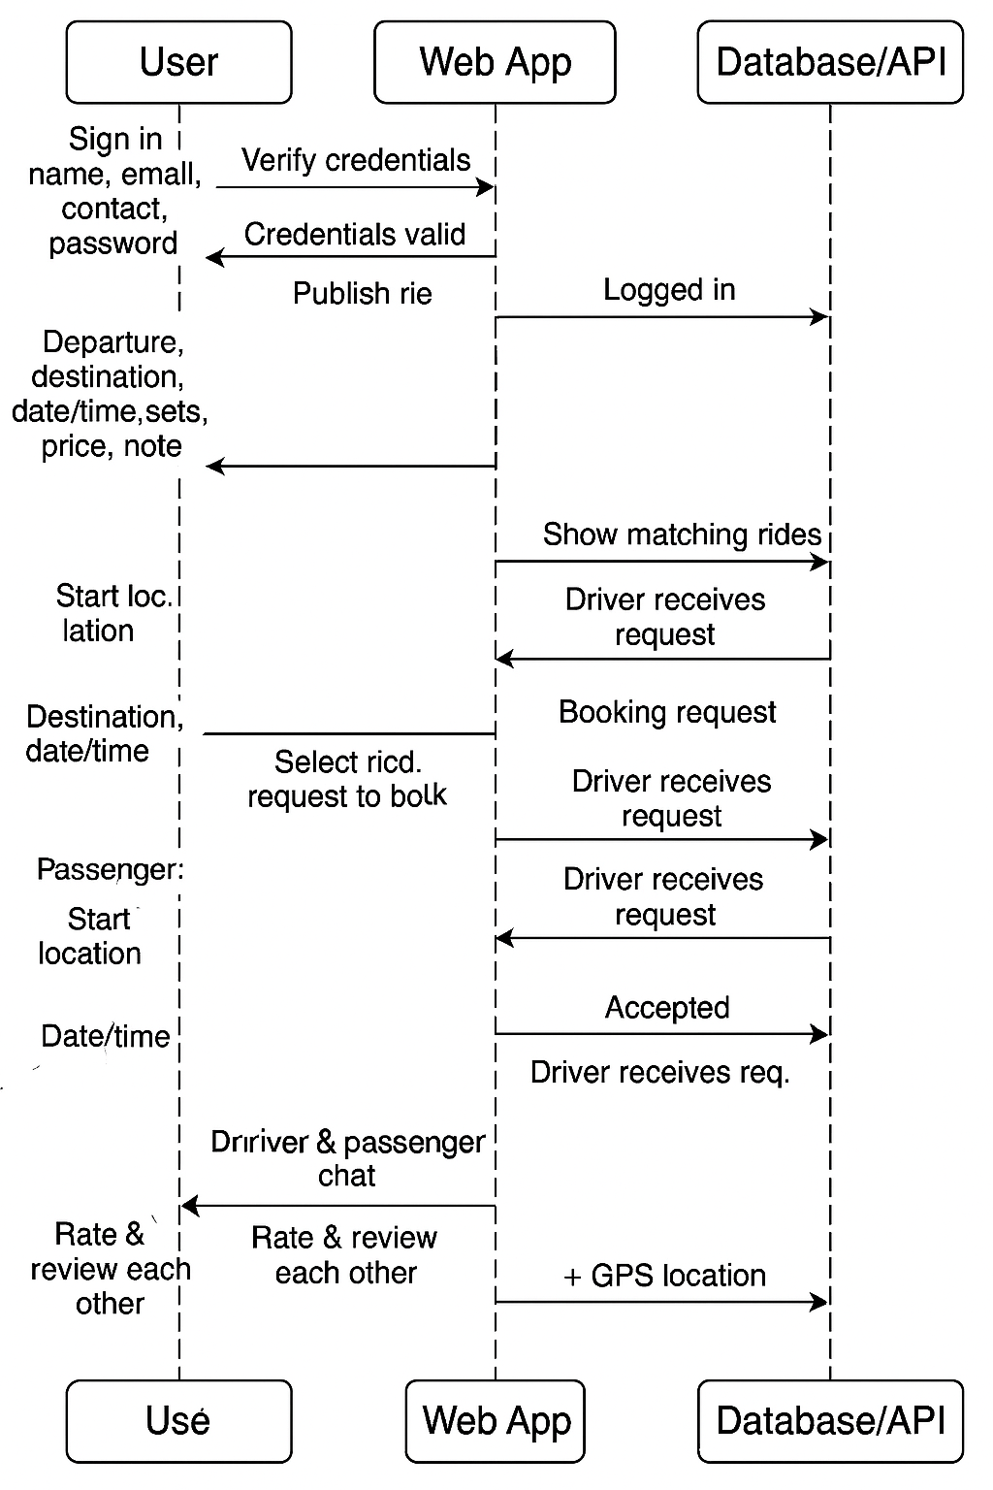
Sequence Diagram

Slide 11
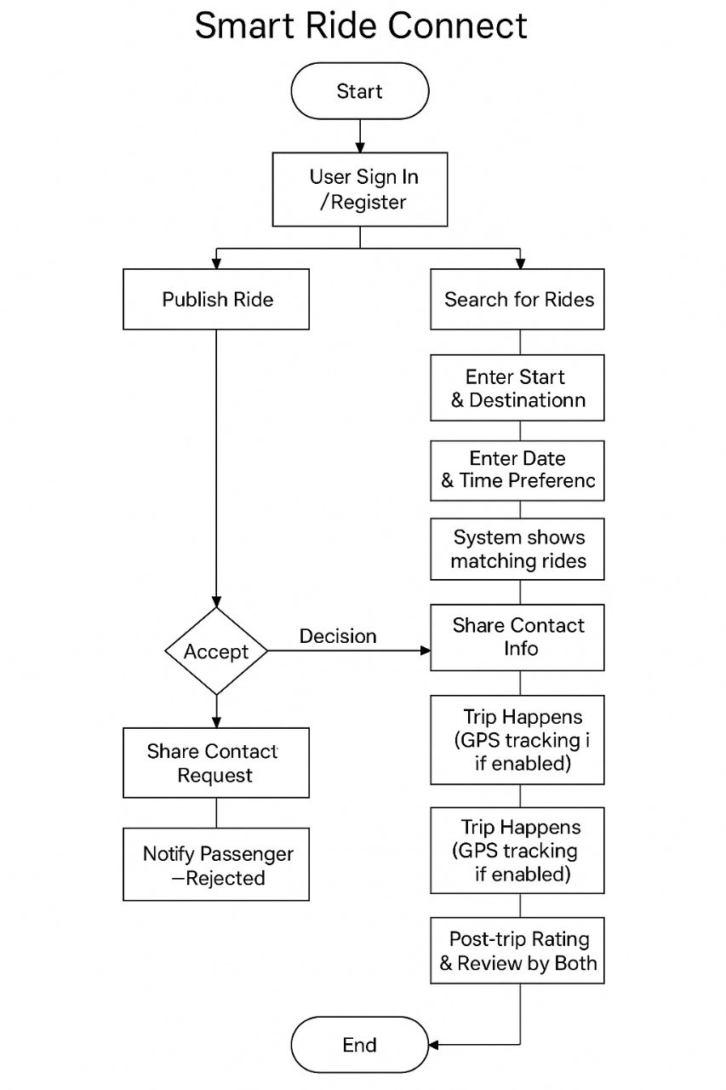
Activity Diagram

Slide 12
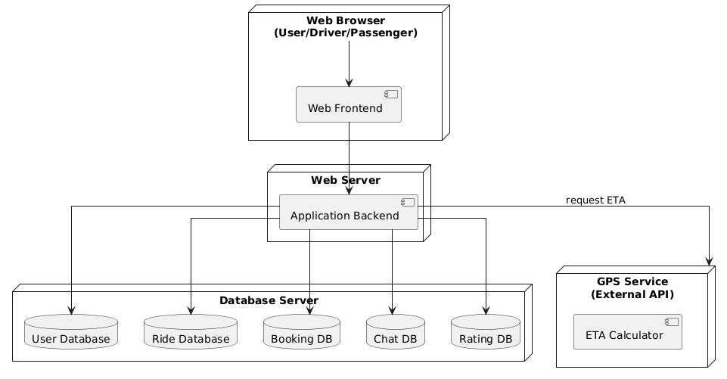
Deployment Diagram

Slide 13
Thank You!!

