Slide 1
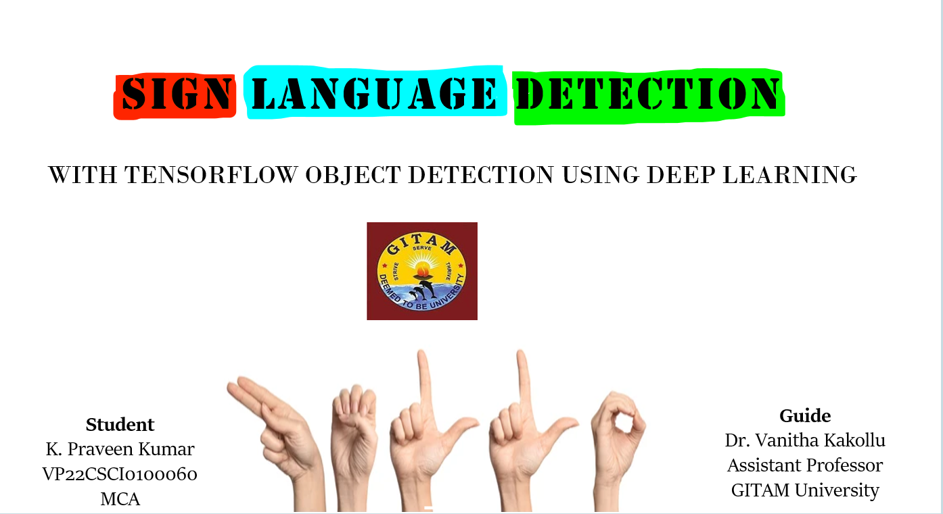

Slide 2
ABSTRACT
This is a cutting-edge project that aims to leverage the power of deep learning, specifically utilizing Tensorflow Object Detection, to enhance sign language detection and interpretation.
The project addresses the need for efficient and accurate real-time recognition of sign language gestures, contributing to improved accessibility and communication for the deaf and hard-of-hearing community.
The system utilizes Convolutional Neural Networks (CNNs) implemented through the Tensorflow framework, providing a robust and versatile solution for detecting and interpreting various sign language gestures.

Slide 3
Problem statement
The project involves the creation of a comprehensive dataset containing a diverse range of sign language gestures, ensuring the model's adaptability across different signing styles and cultural variations.
This project uses implementation of the trained model into a real-time application, allowing users to communicate through sign language in diverse environments.
The system will be designed to recognize and interpret gestures efficiently, providing instantaneous feedback.

Slide 4
Domain
The domain of sign language detection using TensorFlow in deep learning spans several areas, and its applications can be diverse. Sign language detection can be utilized to support sign language interpreters.
Automated systems can assist interpreters in real-time, providing additional resources during situations with high demand for interpretation services.
The domain of sign language detection in deep learning continues to evolve with ongoing research and advancements in technology, opening up new possibilities for improving accessibility and communication across various domains.

Slide 5



WHY THIS PROJECT ?
The idea of this project is to make intercity travel easier for people with disabilities. They can be independent and can travel from place to place without someone to aid them. An incident I once saw in a bus made me think of this. A guardian was very hesitant to help those who are dumb. So I thought of how it would be if they can actually travel without support of anyone and at that time I saw this concept of sign language detection and decided to use it for the benefit of only traveling where it can still be used for many other things.

Slide 6
Model differences
Existing model
Proposed model
The existing models of Sign Language Detection works on the basis of ASL and the recognition of each note is done using only one alphabet at a time.
This model recognizes the hand signs of the words letter by letter.
So to complete a sentence the alphabet which was fixed by ASL is used to spell out like Morse Code.
The previous models of sign language detection uses ASL and each sign denotes only the alphabets available in sign language.
This would take a lot of time for each letter to form a sentence.
In this model we offer the availability of words instead of letters that are present in sign language and can be recognised by the machine.

Slide 7
algorithms
Deep learning models, namely, LSTM(Long Short-Term Memory) and GRU(Gated Recurrent Unit). These are feedback-based learning models and are used to recognize signs from isolated American Sign Language (ASL) video frames. The four different sequential combinations of LSTM and GRU (as there are two layers of LSTM and two layers of GRU) were used with own dataset.

Slide 8
LSTM & GRU
LSTM: Long Short Term Memory (LSTM) is an artificial neural network used in the field of artificial intelligence and deep learning. Unlike standard neural networks, LSTMs have feedback connections. The Long Short Term Memory has three gates which are likely--
Input gate
Forget gate
Output gate
GRU: Sign language recognition is challenged by problems, such as accurate tracking of hand gestures, occlusion of hands, and high computational cost. However, these larger complex approaches cannot manage long-term sequential data and they are characterized by poor information processing and learning efficiency in capturing useful information. To overcome these challenges, I propose an integrated MediaPipe-Optimized Gated Recurrent Unit (MOPGRU) model for ASL.

Slide 9
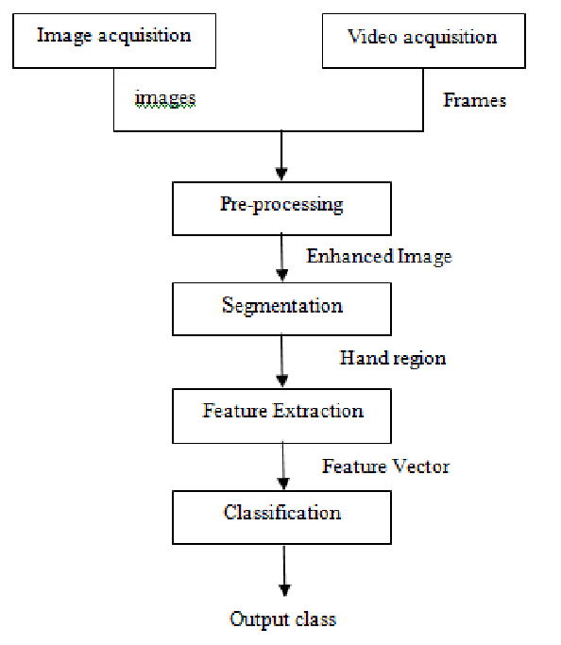
architecture

Slide 10
Dataset description
The dataset was obtained from Kaggle.
The dataset contains a total of 90 instances.
The features include
  Image-based Features
  Temporal Features
  Hand Region of Interest (ROI)
  Hand and Body Pose Estimation
  Optical Flow

Slide 11
Image-based Features
Raw Pixel Values: Uses the raw pixel values of the images as input features.
Color Histograms: Represents the distribution of colors in an image.
Texture Features: Includes information about the texture of the image, such as Gabor filters or local binary patterns.

Slide 12
Temporal features
Temporal Convolutional Networks (TCN): Utilizes 1-D convolutions to capture temporal dependencies in the video sequence.
Long Short-Term Memory (LSTM) Networks: It incorporate the memory cells to model temporal dependencies in the data.

Slide 13
HAND REGION OF INTEREST (ROI)-
Hand Segmentation: Isolates and focuses on the region of the image containing the signer's hands.
HAND AND BODY POSE ESTIMATION-
Keypoint Detection: Identifies key points on the hands and body, which can be used to represent the pose of the signer.
Skeleton Representation: Represents the hand and body pose using a skeletal structure.
OPTICAL FLOW-
Motion Information: Uses optical flow to capture motion information between consecutive frames.

Slide 14
splitting the dataset
Training Set: The largest portion of the dataset, typically around 70-80% of the total data, is allocated to the training set. This is the data used to train the deep learning model.
Validation Set: The validation set is used during training to fine-tune hyperparameters and prevent overfitting. It helps to monitor the model's performance on data it has not seen during training. Around 10-20% of the total data, is allocated to the validation set.
Test Set: This set is not used during training or validation and is kept completely separate until the model is fully trained. It serves as an independent evaluation to assess the model's generalization to new, unseen data. The remaining portion, roughly 10-20% of the total data, is reserved for the test set.

Slide 15
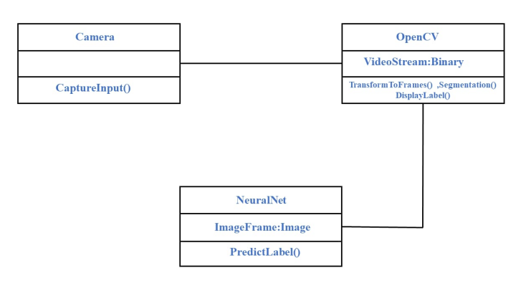
Class Diagram

Slide 16
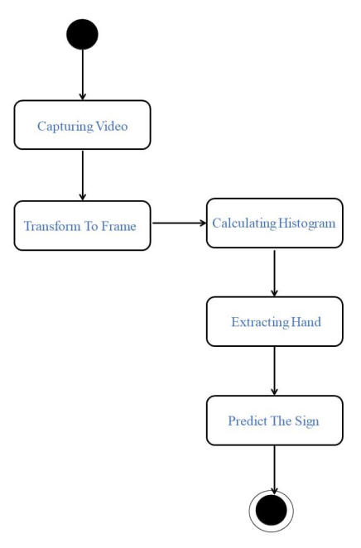
State Chart Diagram

Slide 17
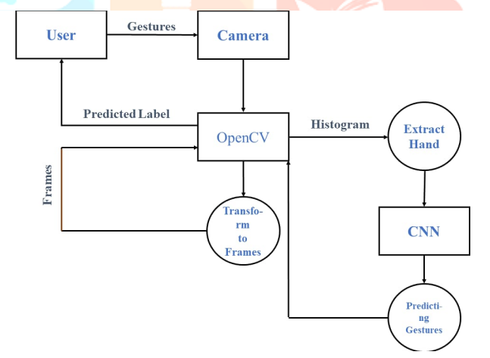
Dataflow Diagram

Slide 18
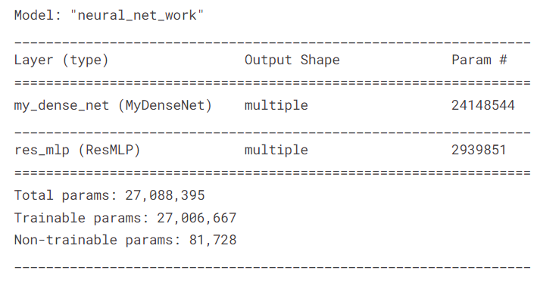
CREATING MODEL

Slide 19
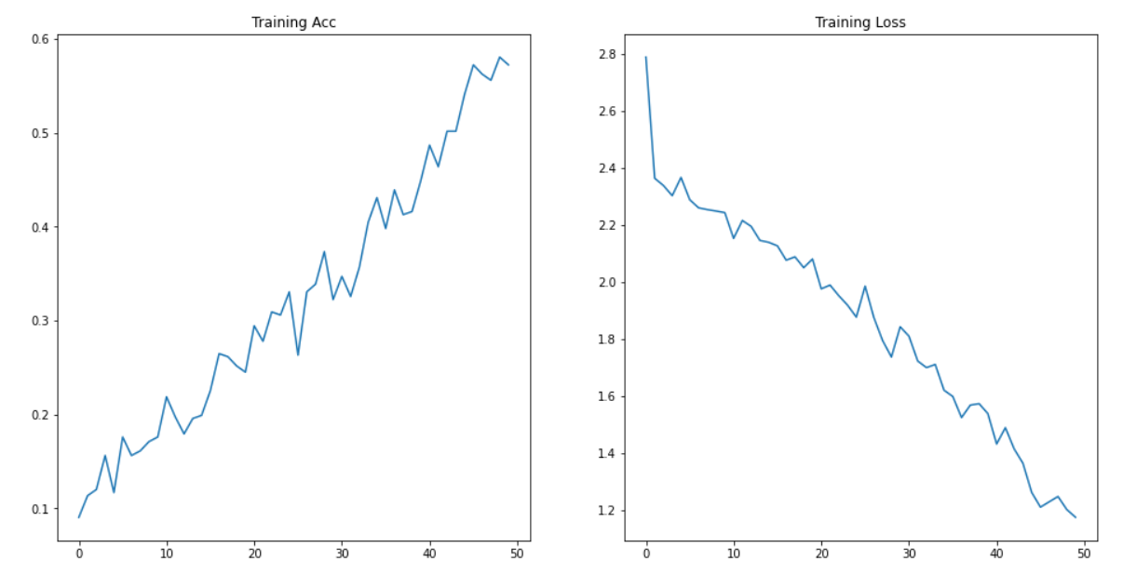
MODEL PERFORMANCE

Slide 20
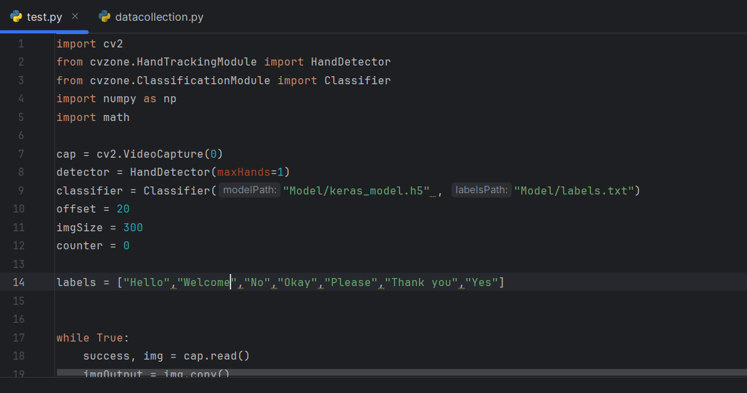
Code

Slide 21
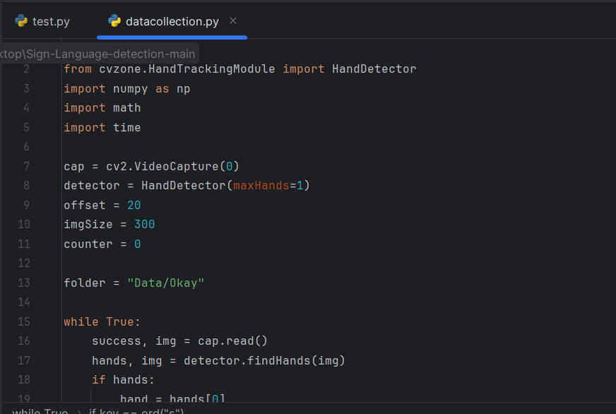
Data COLLECTION

Slide 22
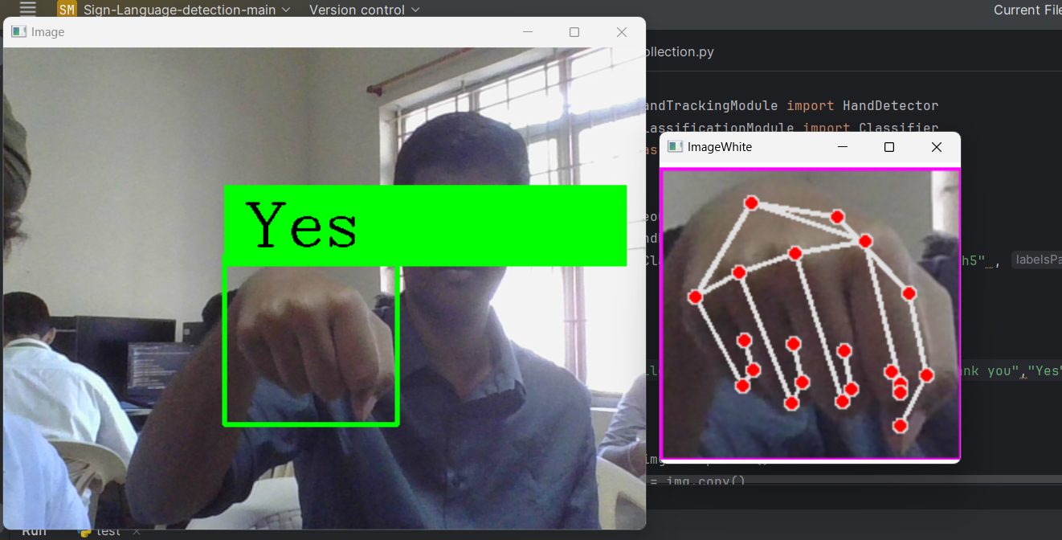
output

Slide 23
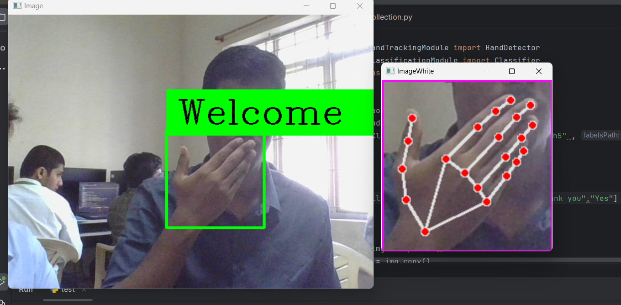

Slide 24
conclusion
To sum everything up, this project uses deep learning to get the desired result of image classification and movement identification . The different algorithms that are used to prepare this model, helps in getting the accurate results by reducing the redundant information and giving out only the desired output.
This project involves the recognition of real time images and video frames and analyze them to detect the hand signs that are being represented to convey the need of a person.

Slide 25
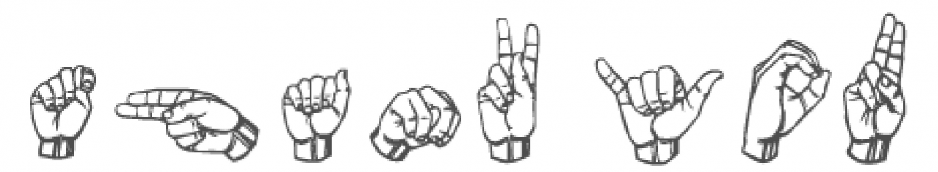
THANK YOU

