Slide 1
DATA VISUALIZATION FOR COVID DATASET
CSE 2026_DHV
Review-1
8ISE2
Roll Number | Student Name
20201ISE0091 | Tushar Tiwari
20201ISE0092 | Aiyaan Hasan
20191ISE9002 | Abu Sufiyan
Ms. Poornima S Ast.Professor
School of Computer Science & Engineering
Presidency University

Slide 2
Abstract
This report explores the application of data visualization techniques to the COVID-19 dataset, aiming to transform raw pandemic data into actionable insights. Utilizing Python's data manipulation and visualization libraries—Pandas and Matplotlib—we present a series of visualizations that highlight the progression and impact of COVID-19 across various countries. Key visualizations include line plots to display trends over time, bar charts to compare the total number of cases and deaths among the top affected nations, heatmaps to illustrate the intensity and temporal distribution of cases, and scatter plots to explore the relationship between confirmed cases and deaths. These visual tools not only simplify the interpretation of complex datasets but also enhance communication, enabling a broader audience to comprehend the pandemic's dynamics. By revealing trends, patterns, and outliers, these techniques empower informed decision-making and provide a comprehensive understanding of the COVID-19 pandemic, facilitating better responses and strategies to mitigate its effects.

Slide 3
Introduction
This report provides a comprehensive analysis of the COVID-19 pandemic using data visualization techniques. By leveraging Python's data manipulation and visualization libraries—Pandas, Matplotlib, and Seaborn—we present clear and insightful visualizations of confirmed cases, deaths, and recoveries from various countries. The primary goals are to uncover trends, compare impacts across countries, and visualize the pandemic's progression.
Key visualization techniques employed include line plots to show trends over time, bar charts to compare total cases and deaths among the top 10 affected countries, heatmaps to illustrate the intensity and temporal distribution of cases, and pie charts to represent the proportion of cases and deaths by country. Data handling involves cleaning, aggregating, and transforming the data to ensure accurate and meaningful insights. This analysis aims to provide a detailed understanding of the COVID-19 pandemic's spread and impact globally, aiding in better comprehension and decision-making.

Slide 4
Libraries
pandas (pd): Powerful tool for working with data tables, like spreadsheets on steroids. You can analyze, clean, and manipulate data easily.
matplotlib.pyplot (plt): Lets you create charts and graphs to visualize your data. Think colorful pictures that tell stories from numbers.
seaborn (sns): Built on top of matplotlib, seaborn makes creating attractive and informative visualizations even easier. It's like having a designer for your data charts.
wordcloud (wordlcloud) (Note: The actual library is called wordcloud, not wordlcloud): Creates artistic word clouds based on the frequency of words in your text data. Imagine a cloud where important words are bigger and less frequent ones are smaller.

Slide 5
Advantages of existing methods:
Enhanced Understanding: Visualizations convert complex data into understandable graphics, making it easier for viewers to grasp insights and trends.
Better Decision-Making: By presenting data in a visually compelling way, these techniques aid stakeholders in making informed decisions based on clear evidence.
Engagement: Visualizations are more engaging than raw data, capturing the audience's attention and facilitating deeper exploration of the data.
Communication: They improve communication of findings, making it easier to share and explain results with diverse audiences, including those without technical backgrounds.
User-Friendly: Data visualizations are often more accessible to a wider audience, including those without advanced analytical skills. They allow non-experts to understand complex datasets through intuitive graphics.
Interactivity: Many visualization tools offer interactive elements, such as zooming, filtering, and clicking to reveal more details. This interactivity makes data exploration more engaging and informative.

Slide 6
Disadvantages of existing methods:
Potential for Misleading Interpretations
Misrepresentation: Poor design choices, such as incorrect scaling, inappropriate chart types, or misleading color schemes, can distort the data and lead to incorrect interpretations.
Over-Simplification: Visualizations might oversimplify complex data, omitting important details and nuances that are crucial for a complete understanding.
Limited Detail
Loss of Granularity: Aggregated data used in visualizations can lose important granular details, which might be necessary for thorough analysis.
Context Omission: Visuals may lack contextual information, leading to misinterpretation of the data without the necessary background or explanatory notes.
Requires Skill and Knowledge
Design Skills: Effective data visualization requires knowledge of design principles and an understanding of which types of charts are appropriate for different data types.
Technical Skills: Creating sophisticated visualizations often requires proficiency with specific software tools and programming languages, which might not be accessible to everyone.
Cognitive Overload
Complex Visuals: Overly complex or cluttered visualizations can overwhelm viewers, making it difficult to extract meaningful insights.
Data Overload: Presenting too much information in a single visualization can confuse the audience and obscure key insights.
Bias and Subjectivity
Selection Bias: The choice of what data to include or exclude in a visualization can introduce bias, influencing the viewer's perception.
Narrative Bias: The way data is presented can reflect the creator's subjective narrative, which may not always be objective or balanced.

Slide 7
Proposed Method
Data Collection:
Loaded COVID-19 datasets for confirmed cases, deaths, and recoveries using get_frame function.
Ensured datasets included comprehensive data by country and over time.
Data Preparation:
Converted relevant columns to numeric types for accurate calculations.
Summed data across columns to get total cases, deaths, and recoveries.
Trend Analysis:
Line Plots:
Plotted trends over time to visualize the progression of confirmed cases, deaths, and recoveries.
Highlighted temporal changes and overall trajectory of the pandemic.
Country Comparison:
Bar Charts:
Grouped data by country and summed values to compare total cases, deaths, and recoveries.
Focused on the top 10 countries with the highest numbers for clear comparison.
Intensity Visualization:
Heatmaps:
Filtered data to include only the top 10 countries.
Transposed and grouped data by country to visualize intensity and distribution over time.
Used color gradients to represent different levels of data concentration.
Proportional Analysis:

Slide 8
Proposed Method cont.
Pie Charts:
Summarized and sorted data to show the proportion of total cases and deaths by country.
Highlighted relative impact among the top 10 most affected countries.
Tools and Libraries:
Utilized Pandas for data manipulation.
Employed Matplotlib and Seaborn for creating visualizations.
Objective:
Provided clear, insightful visualizations to understand trends, make comparisons, and visualize the pandemic's impact, aiding in informed decision-making.

Slide 9
Architecture
Data Acquisition and Preprocessing:
Data Sources:
Public health organizations (WHO, CDC)
Research institutions
News aggregators (with caution due to data quality)
Data Format:
Typically in CSV, Excel, or JSON format
Preprocessing:
Cleaning: Handling missing values, inconsistencies, and outliers.
Transformation: Converting data types, creating new features (e.g., daily case rates).
2. Data Exploration and Analysis:
Understanding the Data:
Descriptive statistics (e.g., mean, median)
Data visualizations for initial exploration (histograms, scatter plots)
Identifying Trends and Patterns:
Time series analysis (line charts for cases over time)
Geographic analysis (choropleth maps for cases by location)
Correlations between variables (scatter plots with regression lines)

Slide 10
Architecture
3. Visualization Design and Storytelling:
Choosing the Right Chart Type:
Line charts for trends
Bar charts for comparisons
Pie charts for proportions (use with caution)
Maps for geographic distribution
Heatmaps for correlations
Customization and Annotations:
Clear titles, labels, and legends
Consistent color palettes
Annotations to highlight key findings
Interactive Dashboards (Optional):
Allow users to explore the data dynamically
4. Deployment and Communication:
Sharing Insights:
Static images (e.g., PNG, JPG)
Interactive dashboards (web-based platforms)
Reports and presentations
Effective Communication:
Focus on the story the data tells
Use clear and concise language
Consider your audience's technical background

Slide 11
Result
Scatter Plot of Confirmed Cases vs. Deaths:
Purpose: Illustrates the relationship between confirmed COVID-19 cases and deaths across various countries.
Findings: By plotting confirmed cases on the x-axis and deaths on the y-axis, the scatter plot highlights which countries have higher or lower mortality rates relative to their number of confirmed cases. Using a logarithmic scale for both axes helps to visualize data across a wide range of values.
Trends Over Time:
Confirmed Cases Trend: Shows the cumulative number of confirmed cases over time, providing insights into the growth rate of the pandemic.
Deaths Trend: Similarly, plots the cumulative deaths over time, which can be compared to the trend in confirmed cases to understand the mortality trend.
Bar Plots of Total Cases by Country:
Confirmed Cases: Highlights the top 10 countries with the highest number of confirmed cases, facilitating comparison among the most affected countries.
Deaths: Displays the top 10 countries with the highest number of deaths, which helps in identifying regions with the highest mortality.
Heatmaps:
Purpose: Visualize the spread of confirmed cases, deaths, and recoveries across different countries over time.
Findings: Heatmaps reveal the intensity and distribution of the pandemic, making it easy to spot surges in cases or recoveries in specific countries.
Pie Charts:
Proportion of Cases and Deaths by Country: Show the percentage distribution of total confirmed cases and deaths among the top 10 countries, providing a quick overview of the global distribution.
These visualization techniques collectively enable a comprehensive understanding of the COVID-19 pandemic by distilling complex datasets into accessible visual formats. They help in identifying key trends, patterns, and outliers, supporting data-driven decision-making and enhanced communication of critical information​ (Health Infobase Canada)​​ (Tableau)​.

Slide 12
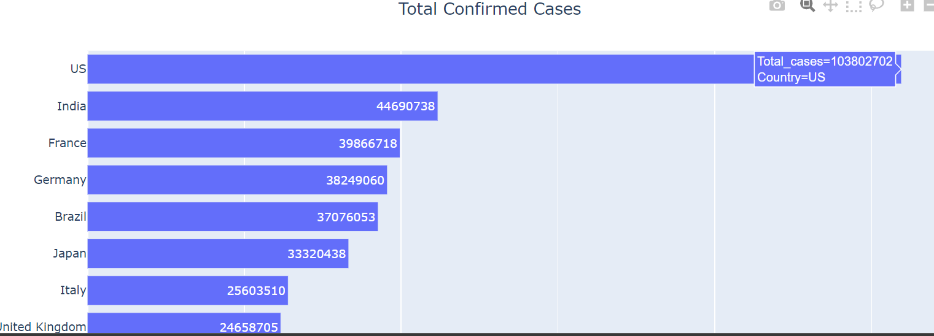
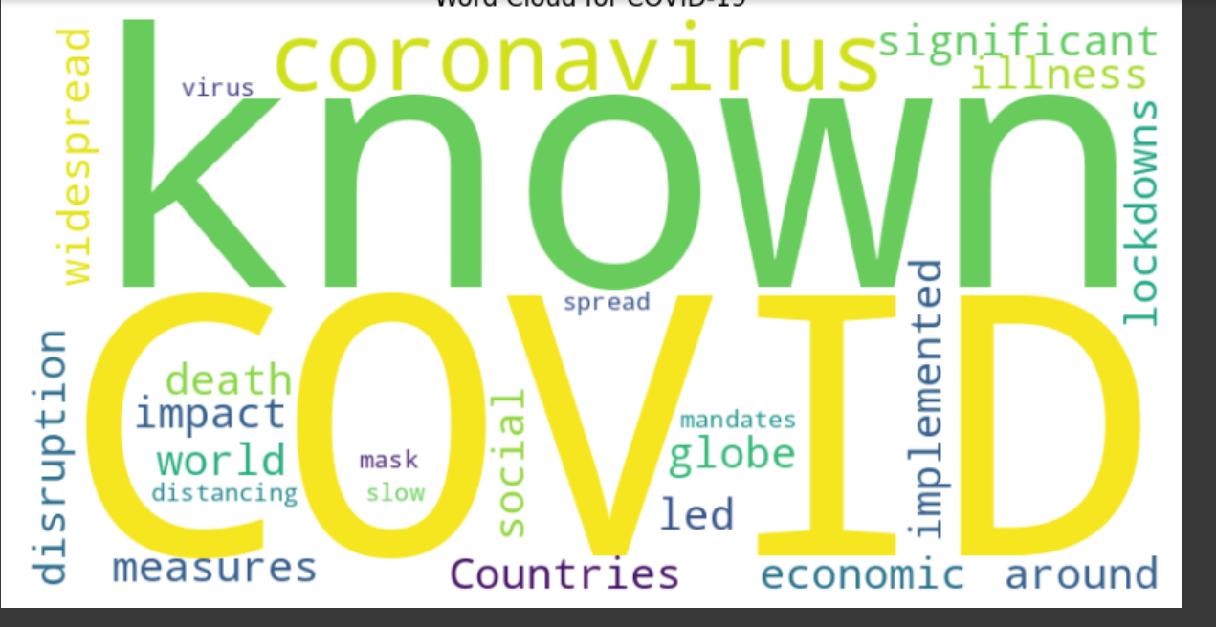
Result

Slide 13
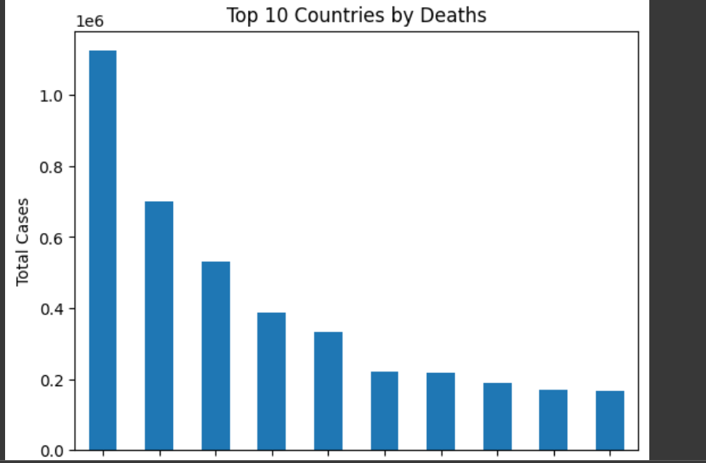
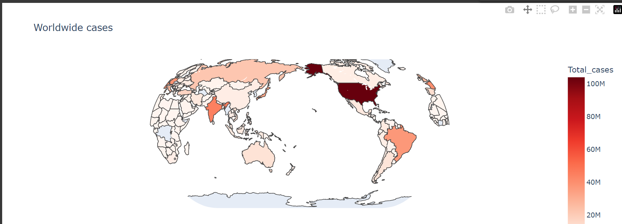
Result

Slide 14
Conclusion
Data visualization techniques act as a bridge between raw COVID-19 data and actionable insights. Here's how they effectively wrap up the analysis:
Condensed Knowledge: By presenting COVID-19 data visually, these techniques distill extensive datasets into understandable formats. This enables viewers to quickly grasp key takeaways, such as trends in confirmed cases, deaths, and recoveries.
Data-Driven Decisions: By uncovering trends, patterns, and outliers in the pandemic's progression, these techniques empower informed decision-making. They help identify potential issues and opportunities, such as hotspots or successful interventions, within the data.
Enhanced Communication: Visualizations break down language barriers and simplify complex COVID-19 data. They present information in a universally understood manner, making the data accessible to a broader audience, including policymakers, healthcare professionals, and the general public.

Slide 15
Thank You

