Slide 1



Pizza
View in Power BI
Last data refresh:
5/5/2025 8:08:11 AM UTC
Downloaded at:
5/5/2025 11:29:04 AM UTC

Slide 2
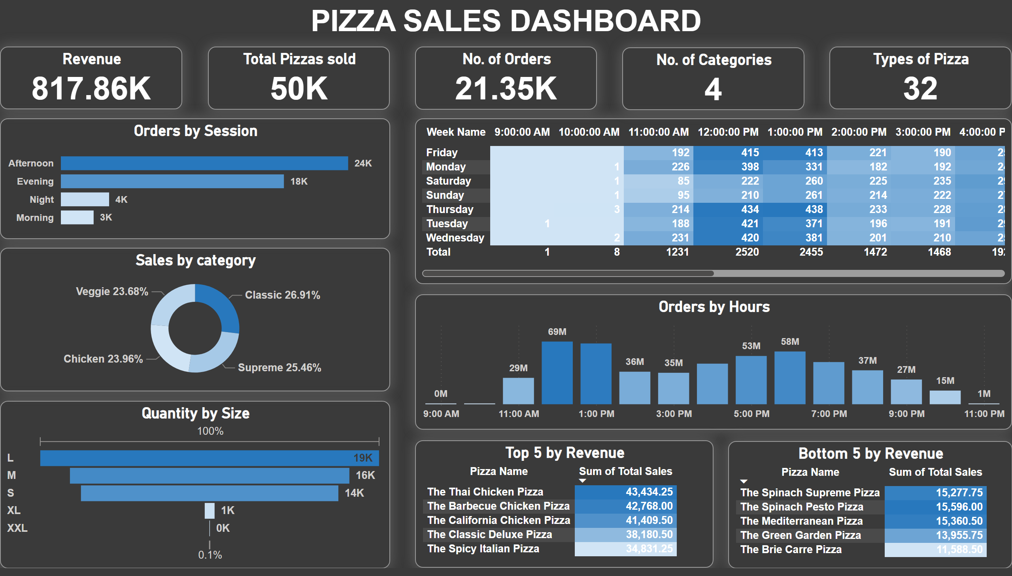
Dashboard
Notes:
Revenue
No alt text provided
Total Pizzas sold
No alt text provided
No. of Orders
No alt text provided
No. of Categories
No alt text provided
Types of Pizza
No alt text provided
textbox
No alt text provided
pivotTable
No alt text provided
Quantity by Size
No alt text provided
Sales by category
No alt text provided
Orders by Session
No alt text provided
Orders by Hours
No alt text provided
Bottom 5 by Revenue
No alt text provided
Top 5 by Revenue
No alt text provided

