Slide 1

SOSIRE 7TH SEM
Odisha University of Technology and Research Bhubaneswar
University Network Using Cisco Packet Tracer
PRESENTED BY
REGD. NO.
DEPARTMENT
SUPERVISED BY
Tushar Ranjan Jena
23110389
Electronics and Communication
Mrs. R.R Mishra Ma’am

Slide 2
Content
AGENDA
1
Introduction
8
Future Work
2
Motivation
9
References
3
Objective
4
Literature Review / Related Work
5
Proposed Methodology
6
Result and Analysis
7
Conclusion
OUTR CAMPUS NETWORK | CISCO PACKET TRACER
2

Slide 3
Introduction
SECTION 01
This project focuses on designing and analyzing a large-scale, secure, and efficient network infrastructure for a university or corporate campus. It helps network engineers understand how different buildings, departments, and network devices can communicate with each other across a large campus.
1
The network is divided into multiple buildings and departments, with each department placed in its own VLAN and IP subnet. Inter-VLAN routing and the RIPv2 dynamic routing protocol are used to ensure seamless communication between all departments and between the Main Campus and the ECE Branch Campus.
2
DHCP pools are configured for every department VLAN to automatically assign IP addresses to connected devices, reducing manual configuration and making network management easier.
3
The Main Campus is connected to the ECE Branch Campus and to an external Cloud Network (hosting the email server) through serial WAN links. Appropriate routing ensures reliable packet delivery across the entire network.
4
The project also demonstrates incoming and outgoing traffic management, inter-department communication, routing decisions, and VLAN-based network segmentation. Packet movement can be monitored to understand how data travels from one department or building to another.
5
OUTR CAMPUS NETWORK | CISCO PACKET TRACER
3

Slide 4
Motivation
SECTION 02
1
2
Growing demand for reliable campus connectivity: Large organizations and universities require seamless communication between multiple buildings, departments, and network devices.
Highlight the problem: Poorly designed networks can cause communication failures, network congestion, inefficient routing, and difficulty in managing large-scale infrastructure.
3
4
Need for efficient network management: Multiple departments often operate across different network segments, creating a need for proper IP addressing, routing, and centralized network management.
Importance of modern routing technologies: Understanding VLANs, Inter-VLAN Routing, DHCP and dynamic routing (RIPv2) is essential for building scalable and efficient networks.
5
Need for practical networking experience: Cisco Packet Tracer provides a cost-effective environment to design, configure, test, and troubleshoot real-world network scenarios without requiring physical networking equipment.
OUTR CAMPUS NETWORK | CISCO PACKET TRACER
4

Slide 5
Objective / Goal
SECTION 03
To design and establish a scalable network infrastructure for a large company or university campus, connecting multiple buildings, departments, and network devices efficiently.
1
To simulate and validate the proposed network topology using Cisco Packet Tracer, ensuring proper connectivity and reliable packet transmission between different network segments.
2
3
To understand and implement various networking technologies, including VLANs, Inter-VLAN Routing, DHCP, RIPv2 dynamic routing, and serial WAN links.
To analyze inter-department and inter-building communication, studying how packets are routed between departments and between the Main Campus and ECE Branch Campus using RIPv2.
4
To improve network management, reliability, and security by implementing appropriate IP addressing, traffic management, WAN connectivity, and VLAN-based segmentation for efficient and controlled data communication.
5
OUTR CAMPUS NETWORK | CISCO PACKET TRACER
5

Slide 6
Literature Review
SECTION 04
1
2
Previous studies have explored University/Campus Network Design using Cisco Packet Tracer to understand network configuration, routing, connectivity, and performance.
Research articles, theses, and technical literature provide the foundation for designing scalable, reliable, and efficient campus networks.
3
4
The reviewed literature mainly focuses on network topology, routing protocols, IP addressing, network security, and communication between different departments.
These studies helped identify suitable network architectures and technologies for implementing our proposed Smart Campus Network.
5
Cisco Packet Tracer is widely used as a simulation tool to design, configure, test, and troubleshoot network infrastructure before real-world deployment.
OUTR CAMPUS NETWORK | CISCO PACKET TRACER
6

Slide 7
Literature Review
NETWORK TOPOLOGY
Network Topology defines the physical or logical arrangement of computers, network devices, and communication links within a network.
1. Point-to-Point
2. Bus Topology
3. Ring Topology
Directly connects two devices through a dedicated communication link.
Provides fast and simple communication.
Easy to configure and relatively inexpensive.
Suitable for direct device-to-device connections.
All devices share a single main communication cable.
Simple and inexpensive to implement.
Suitable for small networks.
Major limitation: failure of the main cable can disrupt the entire network.
Devices are connected in a closed-loop / circular arrangement.
Data travels through connected nodes until it reaches the destination.
Provides an organized path for data transmission.
Failure of a link or node can significantly affect network communication.
OUTR CAMPUS NETWORK | CISCO PACKET TRACER
7

Slide 8
Literature Review
NETWORK TOPOLOGY (CONT.)
4. Mesh Topology
5. Star Topology
Devices are connected through multiple communication paths.
Provides high reliability and fault tolerance.
If one link fails, data can use an alternative path.
Major limitation: high cost due to additional cables, ports, and network interfaces.
Each device is connected to a central switch, hub, or router.
Easy to install, manage, expand, and troubleshoot.
Failure of one individual link generally affects only the connected device.
Major limitation: failure of the central device can affect the entire network.
OUTR CAMPUS NETWORK | CISCO PACKET TRACER
8

Slide 9
Literature Review
IPv4 ADDRESS SCHEME
IPv4 Address is a 32-bit address that uniquely and universally defines the connection of a device to the Internet.
1. Key Features of IPv4
2. Address Structure
3. Types of Addressing
Connectionless protocol: no connection is set up before data is sent.
Fragments packets where necessary.
Addressing is done via 32-bit Internet addresses.
Best-effort delivery: packets are forwarded to the next destination, but delivery is not guaranteed.
No functions for end-to-end message reliability or flow control.
Every IP address is of the form <Network ID, Host ID>.
Range: 0.0.0.0 to 255.255.255.255.
Network number (N) is assigned by the Internet Registry (IR).
Host number (H) is assigned by the Network Administrator.
Classful addressing: Classes A to E.
Classless addressing: the default mask can be changed as required (/25, /26, /27 … /32).
Classes A, B and C represent host and network addresses.
Class D is used for multicasting; Class E is reserved for experimental use.
32-bit
Length of an IPv4 address
0.0.0.0 – 255.255.255.255
Full IPv4 address range
2³² = 4,294,967,296
Total possible addresses
OUTR CAMPUS NETWORK | CISCO PACKET TRACER
9

Slide 10
Literature Review
IPv4 ADDRESS CLASSES
Classful Addressing divides the address space into Classes A–E. The leading bits of the first octet identify the class, and the default mask fixes the network and host portions.
1. Class A
2. Class B
3. Class C
Leading bit 0; first octet 0 – 127.
Default mask /8 (255.0.0.0): 7 network bits + 24 host bits (N.H.H.H).
Networks: 2⁷ = 128; ID 0 is not used and 127 is reserved for loopback, so usable IDs are 1 – 126.
Hosts per network: 2²⁴ − 2 = 16,777,214.
Leading bits 10; first octet 128 – 191.
Default mask /16 (255.255.0.0): 14 network bits + 16 host bits (N.N.H.H).
Networks: 2¹⁴ = 16,384.
Hosts per network: 2¹⁶ − 2 = 65,534.
Leading bits 110; first octet 192 – 223.
Default mask /24 (255.255.255.0): 21 network bits + 8 host bits (N.N.N.H).
Networks: 2²¹ = 2,097,152.
Hosts per network: 2⁸ − 2 = 254.
16,777,214
Usable hosts per network
65,534
Usable hosts per network
254
Usable hosts per network
OUTR CAMPUS NETWORK | CISCO PACKET TRACER
10

Slide 11
Literature Review
IPv4 ADDRESS CLASSES (CONT.)
Special Classes Class D and Class E are not divided into network and host parts. In every class, host IDs with all zeros or all ones are reserved.
4. Class D (Multicast)
5. Class E (Reserved)
6. Usable Hosts Rule
Leading bits 1110; first octet 224 – 239.
Special type of address used for multicasting.
Not divided into network and host portions.
Leading bits 1111; first octet 240 – 255.
Reserved for experimental / research use.
Not used for normal host addressing.
No host ID can have all zeros: the first address identifies the network / subnet (SNID).
No host ID can have all ones: the last address is the broadcast address.
Hence usable hosts per network = 2^{h} − 2, where h is the number of host bits.
224 – 239
First-octet range
240 – 255
First-octet range
2^{h} − 2
Usable hosts per network
OUTR CAMPUS NETWORK | CISCO PACKET TRACER
11

Slide 12
Literature Review
SUBNETTING
Subnetting is chopping a network into smaller networks by assigning some bits of the host portion to a subnet number.
1. Concept & Parameters
2. Finding SNID, BCIP & Range
3. Class C Example (/25)
Format: <N/w No., Subnet No., Host No.>.
Uses the full network address efficiently; it is a real network under a network.
Any class can be subnetted by borrowing host bits.
Parameters: Subnet Mask (SNM), Subnet ID (SNID), Broadcast ID (BCIP) and Host Range.
SNID: keep network and subnet bits, convert all host bits to 0.
BCIP: keep network and subnet bits, convert all host bits to 1.
Host range: SNID + 1 to BCIP − 1.
192.168.1.10/26: 10 = 00|001010, so SNID = 192.168.1.0.
192.168.1.70/26: 70 = 01|000110, so BCIP = 192.168.1.127.
Class C default /24 (8+8+8+0); borrowing 1 bit gives /25, so n = 25 and h = 7.
1 bit gives 2¹ = 2 subnets; hosts per subnet = 2⁷ − 2 = 126.
Subnet 1: 192.168.0.0 – 192.168.0.127 (hosts .1 – .126).
Subnet 2: 192.168.0.128 – 192.168.0.255 (hosts .129 – .254).
<N/w, Subnet, Host>
Subnetted address format
SNID + 1 to BCIP − 1
Assignable host range
255.255.255.128
Subnet mask for /25
OUTR CAMPUS NETWORK | CISCO PACKET TRACER
12

Slide 13
Methodology / Approach
SECTION 05
University Network Design using Cisco Packet Tracer
Design and simulate a four-building university network using Cisco Packet Tracer.
Divide the university into separate departments and IP networks.
Implement VLANs to logically separate users and improve network security.
Configure inter-VLAN routing for communication between departments.
Use RIPv2 for internal dynamic routing.
RIP configured on the Cloud Router
Implement DHCP pools which are configured on the routers for every VLAN.
Verify end-to-end connectivity between PCs, printers, internal servers, and the external email server.
Campus Building Allocation
Building | Department / Area | Main Components
A | Admission,Placement,Examination,CSE | Administrative Offices
B | EIE,EE | Offices + Lecture Rooms
C | AIML,IT | Faculty Offices + Labs
D | ECE | Faculty Offices + Labs
OUTR CAMPUS NETWORK | CISCO PACKET TRACER
13

Slide 14
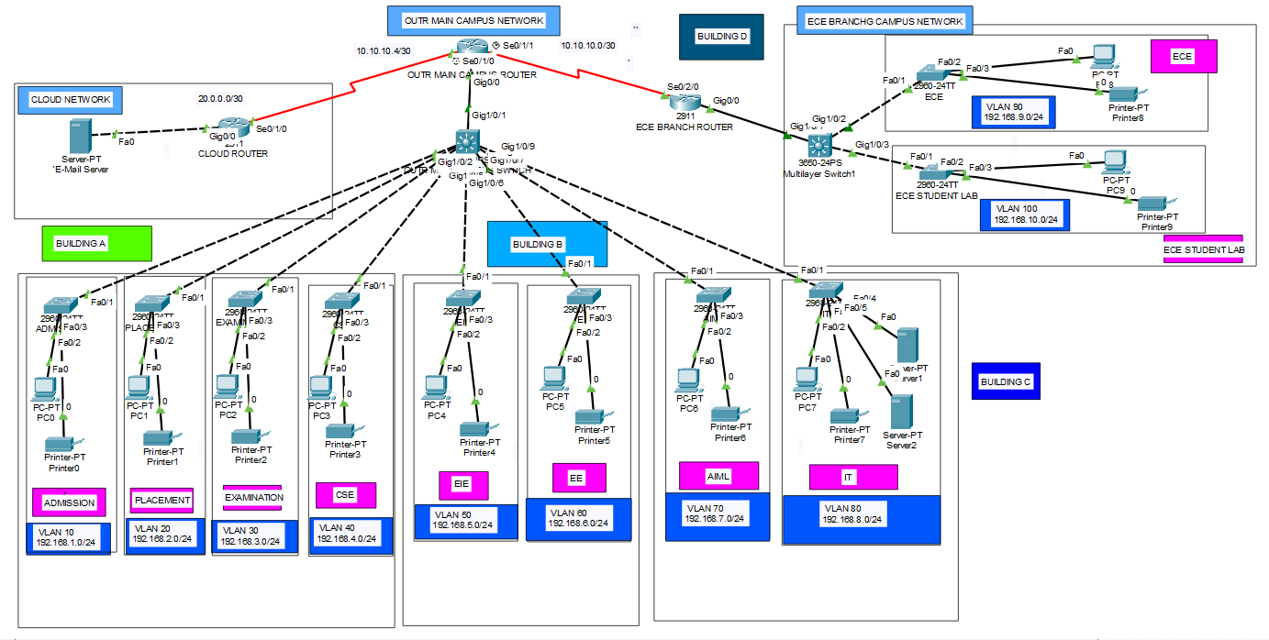
Methodology / Approach
BLOCK DIAGRAM
Figure: Block Diagram of University / Campus Network
OUTR CAMPUS NETWORK | CISCO PACKET TRACER
14

Slide 15
Methodology / Approach
NETWORK ARCHITECTURE
Core Technologies Used
Additional Infrastructure
External Cloud Email Server
Internal Web Server
Routers and Layer-3 switches
Departmental access switches
PCs and printers
1
1) Routing
RIPv2 → Dynamic routing between internal routers
Static Routing → Connectivity with external cloud network
2
Switching
VLANs → Department-wise network segmentation
Layer-3 Switching → Inter-VLAN communication
Switch Security → Controlled and secure network access
Network Architecture
The campus network combines routing, switching, and IP addressing layers described below to connect all departments and buildings into one managed system.
3
2) IP Addressing
Each department assigned a separate IP network
DHCP provides automatic IP addresses to all devices
OUTR CAMPUS NETWORK | CISCO PACKET TRACER
15

Slide 16
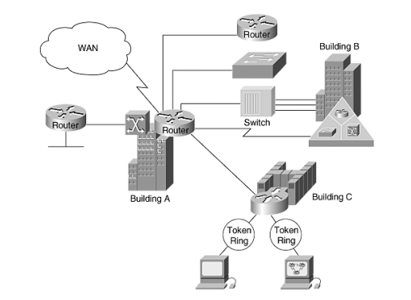
Methodology / Approach
SYSTEM MODEL
University Campus Network Model
The four buildings operate as a connected campus network. Each department uses a separate IP network for better organization and security.
VLANs provide logical segmentation within shared switching infrastructure.
Routers and Layer-3 switches enable communication between different networks.
RIPv2 automatically determines suitable routes within the internal network.
Static routing provides connectivity to the external cloud-based email server.
The architecture can be expanded to support additional buildings, users, and services.
Figure: System Model of University Network
OUTR CAMPUS NETWORK | CISCO PACKET TRACER
16

Slide 17
Methodology / Approach
STEPS
1) OUTR Main Campus Router
2) Cloud Router
3) ECE Main Branch Router
4) OUTR Main Campus Router
int gig0/0
no sh
int se0/1/0
no sh
int se0/1/1
no sh
exit
int gig0/0
no sh
int se0/1/0
no sh
do wr
int gig0/0
no sh
int se0/2/0
no sh
do wr
int se0/1/1
clock rate 6400
int se0/1/0
clock rate 6400
do wr
exit
5) Switch
6) OUTR Main Campus Switch
int range fa0/1-24
switchport mode access
switchport access vlan 10
do wr
exit
. int range fa0/1-24
switchport mode access
switchport access vlan 20
do wr
exit
int range fa0/1-24
switchport mode access
switchport access vlan 30
do wr
exit
int range fa0/1-24
switchport mode access
switchport access vlan 40
do wr
exit
int range fa0/1-24
switchport mode access
switchport access vlan 50
do wr
exit
. int range fa0/1-24
switchport mode access
switchport access vlan 60
do wr
exit
int range fa0/1-24
switchport mode access
switchport access vlan 70
do wr
exit
int range fa0/1-24
switchport mode access
switchport access vlan 80
do wr
exit
int gig1/0/2
switchport mode access
switchport access vlan 10
exit
int gig1/0/3
switchport mode access
switchport access vlan 20
exit
int gig1/0/4
switchport mode access
switchport access vlan 30
exit
int gig1/0/5
switchport mode access
switchport access vlan 40
exit
int gig1/0/6
switchport mode access
switchport access vlan 50
exit
int gig1/0/7
switchport mode access
switchport access vlan 60
exit
int gig1/0/8
switchport mode access
switchport access vlan 70
exit
int gig1/0/9
switchport mode access
switchport access vlan 80
exit
do wr
OUTR CAMPUS NETWORK | CISCO PACKET TRACER
17

Slide 18
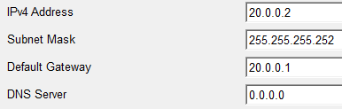
Methodology / Approach
STEPS
7) Switch
8) ECE Branch Switch
9) OUTR Main Campus Router
10) ECE Branch Router
12) Email Server
int range fa0/1-24
switchport mode access
switchport access vlan 90
do wr
exit
. int range fa0/1-24
switchport mode access
switchport access vlan 100
do wr
exit
int gig1/0/2
switchport mode access
switchport access vlan 90
exit
int gig1/0/3
switchport mode access
switchport access vlan 100
exit
do wr
int gig1/0/1
switchport trunk
encapsulation dot1Q
switchport mode trunk
exit
do wr
int se0/2/0
ip add 10.10.10.2
255.255.255.252
exit
do wr
int se0/1/1
ip add 10.10.10.1
255.255.255.252
exit
int se0/1/0
ip add 10.10.10.5
255.255.255.252
exit
do wr
11) Cloud Router
int se0/1/0
ip add 10.10.10.6
255.255.255.252
exit
ip add 20.0.0.1
255.255.255.252
exit
do wr
OUTR CAMPUS NETWORK | CISCO PACKET TRACER
18

Slide 19
Methodology / Approach
STEPS
13) ECE Branch Router
14) OUTR Main Campus Router
int gig0/0.60
encapsulation dot1Q 60
ip add 192.168.6.1
255.255.255.0
exit
int gig0/0.70
encapsulation dot1Q 70
ip add 192.168.7.1
255.255.255.0
exit
int gig0/0.80
encapsulation dot1Q 80
ip add 192.168.8.1
255.255.255.0
exit
do wr
service dhcp
ip dhcp pool ADMISSION-pool
network 192.168.1.0
255.255.255.0
default-router 192.168.1.1
dns-server 192.168.1.1
exit
service dhcp
ip dhcp pool PLACEMENT-pool
network 192.168.2.0
255.255.255.0
default-router 192.168.2.1
dns-server 192.168.2.1
exit service dhcp
ip dhcp pool EXAMINATION-pool
network 192.168.3.0
255.255.255.0
default-router 192.168.3.1
dns-server 192.168.3.1
exit
service dhcp
ip dhcp pool CSE-pool
network 192.168.4.0
255.255.255.0
default-router 192.168.4.1
dns-server 192.168.4.1
exit
service dhcp
ip dhcp pool EIE-pool
network 192.168.5.0
255.255.255.0
default-router 192.168.5.1
dns-server 192.168.5.1
exit
service dhcp
ip dhcp pool EE-pool
network 192.168.6.0
255.255.255.0
default-router 192.168.6.1
dns-server 192.168.6.1
exit service dhcp
ip dhcp pool AIML-pool
network 192.168.7.0
255.255.255.0
default-router 192.168.7.1
dns-server 192.168.7.1
exit
service dhcp
ip dhcp pool IT-pool
network 192.168.8.0
255.255.255.0
default-router 192.168.8.1
dns-server 192.168.8.1
exit
do wr
int gig0/0.90
encapsulation dot1Q 90
ip add 192.168.9.1
255.255.255.0
exit
int gig0/0.100
encapsulation dot1Q 100
ip add 192.168.10.1
255.255.255.0
exit
do wr
service dhcp
ip dhcp pool ECE-pool
network 192.168.9.0
255.255.255.0
default-router 192.168.9.1
dns-server 192.168.9.1
exit do wr
service dhcp
ip dhcp pool ECESTUDENTLAB -pool
network 192.168.10.0
255.255.255.0
default-router 192.168.10.1
dns-server 192.168.10.1
exit do wr
int gig0/0.10
encapsulation dot1Q 10
ip add 192.168.1.1
255.255.255.0
exit
int gig0/0.20
encapsulation dot1Q 20
ip add 192.168.2.1
255.255.255.0
exit
int gig0/0.30
encapsulation dot1Q 30
ip add 192.168.3.1
255.255.255.0
exit
int gig0/0.40
encapsulation dot1Q 40
ip add 192.168.4.1
255.255.255.0
exit
int gig0/0.50
encapsulation dot1Q 50
ip add 192.168.5.1
255.255.255.0
exit
OUTR CAMPUS NETWORK | CISCO PACKET TRACER
19

Slide 20
Methodology / Approach
STEPS
Within Main Campus Router Ping is possible Eg :- PC0 To PC5
But Message between Main Campus and ECE Branch Router Not possible Eg :- PC5 To PC8
15) ECE Branch Router
15) OUTR Main CampusRouter
16) Cloud Router
router rip
version 2
network 192.168.9.0
network 192.168.10.0
network 10.10.10.0
exit
do wr
router rip
version 2
network 10.10.10.0
network 10.10.10.4
network 192.168.1.0
network 192.168.2.0
network 192.168.3.0
network 192.168.4.0
network 192.168.5.0
network 192.168.6.0
network 192.168.7.0
network 192.168.8.0
exit
do wr
router rip
version 2
network 20.0.0.0
network 10.10.10.4
exit
do wr
OUTR CAMPUS NETWORK | CISCO PACKET TRACER
20

Slide 21
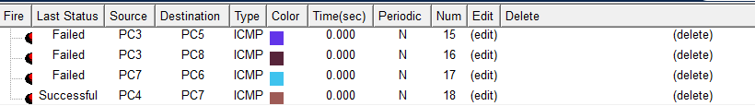
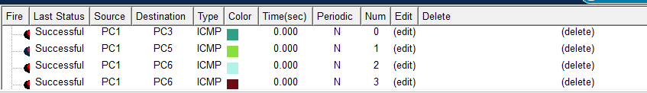
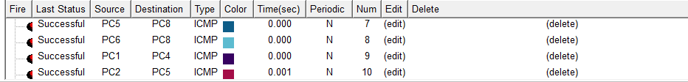
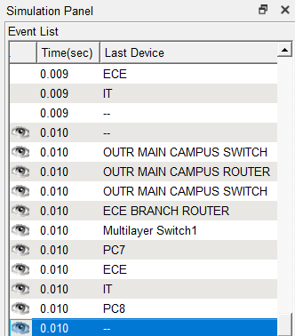
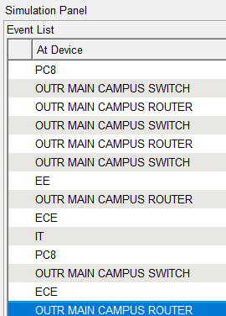

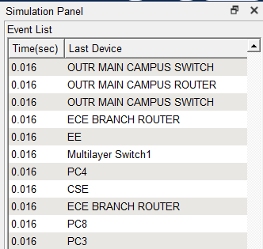
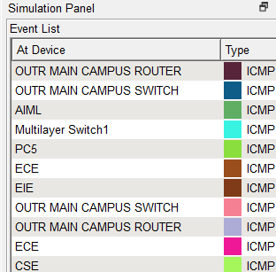


Results and Analysis
SECTION 06
OUTR CAMPUS NETWORK | CISCO PACKET TRACER
21

Slide 22
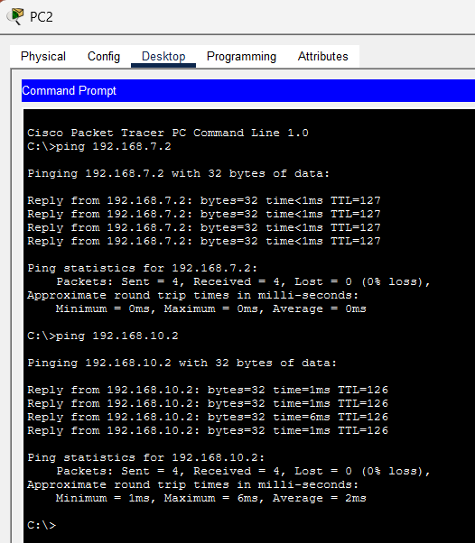

Results and Analysis
SECTION 06
OUTR CAMPUS NETWORK | CISCO PACKET TRACER
22

Slide 23
Conclusion
SECTION 07
Successfully designed and simulated the OUTR Bhubaneswar Campus Network using Cisco Packet Tracer.
✓
Developed a realistic university network topology connecting multiple academic departments and administrative units.
✓
Configured routers, switches, IP addressing, and network services to achieve reliable end-to-end connectivity.
✓
Demonstrated how different departments can communicate and share network resources efficiently within an organization.
✓
Gained practical understanding of network design, configuration, inter-department communication, and troubleshooting.
✓
The proposed network provides a scalable and organized foundation that can be further enhanced for a real-world university environment.
✓
OUTR CAMPUS NETWORK | CISCO PACKET TRACER
23

Slide 24
Future Work
SECTION 08
Real-World Implementation: Deploy the proposed network in an actual university environment and evaluate its performance under real operating conditions.
Enhanced Network Security: Implement advanced security mechanisms such as firewalls, VLANs, access control, authentication, and intrusion detection to protect network resources.
1
2
Performance Optimization: Analyze and improve key parameters such as network throughput, latency, packet delivery, and response time. Advanced Routing: Upgrade from RIPv2 to EIGRP or OSPF and implement route redistribution between different routing domains.
Alternative Simulation Platforms: Replicate and evaluate the network using other networking simulation and emulation platforms to compare performance and functionality.
3
4
Signal and Communication Analysis: Study the accuracy, transmission quality, delay, and reliability of signals exchanged between different network segments.
Scalability and Redundancy: Extend the network to support future campus expansion while introducing backup links and devices for improved network availability.
5
6
OUTR CAMPUS NETWORK | CISCO PACKET TRACER
24

Slide 25
References
SECTION 09
[1]
L. Ezema, W. Mbonu, U. Nwogu, and C. Owuamanam, “Plan, design and simulation of university network,” International Journal of Advanced Computer Research, vol. 4, no. 3, p. 834, 2014.
[2]
A. H. Ahmed and M. Al-Hamadani, “Designing a secure campus network and simulating it using cisco packet tracer,” Indonesian Journal of Electrical Engineering and Computer Science, vol. 23, no. 1, pp. 479–489, 2021.
[3]
P. Kornilovitch, R. Bicknell, and J. Yeo, “Fully-connected networks with local connections,” Applied Physics A, vol. 95, no. 4, pp. 999–1004, 2009.
[4]
R. S. S. AlSarhan, “Computer network design for universities in developing countries,” 2016.
[5]
R. Jiang, “A review of network topology,” in 4th International Conference on Computer, Mechatronics, Control and Electronic Engineering, pp. 1167–1170, Atlantis Press, 2015.
[6]
G. E. Clarke, CompTIA Network+ Certification Study Guide. McGraw-Hill, 2009.
OUTR CAMPUS NETWORK | CISCO PACKET TRACER
25

Slide 26
Thank You
(Any Questions?)

