Slide 1
Impact of Cultural Factors on GDP per Capita Growth: A Comprehensive Analysis
Apurva Shardul (21074438)
Mihirsinh Desai (21037428)
Pinak Bhandarkar (21058307)
Sarthak Lad (21074457)
Tushar Chitnavis (21093113)

Slide 2
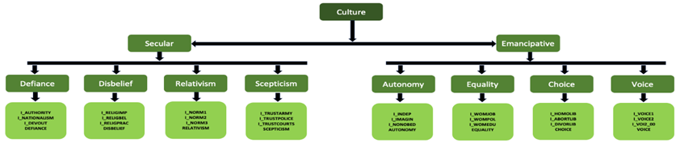
Description of Data
Key Variables:
Independent Variables:
Culture: a) Secular Values b) Emancipative Values

Slide 3
Description of Data
Country and income level categorization
Waves
Initial GDP per Capita (PPP, USD)
Dependent Variables:
GDP Growth Per Capita: GDP Growth Rate = (GDP_{final} −GDP_{initial} / GDP_{initial})×100
Data Sources:
World Values Survey (WVS) Database
World Bank
YEAR | 1981-1984 | 1990-1994 | 1995-1998 | 1999-2004 | 2005-2009 | 2010-2014 | 2017-2022
Wave | 1 | 2 | 3 | 4 | 5 | 6 | 7

Slide 4
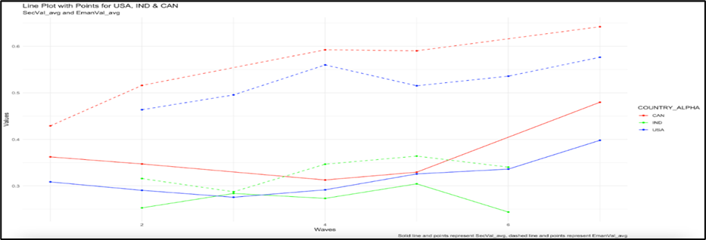
Descriptive Data Analysis

Slide 5
Descriptive Data Analysis
United States of America
Country | Emancipative Values | Secular Values | Party | President | Year
USA | 0.464 | 0.291 | Democratic | Bill Clinton | 1990-1994
USA | 0.496 | 0.276 | Democratic | Bill Clinton | 1995-1998
USA | 0.560 | 0.292 | Republican | George Bush | 1999-2004
USA | 0.515 | 0.326 | Republican | George Bush | 2005-2009
USA | 0.536 | 0.336 | Democratic | Barack Obama | 2010-2014
USA | 0.577 | 0.398 | Republican | Donald Trump | 2017-2022

Slide 6
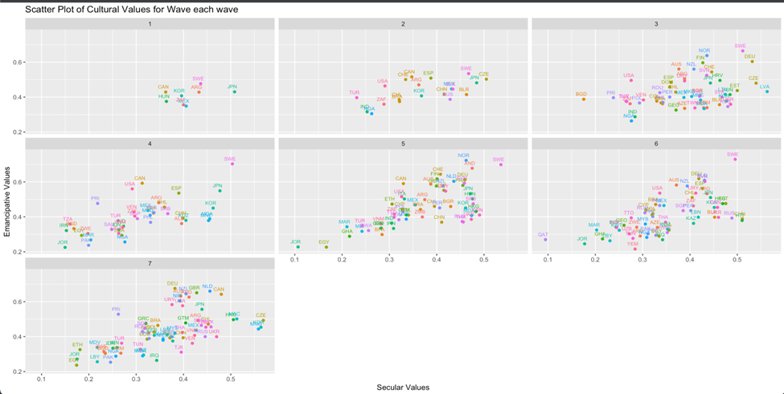
Descriptive Data Analysis

Slide 7
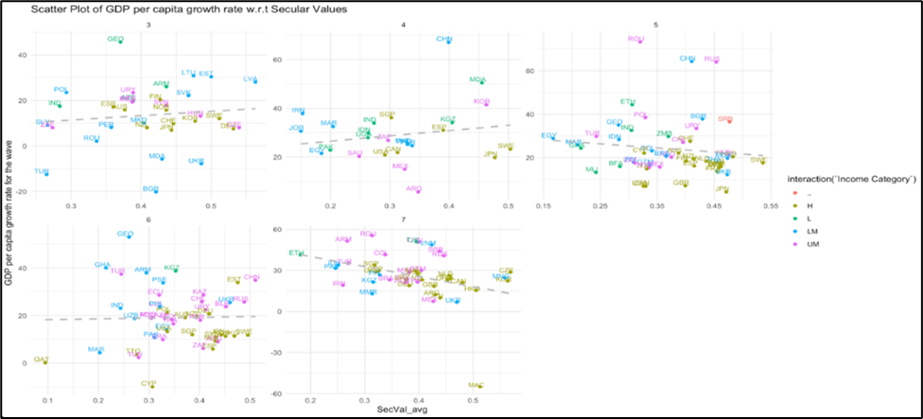
Descriptive Data Analysis

Slide 8
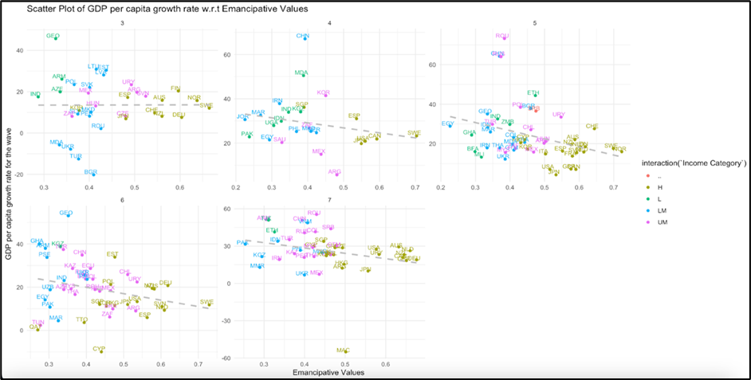
Descriptive Data Analysis

Slide 9
Literature Review
Granato et al. (1996) analyzed 25 countries, finding that achievement motivation and post-materialism significantly predicted economic growth. They emphasized the need for models integrating cultural and economic factors, although their model lacked country and year variables.
Ranganathan et al. (2015) found that critical human development values prompt democratization and citizen emancipation, but emancipative values alone don't ensure continuous wealth accumulation. Highly democratic and emancipated countries tend to reach a balanced economic growth state (steady state).
Edwards et al. explored the impact of cultural values on national income inequality, using the Gini coefficient. The findings suggested that increasing secularization in society is associated with lower income inequality, but no significant correlations were observed for low-income countries.

Slide 10
Question of Interest
The correlation between GDP growth and prominent factors such as imports, exports, consumer spending, investment, government spending, and employment levels is readily apparent. Consequently, our intention is to systematically incorporate cultural factors into our analysis to examine their impact on GDP growth.
Research Question:
To what extent do cultural factors, such as secularism and emancipative values, contribute to a country's GDP growth?

Slide 11
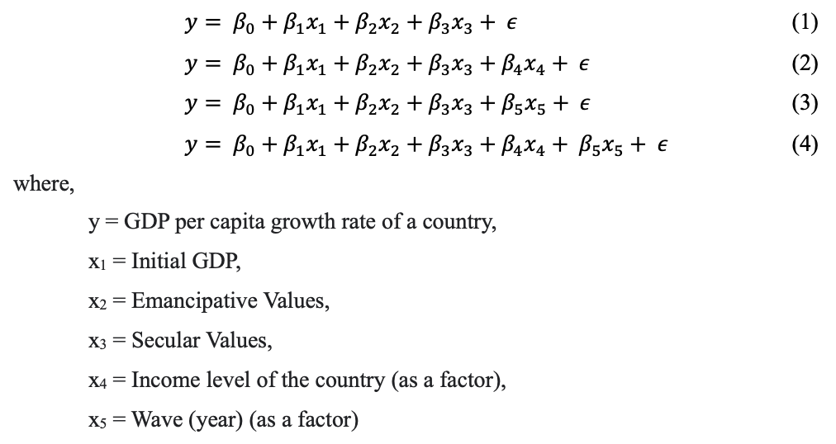
Initial Model and Estimation

Slide 12
Initial Hypothesis
Our interest is in correlating cultural factors that may relate to GDP per capita growth rate of a country. Following hypotheses shall be tested:
Hypotheses 1: Emancipative values and Secular Values should reflect a positive relation with the GDP Growth rate of a country.
Hypotheses 2: Countries with high initial GDP should show a stagnant or a negative growth rate over the years from wave 1 to 7. On the other hand, countries with lower initial GDP should show a hike in the GDP growth rate.

Slide 13
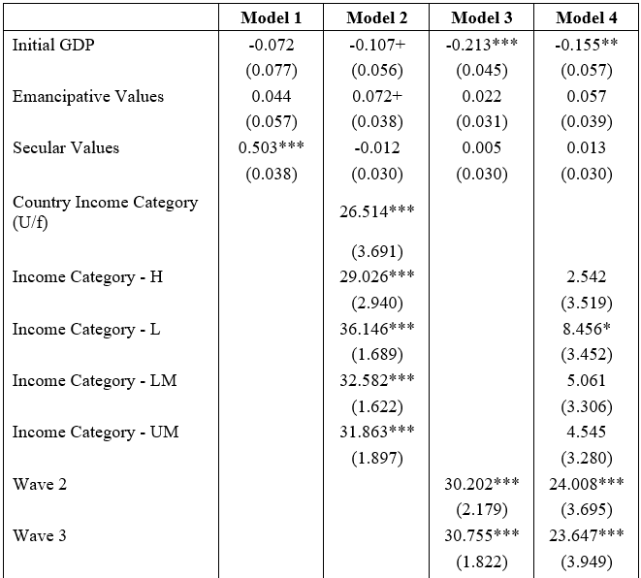
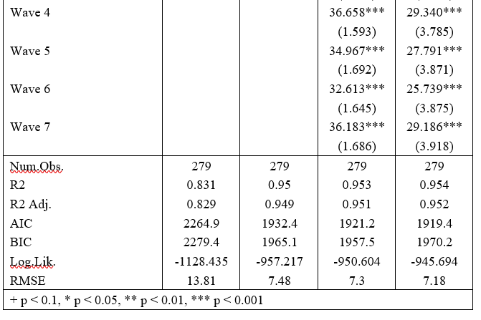
Interpretation of Results

Slide 14
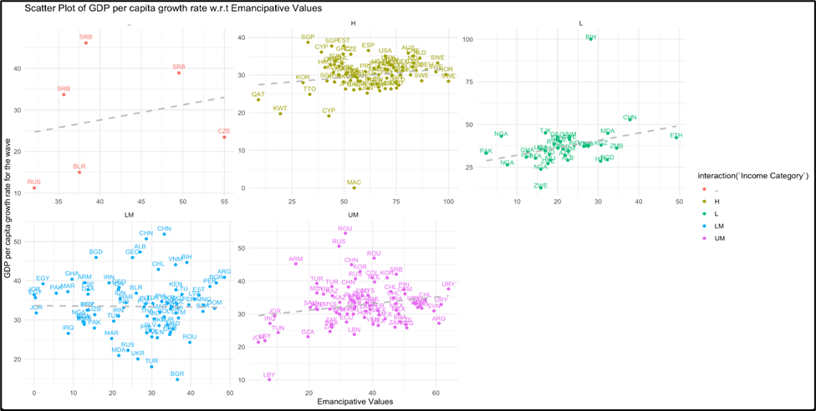
Interpretation of Results

Slide 15
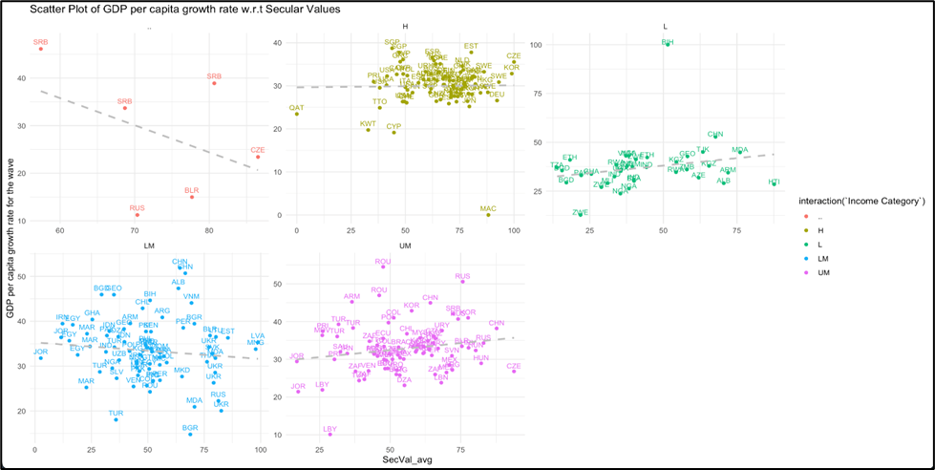
Interpretation of Results

Slide 16
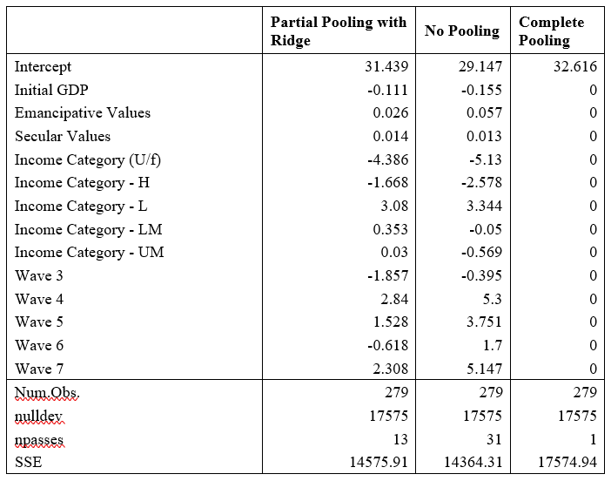
Interpretation of Results

Slide 17
Limitations
Cultural Limitations
Language, customs, the arts, historical narratives, and many other variables make up culture. We have considered culture as defined by Welzel et al. (2013) on Secular and Emancipative scales.
Limited sample points
The secular and emancipative ideals gathered from the World ideals Survey are derived from survey responses provided by citizens of all the mentioned nations.
Consideration of economic control variables
Attempting to analyse the GDP growth rate solely in terms of cultural characteristics has produced some surprising findings, which should make sense when we take into account other control variables like imports and exports, consumer and business spending, investment, government spending, and employment rate.

Slide 18
Division of Labour
Mihirsinh Desai: Literature review, Major contribution in R programming, data collection, analysis and modelling, result interpretation.
Tushar Chitnavis: Logic building and R programming.
Pinak Bhandarkar: Report Writing, Presentation slides, Data Interpretation and logic building.
Sarthak Lad: Report Writing and Data Analysis.
Apurva Shardul: Data Validation and Data Interpretation.

Slide 19
References
Haerpfer, C., Inglehart, R., Moreno, A., Welzel, C., Kizilova, K., Diez-Medrano J., M. Lagos, P. Norris, E. Ponarin & B. Puranen et al. (eds.). 2022. World Values Survey Trend File (1981-2022) Cross-National Data-Set. Madrid, Spain & Vienna, Austria: JD Systems Institute & WVSA Secretariat. Data File Version 3.0.0, doi:10.14281/18241.23.
World Bank. (1990 - 2022). "GDP growth (annual %)." World Bank Open Data. Available: https://data.worldbank.org/indicator/NY.GDP.MKTP.KD.ZG
World Bank. (1987 - 2022). "World Bank Country and Lending Groups." [Online]. Available: https://datahelpdesk.worldbank.org/knowledgebase/articles/906519-world-bank-country-and-lending-groups
Welzel, C. (2013). Freedom Rising: Human Empowerment and the Quest for Emancipation. New York: Cambridge University Press.
Granato, J., Inglehart, R., Leblang, D., "The Effect of Cultural Values on Economic Development: Theory, Hypotheses, and Some Empirical Tests," American Journal of Political Science, vol. 40, no. 3, pp. 607-631, August 1996.
Ranganathan S, Nicolis SC, Spaiser V, Sumpter DJ. Understanding Democracy and Development Traps Using a Data-Driven Approach. Big Data. 2015 Mar 1;3(1):22-33. doi: 10.1089/big.2014.0066. PMID: 26487983; PMCID: PMC4605381.
Edwards, J.A.; Romero, A.; Naanwaab, C., "Income Inequality, the World Values Survey, and the Interaction of Cultural Dimensions," Applied Econometrics & International Development, vol. 22, no. 2, pp. 5, 2022.
IBAN."IBAN Country Codes." [Online]. Available: https://www.iban.com/country-codes.

Slide 20
Thank You

