Slide 1
Survey Analysis on Cleanliness and Hygiene
Data Analysis and Visualization done on Tableau

Slide 2
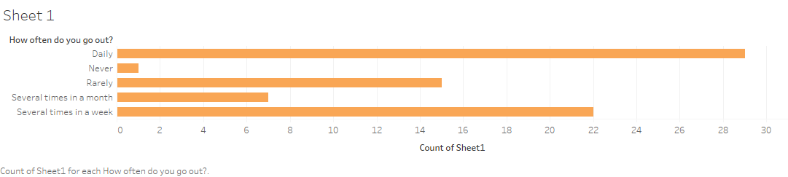
More than 78% of people have to commute and leave their place of residence due to various reasons like work, studies, travel or even leisure activities.

Slide 3
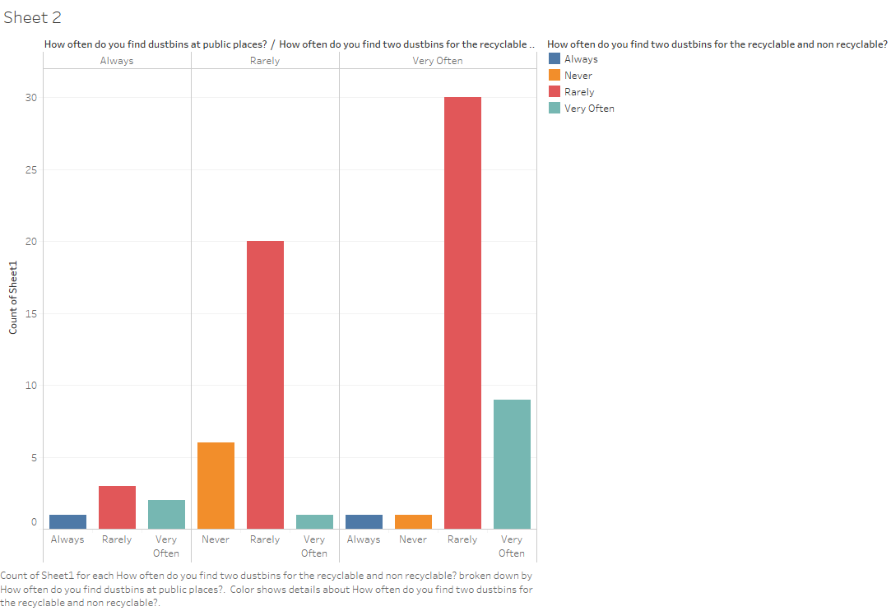
As we can see there are just a handful of entries claiming they always find a dustbin when they go out but a large number of entries saying they rarely find one.
The second part of the study shows people might find a dustbin, but don’t have the liberty to segregate their waste into biodegradable and non-biodegradable.

Slide 4
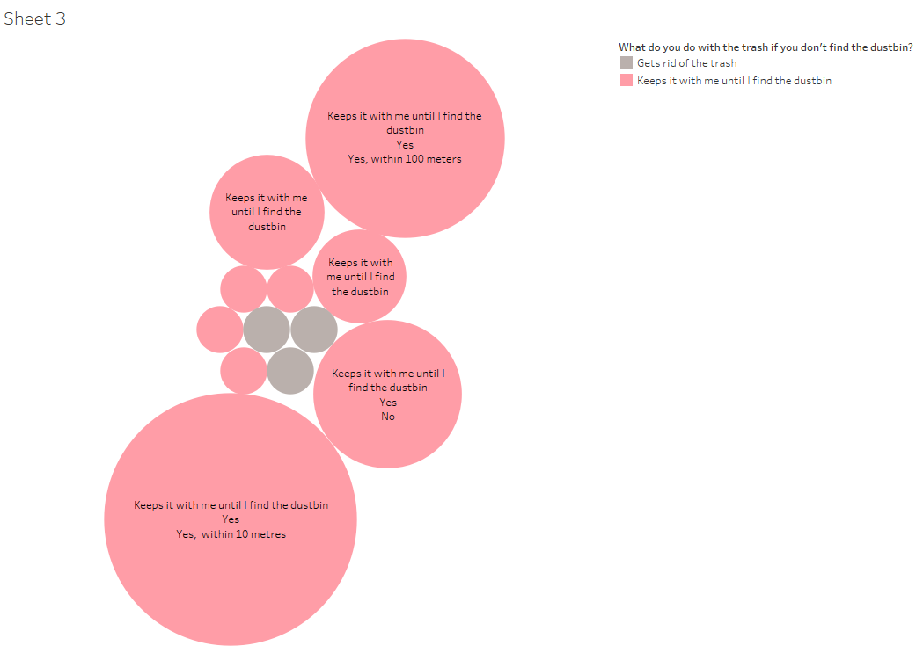
B
D
E
According to the study maximum people (A,B,C,D,E groups) agreed to the fact that they don’t throw away the waste until they find a dustbin and would have no problem in walking to the nearest one if redirected correctly.
C
A

Slide 5
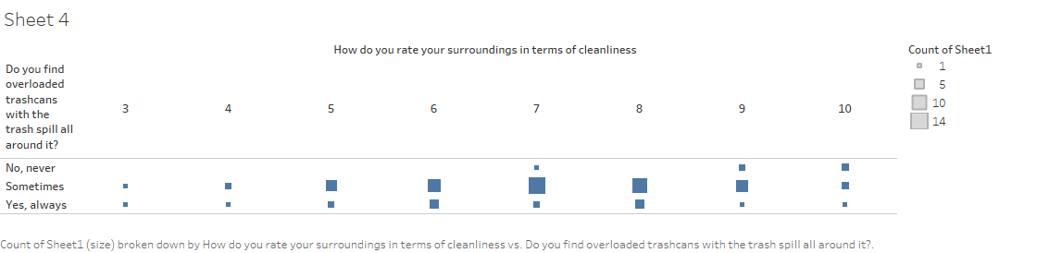
According to the study, majority of the people who found trashcans overloaded with waste have rated their surroundings in range 5-8 which shows clean surroundings come with better management and more dustbins in the area.

Slide 6
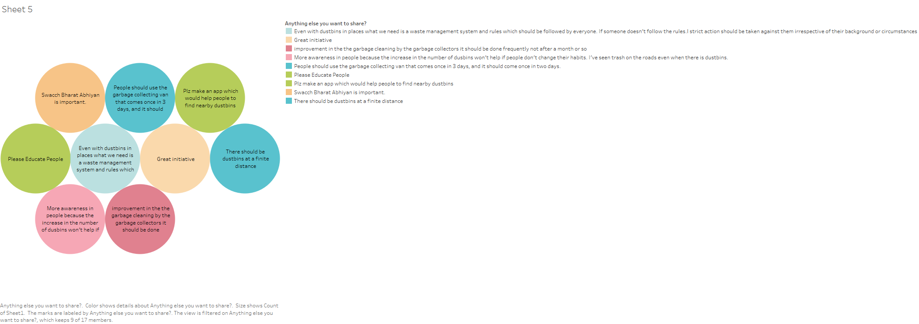
Few suggestions we got in our survey demanding better waste management, more dustbins and awareness regarding cleanliness and hygiene.

