Slide 1


Ballistic Learning System (BLS)
Presented by: Tushar Bhadana
Notes:
1

Slide 2
About Ballistic Learning System
Ballistic is a leading provider of custom open-source learning solutions, delivering innovative and scalable digital learning platforms for over 20+ years.
300+ Global Projects
Across education and enterprise sectors worldwide
End-to-End Solutions
From strategy and development to deployment and beyond
User-Centric Design
Personalised, engaging, and accessible learning experiences
Secure Ecosystems
Scalable and fully integrated learning environments
"Shaping how millions of learners log in, learn, pass, teach, and grow — building communities and impacting lives, especially towards #ViksitBharat."
Notes:
2

Slide 3






What BLS Does
Ballistic Learning System (BLS) delivers end-to-end digital learning solutions that enhance education and training experiences across schools, universities, and enterprises.
LMS Development
Engaging Experiences
Develops and customises Learning Management Systems tailored to your needs
Mobile apps, virtual classrooms, and gamification for immersive learning
Platform Integration
Analytics & Reporting
Connects with CRM, AI tools, and conferencing systems seamlessly
Learning analytics for performance insights and data-driven decisions
Secure Hosting
Digital Transformation
Cloud and on-premise hosting solutions that are secure and scalable
Supports transformation for schools, universities, and enterprises
Notes:
3

Slide 4
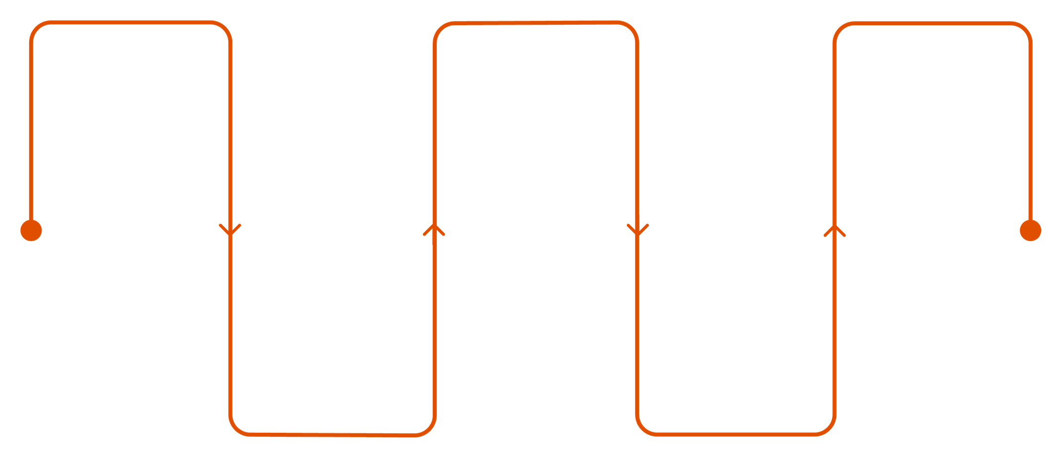
Quick Start
Get started with Ballistic Learning System (BLS) quickly and efficiently — from setup to deployment, BLS ensures a seamless and scalable learning experience.
Define Goals
Integrations
Onboard Users
Set learning objectives and requirements
Connect CRM, video, and analytics
Assign roles and access for learners
Upload Content
Platform Setup
Add SCORM-compliant learning materials
Configure and customise the LMS
From setup to deployment, BLS ensures a seamless and scalable learning experience for every organisation.
Notes:
4

Slide 5

Digital Transformation
Ballistic Learning System (BLS) drives digital transformation by integrating technology into learning ecosystems for smarter, scalable, and efficient education.
Seamless Integration
Cloud & Mobile
Connects with CRM, AI tools, and web conferencing platforms
Enables anytime, anywhere learning through flexible solutions
Workflow Automation
Personalised Learning
Automates processes and reduces manual effort in learning management
Delivers adaptive and personalised learning experiences at scale
Data Analytics
Enhanced Collaboration
Improves decision-making and learner outcomes through insights
Boosts efficiency and overall learning impact across teams
"Empowering organisations to evolve from traditional systems to intelligent, data-driven learning environments."
Notes:
5

Slide 6


Ballistic Academy
Ballistic Academy focuses on building digital learning capabilities for educators, administrators, and learners — empowering individuals and institutions to adapt, innovate, and excel.
1
Capacity Building
Provides training for effective use of digital learning tools across institutions
2
FLIP Classroom Model
Uses flipped classroom and social learning approaches for deeper engagement
3
LMS & Content Training
Offers training in LMS platforms, content creation, and emerging technologies
4
Expert-Led Sessions
Conducts virtual sessions with subject matter experts for real-world learning
5
SCORM Content Creation
Helps create SCORM-compliant digital content for impactful learning outcomes
"Empowering individuals and institutions to adapt, innovate, and excel in digital education."
Notes:
6

Slide 7
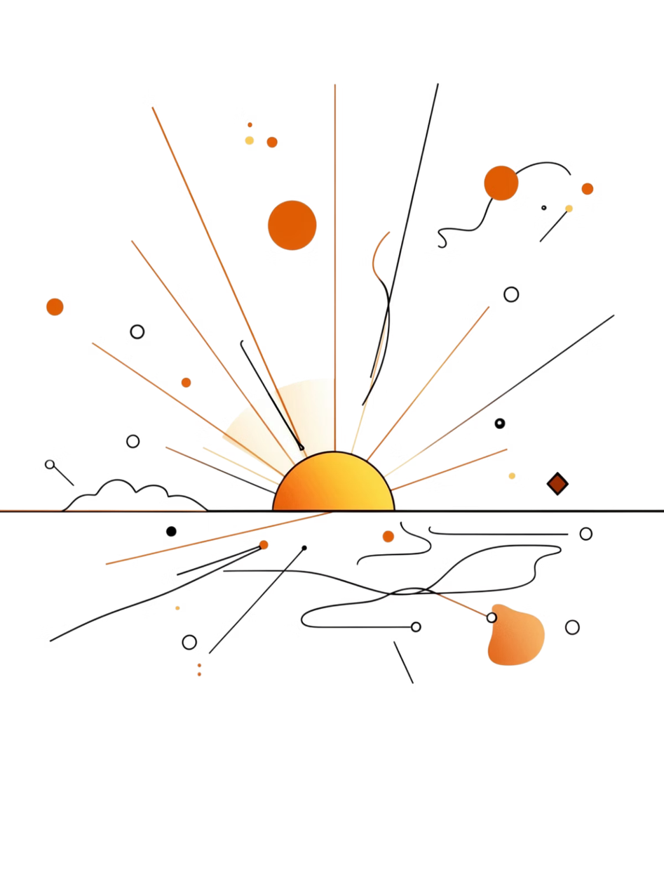
Thank You
We appreciate your time and interest in Ballistic Learning System (BLS).
🌐 Explore BLS
🤝 Partner With Us
Discover our full range of digital learning solutions
Join 200+ global projects shaping the future of education
🚀 Start Your Journey
Transform your learning ecosystem with BLS today
"Shaping how millions of learners log in, learn, pass, teach, and grow — towards #ViksitBharat."
Presented by Tushar Bhadana
Notes:
7

