Slide 1
PREDICTAL
GROUP 50
A ONE STOP MEDICAL SOLUTION FOR EARLY DIAGNOSIS OF MULTIPLE DISEASES
GROUP MEMBERS:
Tushar Budhwani Esha Datwani Anushree Dutt Yukta Jain
Supervising professor: Dr. Archana. B. Patankar

Slide 2
INTRODUCTION
There are multiple techniques in machine learning that can do predictive analysis on a large amount of data in a variety of industries. Predictive analysis in healthcare is a difficult endeavor, but it can eventually assist practitioners in making timely decisions regarding patients’ health and treatment based on massive volume of data.
Diseases like breast cancer, diabetes, heart-related, liver-related and kidney- realated diseases are causing many deaths globally but most of these deaths are due to lack of timely check-ups of the diseases. The above problem occurs due to lack of infrastructure and a low ratio of doctors to the population. These diseases can be a serious threat to mankind if not diagnosed early.
Therefore, early recognition and diagnosis of these diseases can save a lot of lives.
To address these life-threatening issues, we aim to develop a one-stop medical solution platform for early recognition and diagnosis of various diseases like Breast cancer, Diabetes, Heart diseases, Chronic Kidney disease, Liver disease, Parkinson's disease etc. using the concept of machine learning.
GROUP 50
02

Slide 3
AIM
PREDICTAL aims at providing a single platform to its users for early diagnosis of multiple diseases.
It provides a user-friendly interface where the user is prompted to enter certain clinical parameters and symptoms and our models predict the concerned disease.
Our aim is to deduce good Machine Learning algorithms which are efficient and accurate for the prediction of a multiple diseases.
GROUP 50
03

Slide 4
PROBLEM STATEMENT
There is a demand to make a system that will help end users to predict diseases on the basis of symptoms given in it without visiting hospitals.
By doing so, it will decrease the rush at OPD’s of hospitals and bring down the workload on medical staff. Not only this, such a system will reduce the costly treatment and panic moment at the end stages so that proper medication can be provided at the right time and we can lower down the death rate as well.
So our problem statement is to conceptualize and create an all-in-one medical solution that aims to bring early diagnosis of a wide variety of diseases like heart diseases, diabetes, breast cancer, etc. on a single platform - allowing the users to get an early diagnosis at the comfort of their homes in no time.
04
GROUP 50

Slide 5
LITERATURE REVIEW
A. REVIEW PAPER 1 - TO STUDY APPROACHES USED TO DETECT MULTIPLE DISEASES USING ML ALGORITHM
Name of Paper
An approach to detect multiple diseases using machine learning algorithm
Authors
Indukuri Mohit, K. Santhosh Kumar, Avula Reddy, Badhagouni K. Vardhaman College of Engineering, Hyderabad, India
Year Published September, 2021. Proceedings of 1st
International Conference on AMSE. doi:10.1088/1742- 6596/2089/1/0120
09
Research area and Technology Used
The research explores predictive analysis in healthcare by proposing a medical test/disease-predicting web application that uses the concept of machine learning-based predictions about various diseases like Breast Cancer, Diabetes, and Heart Diseases. It makes use of 3 classification algorithms namely, SVM, LR and KNN, from which LR gave good accuracy values for disease prediction of diabetes (77.60%) and breast cancer (94.55%) and KNN (83.84%) for the disease prediction of heart disease.
B. REVIEW PAPER 2 - TO STUDY APPROACHES USED FOR HEART DISEASE PREDICTION USING MACHINE LEARNING
Name of Paper Efficient Heart Disease Prediction System
Authors
Purushottam, Prof. Kanak Saxena, Richa Sharma
Year Published
June, 2016. Procedia Computer
Science 85 (2016) 962
- 969
Research area and Technology Used
The research paper proposes using hill climbing and decision tree algorithms .They used Cleveland dataset and preprocessing of data is performed before using classification algorithms. A decision tree follows top-down order. For each actual node selected by hill-climbing algorithm a node is selected by a test at each level. The parameters and their values
used are confidence. Its minimum confidence value is 0.25. The accuracy of
the system is about 86.7%.
05

Slide 6
C. REVIEW PAPER 3 - TO STUDY APPROACHES USED FOR DIABETES PREDICTION USING MACHINE LEARNING
Name of Paper
Authors
Year Published
October, 2021
Research area and Technology Used
The research explores and proposes a model to predict diabetes in females of Pima Indians heritage by taking the clinical dataset. The work uses supervised ML algorithms like classification tree (CT), SVM, KNN, NB, RF, Neural Network, AdaBoost and LR. K-fold cross-validation has been used to carry out the process of training and testing. The area under the curve (AUC), classification accuracy (CA), F1, precision and recall results have been determined as performance metrics and LR has been concluded to perform better in comparison to other algorithms.
Prediction of Diabetes Sourav K., Sanjaya K.,
in Females of Pima Indian Heritage: A Complete Supervised Learning Approach
Kalyan K. J., P. Anshuman, Turkish Journal of
Kshira Sagar Sahoo, Najm U., Shweta S., Rashmi Ranjan S.
Department of CS & IT, Hyderabad, India
Computer and Mathematics Education
D. REVIEW PAPER 4 - TO STUDY APPROACHES USED FOR BREAST CANCER PREDICTION USING MACHINE LEARNING
Name of Paper Machine Learning Algorithms For
Breast Cancer Prediction And Diagnosis
Authors
Kawtar Aarika, El Habib Benlahmar, Mohammed Amine Naji, Sanaa E., Rachida A., Olivier D.
University of Mons, Mons, Belgium
Year Published
August, 2021 Proceedings of the International Workshop on Edge IA-IoT for Smart Agriculture (SA2IOT)
Research area and Technology Used
The research explores how ML techniques can bring a large contribution on the process of prediction and early diagnosis of breast cancer. In this study, 5 ML algorithms have been applied: SVM, RF, LR, DT(C4.5) and KNN on the Breast Cancer Wisconsin Diagnostic dataset. The study observed that Support Vector Machine (SVM) outperforms all other classifiers and achieved the highest accuracy of 97.2%. The work has been done in the Anaconda environment based on Python language and Scikit-learn library.
06

Slide 7
E. REVIEW PAPER 5 - TO STUDY APPROACHES USED FOR LIVER DISEASE PREDICTION USING MACHINE LEARNING
Name of Paper
Liver Disease Prediction System using Machine Learning Techniques
Authors
Rakshith D B , Mrigank Srivastava , Ashwani Kumar, Gururaj S P
Year Published July 5, 2021 International
Research Journal of Engineering and Technology (IRJET)
Research area and Technology Used
The research proposes a system to detect parkinson's disease in patient’s body using machine learning technology. It makes use of three ML algorithms viz. XGBoost, Navie Bayes and Decision Tree Classifier.
Out of the three algorithms, the best results are obtained using XGB classifier with an accuracy of 94.87%.
F. REVIEW PAPER 6 - TO STUDY APPROACHES USED FOR CHRONIC KIDNEY DISEASE PREDICTION USING MACHINE LEARNING
Name of Paper Chronic kidney disease prediction based
on machine learning algorithms
Authors
Md. Ariful Islam Md. Ziaul Hasan Majumder
Md. Alomgeer Hussein
Year Published
Jan 5, 2023
National Library of Medicine
Research area and Technology Used
The results of various classifiers have been reviewed with a variety of criteria for evaluation, and the 10-fold cross-validation method has been utilized to validate the results against overfitting. Eleven models like Ada boost, Decsion Tree, XG boost, CAT boost, KNN, Random Forest, Naive Bayes, Gradient boosting, SGD have been used in the research.
The best performance for XgBoost was achieved with an accuracy of 98.33% for the original CKD dataset. The accuracy has improved for the
same classifier to 99.16% with the dataset after implementing PCA.
07

Slide 8
G. REVIEW PAPER 7 - TO STUDY APPROACHES USED FOR PARKINSON'S DISEASE PREDICTION USING MACHINE LEARNIN
Name of Paper
The Parkinson's Disease Detection Using Machine Learning Techniques
Authors
Dr. C K Gomathy, Mr. B.
Year Published
October, 2021
Research area and Technology Used
The research explores and proposes a model to predict diabetes in females of Pima Indians heritage by taking the clinical dataset. The work uses supervised ML algorithms like classification tree (CT), SVM, KNN, NB, RF, Neural Network, AdaBoost and LR. K-fold cross-validation has been used to carry out the process of training and testing. The area under the curve (AUC), classification accuracy (CA), F1, precision and recall results have been determined as performance metrics and LR has been concluded to perform better in comparison to other algorithms.
Dheeraj Kumar Reddy, Ms. International
B. Varsha, Ms. B. Varshini
Research Journal of Engineering and Technology (IRJET)
H. REVIEW PAPER 8 - TO STUDY APPROACHES USED FOR SYMPTOMS TO DISEASE PREDICTION USING MACHINE LEARNING
Name of Paper Disease prediction from various
symptoms using machine learning
Authors
Rinkal Keniya Aman Khakharia Vruddhi Shah Vrushabh Gada Ruchi Manjalkar Tirth Thaker Mahesh Warang Ninad Mehendale
Year Published
July 27, 2020
SSRN-elsevier journal
Research area and Technology Used
The manuscript presented the technique of predicting the disease based on the symptoms, age, and gender of an individual patient. The work uses Fine tree, medium tree and coarse tree. It also uses Gaussian Naive Bayes, Kernel Naive Bayes, fine KNN, Medium KNN, Coarse KNN and Subspace KNN. The Weighted KNN model gave the highest accuracy of 93.5 % for the prediction of diseases from give symptoms.
08

Slide 9



DATASETS
Thanks to the never-ending efforts of the researchers to make crucial metadata available to the common public, the following repositories culminated over the years have been chosen to make real-time disease specific predictions.
Heart Disease
Breast Cancer
Diabetes
For predicting the occurrence of heart diseases we will be using the "Heart Disease Dataset" by UCI. This dataset consists of 13 medical predictor features and one target feature. The dataset consists of 303 instances and 75 attributes like chol, cp, trestbps, age, fbs, sex, restecg, etc.
For predicting the occurrence of breast cancer we will be using the "Breast Cancer Wisconsin (Diagnostic) Dataset" by Kaggle. This dataset consists of 31 medical predictor features and one target feature. The dataset consists of 569 instances and 32 attributes like id, radius- mean, texture-mean, perimeter-mean, area-mean, etc.
For predicting the occurrence of Diabetes diseases we will be using the "Pima Indians Diabetes Dataset" by Kaggle. This dataset consists of 8 medical predictor features and one target feature. The dataset consists of 768 instances and 9 attributes like BloodPressure, pregnancies, glucose, SkinThickness, BMI, etc.
09

Slide 10





DATASETS
Thanks to the never-ending efforts of the researchers to make crucial metadata available to the common public, the following repositories culminated over the years have been chosen to make real-time disease specific predictions.
Liver Diseases
Chronic Kidney Diseases
Parkinsons
For predicting the occurrence of liver diseases we will be using the "ILPD (Indian Liver Patient Dataset)" by UCI. This data set contains 416 liver patient records and 167 non liver patient records (583 in total). It consists of 10 medical attributes like age, gender, total_bilirubin, total_proteins, etc.
For predicting the occurrence of Chronic Kidney diseases we will be using the "Chronic Kidney Disease Data Set" by UCI. This dataset consists of 11 numeric and 14 nominal attributes in which one attribute is a class attribute. The dataset consists of 400 instances.
For predicting the occurrence of Parkinsons disease we will be using the "Parkinsons Data Set" by UCI. This dataset consists of 23 medical attributes related to vocal fundamental frequencies, health status of the subject, etc. The dataset consists of 197 instances.
10

Slide 11
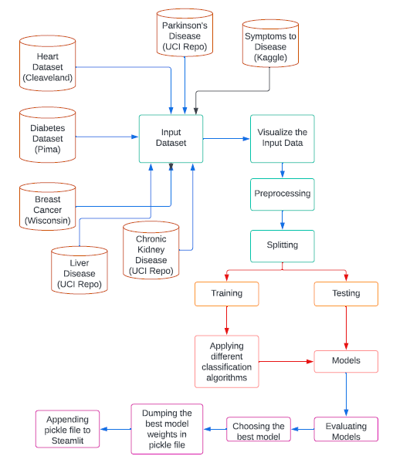
ARCHITECTURE DIAGRAM
03
11
GROUP 50

Slide 12

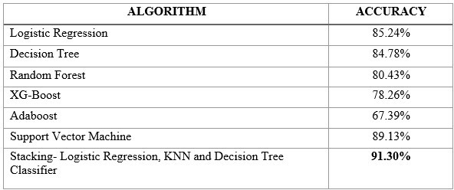
Heart Disease Prediction
We have run our dataset through seven machine learning models. They are:
Out of all these, we are getting the best results for Stacking Ensemble Technique with an accuracy of 91.3% on the test results.
12

Slide 13
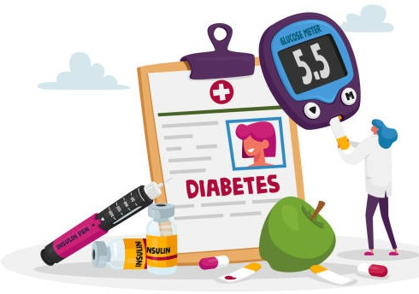
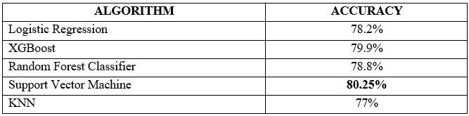
Diabetes Prediction
We have run our dataset through five machine learning models. They are:
Out of all these, we are getting the best results for Support Vector Machine with an accuracy of 80.25% on the test results.
13

Slide 14


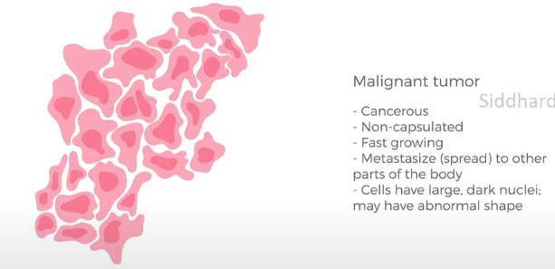
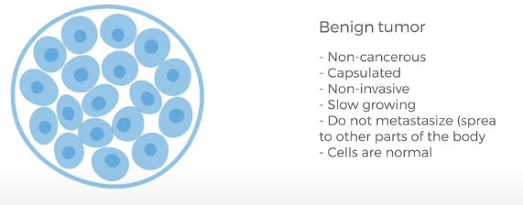
Breast Cancer Prediction
If not a second specialist, then who?
A Machine Learning Specialist!
Problem Definition - "Given the clinical parameters of a patient can we determine whether a breast cancer tumor is Malignant or Benign."
14

Slide 15

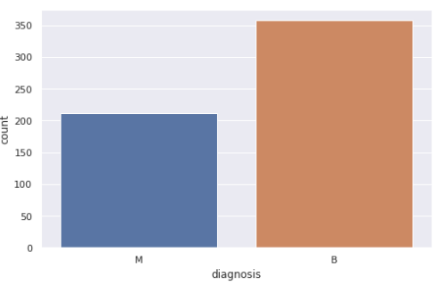
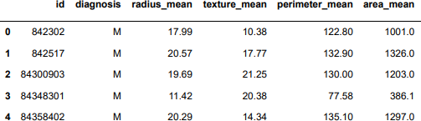
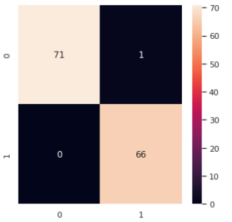
Breast Cancer Prediction
Preprocessing Techniques applied: Feature Scaling (Min-Max Scaler) Outlier Detection (Tukey's Method)
Imbalanced Learning (Naive Random, SMOTE, ADASYN)/Resampling Feature Selection (SelectKBest)
15

Slide 16
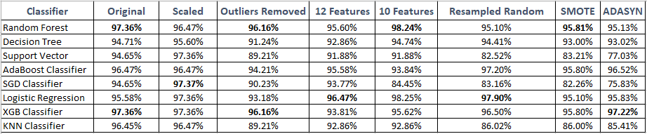
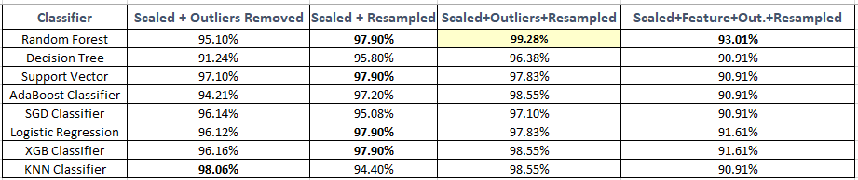
Result when Individual techniques were applied
Result when Combination of techniques were applied
16

Slide 17
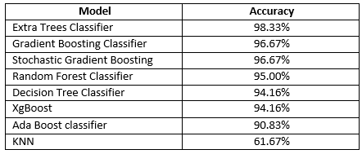
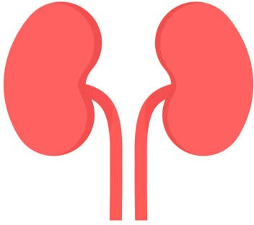
Chronic Kidney Disease Prediction
We have run our dataset through eight machine learning models. They are:
Out of all these, we are getting the best results for ET Classifier with an accuracy of 99.33% on the test results.
17

Slide 18
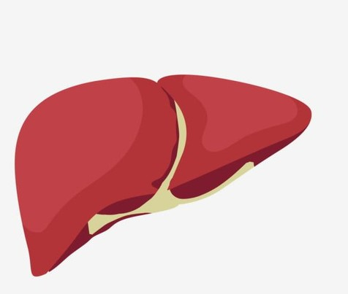
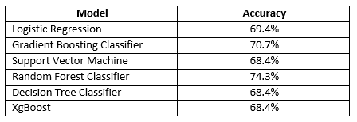
Liver Disease Prediction
We have run our dataset through six machine learning models. They are:
Out of all these, we are getting the best results for Random Forest Classifier with an
accuracy of 74.3% on the test results.
18

Slide 19
SYMPTOMS TO DISEASE PREDICTION
Dataset:
The dataset is taken from Kaggle. It contains 4920 rows of observations and 134 columns of attributes. The data types of the attributes consist of 1 qualitative discrete categorical, 132 quantitative discrete binary and 1 quantitaive continuous numerical float with 64 digit placings.
The testing dataset contains 42 rows of observations and 133 columns.
Data Pre-processing:
Checking for null values and analyzing bar plots to check errors of inconsistent data such as not comparable numerical measurement formats and data types.
Using unique() to check qualitative data for noises of impossible values such as incorrect misspelt data entries.
To handle outliers, the Winsorisation method is popularly chosen to handle numerical outliers, where outlier values are replaced with the minimum or maximum non-outlier value identified using the interquartile range (IQR) method.
Exploratory Data Analysis:
Analyzing individual qualitative attributes and taking a closer look at the individual diagnosis of each symptom will identify the frequency of occurrence of its absence or presence.
Plotting the heat map, it is seen that almost all symptoms have weak linear correlations, which is indicative that these symptoms do not come hand-in-hand.
Feature Selection:
Feature importance step was carried out and the original dataset was reduced to contain 33 columns of predictors, out of the original 132.
20

Slide 20
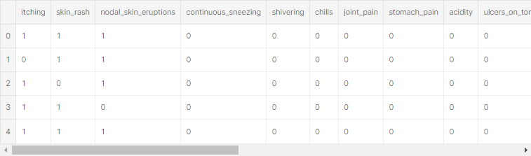
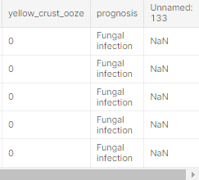
SYMPTOMS TO DISEASE PREDICTION
...
Currently the possible list of symptoms that can be inputted and diseases that can be predicted/diagnosed are as follows:
SYMPTOMS
DISEASES
'(vertigo) Paroymsal Positional Vertigo', 'AIDS','Acne','Alcoholic hepatitis','Allergy', 'Arthritis','Bronchial Asthma', 'Cervical spondylosis', 'Chicken pox', 'Chronic cholestasis', 'Common Cold', 'Dengue', 'Diabetes ', 'Dimorphic hemmorhoids(piles)', 'Drug Reaction' 'Fungal infection', 'GERD','Gastroenteritis', 'Heart attack','Hepatitis B', 'Hepatitis C', 'Hepatitis D', 'Hepatitis E', 'Hypertension','Hyperthyroidism', 'Hypoglycemia','Hypothyroidism', 'Impetigo', 'Jaundice', 'Malaria', 'Migraine','Osteoarthristis', 'Paralysis (brain hemorrhage)', 'Peptic ulcer diseae', 'Pneumonia', 'Psoriasis', 'Tuberculosis',
'itching', 'skin_rash', 'nodal_skin_eruptions' 'continuous_sneezing',' shivering','chills', 'joint_pain', 'stomach_pain', 'acidity',' 'ulcers_on_tongue', 'muscle_wasting', 'vomiting', ''burning_micturition', 'spotting_ urination', 'fatigue', 'weight_gain', 'anxiety', 'cold_hands_and_feets', 'mood_swings', 'weight_loss', 'restlessness', 'lethargy', 'patches_in_throat', 'irregular_sugar_level', 'cough', 'high_fever', 'sunken_eyes', 'breathlessness', 'sweating', 'dehydration', 'indigestion', 'headache', 'yellowish_skin', 'dark_urine', 'nausea', 'loss_of_appetite', 'pain_behind_the_eyes', back_pain', constipation','abdominal_pain', 'diarrhoea', 'mild_fever', etc.
21

Slide 21
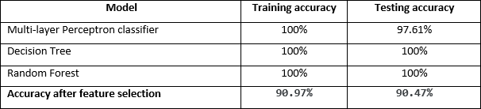
Symptoms to Disease Prediction
We have run our dataset through the following machine learning models:
DT model has the best performance metrics of 100% for all four metrics of test accuracy, precision, recall, and F1-score. The RF model also achieved 100% for all, but this is not preferred as the time complexity will usually be larger. On the other hand, the MLP model provides a testing accuracy of 97.62%. Hence, for all three chosen models, all the prognosis are almost perfectly classified and predicted.
19

Slide 22
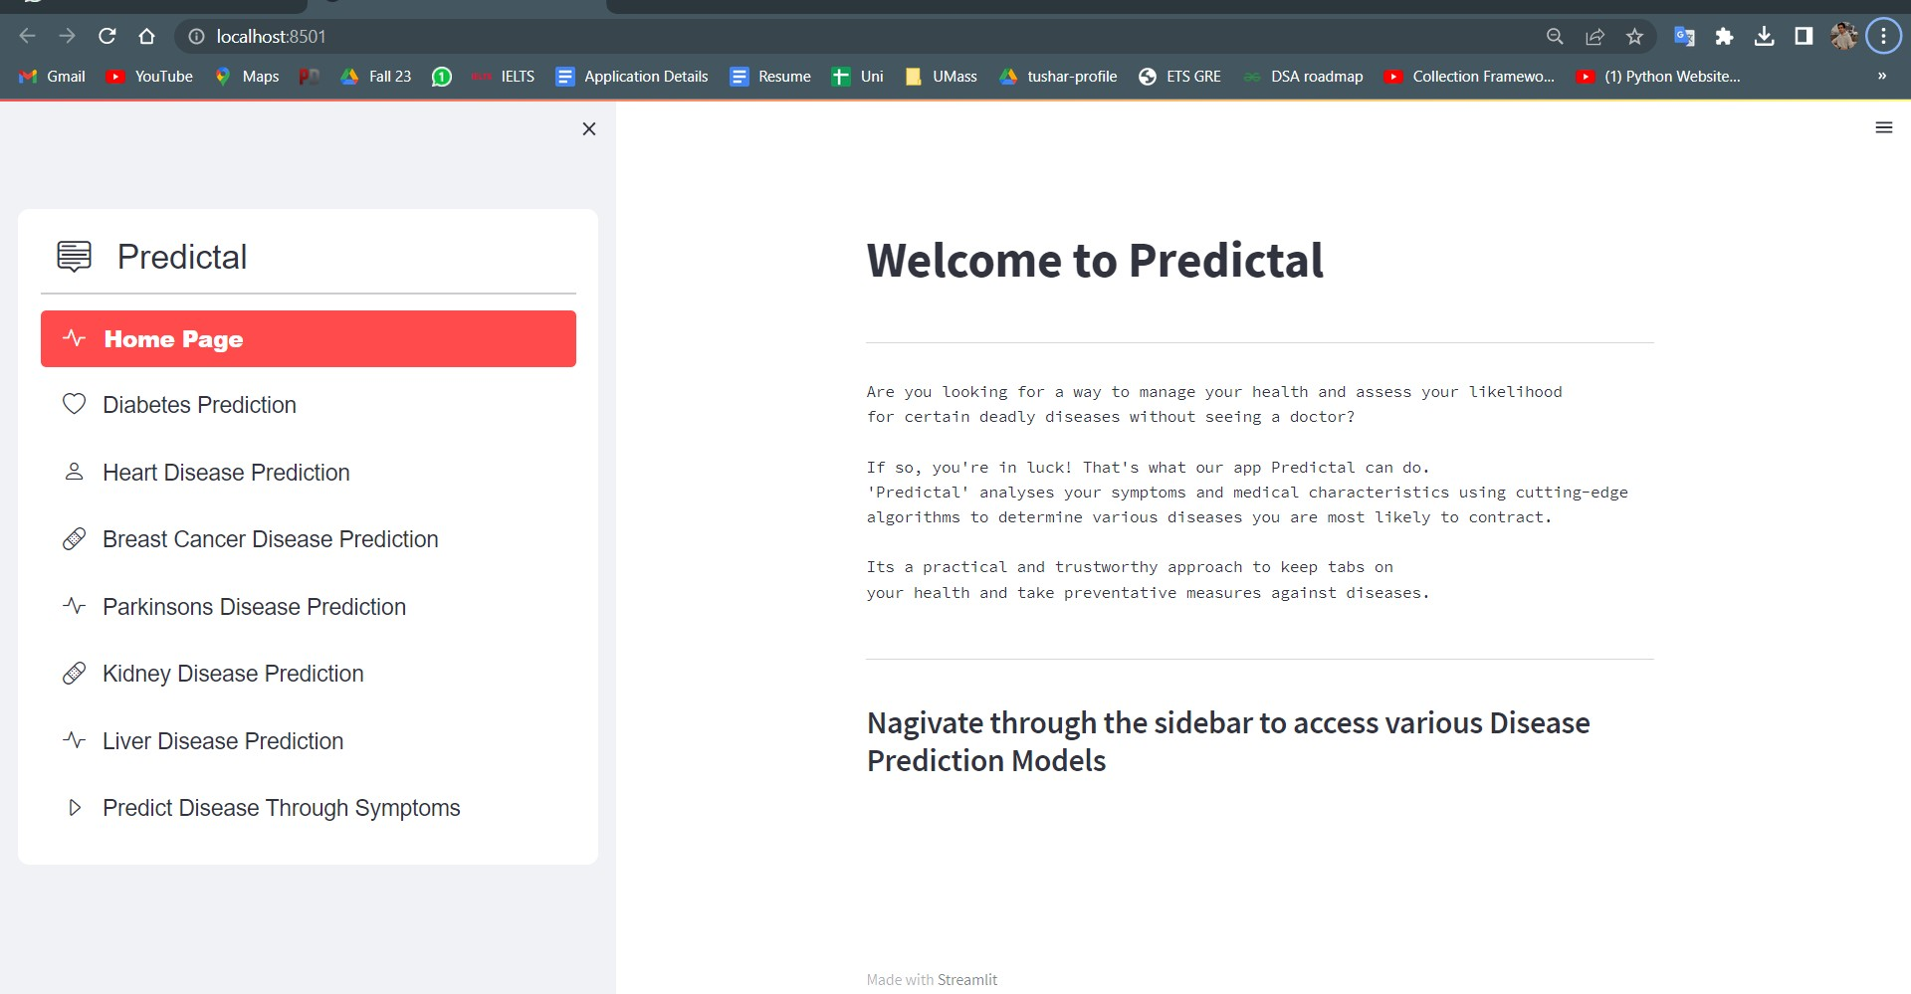
Results
22

Slide 23
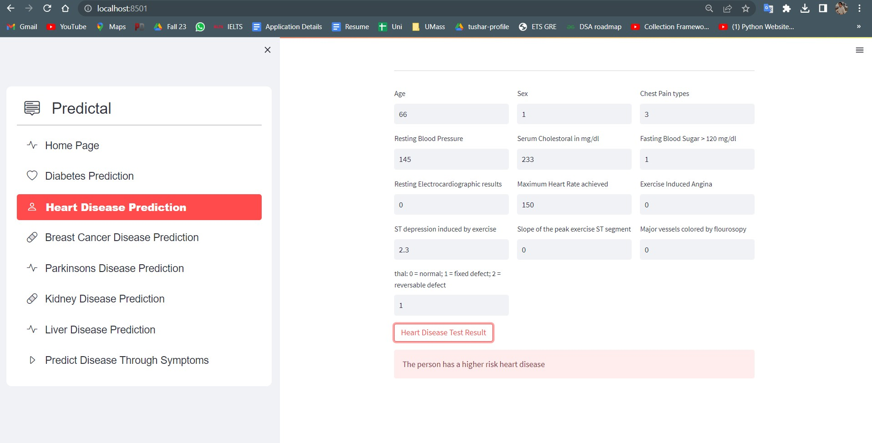
Results
23

Slide 24
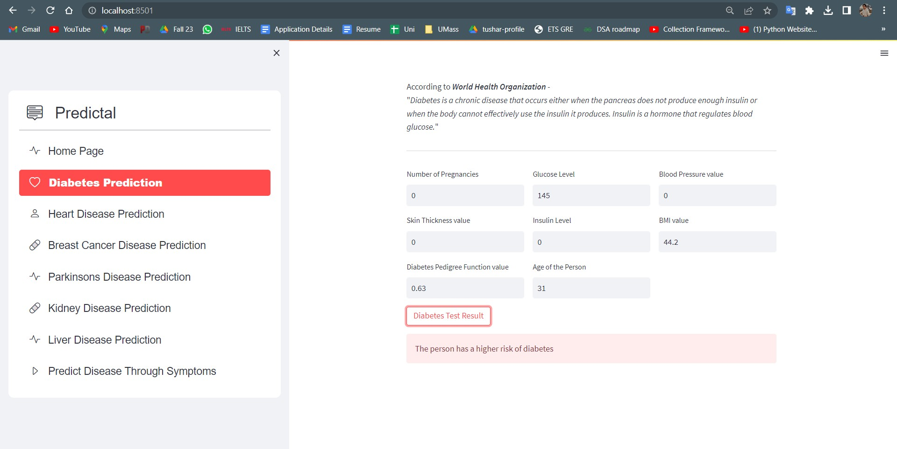
Results
24

Slide 25
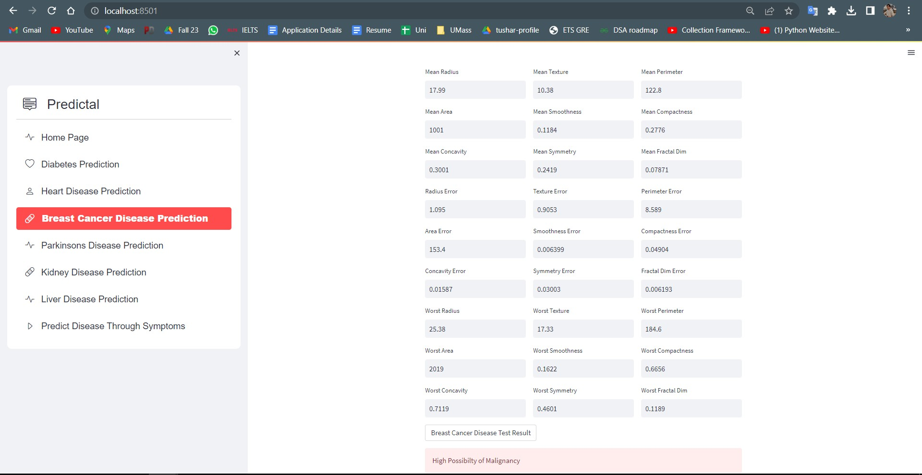
Results
25

Slide 26
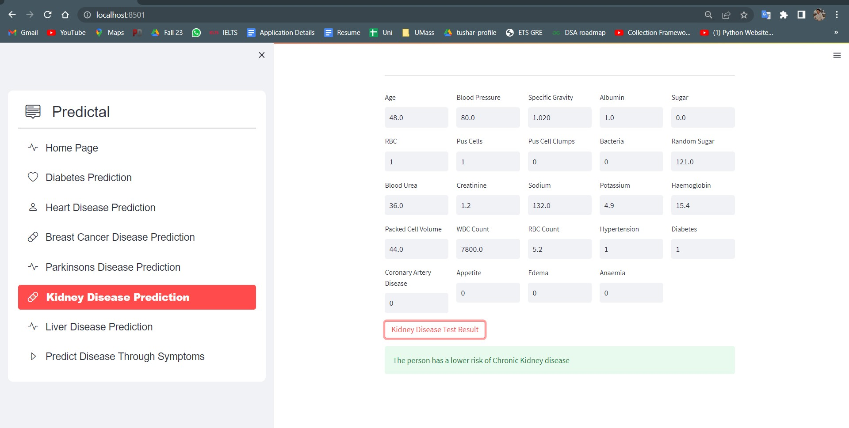
Results
26

Slide 27
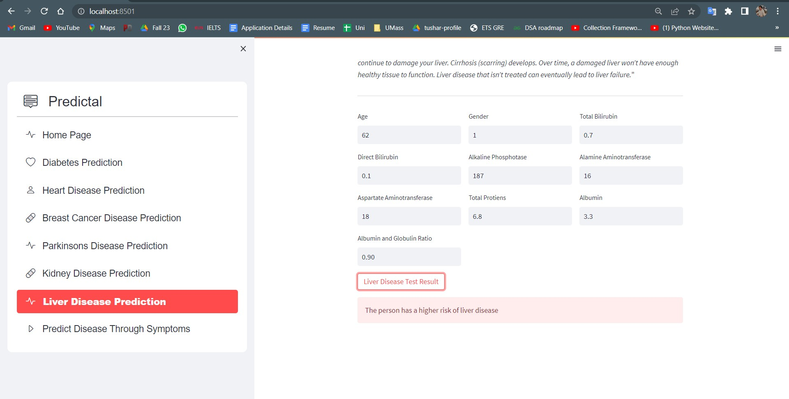
Results
27

Slide 28
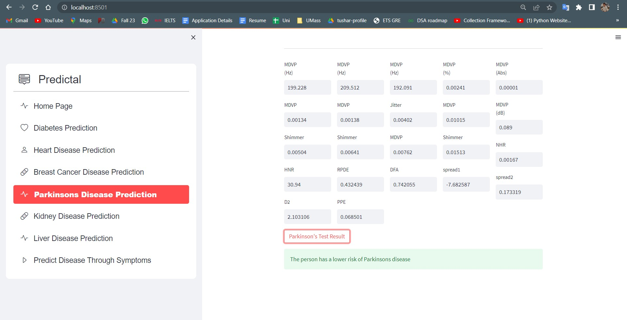
Results
28

Slide 29
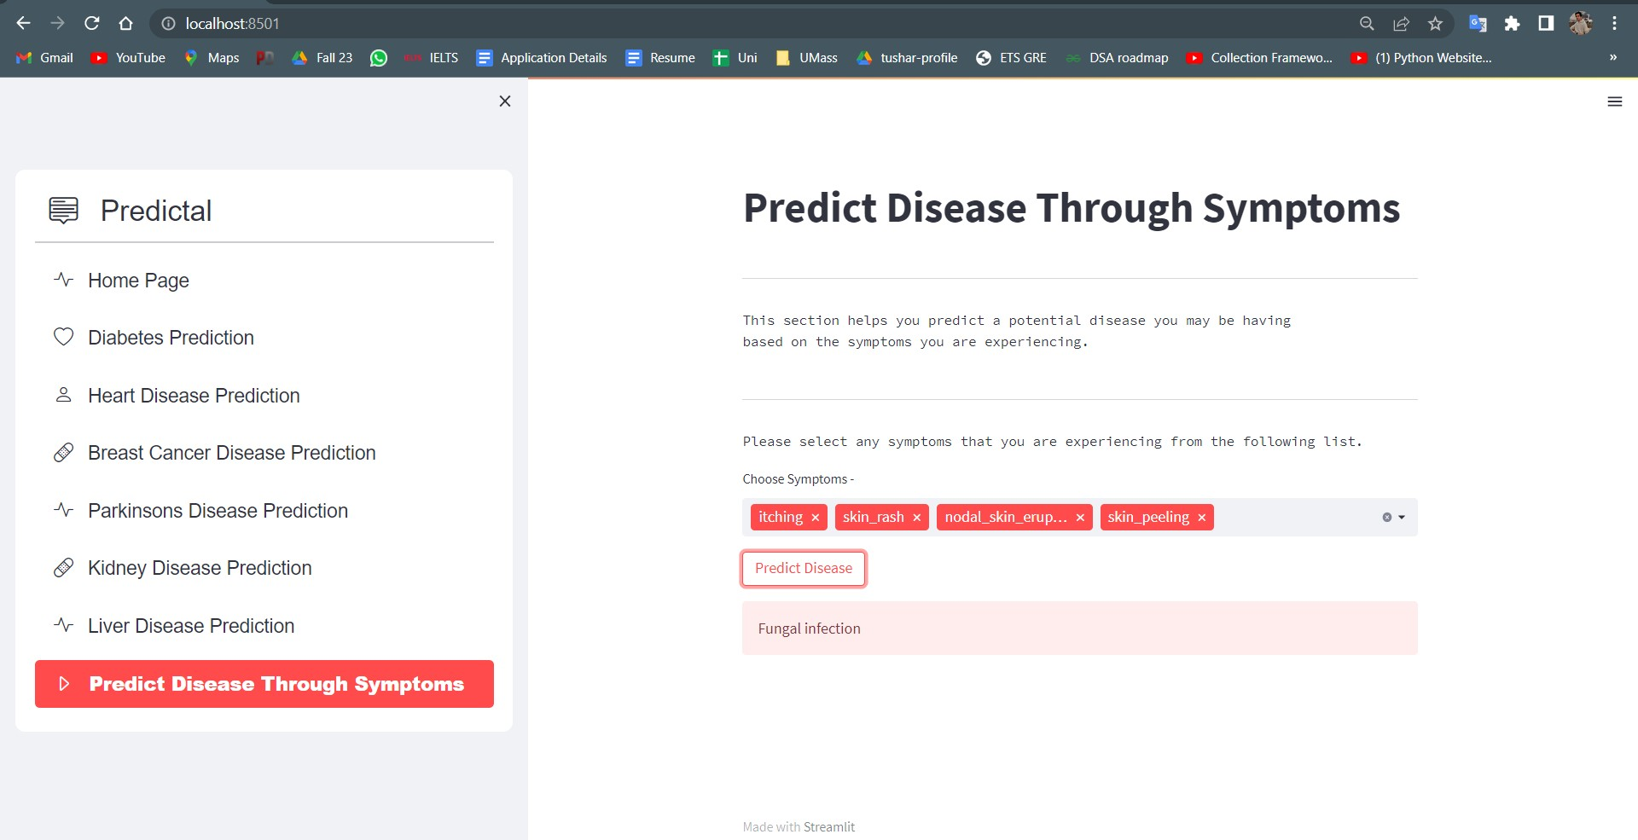
Results
29

Slide 30
CONCLUSION
Using traditional methods of health check up can be cumbersome at times. Hence, people ignore small indications of a potential health conditions.
Predictal was to created to predict the risk of major diseases -like Heart Disease, Breast Cancer, Diabetes, Liver and chronic kidney diseases and do so with good accuracy.
The user does not need to traverse different websites to check for different symptoms, which saves time as the user can simply enter some parameter values and find out if they are at a risk of the disease.
Diseases if predicted early can increase your life expectancy. Predictal is developed for this purpose, using different models and chosing the one with the highest accuracy which enables the user to check whether he/she has a higher risk of certain disease.
Predictal provides an optimal performance compared to other state of art approaches and helps users take timely action for these critical health conditions.
30

Slide 31
FUTURE SCOPE
Our future scope involves working on the following features:
Connecting our product with trustworthy medical data sources such as Hospital Databases, and EHRs (Electronic Health Records) can provide us with more accurate as well as detailed data about the patients. This will help us in achieving reliable data and hence improve prediction accuracy.
Developing our platform in terms of visualization. Users can understand the results in a better way if the presented output is visual.
Providing admin controls to upload, delete the dataset which will be used to train the model.
Providing a user account which allows the user to keep track of their medical test data and get suggestions or support to meet the right specialists or the tests to be taken.
31

Slide 32
REFERENCES
https://towardsdatascience.com/heart-disease-uci-diagnosis-prediction-b1943ee835a7
https://towardsdatascience.com/pima-indian-diabetes-prediction-7573698bd5fe
https://www.sciencedirect.com/science/article/pii/S1877050915031786
https://deepnote.com/@umaima-khurshid-ahmad-a1fd/Wisconsin-Breast-Cancer Analysis-7f141f92-beb3-42ac-a223-de5569144e9b
https://towardsdatascience.com/end-to-end-data-science-example-predicting-diabetes- with-logistic-regression-db9bc88b4d16 [6]https://www.researchgate.net/publication/341547725_Comparison_of_Classification_Mod els_for_Breast_Cancer_Identification_using_Google_Colab
32

Slide 33
GROUP 50
THANK YOU!

