Slide 1
NORTH STAR
Workload Optimizer
Digital Transformation for Enterprise Expense Management
Technology Strategy & Transformation
Process Reengineering | Solution Architecture | Automation
Confidential | Prepared for Leadership Review

Slide 2
Executive Summary
PROBLEM: Manual expense reporting costs $620K/year with 9.7-day cycle times
SOLUTION: AI-powered automation reducing cycle time by 78% (9.7 to 2.1 days)
IMPACT: $434K annual savings | 70% cost reduction | 3.1x productivity gain
APPROACH: Phased implementation over 12 weeks using Power Platform + Python
ROI: 865% return in Year 1 with 1.2-month payback period

Slide 3
Problem Statement
The current expense reporting process is manual, error-prone, and slow:
- 12-step manual workflow across 4 organizational layers
- Average 9.7-day end-to-end processing time
- 18% data entry error rate requiring rework
- $620,647 annual operational cost
- 81.5% receipt attachment rate (target: 98%)
- Employee satisfaction: LOW (delayed reimbursements)
Data Source: Analysis of 5,000 expense records over 18 months

Slide 4
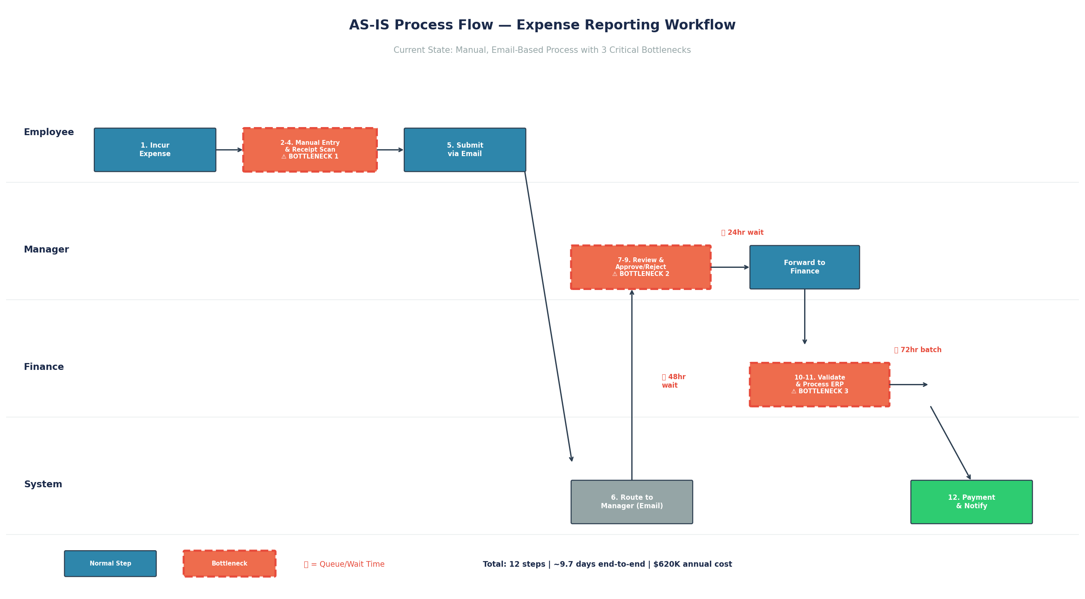
AS-IS Process Flow

Slide 5
Bottleneck Analysis
Bottleneck | Root Cause | Time Lost | Annual Cost
Manual Data Entry | No OCR/auto-import | 33 min/report | $124,740
Approval Queue Delays | Email routing, no SLA | 72+ hrs avg wait | $233,100
Finance Reconciliation | Manual validation, batch | 40 min + 5-day batch | $184,800

Slide 6
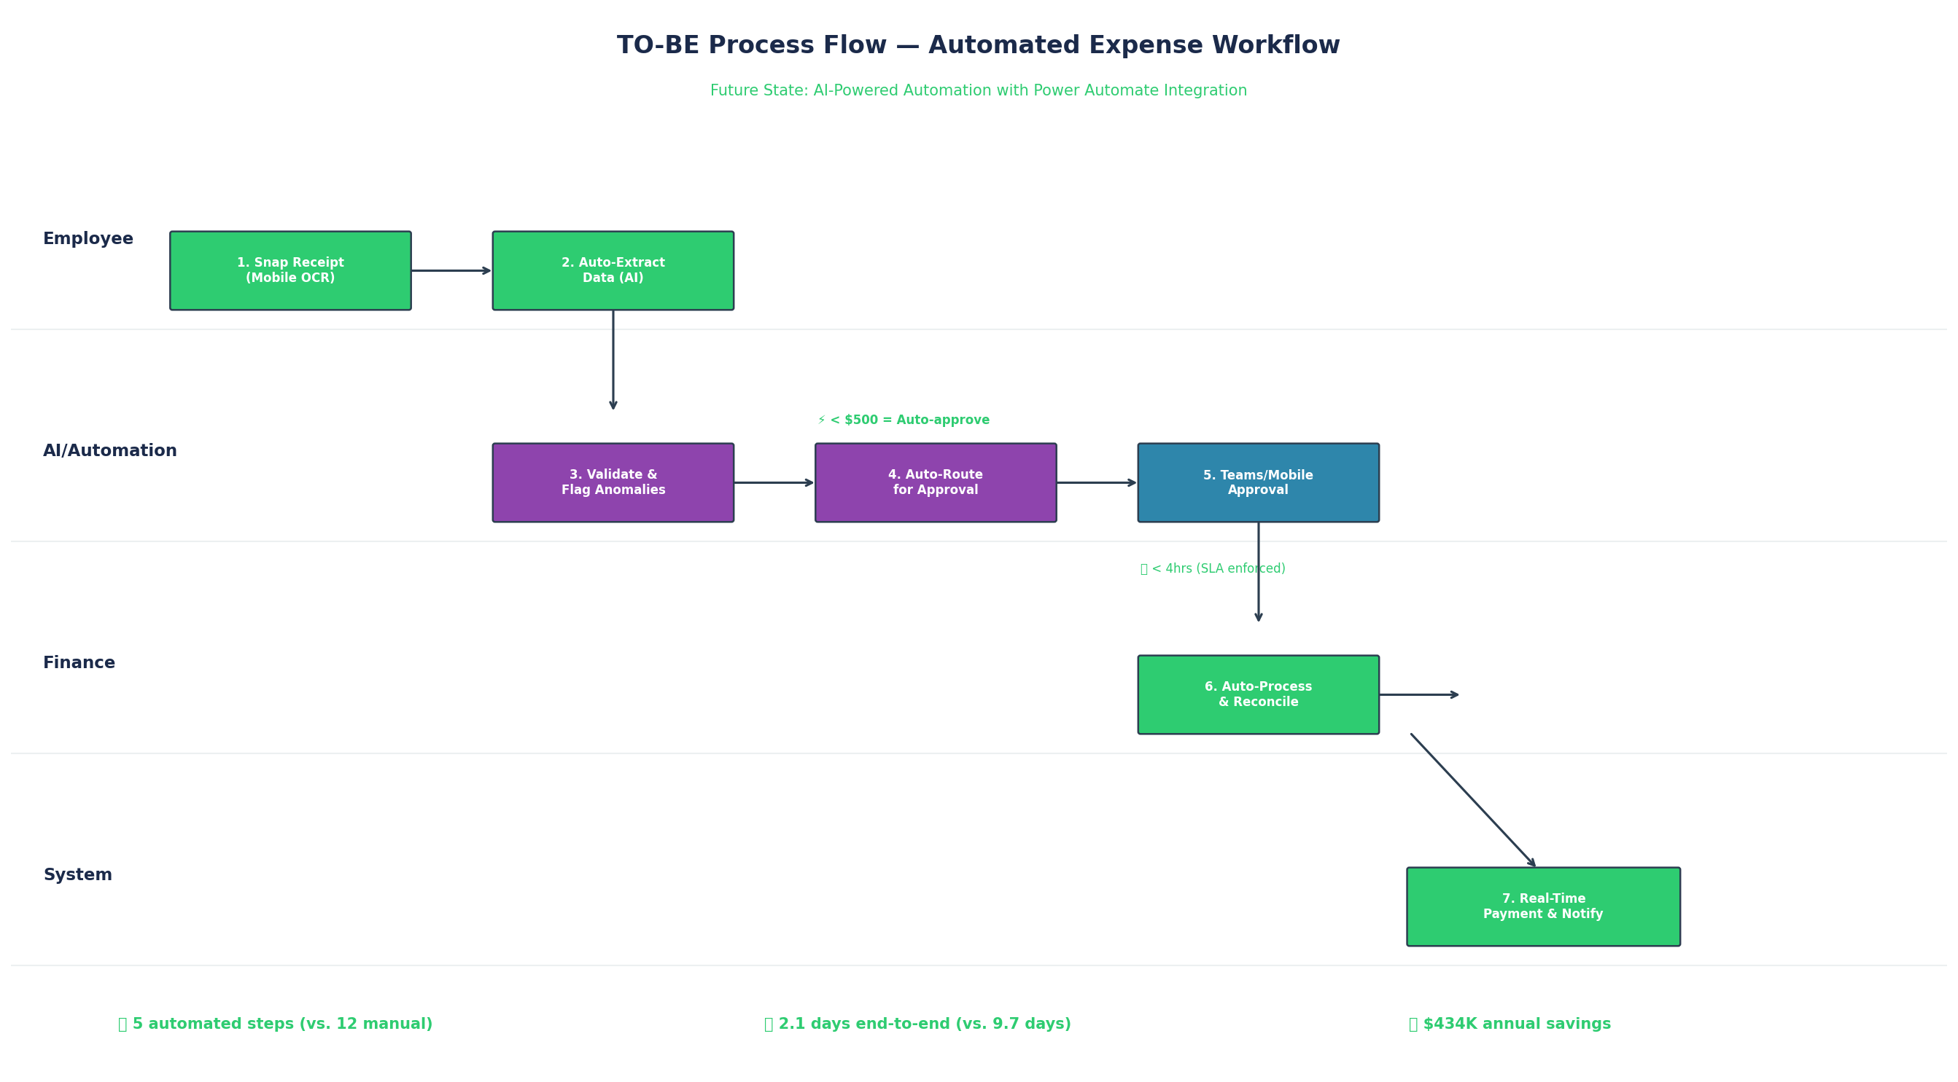
TO-BE Process Flow (Automated)

Slide 7
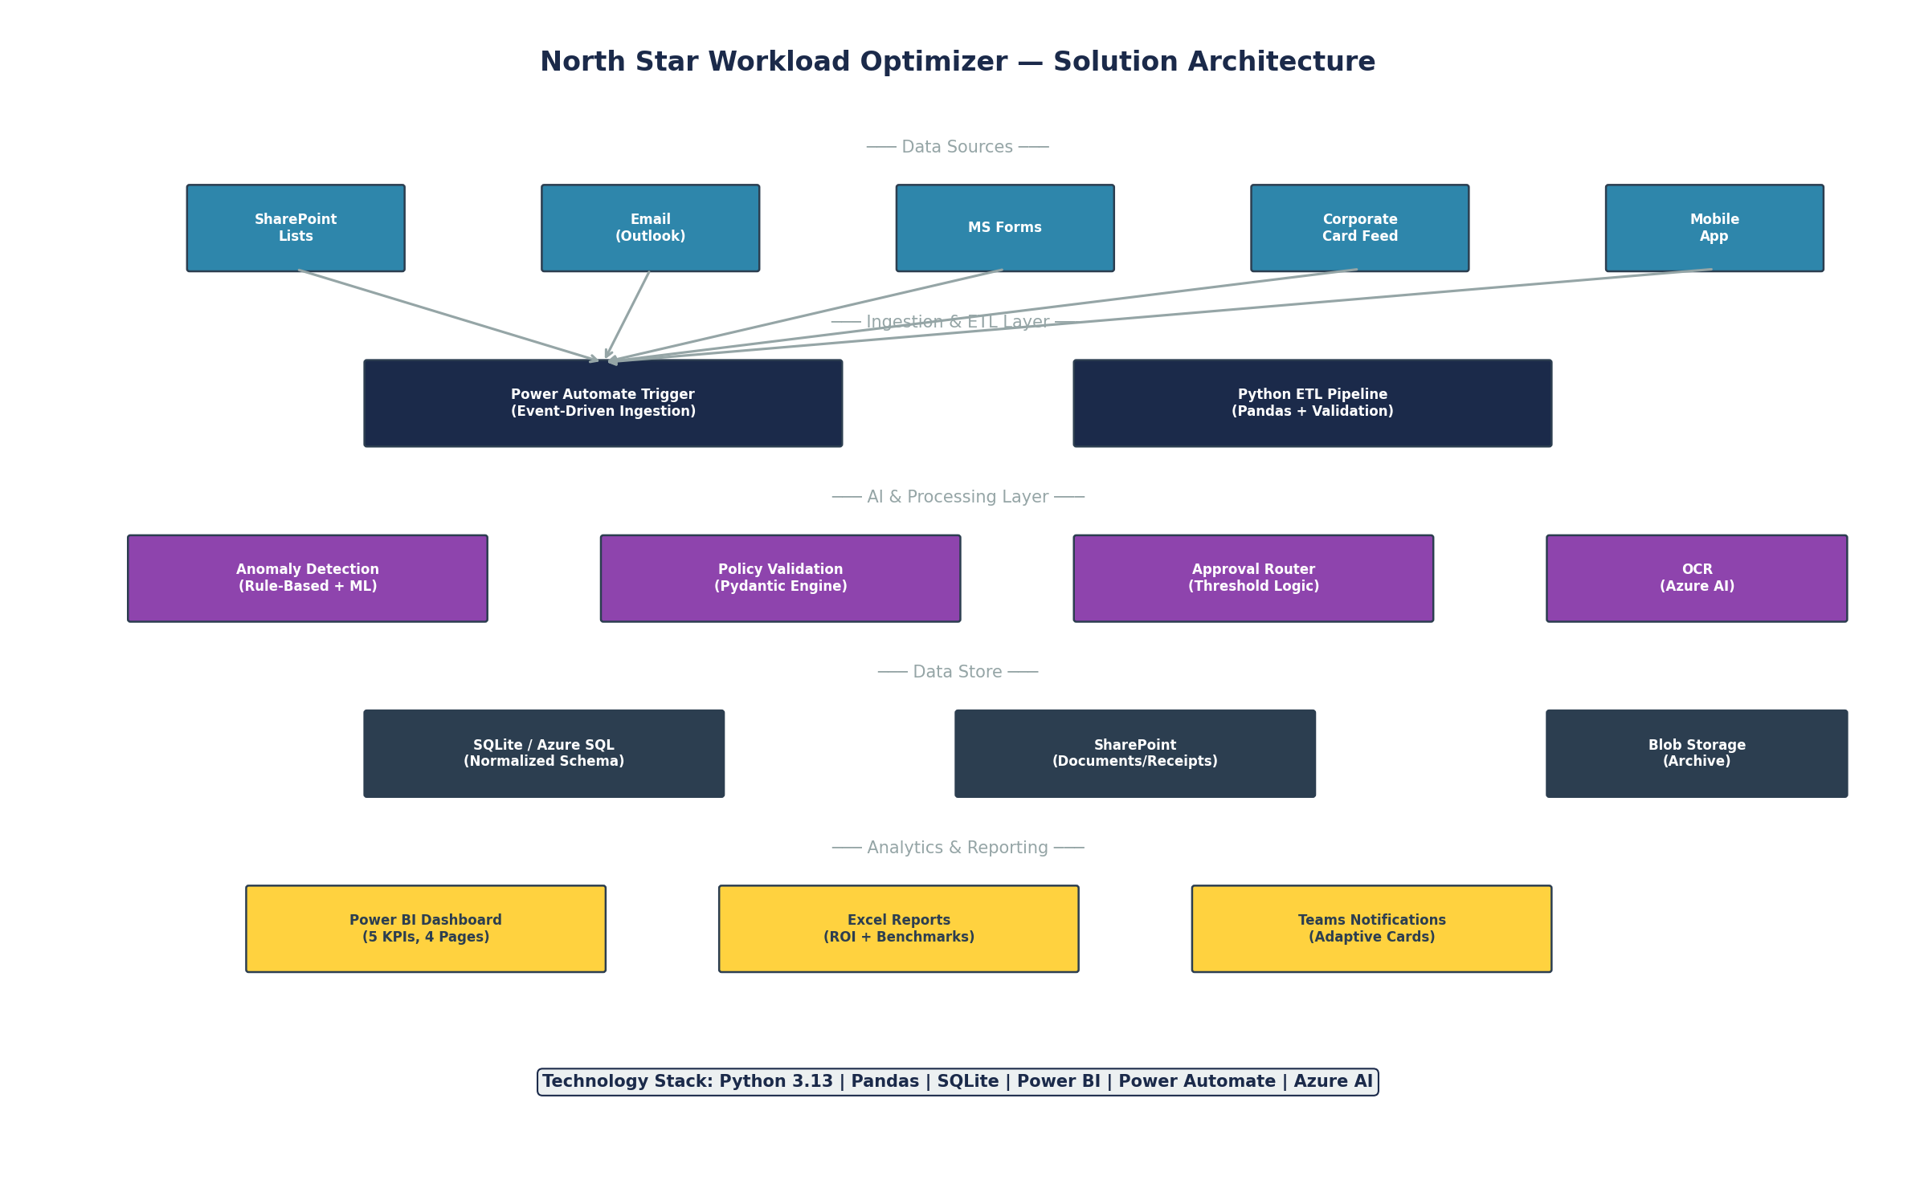
Solution Architecture

Slide 8
ROI Analysis
Metric | Current | Future | Improvement
Annual Operating Cost | $620,647 | $186,194 | 70% reduction
Cycle Time | 9.7 days | 2.1 days | 78% faster
Reports per FTE/day | 8 | 25 | 3.1x increase
Error Rate | 18% | 5% | 72% reduction
Annual Savings | — | $434,453 | —
ROI (Year 1) | — | 865% | —
Payback Period | — | 1.2 months | —

Slide 9
Risk Register
Risk | Likelihood | Impact | Mitigation | Status
User adoption resistance | Medium | High | Change mgmt + training | AMBER
Data migration errors | Low | High | Phased rollout + validation | GREEN
Integration complexity | Medium | Medium | API-first architecture | AMBER
Budget overrun | Low | Medium | Agile sprints + checkpoints | GREEN
Vendor lock-in | Low | Low | Modular design + standards | GREEN

Slide 10
Implementation Roadmap
Phase | Weeks | Deliverables | Owner
1. Discovery & Design | 1-2 | AS-IS map, requirements, architecture | Consultant
2. Data Engineering | 3-4 | ETL pipeline, database, analytics | Data Engineer
3. Dashboard & Reporting | 5-6 | Power BI dashboard, KPI framework | BI Developer
4. Automation Build | 7-9 | Power Automate flows, AI detection | Automation Dev
5. Testing & Training | 10-11 | UAT, change management, documentation | QA + PM
6. Go-Live & Handover | 12 | Production deployment, support handover | Full Team

