Slide 1
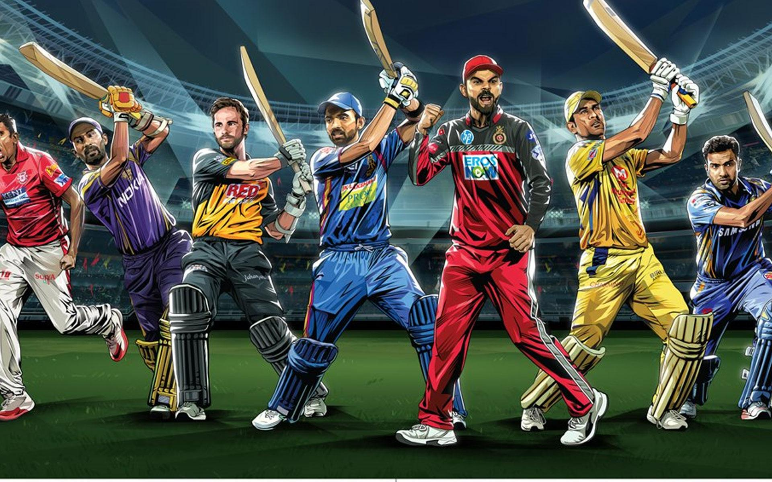
IPL Win Probability Predictor
TEAM MEMBER:- SUBMITTED to:-
Tushar gupta Mr. Mandeep singh sir Mayank Chandra (technical trainer)

Slide 2
IPL WIN PROBABILITY PREDICTOR
Data Science are one of the fastest-growing technological fields. This field results in amazing changes in the Sports Analytics. The main reason for the advancement in this field is the increase in the computational power and availability of large amounts of data. In Data Science, this data is analyzed and made suitable for creating machine learning models and products.
we are going to discuss the IPL team win prediction. Based on some match stats, we’re predicting who is the winner of an IPL match. Through this project, you will get familiar with the exploratory data analysis and feature engineering techniques that need to be applied to process data.

Slide 3
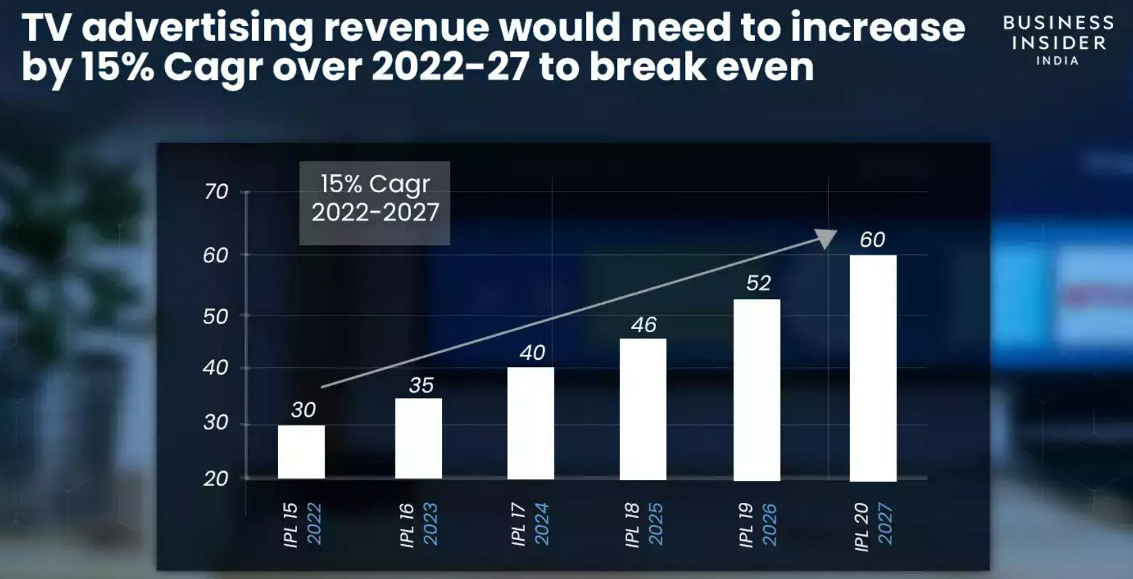
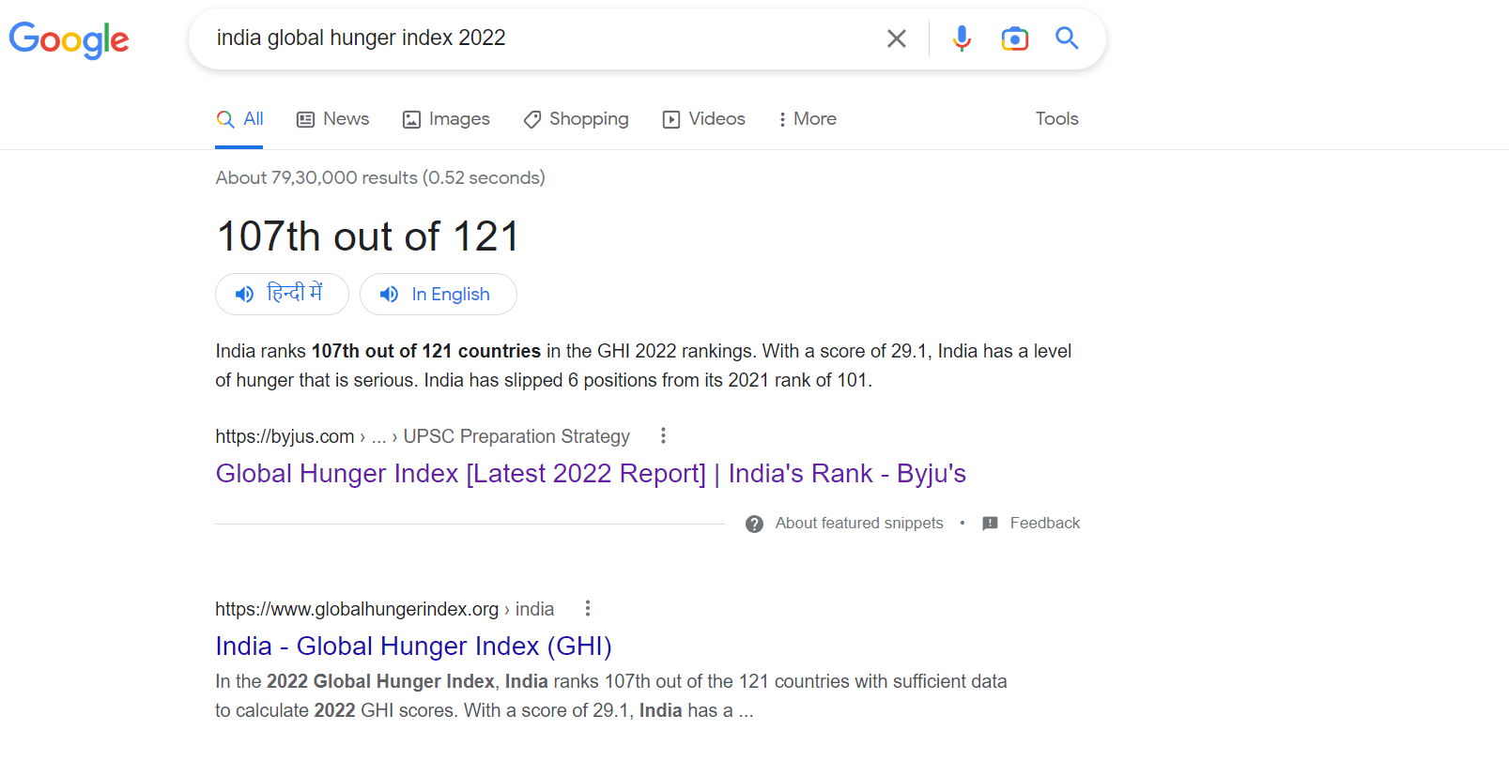

Slide 4
What Is IPL WIN PROBABILITY PREDICTOR and Why Do WE Need it
Helps in making informed decisions
Enhances the viewing experience
Can help in sports betting

Slide 5
BENEFITS OF IPL WIN PROBABILITY PREDICTOR
Data-driven insights
Improved fan engagement
Better betting decisions
Improved team strategies

Slide 6
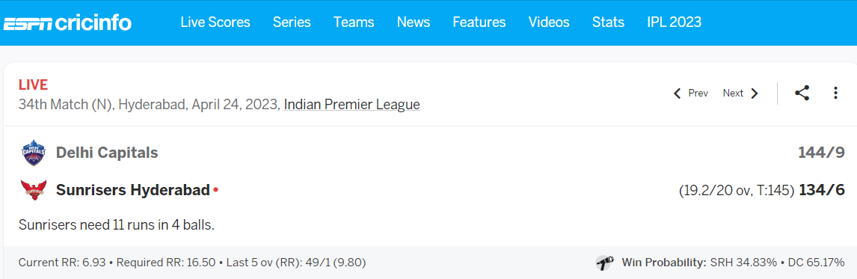
MOTIVATION OF IPL WIN PROBABILITY PREDICTOR

Slide 7
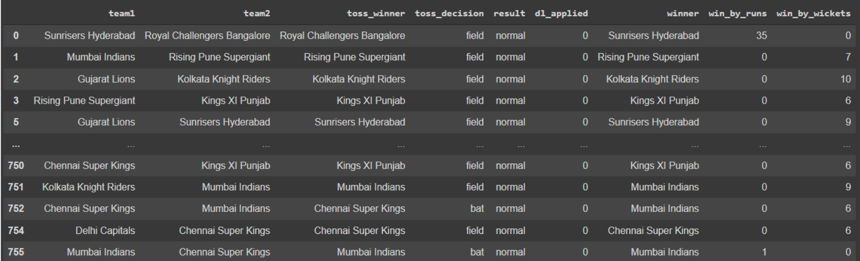
Our data looks like

Slide 8
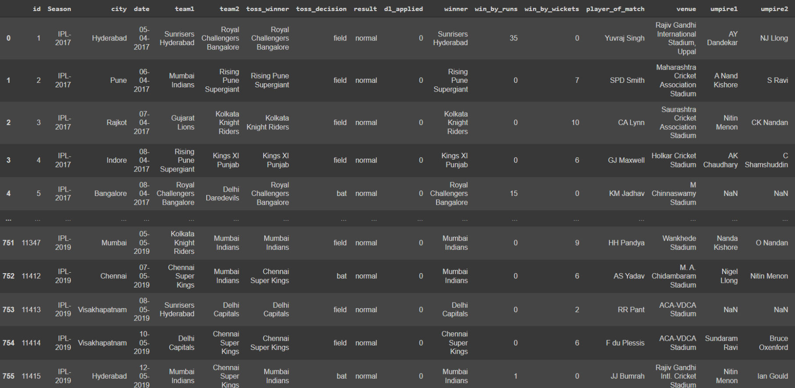

Slide 9
SELECTED ATTRIBUTES OF DATASET
BATTING TEAM
BOWLING TEAM
VENUE
RUNS LEFT
BALLS LEFT
WICKEST LEFT
CURRENT RUN RATE
REQUIRED RUN RATE
RESULT

Slide 10
Machine learning Algorithm used
Logistic Regression is a statistical method used for modeling the relationship between a binary dependent variable and one or more independent variables.
In logistic regression, the dependent variable is a binary variable, which takes the value 0 or 1.

Slide 11
Python Libraries Used
Pandas
NumPy
Matplotlib
Scikit-learn
Streamlit

Slide 12
Tools Used
Jupyter Notebook
Pycharm
Render
Github
Git
kaggle

Slide 13
How its Works
Firstly, Search ipl-match.onrender.com/
Then Enter the required attributes of 2nd Inning on streamlit interface
Model predict winning probability of both Teams

Slide 14
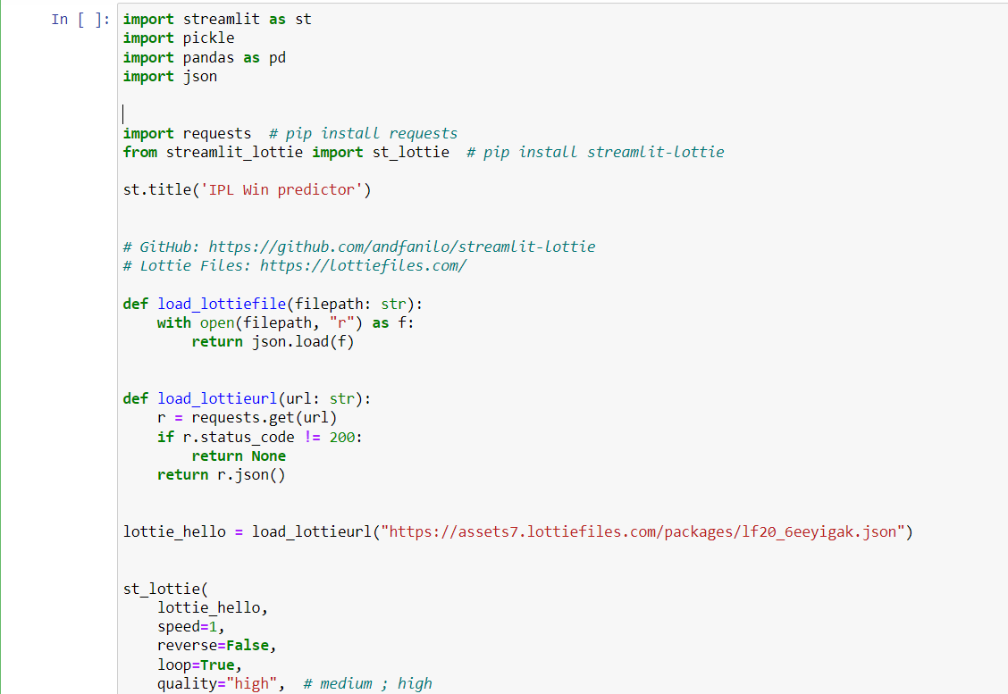
Code Snippet

Slide 15
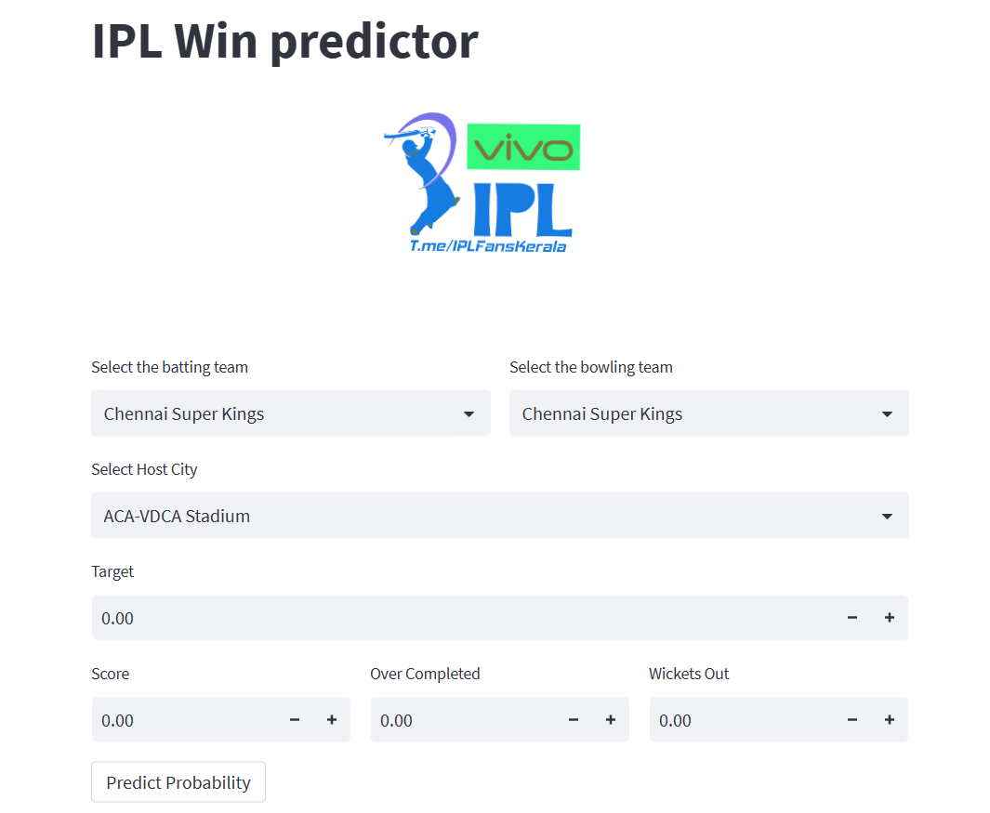
Home Page of Project

Slide 16
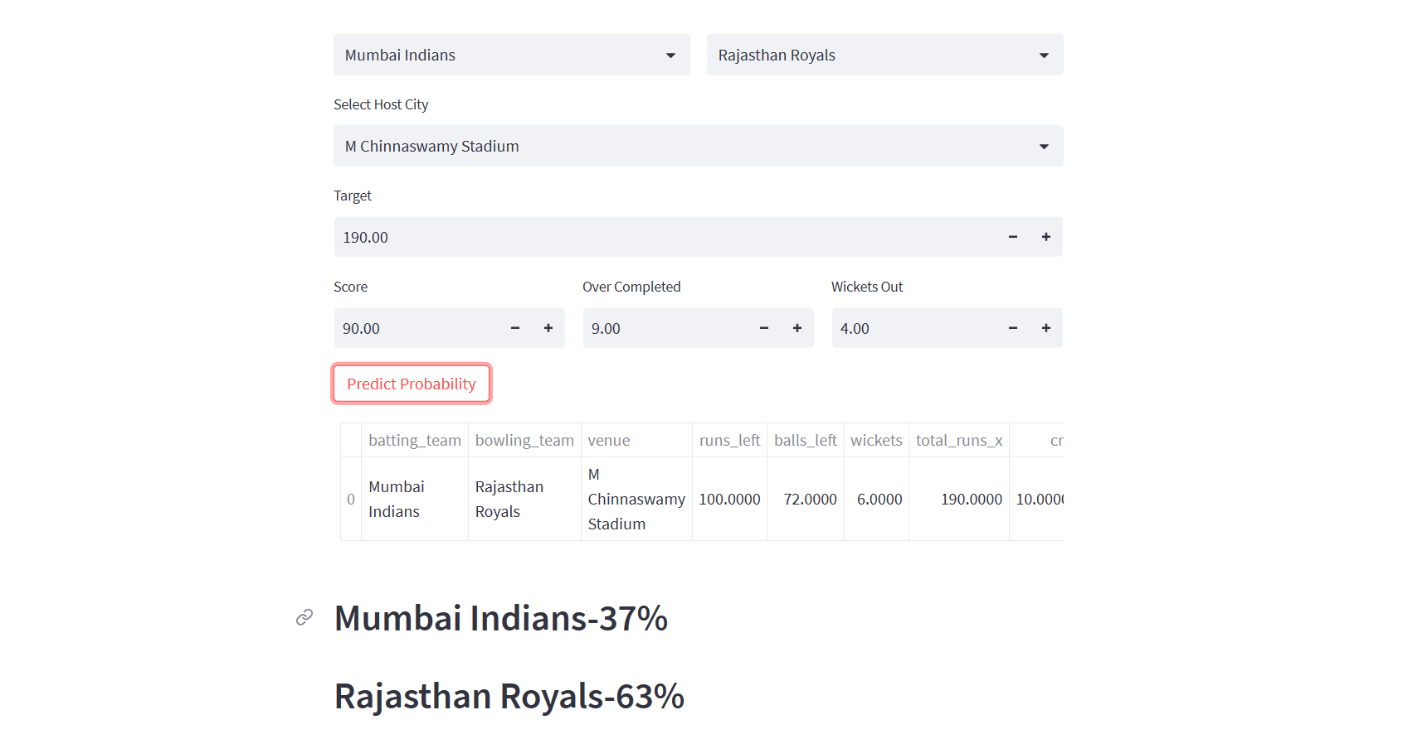

Slide 17
thank you

