Slide 1


Bluestock Mutual Fund Analytics — Capstone Project
This capstone transforms fragmented mutual fund datasets into a centralized analytics solution. It combines data engineering (Python ETL), a SQLite analytical database, SQL-driven analysis, exploratory data analysis (EDA), and a four‑page Power BI dashboard that surfaces industry growth, fund performance, investor behaviour, and SIP market trends for stakeholders.
Theme color: #6237C8 — used across visuals for emphasis and cohesion.

Slide 2

Executive Summary & Project Objectives
Context
Goal
Indian mutual fund adoption has accelerated: rising SIP contributions, broader investor participation, and stronger market awareness drove this analysis.
Convert raw mutual fund datasets into actionable business intelligence to support investment analysis and decision-making.
Objectives
Analyze industry growth
Evaluate fund performance and risk
Study investor behaviour and transactions
Analyse SIP inflows & trends
Build an interactive Power BI dashboard

Slide 3
Data Sources — Ten Core Datasets
Dataset
Purpose
Fund Master
Scheme information and metadata
NAV History
Historical NAV time series for schemes
AUM by Fund House
Assets under management analysis and concentration
Monthly SIP Inflows
SIP growth and resilience trends
Category Inflows
Category-level investment patterns
Industry Folio Count
Investor participation & folio trends
Scheme Performance
Returns, risk metrics, and scorecards
Investor Transactions
Transaction-level analysis and geography
Portfolio Holdings
Portfolio composition and exposure
Benchmark Indices
Market comparison and benchmark analysis
Each dataset was profiled and validated before ingestion; these sources enabled cross-sectional and time-series analysis supporting the dashboard and SQL queries.

Slide 4


ETL & Data Quality Workflow
01
02
Extract (Python/Pandas)
Transform (Cleaning & Standardization)
Load raw datasets, validate schemas, and perform initial profiling to capture completeness and structural issues.
Missing value analysis, duplicate removal, date standardization, data type corrections, outlier detection, and consistency checks were applied to ensure analytic readiness.
03
Load (SQLite)
Exported cleaned CSVs and loaded tables into a SQLite analytical database for structured SQL analysis and to power the Power BI dashboard.
Key validations: Missing Value Analysis, Duplicate Detection, Data Type Validation, Date Standardization, Outlier Detection, Column Consistency.

Slide 5
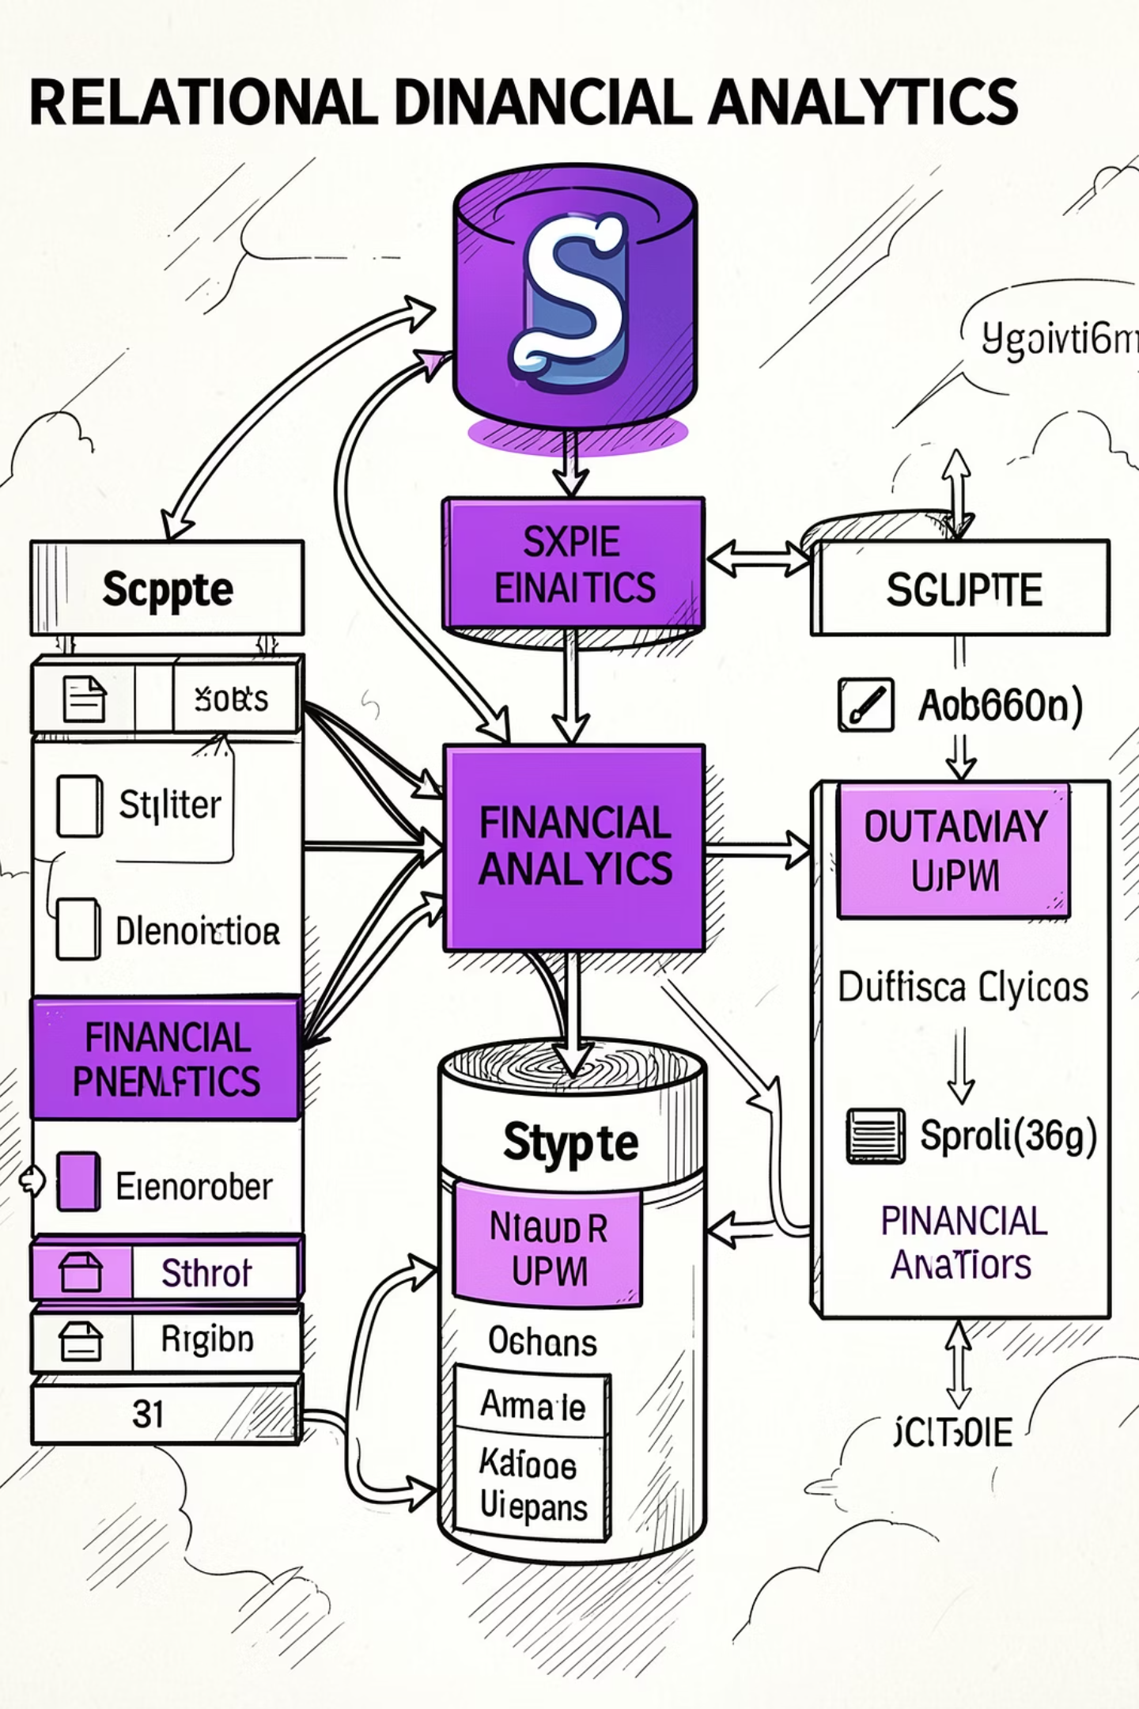
Database Design & Tables
SQLite was chosen for its simplicity and portability. Main analytical tables created include:
Core Tables
fund_master
nav_history
aum_by_fund_house
monthly_sip_inflows
category_inflows
industry_folio_count
scheme_performance
investor_transactions
portfolio_holdings
benchmark_indices
Analytical Benefits
Structured querying, reproducible joins across datasets, and simplified workflows for generating Power BI extracts and SQL-driven metrics.

Slide 6

SQL Analysis — Business Questions Answered
A set of SQL queries validated trends surfaced in EDA and dashboard visuals. Representative queries:
1
Query 1: AUM Leaders
Identify top fund houses by Assets Under Management to reveal concentration.
2
Query 2: Top Schemes
Rank mutual fund schemes by risk-adjusted returns (Sharpe Ratio, annualized returns).
3
Query 3: SIP Trends
Monthly SIP contributions and growth patterns to assess resilience through market cycles.
4
Query 4: Category Inflows
Category-wise net inflows to identify investor preference shifts.
5
Query 5: Transactions by Geography
State-wise transaction volumes and demographic splits.
6
Query 6: Benchmark Comparison
Compare scheme NAV trends against benchmark indices for performance attribution.
Data cleaning is essential: null handling, duplicate removal, date conversion, column standardization, and numeric validation were prerequisites to avoid misleading analytics.

Slide 7
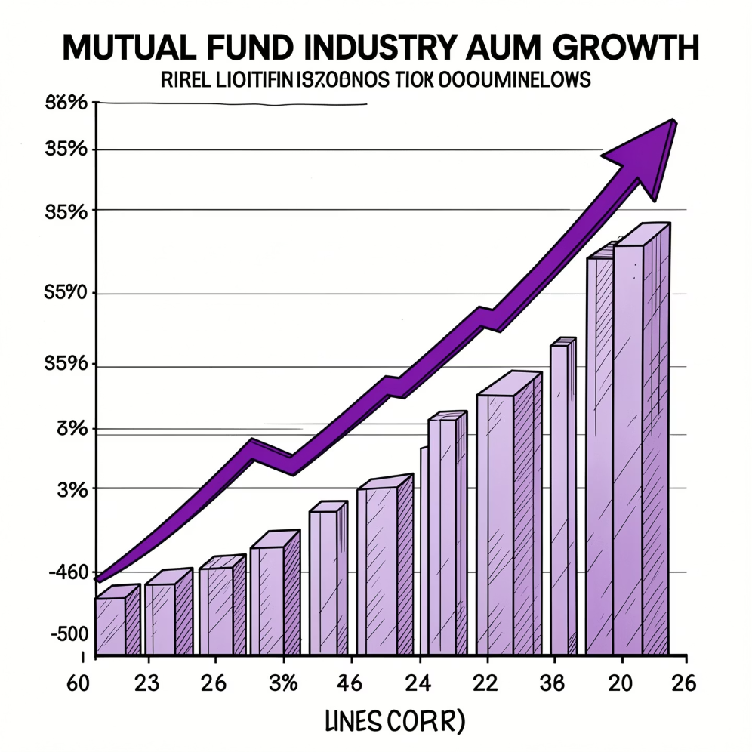
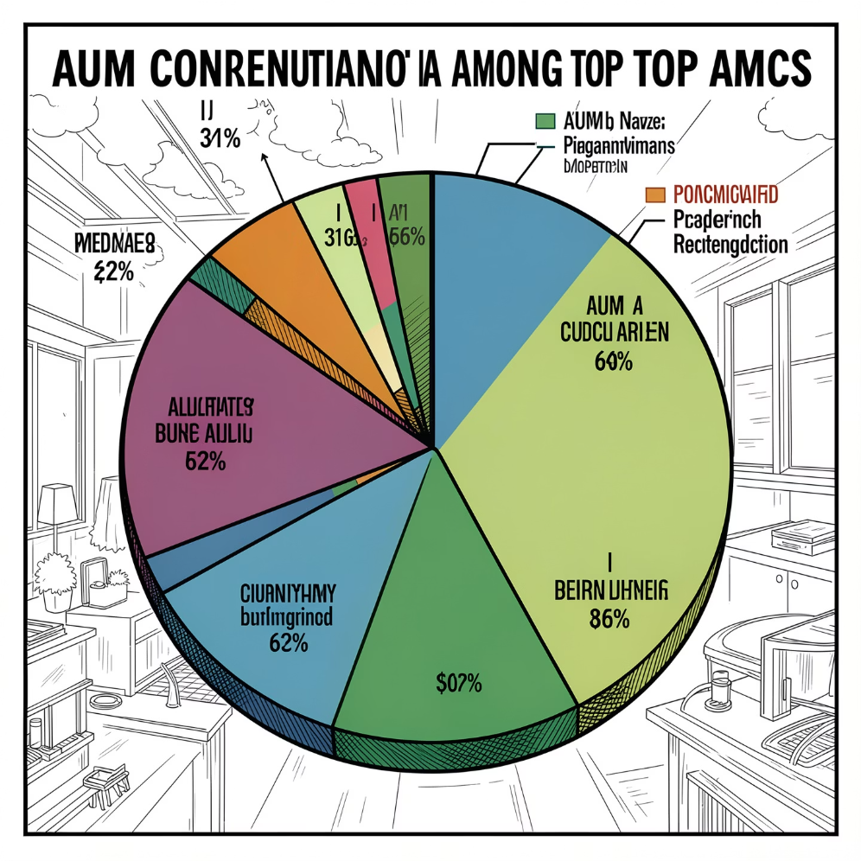
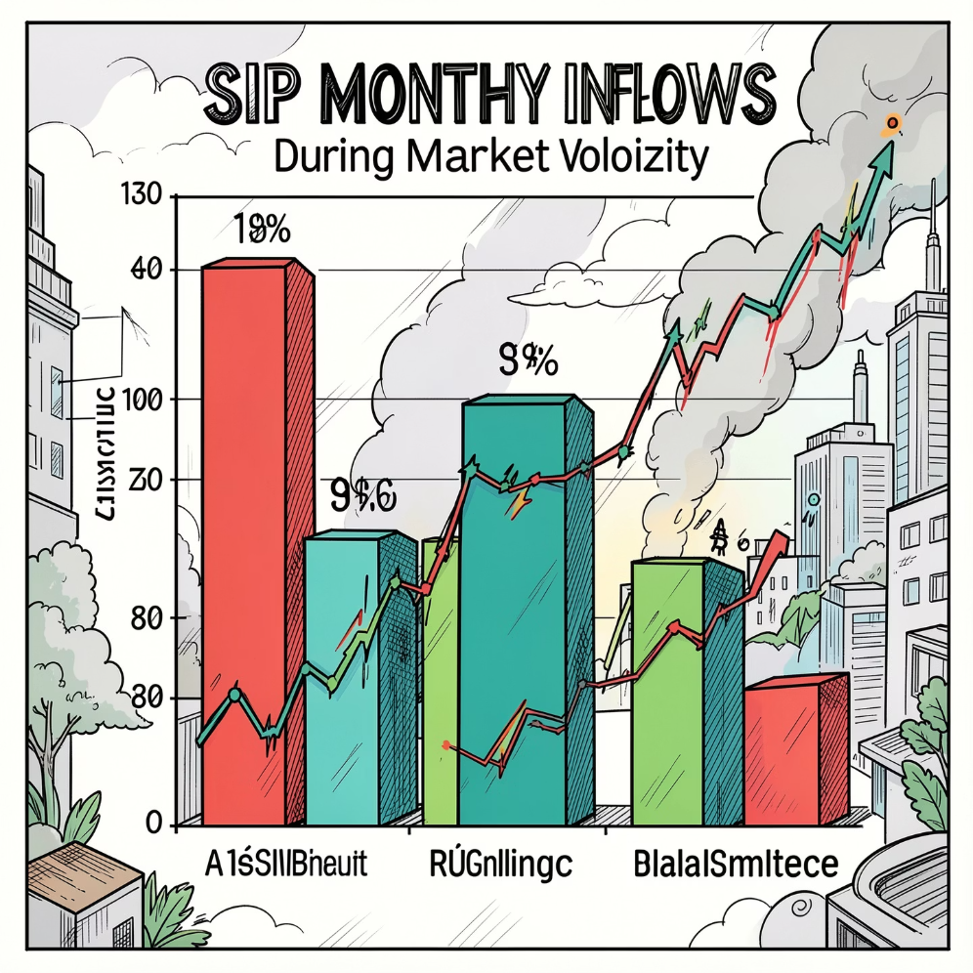
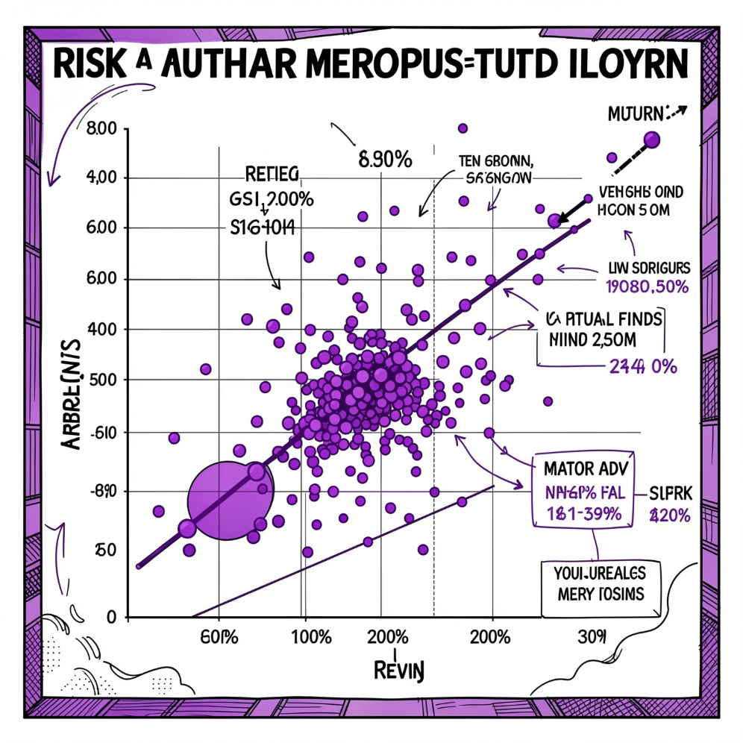
Exploratory Data Analysis — Key Observations
Industry Growth: Industry assets increased steadily across the analysis period, reflecting rising mutual fund adoption.
AMC Concentration: A limited number of AMCs account for a significant share of total assets — concentration risk exists.
SIP Analysis: Monthly SIP contributions rose consistently — SIP inflows remained resilient despite market fluctuations.
Risk Analysis: Higher-return funds generally exhibit higher volatility; risk-return trade-offs vary widely by category.
EDA combined time-series, distributional, and cross-sectional analyses to surface trends used in dashboard KPIs and visualisations.

Slide 8
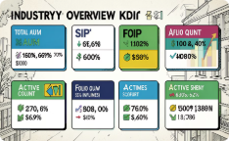
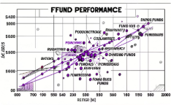
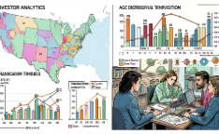
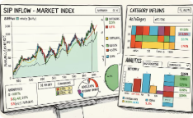
Power BI Dashboard — Four Pages & Design Philosophy
Design principles: Simplicity, Business Relevance, Actionable Insights. The dashboard contains four analytical pages that deliver executive-level KPIs and operational detail.
Page 1 — Industry Overview
Page 2 — Fund Performance
Page 3 — Investor Analytics
Page 4 — SIP & Market Trends
Visuals: Risk vs Return scatter, fund scorecard, NAV trends, benchmark comparisons. Business value: Identify high-performing schemes and risk-adjusted leaders.
Visuals: SIP vs Nifty trends, category inflow heatmap, top categories by net inflow, SIP growth KPIs. Business value: Correlate investor flows with market performance and category rotations.
KPIs: Total AUM, SIP Inflows, Industry Folios, Active Schemes. Business value: Rapid assessment of market growth and participation.
Visuals: State-wise transactions, SIP vs lumpsum split, age distribution, monthly trends. Business value: Understand investor demographics and preferences.

Slide 9

Key Findings, Limitations & Recommendations
Key Findings
Limitations
Recommendations
Consistent industry AUM growth and rising mutual fund penetration.
SIP participation continues to increase year‑on‑year and shows resilience.
Large AMCs dominate aggregate AUM; concentration is notable.
Higher returns typically coincide with higher volatility; Sharpe Ratio adds context.
Investors aged 26–35 contribute substantially to SIP flows.
Certain categories capture most net inflows; market conditions influence investor participation.
Dataset is a limited industry sample; real‑time NAV feeds were not integrated; many analyses rely on historical data; forecasting and advanced modelling were outside scope.
Integrate live NAV APIs for real‑time monitoring.
Develop automated ETL pipelines for repeatability.
Build a recommendation engine to personalise investor advice.
Implement predictive analytics for SIP forecasting and category rotation.
Automate dashboard refresh and performance tuning for responsiveness.

Slide 10

Challenges, Learnings & Business Impact — Conclusion
Challenges
Learnings
Data quality issues (missing values, duplicates, inconsistent formats), integration across datasets, dashboard design tradeoffs, and performance constraints with large visualisations.
Practical experience in ETL design, data validation, SQLite schema implementation, SQL optimisation, EDA, risk‑return evaluation, and delivering business-focused Power BI dashboards.
Business Impact
Conclusion
The solution centralizes analytics for AMCs, analysts, investors, and senior management — enabling monitoring of industry growth, comparison of risk‑adjusted returns, investor segmentation, and SIP trend analysis. The platform lays the foundation for predictive enhancements and real‑time reporting.
This capstone demonstrates an end‑to‑end analytics workflow—transforming raw mutual fund datasets into actionable insights using Python, SQLite, SQL, and Power BI. The interactive dashboard provides stakeholders with clarity on industry trends, fund performance, investor behaviour, and SIP market dynamics, forming a robust base for future predictive and recommendation capabilities.
Next steps: Prioritise live data integration, ETL automation, and prototyping predictive SIP models to increase the dashboard’s strategic value.

