Slide 1
MidTerm Assignment
INFO7390 Advances Data Sci/Architecture SEC 02 - Fall 2017
Team Members :
Jaini Bhansali
Tushar Goel

Slide 2
Introduction
Language used : Python
2. Process Followed : Data Ingestion, Data
Wrangling, Data Cleansing, Exploratory Data
Analysis,Feature Selection,Clustering,Prediction Models
3. Tools used : Jupyter Notebook, LUIGI
4. Deploying a the model as a service
5. Deployment of Workflow

Slide 3
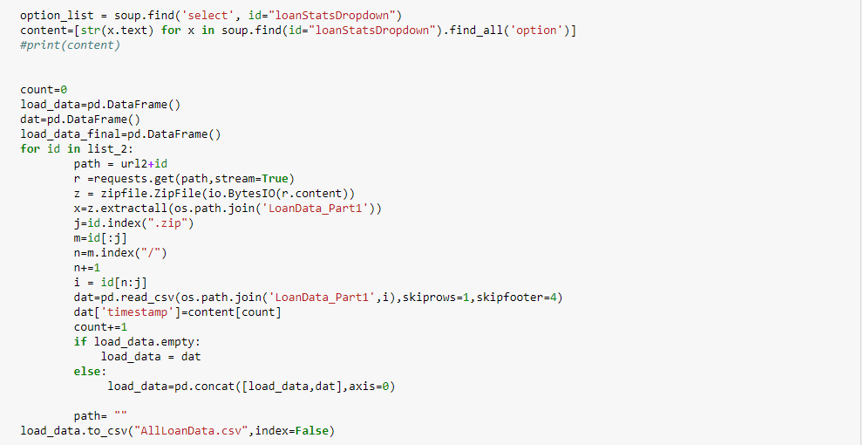
Data Download
We first signed in to Lending club website to collect the full data.
SITE: https://www.lendingclub.com/info/download-data.action
Signed Up
Downloaded the Data
Using the Python Library – Beautiful Soup
Notes:
We should be able to replace IBM’s CIK and document accession number with Googles to generate the url

Slide 4
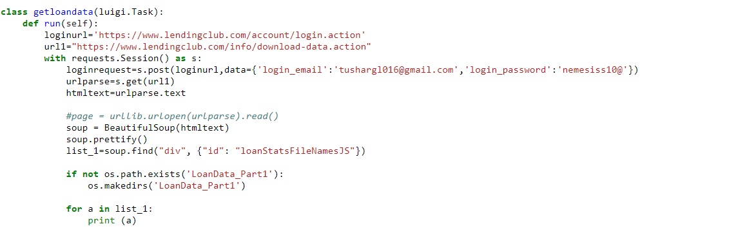
LUIGI PIPELINE
Pipe line consists of 3 Classes
Steps Followed
Data Download
Missing Data Analysis
Feature selection
Pipe Line – Tasks,Requires and Run Key words
These define the pipeline
LUIGI is used to run a series of tasks sequentially at a faster rate

Slide 5
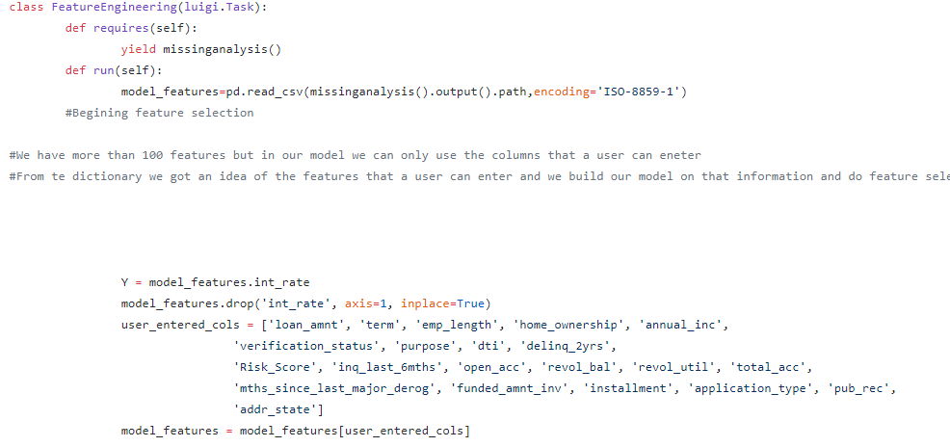
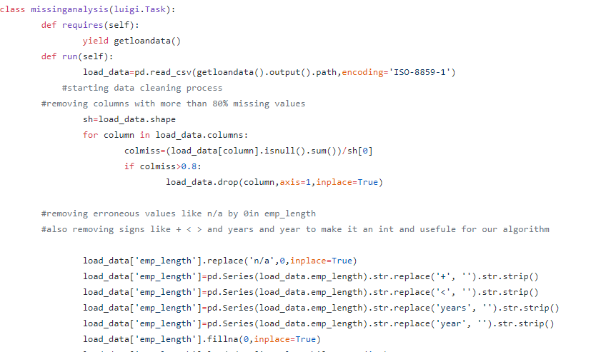
Snapshots of 3 Classes
Fetch Data
Feature Engineering
Missing Data Analysis

Slide 6
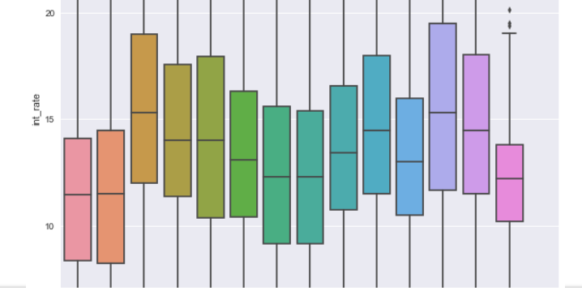
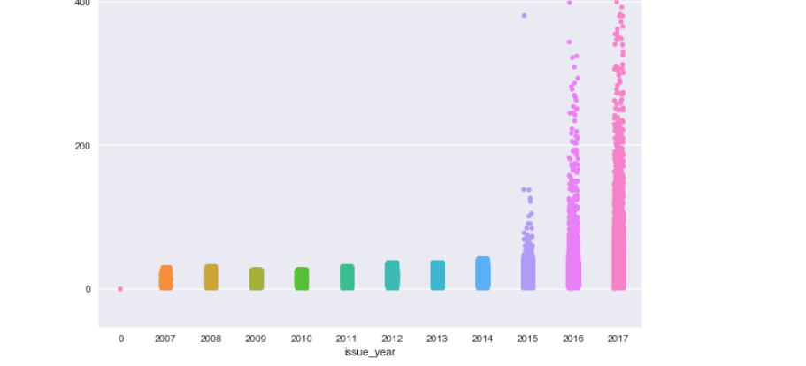
Exploratory Data Analysis
Exploratory Data Analysis Loan Data
Mean Risk Score by Interest Rate
Analysis of DTI
Employee Title by Interest Rate
Purpose by Interest Rate
Loan Amount by Purpose
Mean risk Score by Employee Length
Mean risk Score by Employee Title

Slide 7
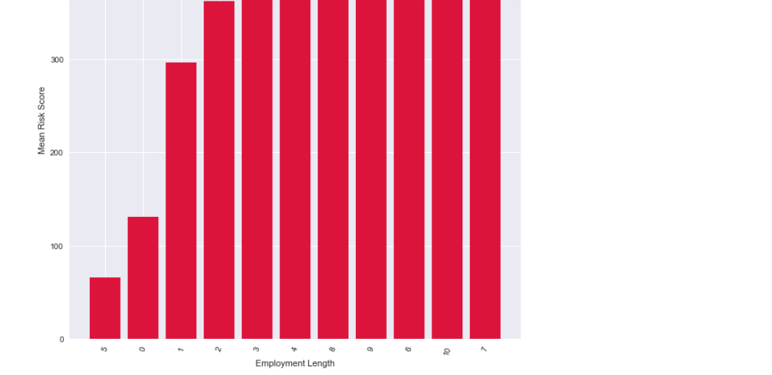
Exploratory Data Analysis
Exploratory Data Analysis Declined Loan Data
Analysis of Risk Score and Employee Year Length

Slide 8
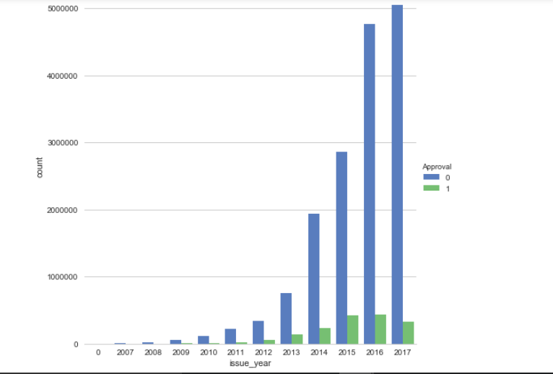
Exploratory Data Analysis
Exploratory Data Analysis of Loan Approval
Analysis of Approval Counts versus Issue Year

Slide 9
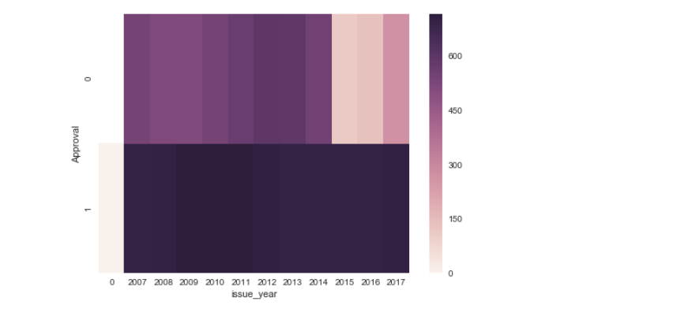
Exploratory Data Analysis
Analysis of Approval Counts versus Issue Year

Slide 10
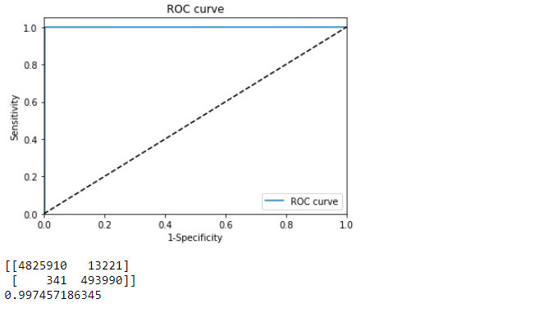
Classification
Check if user is eligible for a Loan
Used Logistic Regression, Neural Networks and Random Forest Algorithms

Slide 11
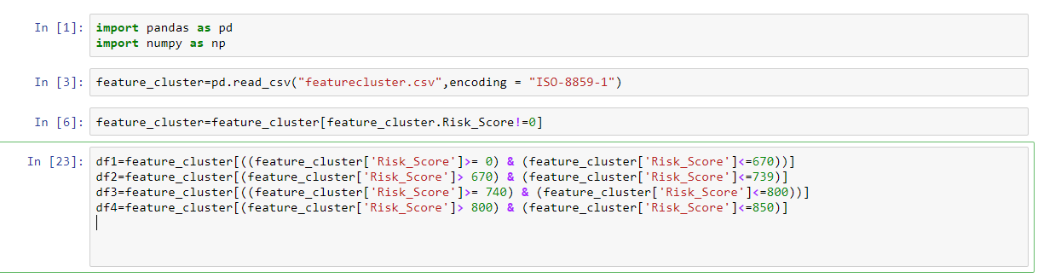
Clustering
Manual Clustering
Used Risk Score as a basis to segregate

Slide 12
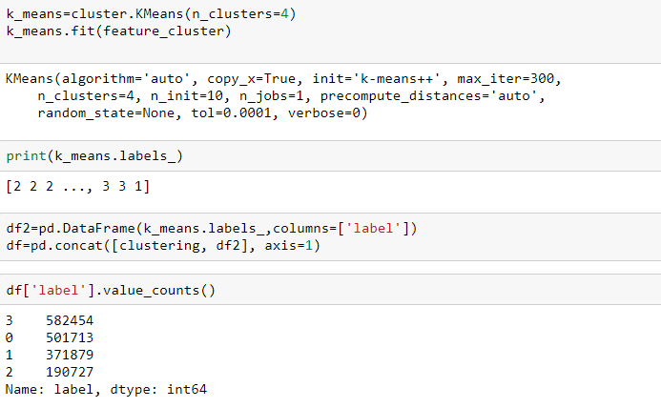
Clustering
Used K Means Algorithm
Used Elbow chart to find number of Centroids
Altered number of Centroid to get optimum Clusters

Slide 13
Prediction
Prediction was done on each cluster
Used Neural Networks, Random Forest and KNN Algorithms on each Cluster
After tuning the algorithm , the best model was deployed on Azure for each cluster
A REST API was made for each cluster
9 Rest API were created for 9 clusters

Slide 14
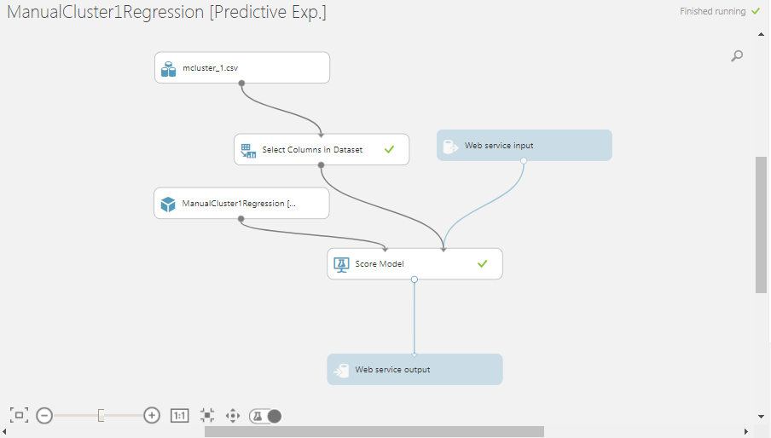
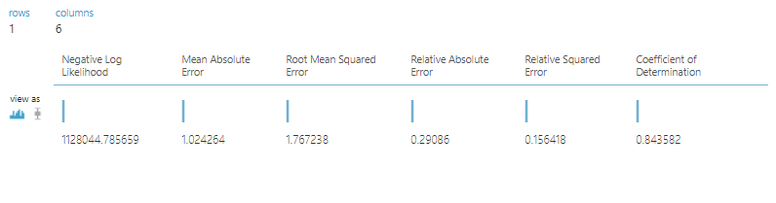
Deployment in Azure

Slide 15
Prediction Results
Regression with no Clustering
 | MAE | RMSE | MAPE
Linear Regression | 2.193 | 2.837 | 18.03%
KNN Regressor | 3.63 | 4.69 | 31%
Random Forest Regressor | 0.65 | 1.33 | 6.05%
Neural Network | 36.37 | 105 | 333%
Manual Clustering | MAE | RMSE | MAPE
CLUSTER 1 (Risk Score (<670))
Linear Regression | 2.214 | 2.845 | 15.33%
KNN Regressor | 3.5 | 4.51 | 24.50%
Random Forest Regressor | 0.5 | 1.07 | 3.60%
Neural Network | 5.88 | 13.53 | 42.90%
Manual Clustering
CLUSTER 2 (Risk Score (670 - 739)) | MAE | RMSE | MAPE
Linear Regression | 2.19 | 2.83 | 17.93%
KNN Regressor | 3.5 | 4.55 | 29.40%
Random Forest Regressor | 0.68 | 1.36 | 6.26%
Neural Network | 54.5 | 876 | 478.00%
Manual Clustering | MAE | RMSE | MAPE
CLUSTER 3 (Risk Score (740 - 800))
Linear Regression | 1.83 | 2.47 | 19.80%
KNN Regressor | 2.7 | 3.6 | 30.20%
Random Forest Regressor | 1 | 1.7 | 12.10%
Neural Network | 23.2 | 41.3 | 272%
Manual Clustering | MAE | RMSE | MAPE
CLUSTER 4 (Risk Score (800 - 850))
Linear Regression | 1.5 | 2.13 | 18%
KNN Regressor | 2.13 | 3 | 26%
Random Forest Regressor | 1 | 1.6 | 12.80%
Neural Network | 25.4 | 62.4 | 324%
Clustering using Clustering Algorithm K Means
CLUSTER 0 | MAE | RMSE | MAPE
Linear Regression | 1.01 | 1.7 | 9.07%
KNN Regressor | 3.2 | 4.19 | 29.50%
Random Forest Regressor | 0.63 | 1.34 | 5.80%
Neural Network | 26 | 49 | 232%
CLUSTER 1
Linear Regression | 0.93 | 1.2 | 7.76%
KNN Regressor | 3.94 | 5.07 | 33.33%
Random Forest Regressor | 0.03 | 0.14 | 0.24%
Neural Network | 12.2 | 33.5 | 103%
CLUSTER 2
Linear Regression | 0.78 | 1.03 | 6.22%
KNN Regressor | 4.2 | 5.3 | 33.10%
Random Forest Regressor | 0.02 | 0.11 | 0.17%
Neural Network | 375 | 1016 | 3100%
CLUSTER 3
Linear Regression | 1.16 | 1.61 | 9.61%
KNN Regressor | 3.5 | 4.6 | 30.80%
Random Forest Regressor | 0.02 | 0.12 | 0.18%
Neural Network | 20 | 51 | 180%

Slide 16
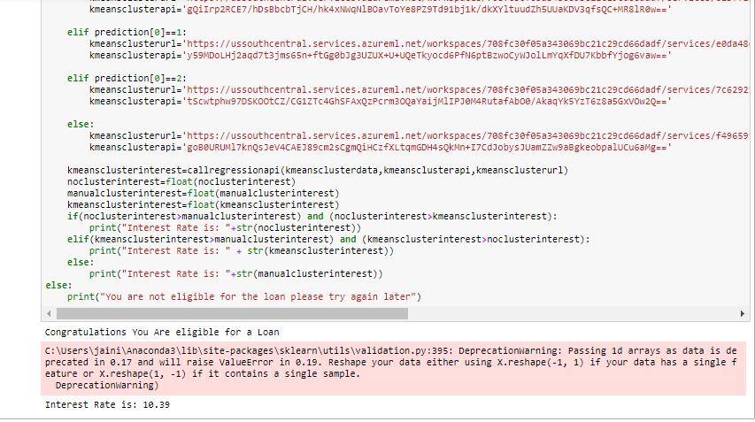
Deployment
Process of eligibility , cluster assignment and prediction of interest rate was integrated using the REST APIS created in azure
User enters parameters and checks eligibility
The user is assigned to cluster created using Manual , clustering algorithm and no clustered data
Prediction model is run for each and user is provided with the highest interest rate

Slide 17


