Slide 1
Case 1: Working with Edgar datasets:Wrangling, Pre-processing and exploratory data analysis
INFO7390 Advances Data Sci/Architecture SEC 02 - Fall 2017
Team Members :
Jaini Bhansali
Tushar Goel

Slide 2
Outline of the Case
1. Language used : Python
2. Process Followed : Data Ingestion, Data
Wrangling, Data Cleansing, Exploratory Data
Analysis
3. Tools used : Jupyter Notebook, boto 3, boto,
Amazon S3 Bucket

Slide 3
Problem : Part 1
Part 1
Parse files https://datahub.io/dataset/edgar lists how to access data from Edgar. The goal of this exercise is to extract tables from 10Q filings using R/Python
Part 2
Dockerize this pipeline Build a docker image that can automate this task for any CIK and document accession number which could be parameterized in a config file.
Notes:
We should be able to replace IBM’s CIK and document accession number with Googles to generate the url

Slide 4
Solution Proposed for Problem 1 Part 1
Web Scraping
a. Programmatically generated the URL
b. The CIK and Accession Number was accessed using arguments.
Library Used : argparse
c. To parse through the HTML form and finding the 10-Q filings link ,the Library used was Beautiful Soup.
If the 10Q file is not present it will provide a note showing that the 10Q file for the specified CIK does not exist.
d. We read all the tables from the 10Q form in the dataframe using Pandas.read_html (). We have also programmatically generated a note if an incorrect CIK and Accession Number is provided.

Slide 5
Data Cleansing
The data when inserted into the data frame was out of format, columns were not organized and consisted of NaN, None and empty strings.
Problem
In order to align the ‘$’ signs, we first retrieved all records that had “$’ or “%”
Next, we extracted all the tables with condition
If this loop found instances of a ‘$’ sign in a cell and a float number in the preceding cell
Next we replaced all occurrences of opening and closing parenthesis, empty cell values,and any other ‘%’ in combination of ‘)’
Next we dropped all ‘NaN’ and None values and reindexed the table.In order to eliminate this we formulated another ‘for’ loop.
Solution
By iterating through the shape of the data frame using a ‘for’ loop and stored it in variable x
All the columns were greater than 3 as they were the tables we wanted to extract.
It would append the ‘$’ sign found to the float number found.
Using regex expressions and replaced these with NaN.
Using the current shape of the data frame we iterated through the data frame and if a float number or value was found after the NaN or None value it would move that particular column field to replace the null.

Slide 6
CONTINUE….
Problem
The next challenge we faced was the tables that had subheading columns were occurring.one index before the its actual position (Example: year 2013, 2014 and 2015).
Solution
In order to overcome this we formulated a for loop that would take the first column subheading and push it to the very next column, subsequently pushing each column to the very next index.
Next, if there were any other NaN present, were replaced with empty strings.
Finally, the cleaned data was appended into a csv file that was created in a directory
using os.path() and os.mkdir()
A new csv file would be created for each table as it iterated through the for loop
(for loop 1)

Slide 7
Problem 1 Part 2
Python Libraries used
1. To pass CIK, Accession Number , Amazon keys as arguments – Library argparse
2. In order to log activities – Library logging
3. In order to create csv and zip file and create a folder – Library csv, zipfile, os, datetime
4. Amazon s3 – Used boto3
5. Data Ingestion and Cleaning : Libraries :
6. Numpy,urllib,urllib3,html5lib,zipfile,urllib.request,pandas,BeautifulSoup

Slide 8
METHODOLOGY
1. We passed Accession Key, CIK, Amazon s3 keys , S3 location as arguments by the user and handled scenarios when CIK and Accession Key are blank or if the values are missing with respective –help option
3. We have accommodated logging. Logging details can be found in the file name ‘Part2.log’.
4. Logging occurs at different instances. To name a few :
a. Incorrect or blank user arguments – CIK,Accession Key, S3 loc, Amazon
access keys
b. Also occurs when these are found and program proceeds
c. Creation of url, incorrect url or url not found
d. Creation of directory to store table data
e. Various stages of Data Cleaning process
f. Table creation
g. Table input into a csv
h. Creation of zip file with log file and csvs

Slide 9
PROBLEM 2
Python Libraries used
1. To pass CIK, Accession Number , Amazon keys as arguments – Library argparse
2. In order to log activities – Library logging
3. In order to create csv and zip file and create a folder – Library csv, zipfile, os, datetime
4. Amazon s3 – Used boto3
5. Data Ingestion and Cleaning : Libraries :
Numpy,urllib,urllib3,html5lib,zipfile,urllib.request,pandas,BeautifulSoup

Slide 10
METHODOLOGY
We passed Accession Key, CIK, Amazon s3 keys , S3 location as arguments by the user
Handled scenarios when CIK and Accession Key are blank or if the values are missing with respective –help option
We have accomadated logging. Logging details can be found in the file name ‘Part2.log’
Exception Handling: To name a few:
a. Incorrect or blank CIK, Accession Number, Amazon Keys or S3 Location
b. Blank year or incorrect year entered by user
c. When stream of data is created to input into a csv
d. When data for the particular 1st day of the month is not present
5. Once missing data is analyzed , summary metrics are calculated and plots are
constructed. We put these into a zip file ( python library zipfile) located in a
Directory created using os.path()
6. Next, using boto3 library we programmatically upload the file into Amazon s3

Slide 11
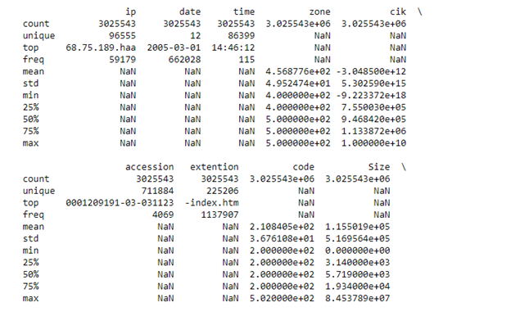
SCREENSHOTS FOR PROBLEM 2
Summary Metrics Using pandas.Describe()

Slide 12

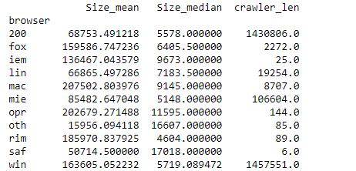
Median of all columns with respect to idx
Mean and Median file sizes for each browser were calculated

Slide 13


File size with respect to idx
All Columns Median Group by Idx

Slide 14
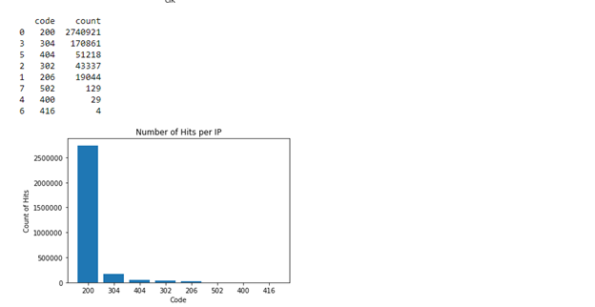
Number of Hits per IP

Slide 15
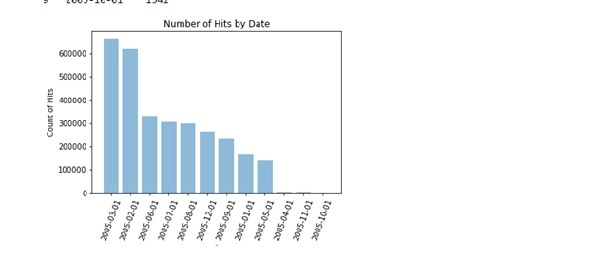
Number of hits by Date

Slide 16
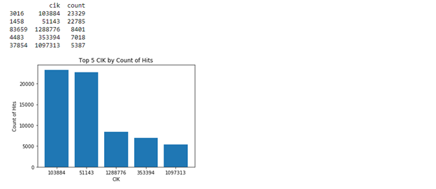
Top 5 CIK based on the count of hits

Slide 17
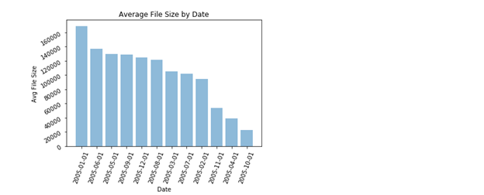
Average file Size by Date

Slide 18
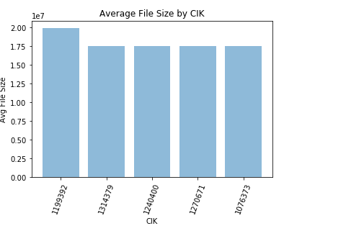
Top 5 CIK by average file size

Slide 19
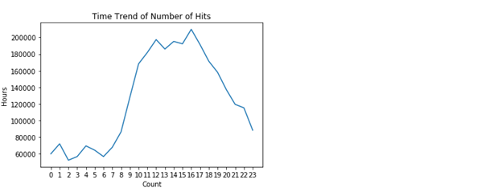
Time Series Graph of Traffic Activity through the day

Slide 20


