Slide 1

Ambiguity reduction and sentimental analysis of Post/Tweet Predicting a TV Show’s revenue
Abhijit Shinde
Tushar Goel
Reema D’mello

Slide 2
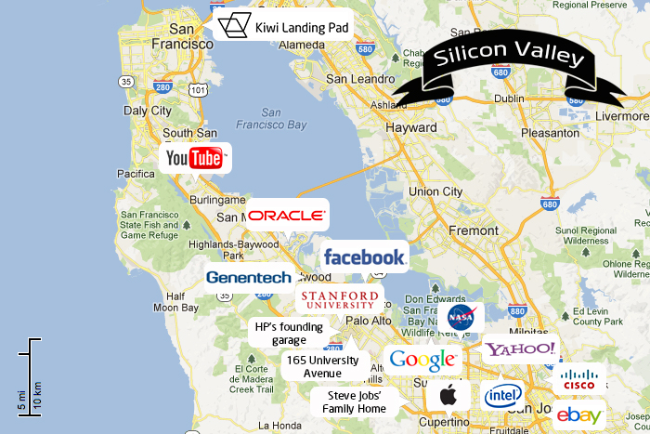

SILICON VALLEY !!!

Slide 3


#MOAB

Slide 4


GOT7

Slide 5
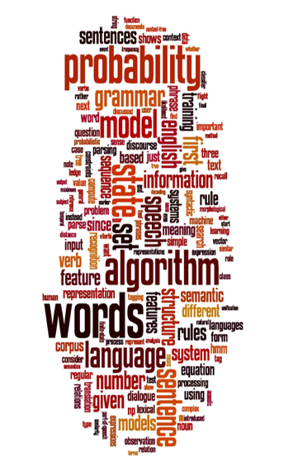
Agenda
Introduction
What’s New
Methodology
Experiments
Conclusion
Q and A

Slide 6

Introduction
The volume, velocity, and variety of data generated on the internet have made it necessary for us to mine only required data from internet for our efficient business decisions.
Ambiguity is one of main challenges while mining data.
Despite of the use of Hashtag on most of the social media, Sometimes ambiguous names can make or break image of the brand.

Slide 7
What’s new
After analyzing some of the works done by other people on this topic there were some major flaws found:
There are many ambiguous hashtags that are reference different entities like #SiliconValley can be used for the region as well as the TV Show on HBO
Any analysis done without this classification would result in incorrect analysis.
There are many other factors which are not taken into account for the analysis, textual analysis like understanding sarcasm, intensity of the words in comment/tweets can help us to determine he sentimental analysis in better way.

Slide 8
Our Work
We are creating a generic Big Data Application which can help to resolve ambiguity and perform sentimental analysis on classified big data.
As the scope of the project, we will be focusing on TV show Silicon Valley, which has ambiguous name.
Our approach is to resolve ambiguity and to determine the sentiment, determining people’s opinions towards a TV shows would have huge impact on its success.
Data will be streamed, data with the keyword “siliconvalley”(ambiguous)

Slide 9
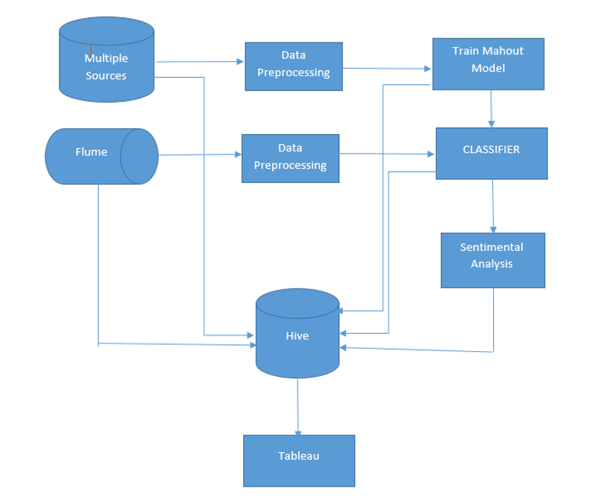
Project Workflow

Slide 10
Web Scraping
Data was scraped from authorized twitter keywords like SiliconValHBO, SiliconHBO, SiliconVallism and Facebook: official page : group id: 267012543446119
Data Collection is done using Apache Flume and python script using Twitter and Facebook APIs
Since we have data from multiple sources we have different sets of features:
User_ID, Screen_name, created_at, tweet_type, text
User ID, created_at, text
Comment_id, status_id, comment_message, comment_likes
Status_id, status_message, number_of_shares, status_type, status_link, permalink_url, status_published, num_reactions, num_comments, num_shares, num_likes, num_loves, num_wows, num_hahas, num_sads, num_angrys

Slide 11
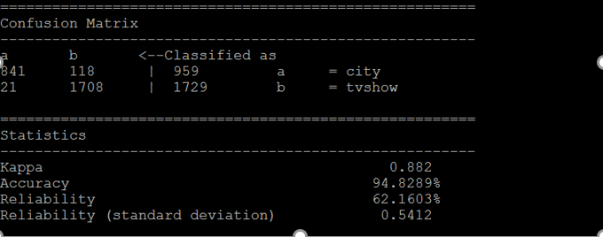
Naive Bayes Using mahout
Converting files to sequence as mahout process files in sequence
Vectoring files converting word2vec using mahout seq2sparse
Performing training, dividing data into 80/20 (splitting, training, testing)
Training model on 80 % of data and running test
Found that model is 94% accurate with 0.82 kappa score

Slide 12
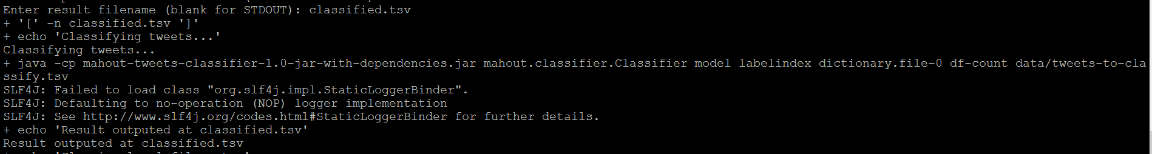
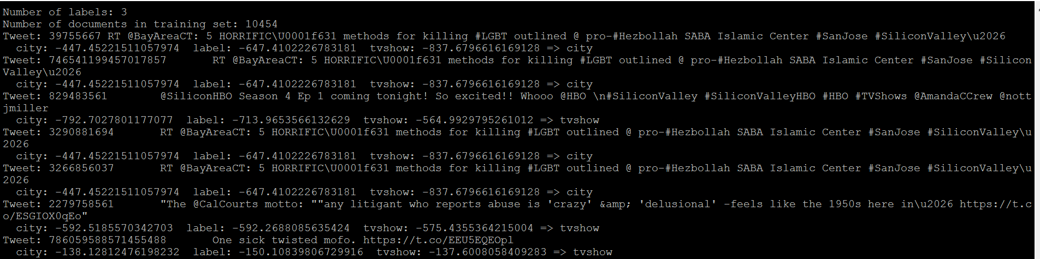
Classifying new ambiguous tweets with same #

Slide 13
Sentiment analysis
NLTK platform in Python to work with human languages
Used Vader Sentiment Analyser
To calculate emotion within the text, it uses the vader lexicon library
The computes the intensity of the words along with the sentiment.
Eg: AWESOME!!!!!!!!!!!!!!!! has more weightage than ‘great’

Slide 14
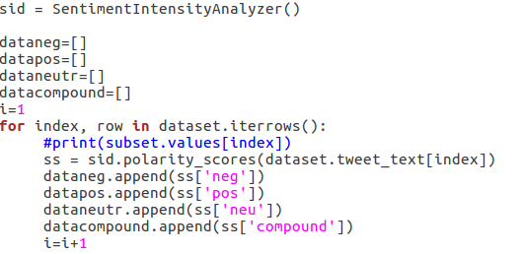
Continued..
Polarity within the text is calculated and we have weights of each sentiment positive, negative, neutral

Slide 15
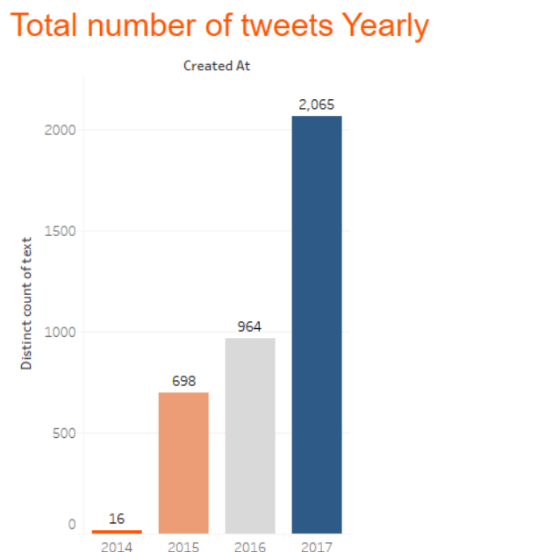
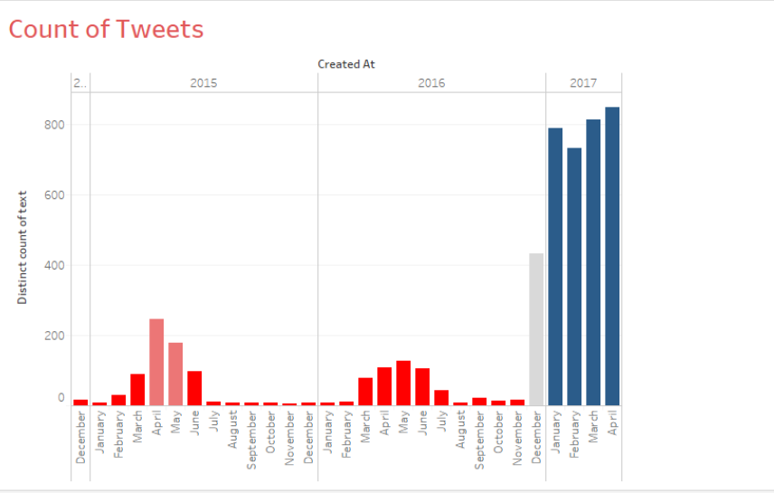
Count of Tweets

Slide 16
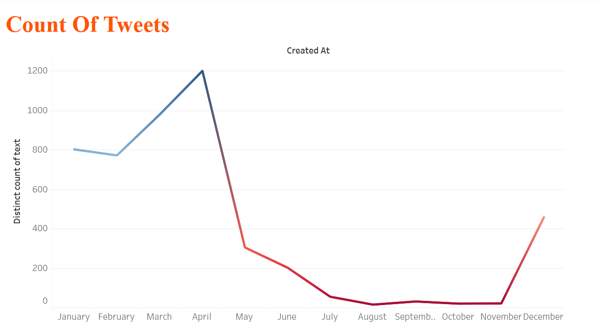
Data Trend

Slide 17
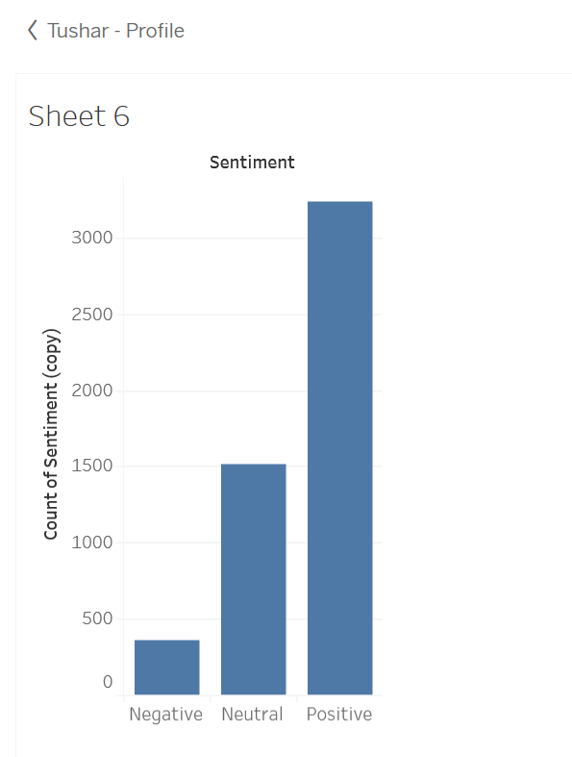
Sentiment view of polarity

Slide 18
conclusion
We found that 40% of time people talk about the show silicon valley using the generic #siliconvalley
This classification can help the show producers correctly classify and analyze the sentiment of the viewers

Slide 19
Future scope
By correctly classifying the text and sentiment related to post/tweet the producers can estimate the number of viewers
They can consider peoples opinion/recommendations and see what is trending
Ad agencies can also benefit if they know the number of viewers who will watch the show at a given time, as they can post their ad at that time and get worth their money

Slide 20
references
https://chimpler.wordpress.com/2013/03/13/using-the-mahout-naive-bayes-classifier-to-automatically-classify-twitter-messages/
https://chameerawijebandara.wordpress.com/2014/01/03/install-mahout-in-ubuntu-for-beginners/
http://hadooptutorial.info/apache-flume-installation/
https://www.edureka.co/blog/apache-hive-installation-on-ubuntu
http://apache.mirrors.pair.com/hive/hive-1.2.2/apache-hive-1.2.2-bin.tar.gz
http://www.nltk.org/howto/sentiment.html

