Slide 1
MidTerm Assignment
INFO7390 Advances Data Sci/Architecture SEC 02 - Fall 2017
Team Members :
Jaini Bhansali
Tushar Goel

Slide 2
Outline of the Case
Language used : Python
2. Process Followed : Data Ingestion, Data
Wrangling, Data Cleansing, Exploratory Data
Analysis,Feature Selection,Prediction Models
3. Tools used : Jupyter Notebook, boto 3, boto,
Amazon S3 Bucket
4. Deploying a the model as a service
5. Geospatial Search

Slide 3
Problem : Part 1
Part 2
Data Ingestion, Data Wrangling,
Data Cleaning,Exploratory Data Analysis,Feature Selection
Part 1
Data Ingestion, Data Wrangling,
Data Cleaning,Exploratory Data Analysis,Feature Selection
Part 4
Geospatial Analysis
Part 3
Deploying the Model as a Rest API
Notes:
We should be able to replace IBM’s CIK and document accession number with Googles to generate the url

Slide 4
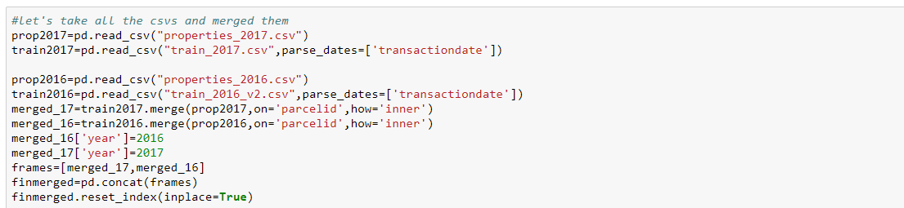
Solution Proposed for Problem 1 Part 1
Steps Followed
Data Ingestion
2. Exploratory Data Analysis
3. Data Cleaning
Feature selection
Prediction Models

Slide 5
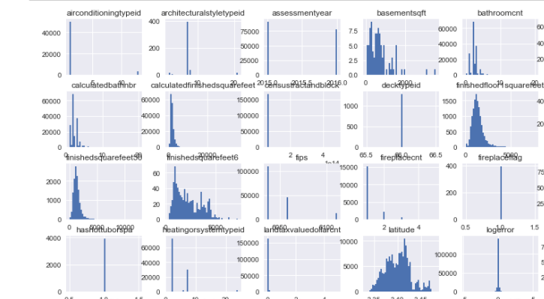
Exploratory Data Analysis
Analysed Datatype of each feature
Object data types and replaced "Yes“ or "True" with 1 for the usability and future usage
Correlation of Tax Data with Log error
Correlation of Area Features with Log Error
Correlation of Categorical Features and Log Error
Correlation of Numerical fields with Log Error
Correlation of Area Features with Log Error
Correlation of Categorical Features and Log error
Count of Missing Values per Feature

Slide 6
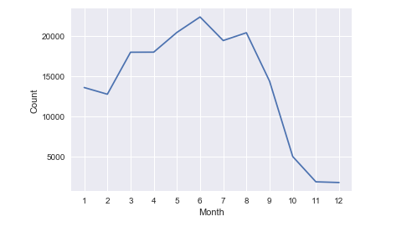
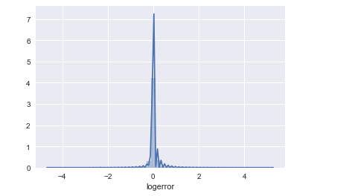
Study of Features with Log Error
Number of Transactions over Time
Analysis of Transaction Month with Mean Log Error
Analysis of Bedroom Count (Most occurred count for 2 or 3)
Analysis of Log Error

Slide 7
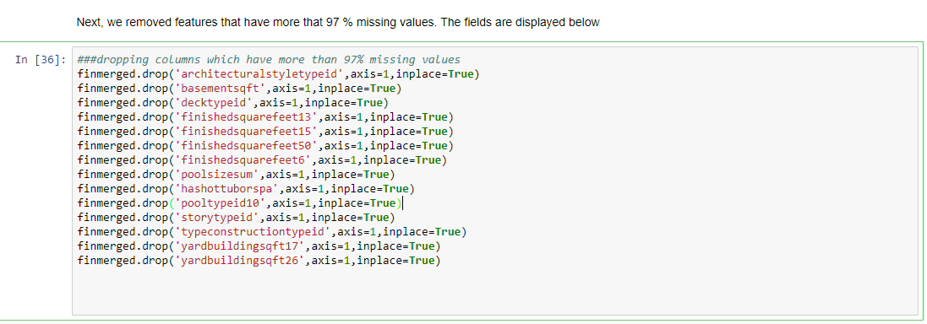
Handling Missing Values
Removed 97 % missing values
We identified all features with no missing values
nomisscol=['parcelid','logerror','transactiondate','bathroomcnt','bedroomcnt','fips','latitude','longitude','propertylandusetypeid','rawcensustractandblock','regionidcounty','roomcnt','assessmentyear','year','time_month']

Slide 8
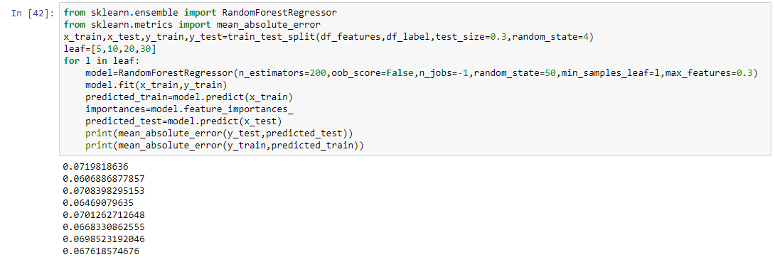
Early Prediction and Benchmark
We used the random Forest Regressor for early Predictions
Early Prediction value
0.0698523192046 -Testing Data
0.067618574676 – Training Data
3.

Slide 9

Handle Missing Values
pooltypeid2 and pooltypeid7 are one hot encoded values
pooltypeid2 and pooltypeid7 with 0.
we observed in the correlation matrix that finishedsquarefeet12 and calculatedfinishedsquarefeet seemed to be highly correlated, the values were all the same and hence, dropped finishedsquarefeet12
finmerged.bathroomcnt and finmerged.calculatedbathnbr seemed to be highly correlated, the values were all the same and hence, dropped calculatedbathnbr.

Slide 10
Handle Missing Values continued
Relation between Fire Place Count and Fire Place Flag
Handled Garage Car Count and Garage Total Squarefeet
correlation of finishedfloor1squarefeet and calculatedfinishedsquarefeet
Filling using structuretaxvaluedollarcnt+landtaxvaluedollarcnt= taxvaluedollarcnt
Tax Amount missing values with mean
Handle missing values of RegionidCity, RegionidNeighborhood, Regionidzip,Unitcnt,Year built, Building quality type id, Lot size squarefeet,Building quality type id

Slide 11
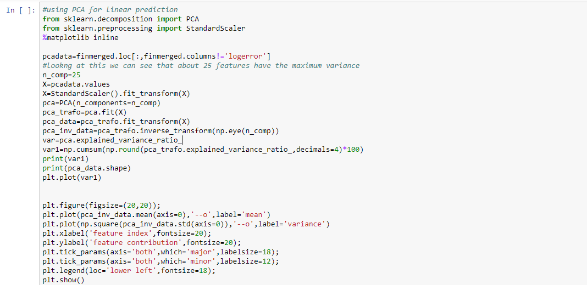
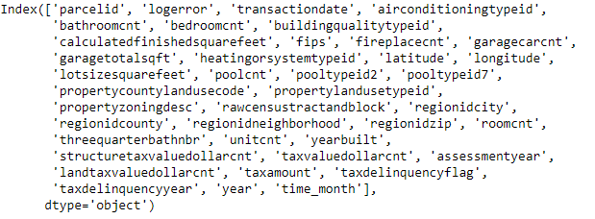
Feature Selection
Feature Selection using Baruta
Feature Selection using XGBoost
Feature Selection using random Forest regressor
Results after Feature Selection :
5. Used PCA to get linear relationships

Slide 12
Prediction Model Results
Results of Exp1
Testing :0.0687
Training : 0.0634
Optimum Tuning Params: n_estimators of 100, min_sample_leaf as 20 and max_featurs as sqrt
Results of Exp2
Testing :0.0688
Training: 0.0686
Results of Exp3
Testing :0.0688
Training :0.0686
Results Exp 4
Our optimum result was obtained at a MAE of Testing of 0.065534
Our optimum result was obtained at a MAE of Training of 0.064569
Tuning Parameter : max_feature=3, n_estimators=200,min_sample_leaf=20

Slide 13
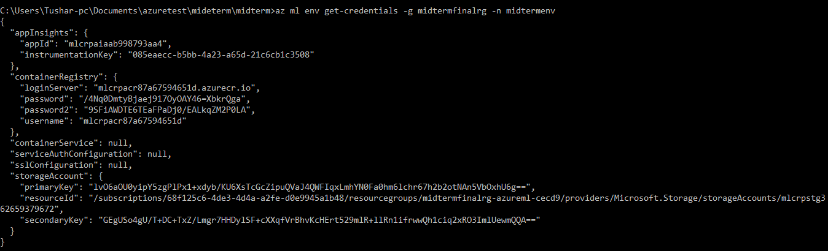
Part 3 – Model deployment
Since, Azure-ML can only be used for local deployment we developed Part 3 in 3 different ways
Deployed using Azure ML CLI
Deployed using Azure ML Studios
Created a WebApp
Deployed using Azure ML CLI
First set up environment
This allocates resource groups,
container registeries, and
model management accounts
Challenges:
No proper documentation for MSDN
Each documentation had
different overlapping instructions
Different Time consuming installations

Slide 14
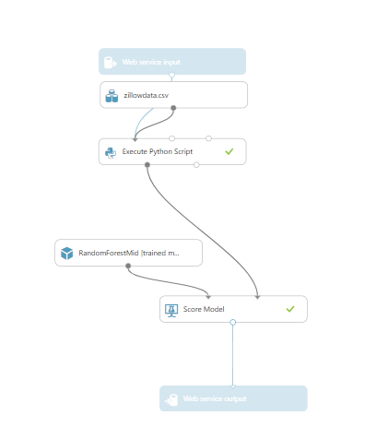
Web Deployment continued
Used Azure ML Studios
Click Run to populate to the Score Model module.
Added the cleaned data set and selected visualize
We now pick the model to be trained which was our random forest
regressor as it was our best model in Step 2 and connected the
train model module to Decision Forest Regression Module
http://zillowdataapi.azurewebsites.net/

Slide 15
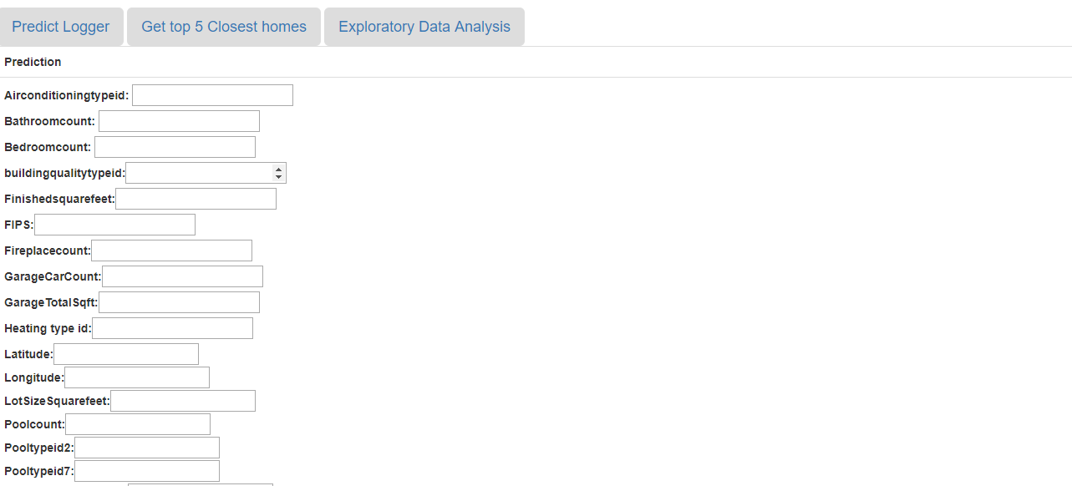
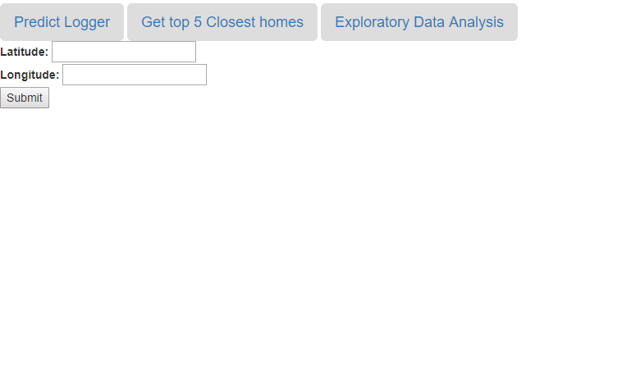
Web Deployment continued

Slide 16
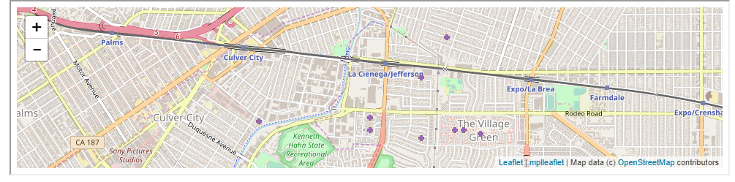
Web deployment and GeoSpatial Search
We implemented geospatial search using the Harvesian Algorithm using Mysql
We are capturing the Latitudes and Longitudes from the cleaned data to calculate the distance and return the top 10 closest home
The database with our cleaned file is being accessed from AWS
We combined the predictive modeling and geospatial search using a webapp and enhanced our webapp.

Slide 17


