Slide 2
Minor Project – II
Title of the project - Object Detection
MEMBER’S NAME | ROLL NUMBER | SAP ID | BRANCH
Tushar Goyal | R103218163 | 500067581 | BAO
Vinay | R103218167 | 500068489 | BAO
Sourabh Verma | R103218156 | 500069030 | BAO
Shivam Sahu | R103218140 | 500069419 | BAO
Under the guidance of
Dr. Bhupesh Kumar Dewangan

Slide 3
CONTENTS
Abstract
Introduction
Literature Review
Problem Statement
Objective
Methodology
Flow Chart, Algorithm
Progress (results if any)
References

Slide 4
Abstract

Slide 5
Object detection is a well-known computer technology connected with computer vision and image processing that focuses on detecting objects or its instances of a certain class (such as humans, flowers, animals) in digital images and videos. There are various applications of object detection that have been well researched including face detection, and character recognition. The most often complications that comes under the Object detection is that sometimes the results we get is not 100% accurate and there are object localization error. Object detection technology has been driven by an increasing processing power available in software and hardware. In this work we present a developed application for multiple objects detection based on OpenCV libraries. The aim is to get more accurate results by using various enhancement and segmentation techniques.
Keywords: Object Detection, Image processing, computer vision, edge detector.

Slide 6
Introduction

Slide 7
Object detection is commonly referred to as a method that is responsible for discovering and identifying the existence of objects of a certain class. An extension of this can be considered as a method of image processing to identify objects from digital images.
Image processing aims to transform an image into digital form and performs some process on it, to get an enhanced image and analyze image to take some utilized information from it.
OpenCV is a library of programming functions mainly aimed at real-time computer vision.
It has been proved that lung cancer is the topmost cause of cancer death in men and women worldwide. So, image processing in OpenCV can be helpful for more accurate detection of tumor in lungs.
With the help of canny edge detection in OpenCV the CT image of lungs is first processed on a lower level to enhance picture quality for example, by removing noise and finding Intensity Gradient of the Image.
Then the picture is processed on a higher level, for example detecting patterns and shapes, and thereby trying to determine, what is in the CT image of the lungs.

Slide 8
Literature Review

Slide 9
We will apply image processing and computer vision technologies to detect tumour in lung on the basis of previous work[1].
Let's say, Lung cancer is a disease of abnormal cells multiplying and growing into a tumour. The process of early detection of cancer plays an important role to prevent cancer cells from multiplying and spreading. Previous researches have been conducted for analysing[2]
lung cancer such as using clustering method in microarray data, the detection of lung cancer with general image processing techniques in CT scan data with good results and accuracy[3].
we proposed and evaluated additional image segmentation methods in analysing lung cancer using image processing techniques[4].

Slide 10
We also learnt about various methods and algorithms for Object Detection where the some key points were identified for every object using different algorithms[5].

Slide 11
Problem Statement

Slide 12
The early detection and diagnosis of nodules in CT image are among the most challenging clinical tasks performed by radiologists.
Radiologists can miss up to 25% of lung nodules in chest radiographs due to the background anatomy of the lungs which can hide the nodules.
Although the filter can detect the lung edge, unfortunately, the final edges lines produce are still unsatisfied.

Slide 13
Objective

Slide 14
Objective:
To develop a computer aided diagnosis system for finding the early cancer nodules using the lung CT images and find the number of nodules and area of nodules.
Sub-Objectives:
1. To collect a data set as a standard for processing of other images.
2. To pass the image that is to be analyzed through the image processing in OpenCV for further diagnosis.
3. A lung cancer detection system using image processing is used to classify the present of lung cancer in an CT- images.
4. In order to examine the performance lung cancer detection system by using image processing to extract features like length of tumor ,size of tumor and maximum area of a tumor.

Slide 15
Methodology

Slide 16
. The proposed solution to segment the lung from the CT images was based on the shape of the lung. In order to decompose the region, canny operator is used as the edge detection algorithm to detect the structure of the lung shape. This edge detection algorithm serves to simplify the analysis of images by drastically reducing the amount of data to be processed, at the same time preserving useful structural information about object boundaries. Once the edge detection completed. In this project we are basically using OpenCV is used as an image processing library in many computer vision real-time applications. we followed further steps.
1. In the first task; read image, selection of CXR images are made from the dataset which in our case.
2. Using Opencv as an image processing in various computer vision real time applications.
3. Tumor detection in a lung using image processing and computer vision
Creating an application for detecting tumor which will eventually extract necessary informations.

Slide 17
Object detection determines the presence of an object and/or its scope, and locations in the image. Object detection field is typically carried out by searching each part of an image to localize parts, whose photometric or geometric properties match those of the target object in the dataset.
Computer vision is such kind of research field which tries to perceive and represents the 3Dinformation for world objects. Its main purpose is reconstructing the visual aspects of 3D objects after analysing the 2D information extraction.
Image processing is a method to convert an image into digital form and perform some operations on it, in order to get an enhanced image or to extract some useful information from it.
Image Processing system includes treating images as two dimensional signals while applying already set signal processing methods to them. Image processing basically includes the following three steps:
a) Importing the image with optical scanner or by digital photography.
b) Analyzing and manipulating the image which includes data compression and image enhancement and spotting patterns that are not to human eyes like satellite photographs.
c) Output is the last stage in which result can be altered image or report that is based on image
analysis.

Slide 18
Flow Chart, & Algorithm

Slide 19
Algorithm steps
Start: Gathering required dataset in form of images.
Step-2: Processing and enhancing the dataset obtained.
Step-3: OpenCV for detecting an object present in an image.
Step-4: Canny edge detector algorithm used as a multi stage algorithm to detect a wide range of edges in images.
Step-5: By the use of image processing in computer vision for detection of tumour that may be present in any individual lung.
Step-6: Making an application for general use by the people for detecting the presence of lung cancer inside the human body.
End: The application will then give necessary information based upon the results obtained.

Slide 20
Canny edge detection algorithm
Step-1: Apply Gaussian Filter to smooth the image in order to remove the noise
Step-2: Find the intensity gradients of the image
Step-3: Apply gradient magnitude thresholding or lower bound cut-off suppression to get rid of spurious response to edge detection
Step-4: Apply double threshold to determine potential edges
Step-5: Track edge by hysteresis: Finalize the detection of edges by suppressing all the other edges that are weak and not connected to strong edges.
Time complexity of canny edge detection algorithm is “O(mn log mn).”

Slide 21
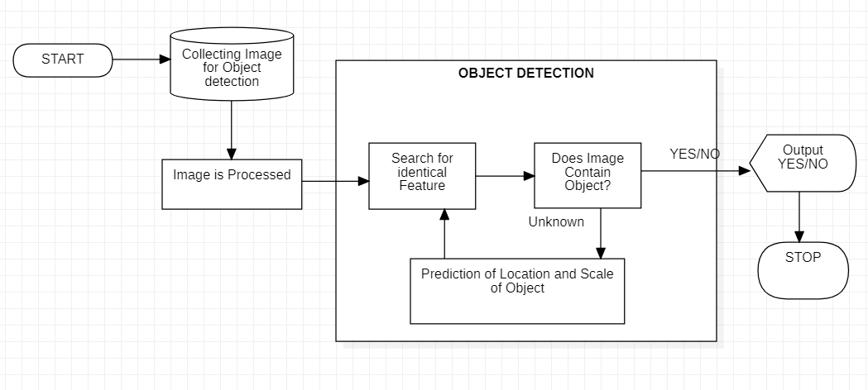
Figure 1. Basic Object Detection model

Slide 22
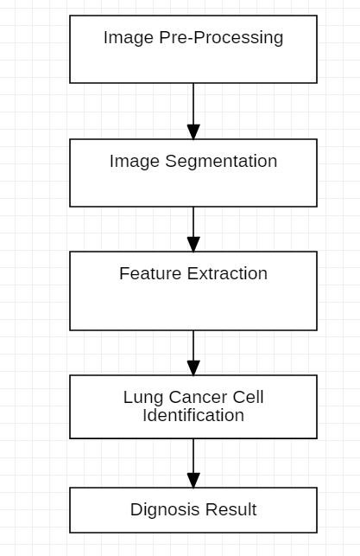
Figure 2. Lung Cancer Detection

Slide 23
References

Slide 24
[1] . Asuntha1 , A.Brindha1 , S.Indirani1 , Andy Srinivasan,” Lung cancer detection using SVM algorithm and optimization techniques”, Lung cancer detection using SVM algorithm and optimization techniques, ISSN: 0974-2115.
[2] Ms. Swati P. Tidke, 2 Prof. Vrishali A. 3Chakkarwar, “Classification of Lung Tumor Using SVM”, International Journal Of Computational Engineering Research (ijceronline.com) Vol. 2 Issue. 5 .
[3] Shradha fule,” LUNG CANCER DETECTION USING IMAGE PROCESSING TECHNIQUES”, International Research Journal of Engineering and Technology (IRJET) , volume: 04 Issue: 12 , Dec-2017, e-ISSN: 2395-0056.
[4] Fares Jalled, Ilia Voronkov, “Object Detection Using Image Processing”, Moscow Institute of Physics & Technology, Department of Radio Engineering & Cybernetics.
[5] Souhail Guennouni, Anass Mansouri, Ali Ahaitouf , “Multiple Object Detection using OpenCV on an Embedded Platform”, Sidi Mohammed Ben Abdellah University, National School of Applied Sciences, Signals Systems and Components Laboratory ,2014 IEEE.

Slide 25
[6] Sander Soo,” Object detection using Haar-cascade Classifier”, Institute of Computer Science, University of Tartu.
[7] Ashish Chaube, Bhumika Gupta,Ashish Negi, Umang Goel,” Study on Object Detection using Open CV - Python”, International Journal of Computer Applications (0975 – 8887) Volume 162 – No 8, March 2017,

