Slide 1
Plant Disease Detection with Classical Machine Learning
Unit 5: neural networks · combining models · kernel methods · sampling & graphical models
Tomato leaf photos · 55 explainable features · every from-scratch model checked against scikit-learn
Notes:
This presentation covers Unit 5 of the syllabus, applied to our plant disease project. The project detects tomato leaf diseases from one photo using classical machine learning only - no deep learning - so every decision can be explained. Unit 5 adds four families of methods: neural networks, combining models, kernel methods with sparse kernel machines, and sampling methods with graphical models. The key models are written from scratch in NumPy and checked against scikit-learn.

Slide 2
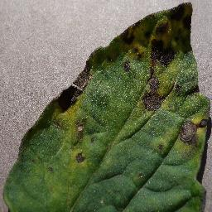
One leaf photo becomes 55 numbers
The project
1
Photo
11,628
resize to 256 × 256, blur away sensor noise
tomato leaf photos (9,302 train, 2,326 held out)
2
Find the leaf
HSV colour thresholds for green leaf and brown lesions
5
3
Measure it
classes: 4 diseases + healthy
55 features: colour, greenness, lesion %, texture, shape
4
Unit 5 models
55
learn the disease from those 55 numbers
explainable features per leaf
Sample: tomato leaf with early blight
Notes:
Every photo goes through the same pipeline. We resize and blur it, then find which pixels are leaf using colour thresholds in HSV space, which separates green leaf tissue from brown lesions. Then we measure 55 features on leaf pixels only: colour averages, greenness indices, the lesion fraction, a colour histogram, GLCM texture and Hu shape moments. The dataset is 11,628 tomato leaves in five classes: early blight, late blight, Septoria leaf spot, yellow leaf curl virus and healthy. 80% train, 20% held out for a single final test. All Unit 5 models use these same features.

Slide 3
Unit 5 at a glance
Overview
1
Neural networks
2
Combining models
Multilayer perceptron written in NumPy, trained with backpropagation
AdaBoost written from scratch, voting committees and stacking
93.2% held-out accuracy
91.8% with stacking, above every single model
3
Kernel methods
4
Sampling & graphical models
SVM dual, Gaussian process, Relevance Vector Machine from scratch
Metropolis-Hastings, Gibbs sampling in an MRF, a Bayesian network
35 vs 447 training leaves kept: RVM vs SVR
15% → 2.1% wrong pixels, noisy lesion mask
Notes:
Here are the four parts of Unit 5 with one headline result each. The neural network reaches 93.2% on leaves it never saw. Stacking - learning how to combine five models - reaches 91.8%, better than any single member. The Relevance Vector Machine needs only 35 training leaves where Support Vector Regression keeps 447. Gibbs sampling in a Markov random field cleans a lesion mask from 15% wrong pixels down to 2.1%. The next slides go through each part.

Slide 4
A network learns its own features
1 · Neural networks
Forward pass
z = tanh(x W₁ + b₁), p = softmax(z W₂ + b₂)
Error
cross-entropy + weight decay λ/2 ‖W‖²
Backpropagation
δ₂ = p − t, δ₁ = (δ₂ W₂ᵀ) ⊙ (1 − z²): every gradient in one backward pass
Update
mini-batch gradient descent with Adam, 60 epochs
55 inputs
(leaf features)
32 hidden units
(tanh)
5 outputs
(softmax)
Gradient check: 2 × 10⁻⁶ backprop agrees with numerical derivatives
Notes:
The network has 55 inputs, one hidden layer of 32 tanh units and 5 softmax outputs, one per class. The hidden units combine the inputs non-linearly, so the network learns its own features. Training minimises the cross-entropy error plus weight decay. Backpropagation uses the chain rule to get every gradient in one backward pass: the output error is p minus t, and it is sent back through the tanh derivative 1 minus z squared. To prove the code is right we compare it with numerical derivatives: the largest relative difference is 2 times 10 to the minus 6, so backprop is correct.

Slide 5
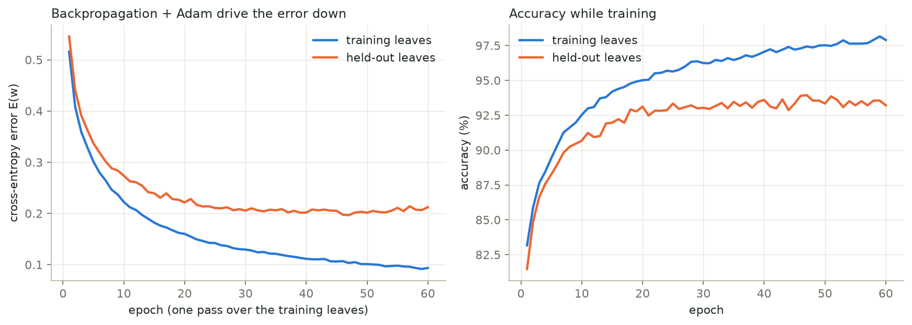
93.2% — better than a linear model
1 · Neural networks
93.2%
93.0%
89.3%
our NumPy network, held-out leaves
sklearn MLPClassifier, same architecture
logistic regression (no hidden layer)
Notes:
Left: the cross-entropy error falls every epoch on the training leaves, and levels off on the held-out leaves. Right: accuracy rises the same way. Our from-scratch network gets 93.2% on held-out leaves, matching scikit-learn's MLPClassifier with the same architecture at 93.0%. Logistic regression - a network without a hidden layer - gets 89.3%, so the hidden layer adds about 4 points. The gap between the two curves is over-fitting; weight decay keeps it small.

Slide 6
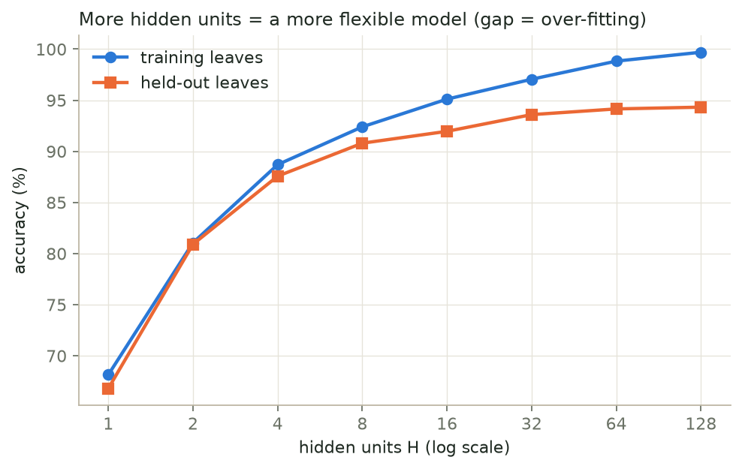
How many hidden units?
1 · Neural networks
66.8%
1 hidden unit: too simple
93.6%
32 hidden units: the model we use
94.3%
128 units held-out, but 99.7% on training leaves
More units = more flexible; beyond ~64 only the training score improves.
Notes:
This is model complexity. With one hidden unit the network is too simple: 67%. Accuracy rises quickly up to about 16 to 32 units. Beyond 64 units the training accuracy keeps climbing towards 100% while the held-out accuracy stays at about 94%: the extra flexibility only memorises the training leaves. That is why we use 32 units.

Slide 7
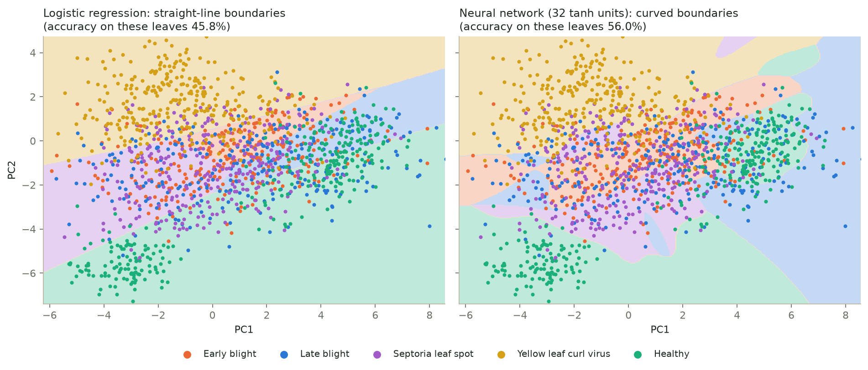
Straight lines vs curved boundaries
1 · Neural networks
45.8%
56.0%
2 → 55
logistic regression on 2 PCA inputs
neural network on the same 2 inputs
with all 55 features both are far higher
Notes:
To see what the hidden layer does, we give both models only the first two principal components. Logistic regression can only cut the plane with straight lines. The network bends its boundaries around the clusters, for example the yellow leaf curl virus region at the top and the healthy groups at the bottom, and gets 56% instead of 46% with the same two numbers. With all 55 features both models are much higher.

Slide 8
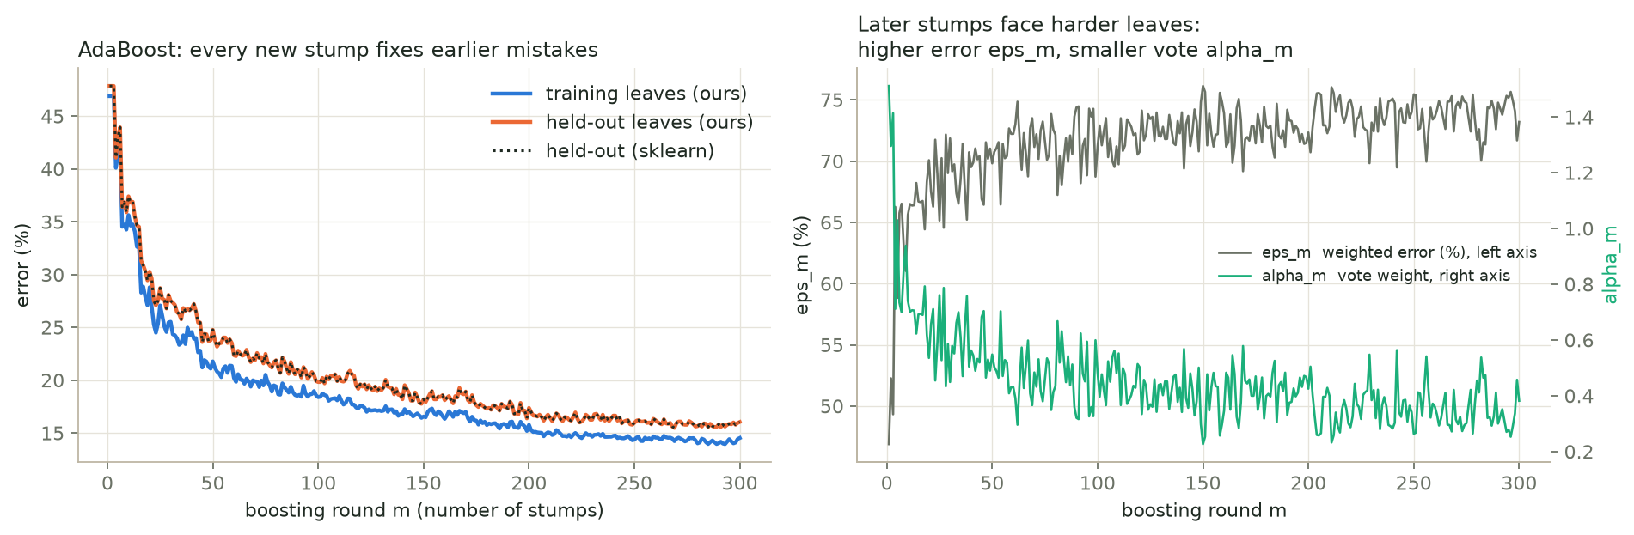
AdaBoost: many weak stumps, one strong vote
2 · Combining models
52.1%
84.0%
100%
one decision stump (one yes/no question)
300 stumps with AdaBoost
same predictions as sklearn's AdaBoost
Notes:
AdaBoost, written from scratch. A decision stump asks one yes-or-no question about one feature, which alone gives 52%. After each stump, the leaves it got wrong get more weight, so the next stump has to fix them. Each stump votes with weight alpha = ln((1 - error) / error) + ln(K - 1); for two classes this is exactly Bishop's AdaBoost, for five classes it is the SAMME version. 300 stumps reach 84%, and our predictions are identical to scikit-learn's AdaBoost on every leaf. On the right: later stumps face harder leaves, so their weighted error is higher and their vote smaller.

Slide 9
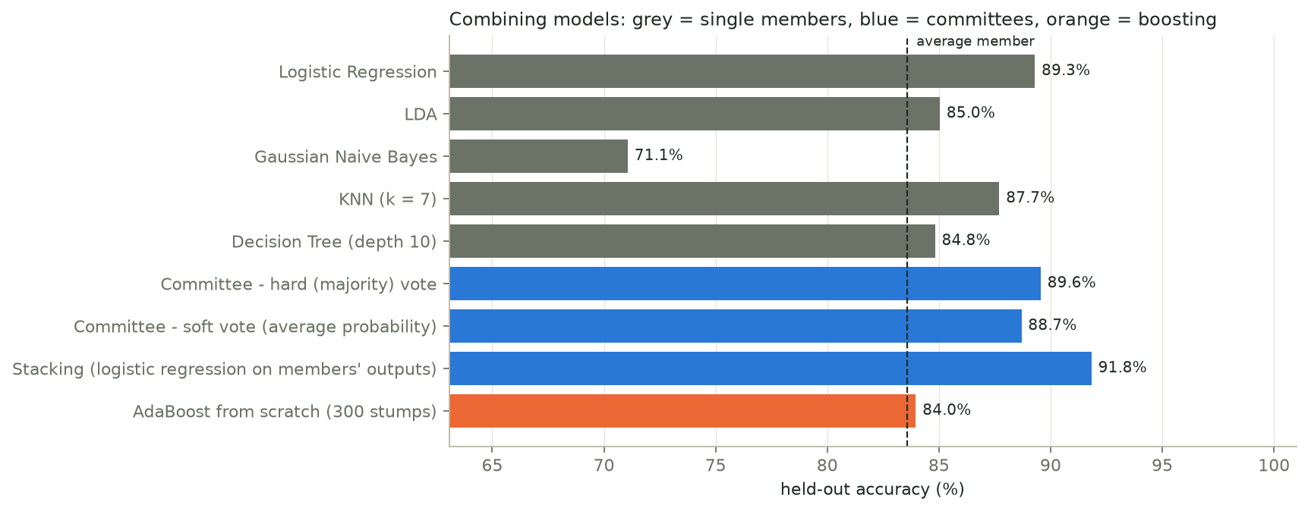
A committee beats its members
2 · Combining models
16.4%
11.3%
91.8%
average error of the 5 members
error of the soft-vote committee
stacking: learns whom to trust
Notes:
Five different models - logistic regression, LDA, Naive Bayes, KNN and a decision tree - vote together. Their average error is 16.4%; averaging their probabilities gives 11.3%, because independent mistakes partly cancel - as Bishop's committee result says, the committee error is at most the average error. A plain vote is pulled down by the weak Naive Bayes member. Stacking trains a logistic regression on the members' outputs, learns how much to trust each one, and reaches 91.8%, better than every member.

Slide 10
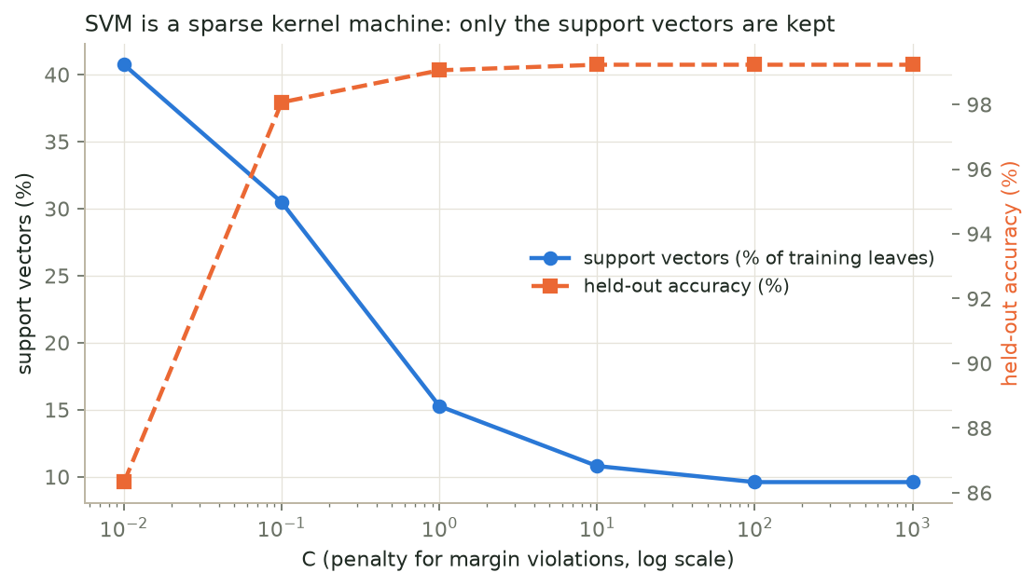
The SVM only needs its support vectors
3 · Kernel methods & sparse kernel machines
162 / 1,500
training leaves are support vectors (C = 10)
10⁻¹³
difference between our hand-built y(x) and sklearn
99.2%
healthy vs diseased, held-out
y(x) = Σ aₙ tₙ k(x, xₙ) + b over support vectors only.
Notes:
A kernel measures how similar two leaves are; the RBF kernel is exp(-gamma times squared distance). In the dual form the SVM predicts with a weighted sum of kernels to the training leaves, and almost all weights are zero. We rebuilt the decision function by hand from the dual coefficients: it uses only 162 of the 1,500 training leaves and matches scikit-learn to 10 to the minus 13. A larger C allows fewer margin violations, so fewer leaves become support vectors.

Slide 11
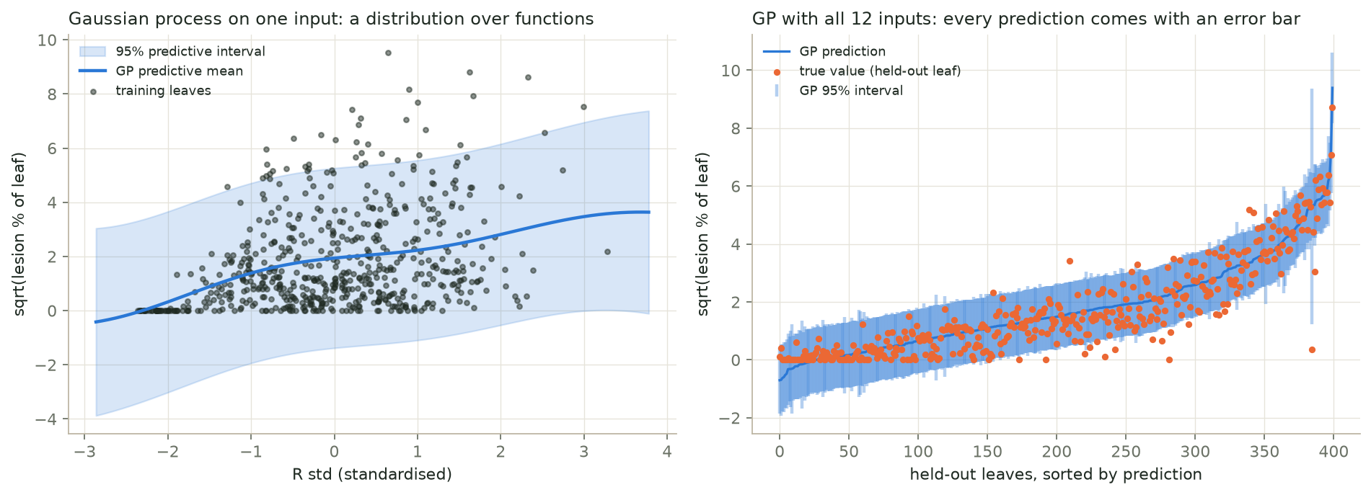
A Gaussian process gives honest error bars
3 · Kernel methods & sparse kernel machines
R² 0.84
94%
3 inputs
predicting lesion % from colour + texture
of held-out leaves inside the 95% interval
switched off by automatic relevance determination
Notes:
Here the task is regression: estimate disease severity, the lesion percentage, from 12 colour and texture features, without using the brown-pixel mask. A Gaussian process is a distribution over functions; its kernel settings are learned by maximising the marginal likelihood. Left: on one input you can see the mean and the 95% band. Right: every held-out leaf gets a prediction with an error bar, and 94% of the true values fall inside the 95% interval, so the error bars are honest. With one length-scale per input, the GP switched off three GLCM texture inputs it did not need.

Slide 12
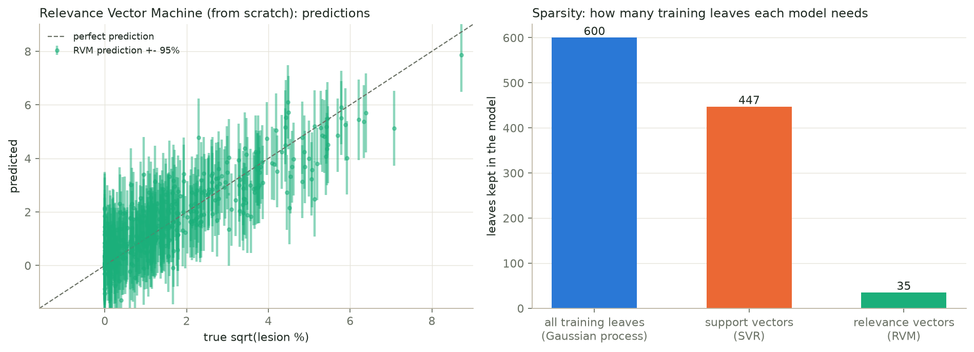
The RVM is the sparsest kernel machine
3 · Kernel methods & sparse kernel machines
35
447
0.76 vs 0.80
relevance vectors kept by our RVM
support vectors kept by SVR
R²: RVM vs SVR, with far fewer leaves
Notes:
The Relevance Vector Machine, written from scratch, gives every training leaf its own prior precision alpha. Re-estimating them from the evidence drives most alphas to infinity, which sets those weights to zero and prunes the leaf. Only 35 relevance vectors survive, while Support Vector Regression keeps 447 and the Gaussian process uses all 600. Accuracy is close - R squared 0.76 against 0.80 - and the RVM also gives error bars.

Slide 13
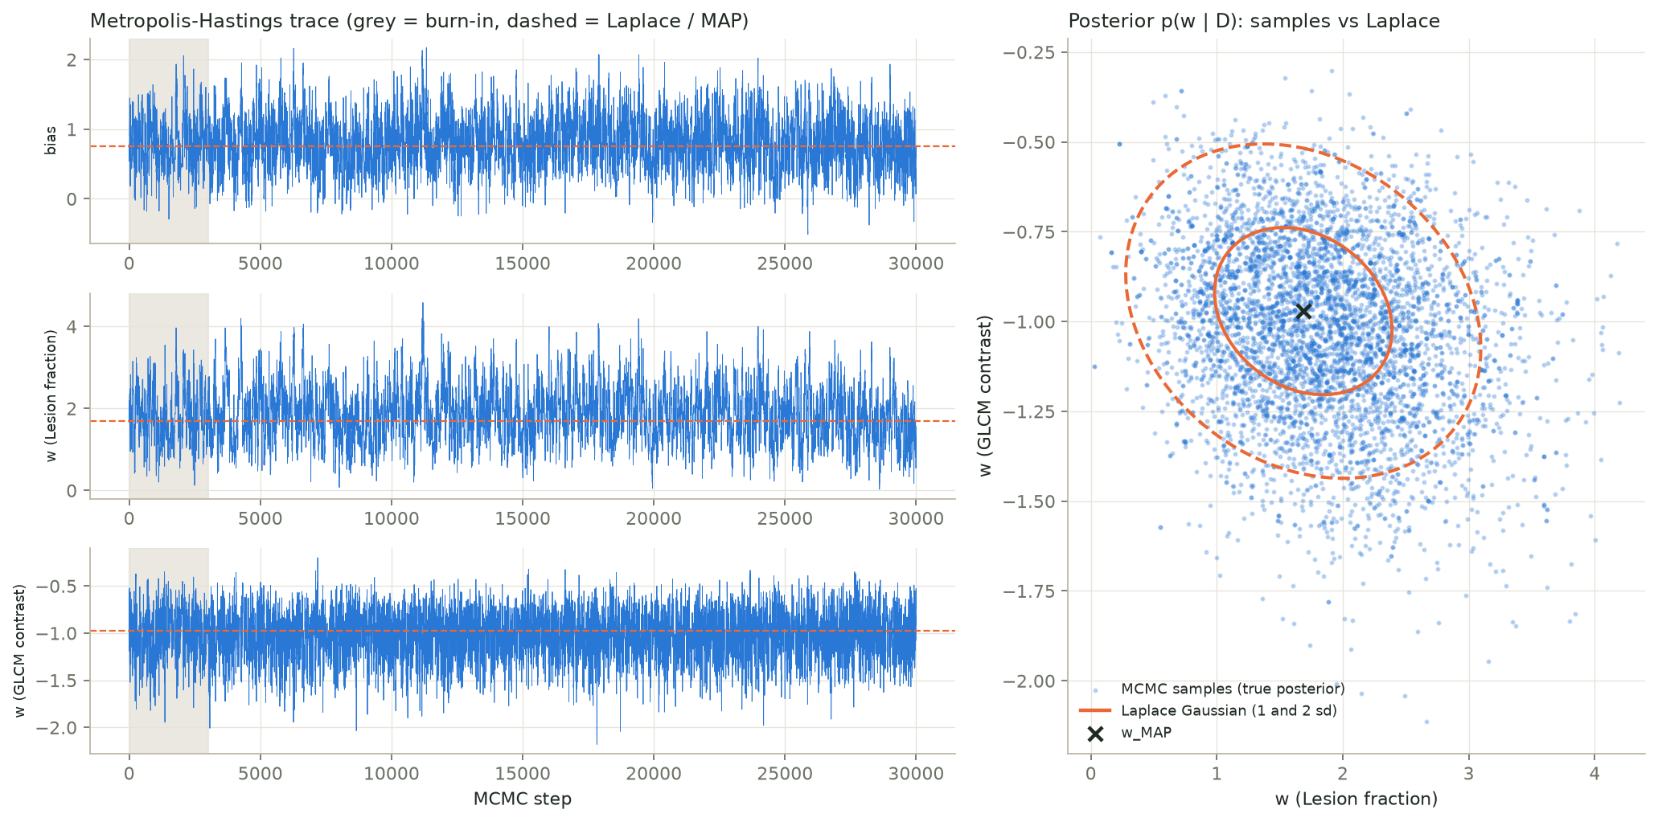
MCMC confirms the Laplace approximation
4 · Sampling methods & graphical models
30,000
Metropolis-Hastings samples, 29% accepted
1.85 vs 1.69
lesion weight: MCMC mean vs Laplace (sd 0.70)
0.464 vs 0.470
held-out log-loss: MCMC vs Laplace
Notes:
Metropolis-Hastings samples the posterior of Bayesian logistic regression - healthy versus diseased - on two features. Each step proposes a small random move and accepts it with probability min(1, p(new) over p(old)); only ratios are needed, never the normalising constant. Left: the traces after the grey burn-in wander around the posterior. Right: the samples fall inside the Laplace Gaussian ellipses we used in Unit 2. The means differ by less than a quarter of a standard deviation, and predictions are almost identical, so the Laplace approximation was justified.

Slide 14
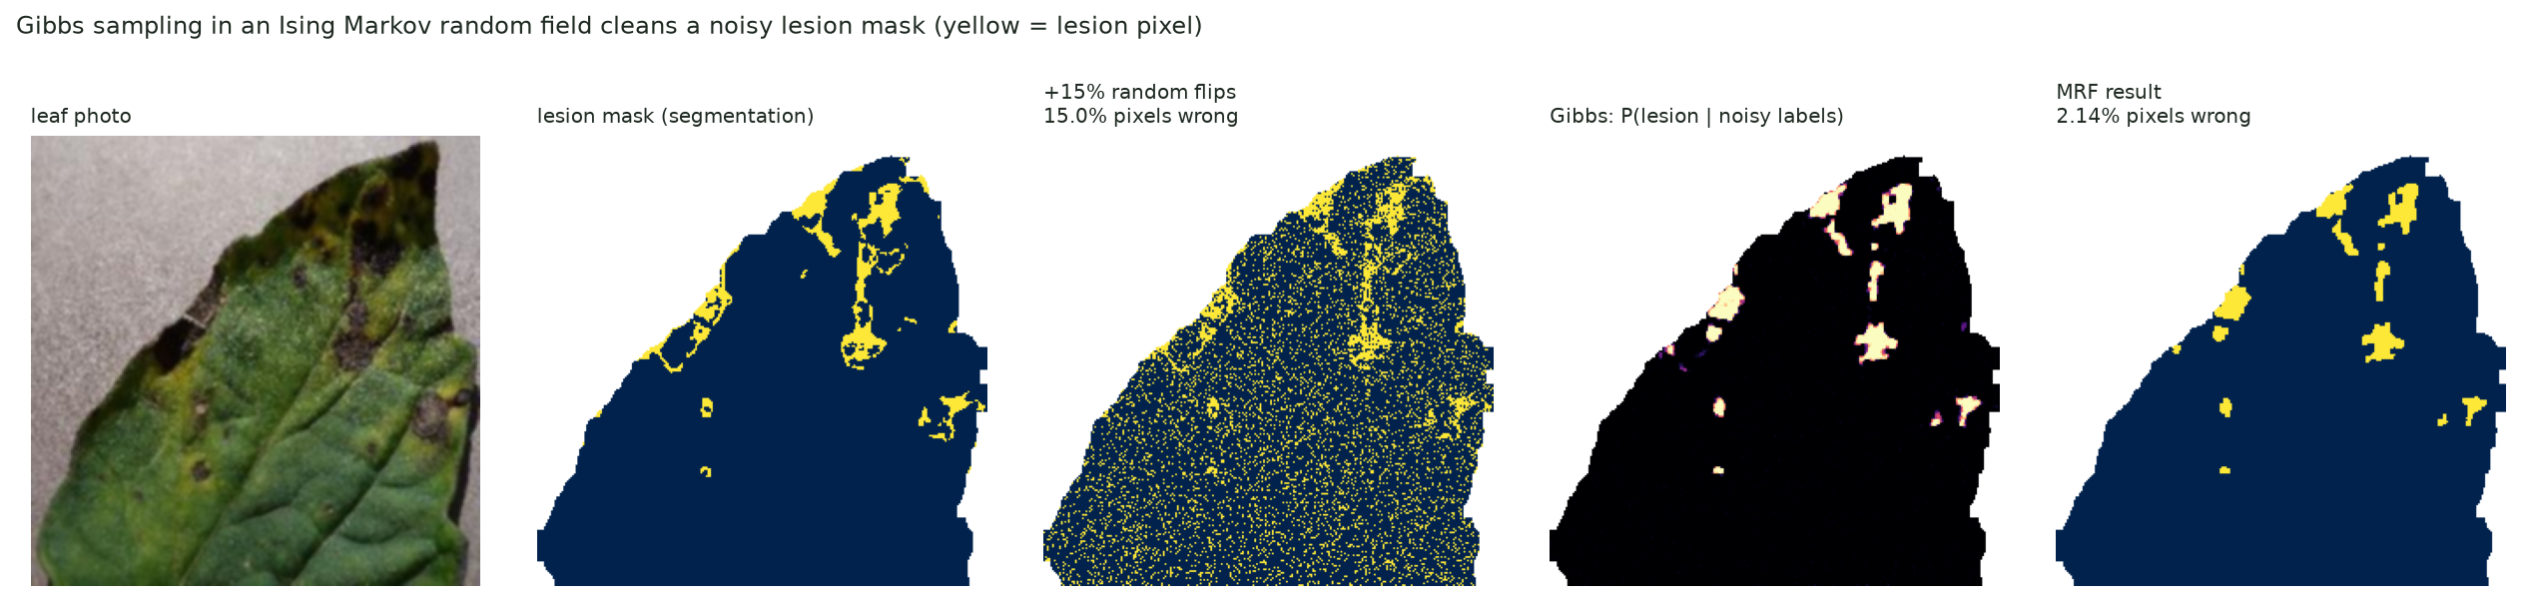
Gibbs sampling cleans a lesion mask
4 · Sampling methods & graphical models
15.0%
2.1%
β 1.0 · η 0.87
pixels wrong after adding random noise
pixels wrong after 40 Gibbs sweeps
neighbour agreement · trust in each label
Ising MRF: p(xᵢ = lesion | rest) = σ(2(β Σⱼ xⱼ + η yᵢ)).
Notes:
A Markov random field is an undirected graphical model on the pixel grid: neighbouring pixels usually have the same label. We take the real lesion mask of the early blight leaf, flip 15% of its pixels at random, and let Gibbs sampling recover it. Gibbs resamples each pixel from its conditional given its four neighbours and its noisy label. Averaging the samples gives the probability that each pixel is lesion. After 40 sweeps only 2.1% of pixels are wrong.

Slide 15
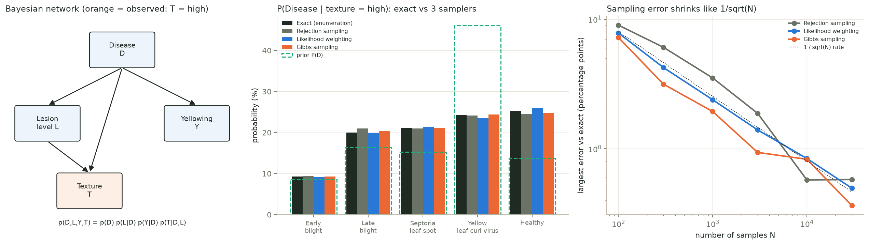
A Bayesian network, solved exactly and by sampling
4 · Sampling methods & graphical models
13.7% → 25.3%
≤ 1 point
50.9%
P(healthy) before and after seeing rough texture
gap between exact answer and 3 samplers (30,000 samples)
accuracy from only 3 coarse variables (chance 20%)
Notes:
A Bayesian network is a directed graphical model: disease causes lesion level, yellowing and texture, and lesions also make the texture rougher. The tables are learned by counting training leaves. We ask: what is the disease if the texture contrast is high? Exact inference sums the joint distribution over the hidden variables; healthy leaves have strong vein texture, so P(healthy) rises from 13.7% to 25.3%. Rejection sampling, likelihood weighting and Gibbs sampling all agree with the exact answer within one percentage point, and their error falls like one over the square root of the number of samples.

Slide 16
Every from-scratch model was checked
Verification
Our code | Checked against | Result
Backpropagation | numerical (finite-difference) derivatives | worst relative error 2 × 10⁻⁶
Neural network | sklearn MLPClassifier, same architecture | 93.2% vs 93.0% held-out
AdaBoost (SAMME) | sklearn AdaBoostClassifier | identical predictions on 100% of leaves
SVM decision function | sklearn SVC.decision_function | max difference 10⁻¹³
Metropolis-Hastings | Laplace approximation (Unit 2) | means within 0.25 standard deviations
Bayes net samplers | exact inference by enumeration | within 1 percentage point
Plus 15 automated tests for Unit 5 (97 in the whole project).
Notes:
We did not just call library functions: the key models are written from scratch, and each one is checked against an independent reference. Backpropagation against numerical derivatives; the network and AdaBoost against scikit-learn; the SVM decision function rebuilt from its dual coefficients; MCMC against the Laplace approximation; and the Bayesian network samplers against exact enumeration. These checks are also automated tests in the project.

Slide 17
What Unit 5 adds to the project
A neural network learns its own features: 93.2%, 4 points above logistic regression
Combining models helps: stacking reaches 91.8%, better than any single member
Kernel machines are sparse: an RVM needs 35 leaves; a GP gives honest error bars
Sampling answers what formulas cannot: MCMC, Gibbs on an MRF, Bayesian network queries
Live demo: python demo.py · web app: streamlit run app.py
Notes:
To sum up: the neural network gives the best single result of Unit 5 by learning its own features. Combining models helps when the combination is learned, as in stacking. Kernel machines can be very sparse, and Gaussian processes add trustworthy uncertainty. Sampling methods and graphical models let us answer questions that have no closed-form solution, and they confirmed our earlier approximations. Everything can be shown live with python demo.py in the terminal, or in the Streamlit web app.

