Slide 1

Food Delivery Cancellation Predictor
AI that predicts cancelled orders and tells us how to save them.
Name: [Your Name] · Roll No: [_____ ] · Guide: [Guide Name]

Slide 2
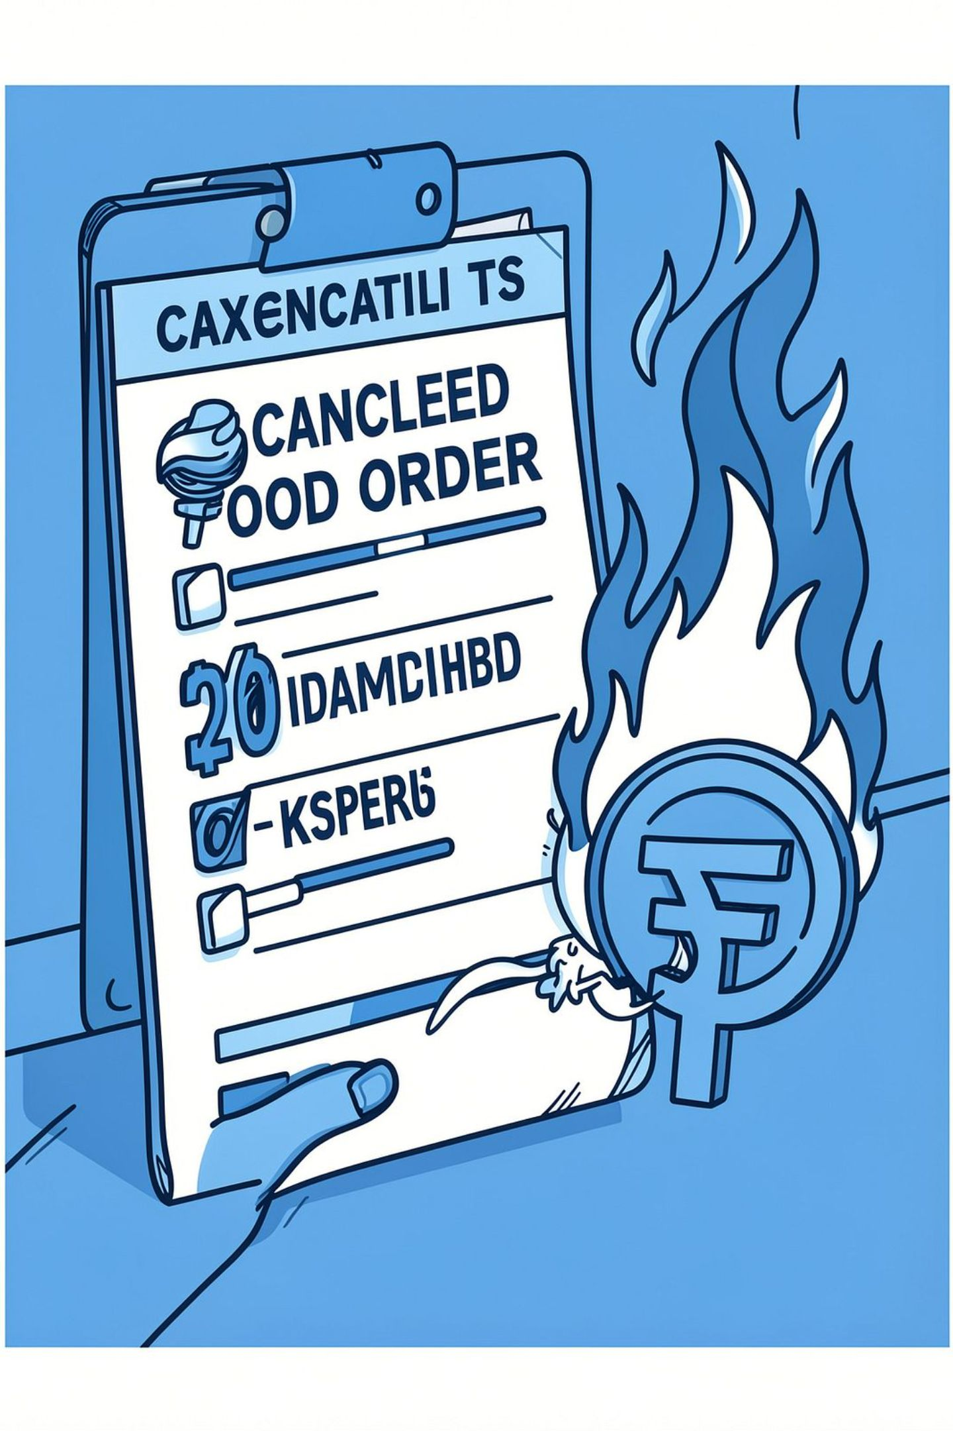
The Problem
Orders cancel after the kitchen has started and a rider is assigned.
Restaurants lose money on prepared food and delivery costs.
Customers are left unhappy and may stop ordering.

Slide 3
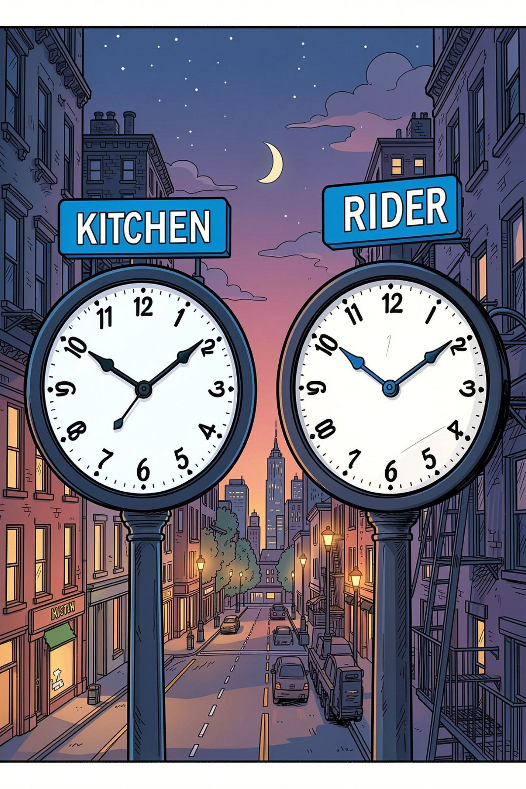
Why Orders Get Cancelled
Long kitchen prep time — food takes too long to be ready.
Long rider wait time — riders arrive late or wait too long.
Problems peak during evening and night rush hours.

Slide 4
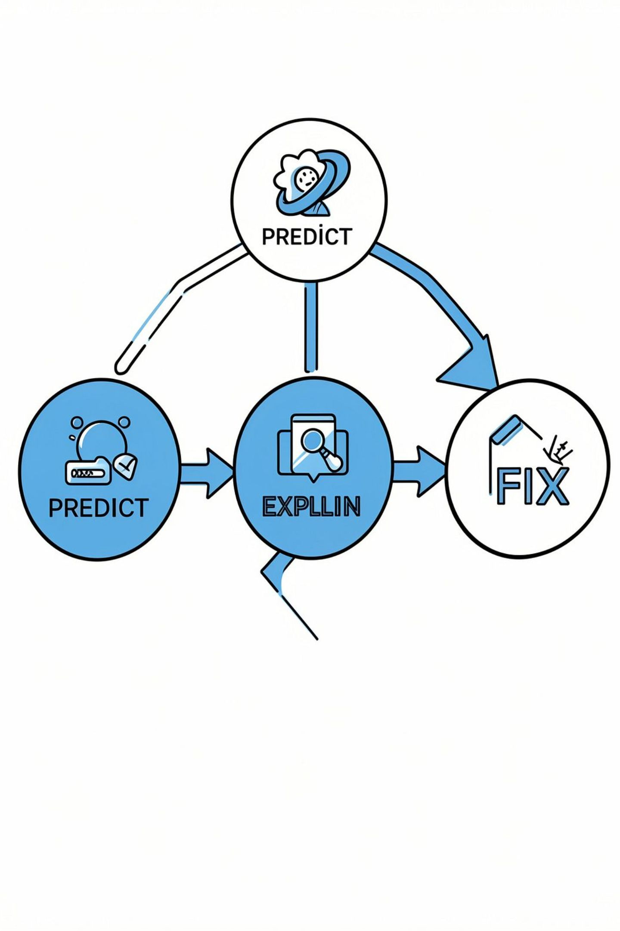
Our Solution
Predict which orders are likely to cancel before loss occurs.
Explain the main reason for each risky order in plain terms.
Recommend the cheapest fix — a small discount or faster rider.

Slide 5
How We Built It
A five-step pipeline that turns raw delivery data into live prevention:
Collect data
Clean data
Analyze (PySpark)
Order logs, timestamps, rider traces.
Remove duplicates, fix timestamps, handle missing values.
Fast processing of large logs. PySpark = tool for big data processing.
Train (Random Forest)
Deploy
Robust model that handles many features and rare events.
Web app for alerts + Power BI for operational views.

Slide 6
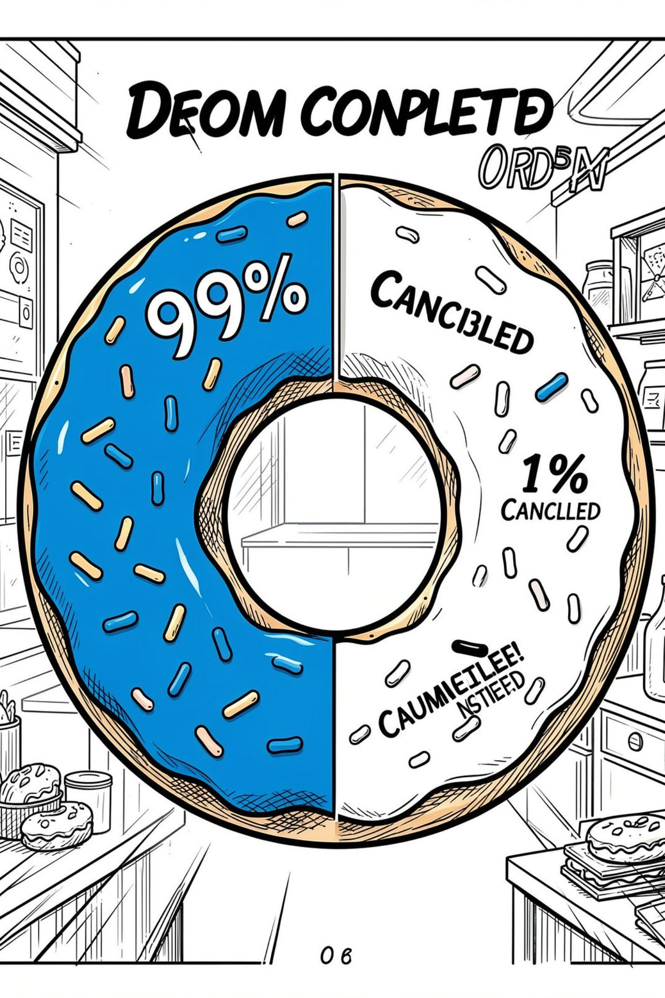
The Data
21,321 real food-delivery orders in our dataset.
Only ~1% were cancelled — a rare event the model needs to detect.
Dataset balancing and careful sampling were used to train the AI.

Slide 7
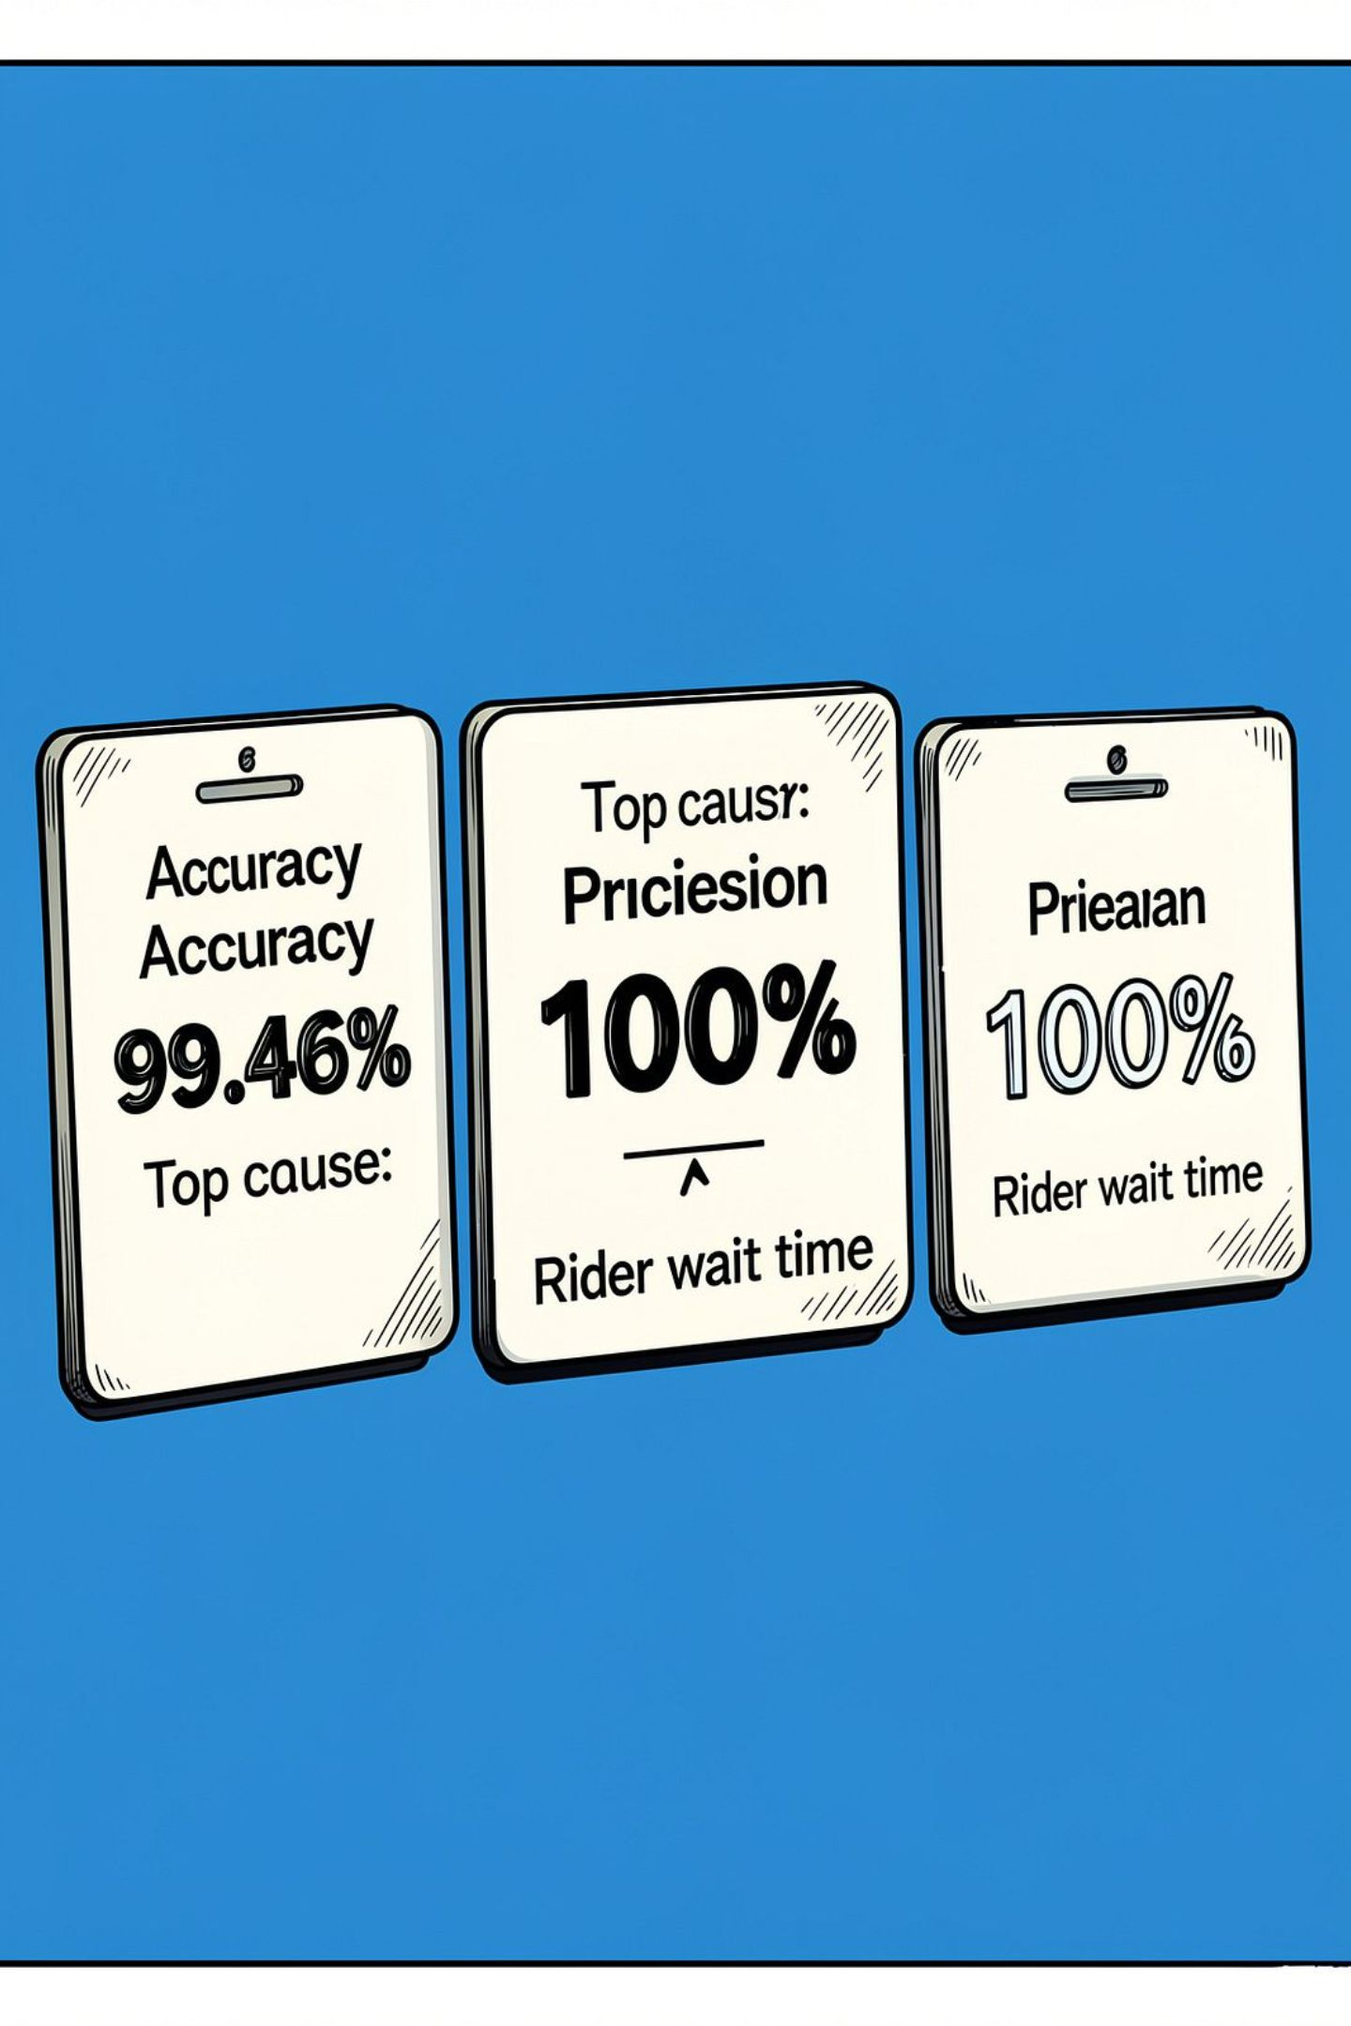
Results
Accuracy: 99.46% — model correctly labels most cases.
Precision: 100% — every flagged order was truly risky.
Key finding: Rider wait time is the #1 cause of cancellations.

Slide 8
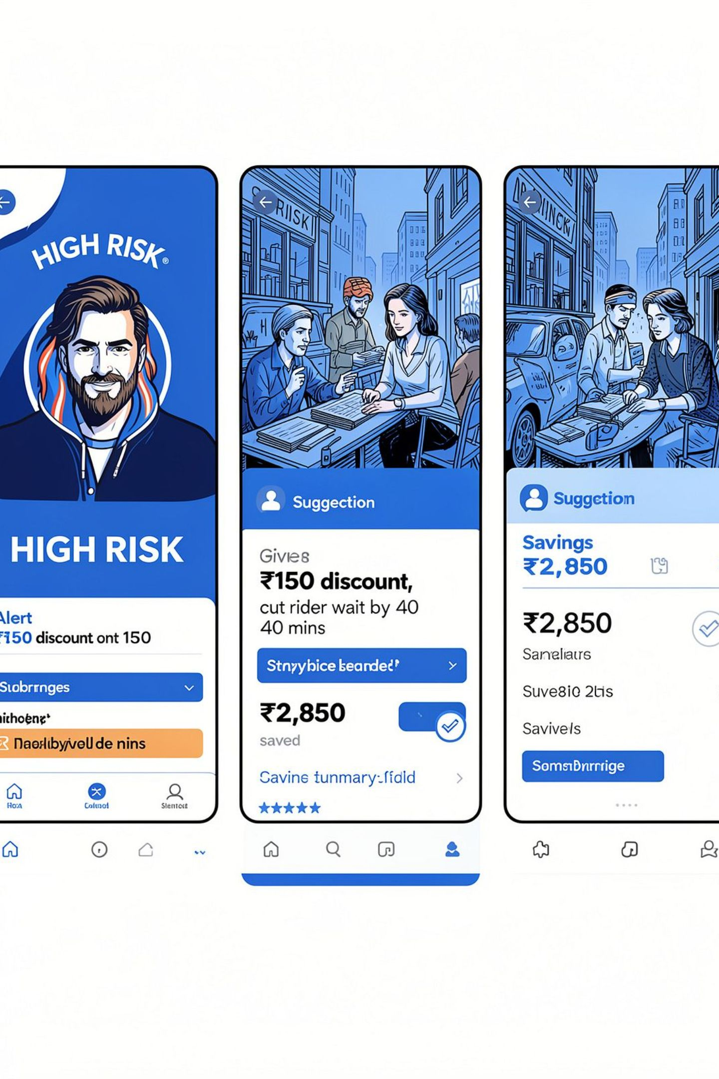
Live App — What It Shows
HIGH RISK alert on orders that need attention now.
Auto-suggestion: e.g., give ₹150 discount or speed up rider arrival.
Savings estimate: shows net profit saved if the order is rescued.

Slide 9
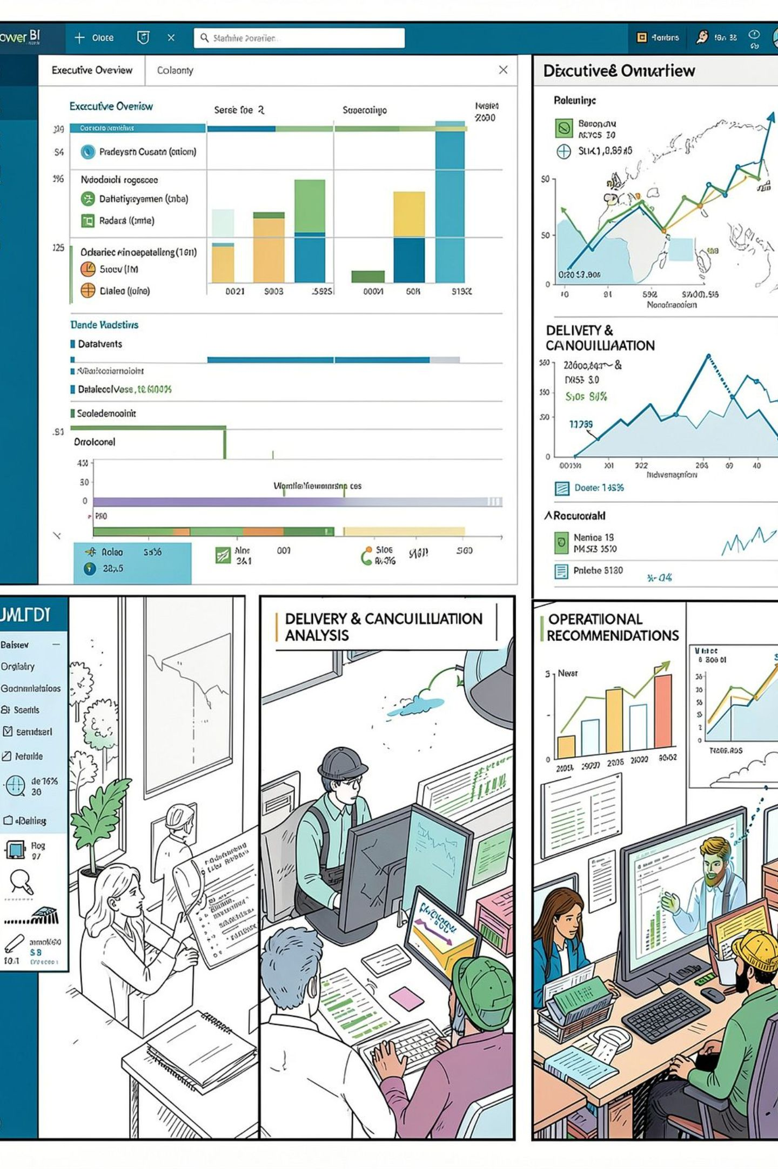
Power BI Dashboard
Executive Overview: key metrics and trend lines at a glance.
Delivery & Cancellation Analysis: filters by time, area, rider.
Operational Recommendations: suggested fixes and expected savings.

Slide 10
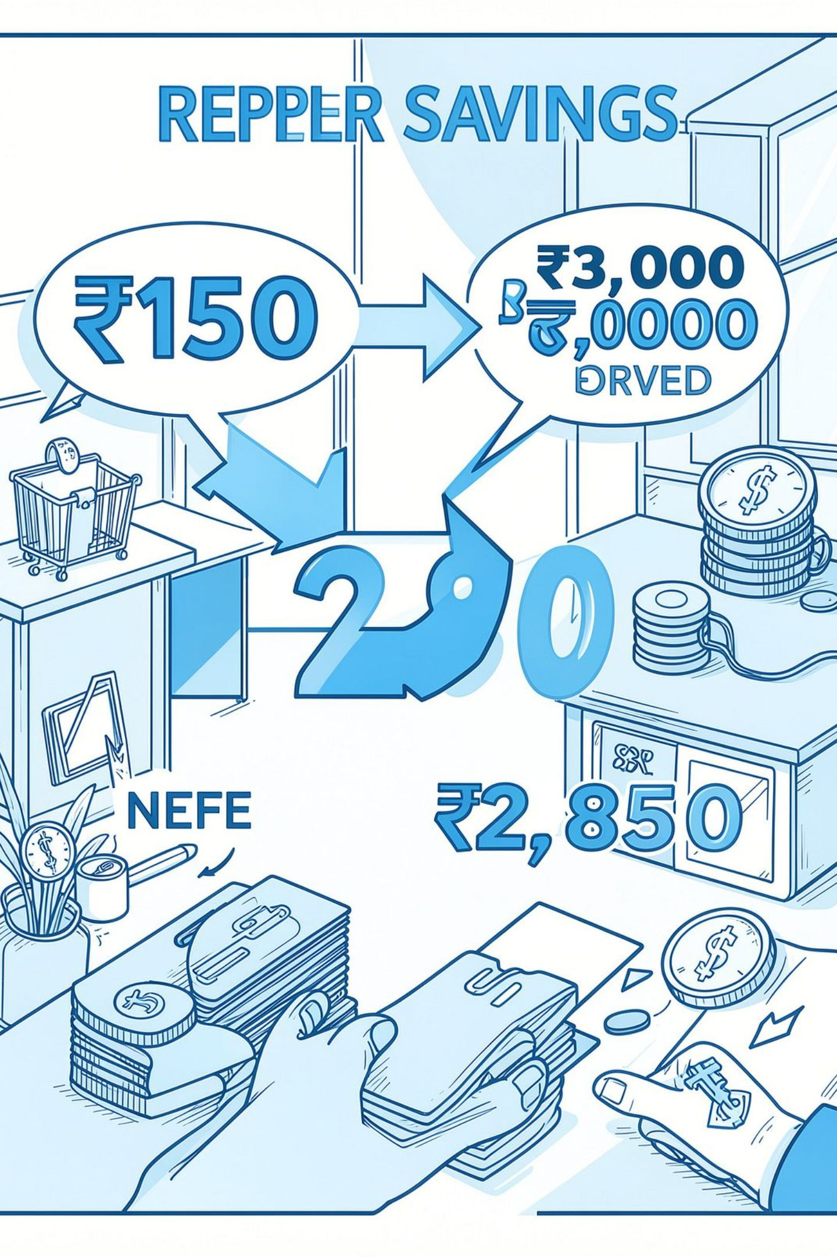
Impact & Conclusion
Spend ₹150 (discount/time) to save a ₹3,000 order — net ₹2,850 saved per rescued order.
The project shifts the business from predicting failures to preventing them.
Thank you — Questions?

