Slide 1


SMART INDIA HACKATHON 2026
TITLE PAGE
Problem Statement ID –SIH26032
Problem Statement Title- Farmers often face long waiting times, lack of information regarding procurement schedules,
and uncertainty about procurement status
Theme-Smart Automation
PS Category- Software
Team ID-
Team Name (Registered on portal)-GreenTech

Slide 2

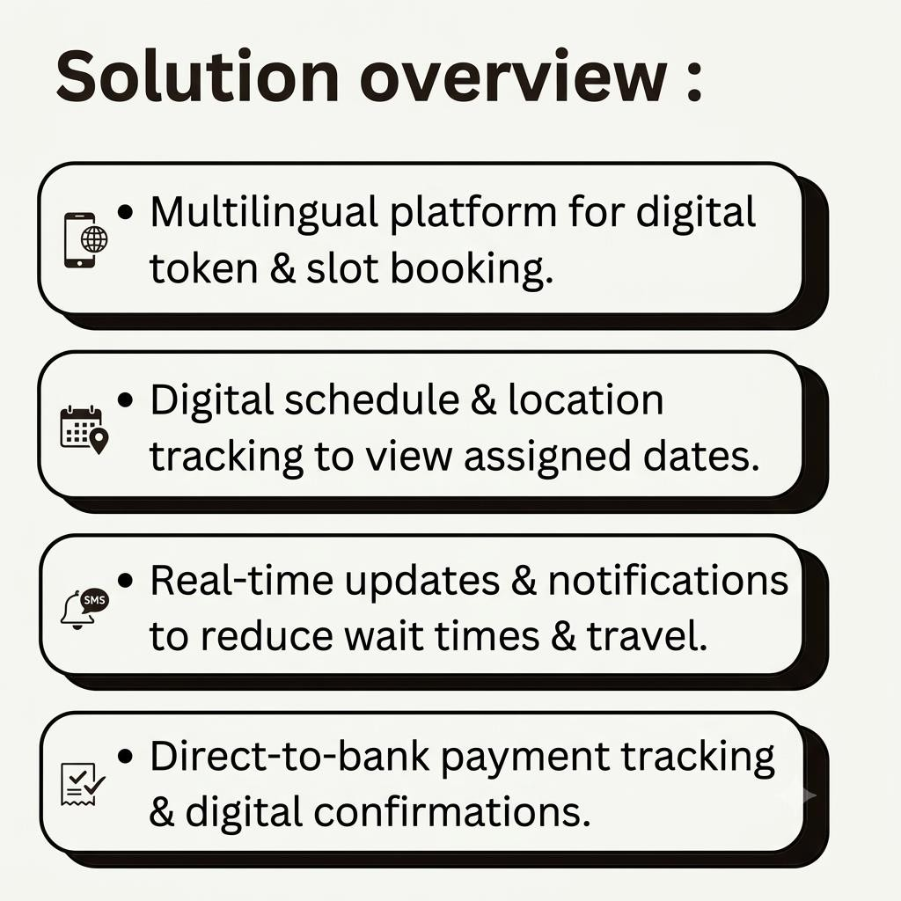
IDEA TITLE
Green
Tech
Proposed Solution
“A multilingual digital platform that simplifies government crop procurement by enabling farmers to book tokens, check schedules, track procurement and payments, and receive real-time updates reducing waiting time, travel, and uncertainty.”
Digital Token & Smart Queue – Reduces waiting and overcrowding.
Real-Time Updates – Centre schedules, capacity & queue status.
End-to-End Tracking – Registration to produce acceptance and payment.
Multilingual Voice/SMS Alerts – Accessible to all farmers.
Official Dashboard – Helps manage capacity and resolve delays.
Transparent System – Farmers can track every stage independently.

Slide 3
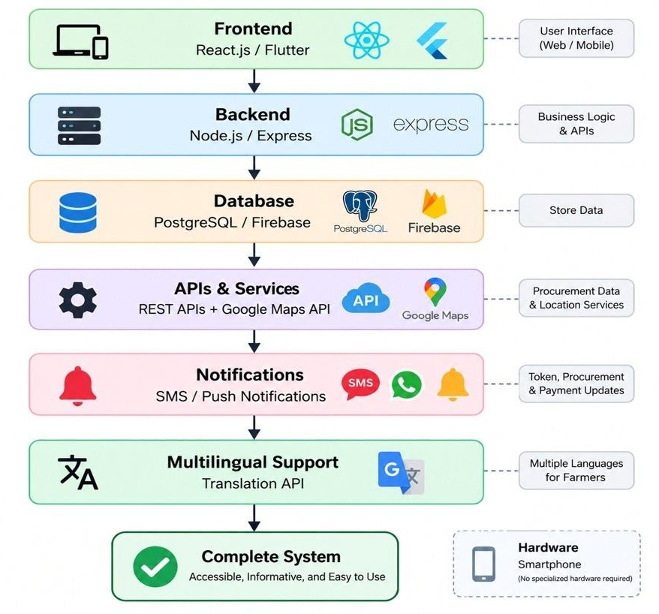
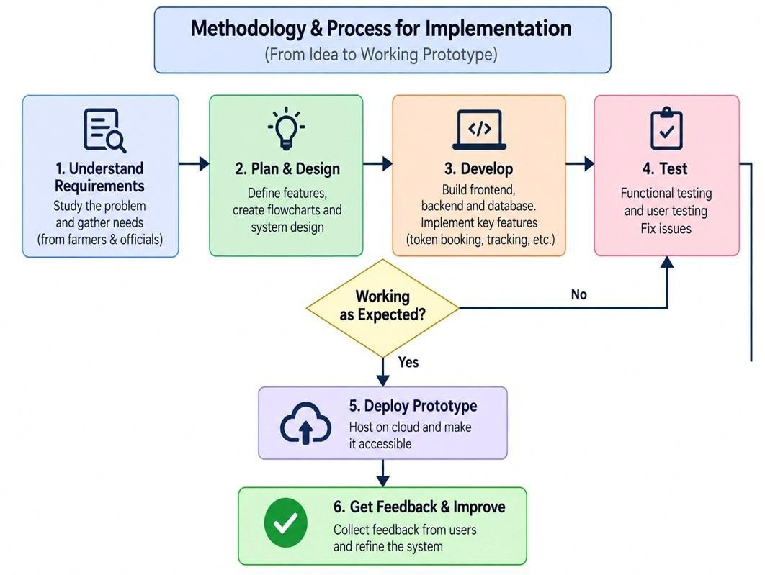
TECHNICAL APPROACH
Green Tech

Slide 4
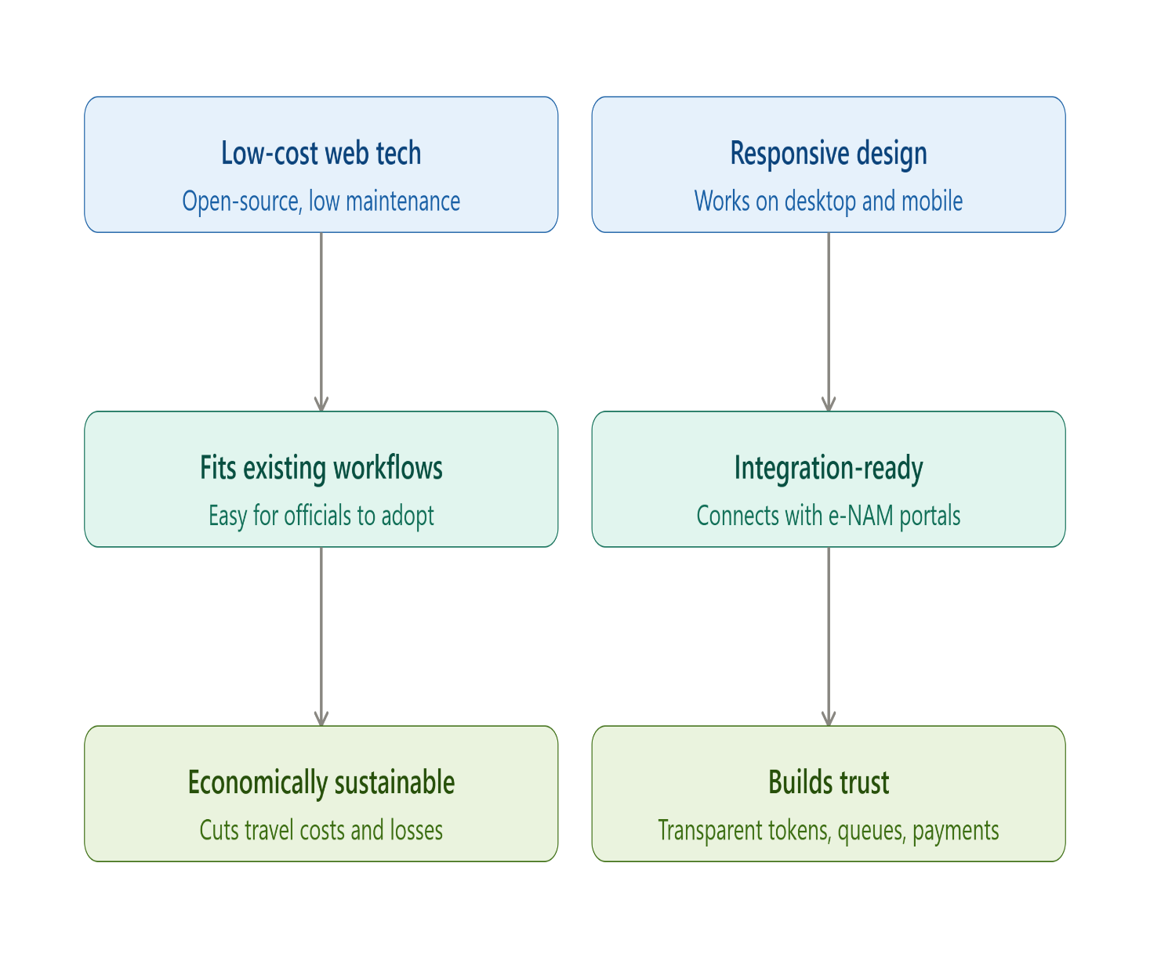
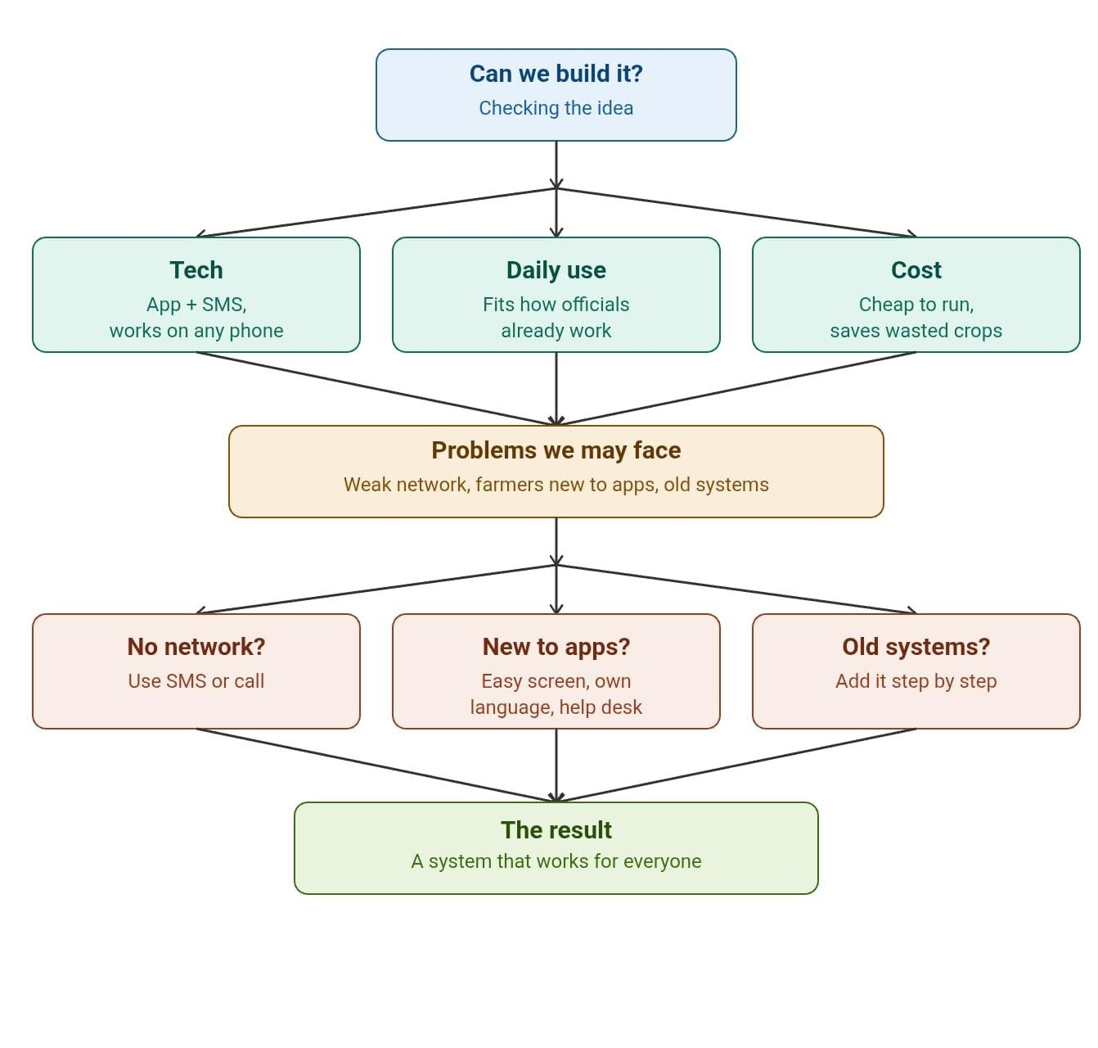
FEASIBILITY AND VIABILITY
Green Tech

Slide 5
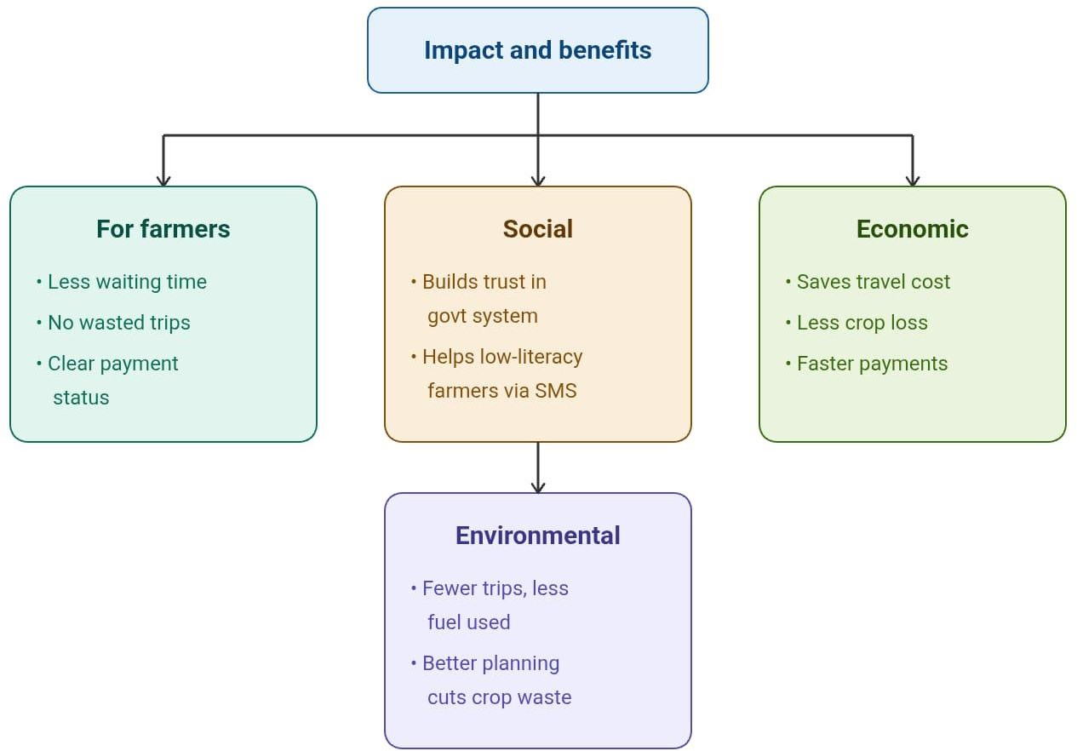
IMPACT AND BENEFITS
Time saved: Farmers spend far less time waiting, thanks to token booking and real-time queue updates.
Reduced travel: Checking schedules and availability beforehand cuts down unnecessary trips to centres.
Transparency: Clear visibility into schedules, tokens, and payments builds farmer trust in the system.
Faster payments: Real-time tracking from registration to payment reduces delays and uncertainty.
Social: Builds trust in government procurement and ensures fair, equal access for all farmers.
Economic: Saves travel costs, reduces crop losses, and speeds up farmer payments.
Environmental: Fewer unnecessary trips mean less fuel use; better planning reduces produce wastage.
Green Tech

Slide 6
RESEARCH AND REFERENCES
Green Tech
Registration for Crop Procurement: Provides online registration schemes for landholding farmers selling crops at minimum support prices. https://www.myscheme.gov.in/schemes/rfcp
Central Foodgrains Procurement Portal: Tracks real-time grain procurement statistics, active center operations, weighing logs, and payment disbursements centrally. https://cfpp.nic.in/
e-Samridhi Platform: Integrates procurement records, inventory lot numbering, and direct benefit transfers through the Public Financial Management System. https://esamridhi.in/
Digital Agriculture Mission 2024: Analyzes digital infrastructure like AgriStack that links farmer IDs with digitized land records to validate yield limits. https://www.impriindia.com/insights/policy-update/digital-agriculture-mission-2024-building-indias-digital-farming-infrastructure/
Wheat Procurement Slot Booking: Details online self-scheduling slot reservation systems that replace SMS alerts to reduce market overcrowding and wait times. https://www.cmv360.com/news/wheat-procurement-msp-now-farmers-require-slot-booking

