Slide 1
C4T Enquiry API
By:
Tushar Kukreti

Slide 2
Introduction
This API is responsible for fetching countries’ data by their name and push each country record to an Azure Service Bus queue.

Slide 3
Technologies & tools used:
.NET 5
C# 9.0
Azure
Visual Studio 2019
Swagger/Postman for API testing

Slide 4
Project Layers:
C4TAssessment.API – The API layer consumed by the enduser.
C4TAssessment.BusinessAbstraction- Contains the business contracts
C4TAssessment.BusinessImplementations – Contains the business logic
C4TAssessment.DI – For registering the external services.
C4TAssessment.Models – Contains the business models
C4TAssessment.Test- Unit testing for the APIs

Slide 5
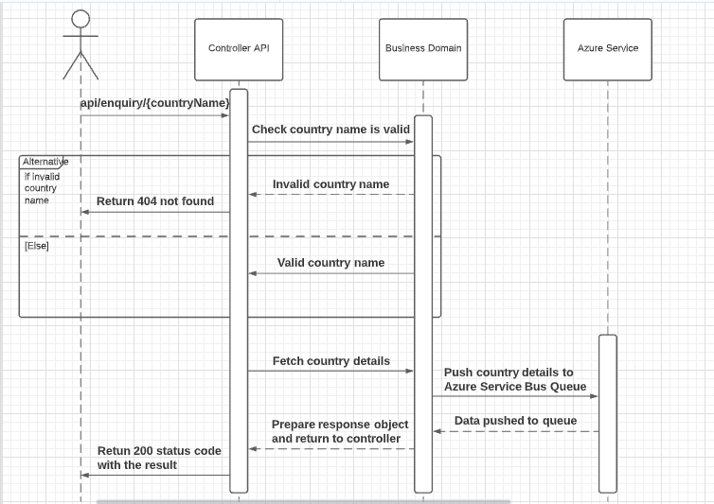
UML Sequence Diagram:

Slide 6
Global level exception handling is implemented in the project.
app.UseExceptionHandler() middleware is used for global exception handling.
If any exception occurs in the code, then 500 Internal Server Error with a complete stack trace will be returned by the API.
Exception Handling

Slide 7
SOLID principles
Each class and project is responsible for performing only one business job.
Dependency Injection is used to make the system loosely coupled.
Project is developed in a way that it is open for extension.
Data abstraction is used in between the API and the business domain.

Slide 8

Some snapshots of the API service.

Slide 9
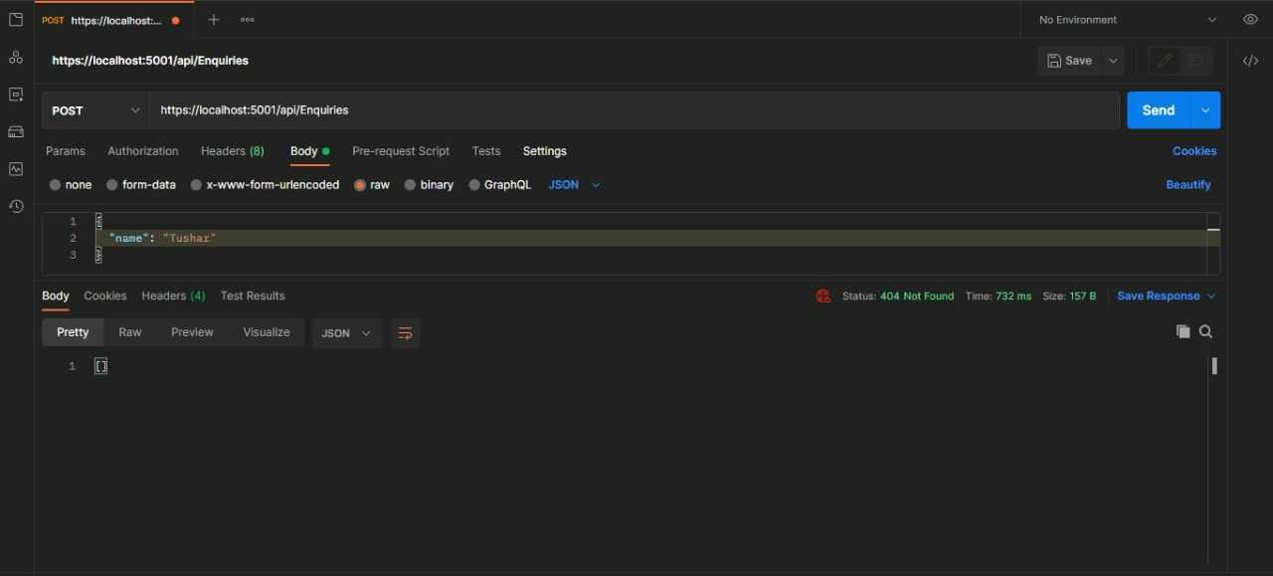
When invalid country name is passed

Slide 10
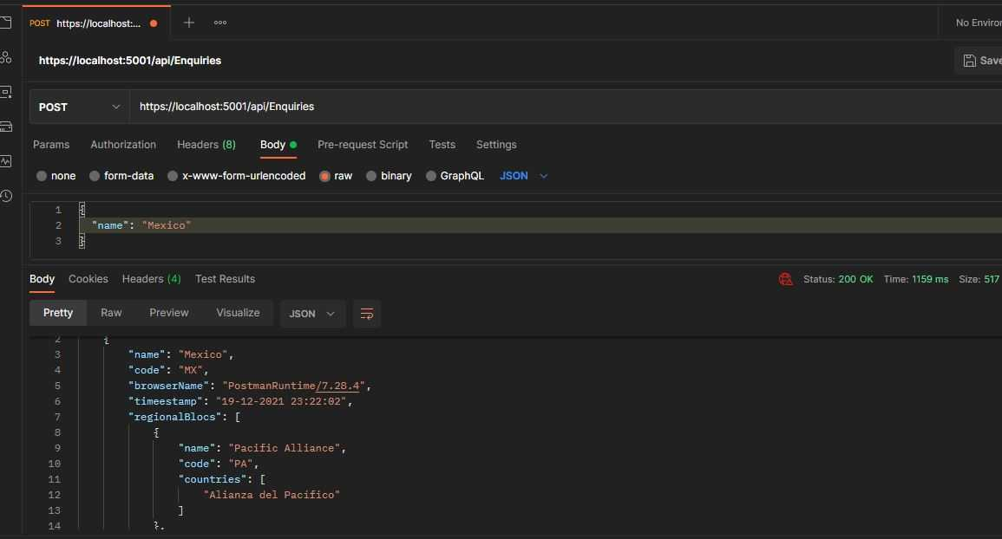
When valid country name is passed

Slide 11
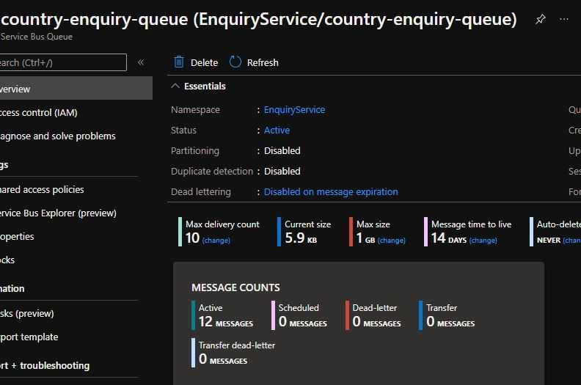
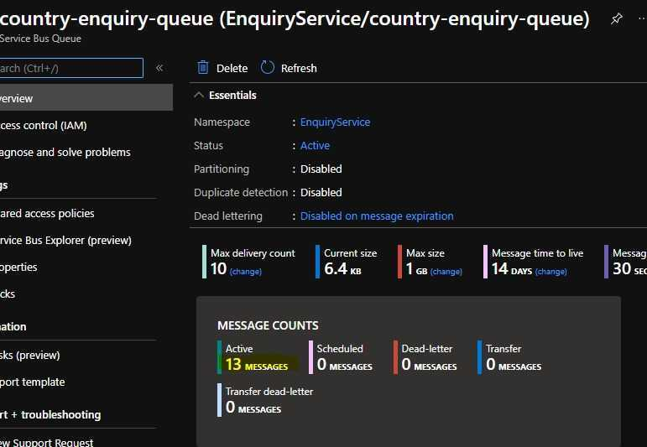
Azure Service Bus Queue
Before making the API call
After making the API call

Slide 12
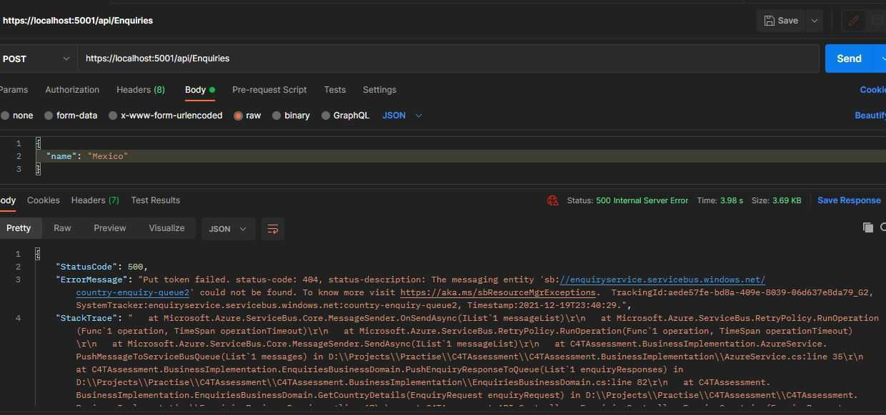
If Queue doesn’t exist in the Azure Server

Slide 13

Thank you

