Slide 1

Q3 technologies
Building Quality Software

Slide 2

Blockchain
Last Mile Delivery

Slide 3
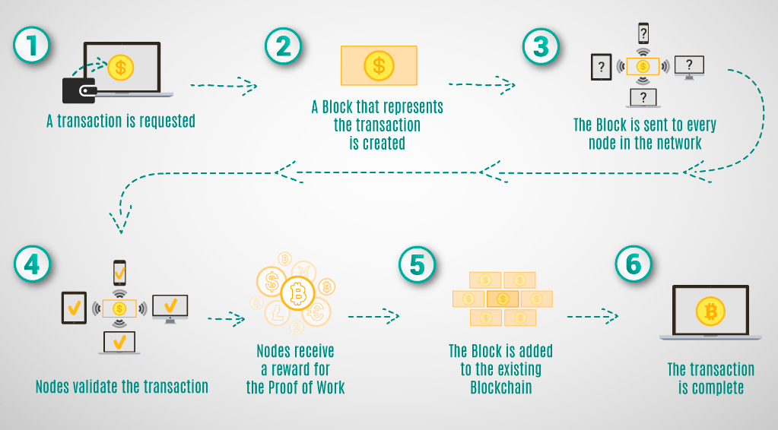
OVERVIEW-BLOCKCHAIN
Blockchain

Slide 4
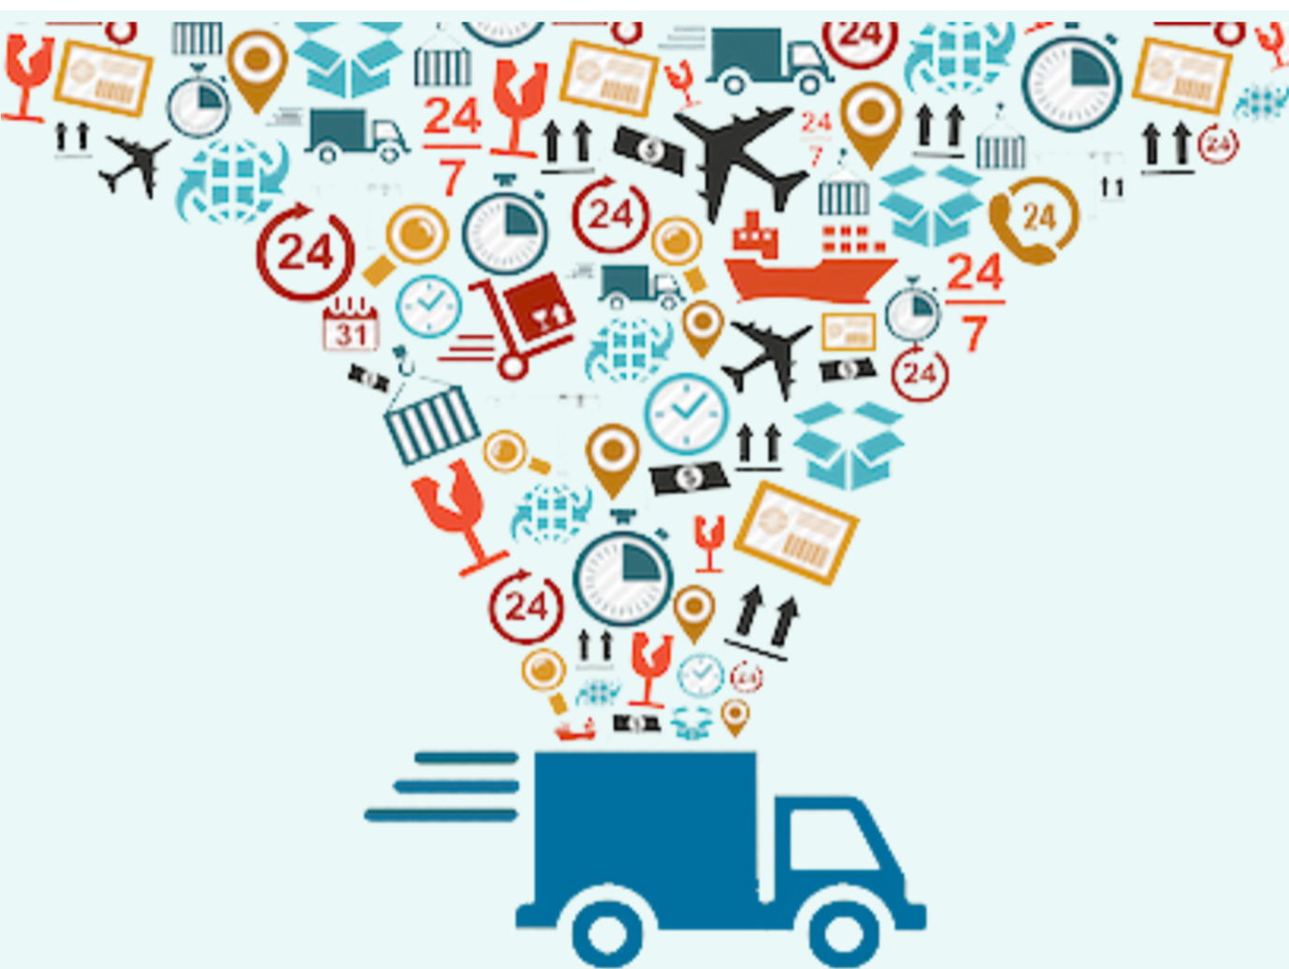
OVERVIEW-LAST MILE DELIVERY
Last mile delivery refers to the movement of goods from the distribution center to the final destination (business or consumer).
The developed POC deals with tracking of shipment from source(Hub) to destination(consumer)
There are 4 basic system components:
Hub
WH
Transporter
Courier

Slide 5
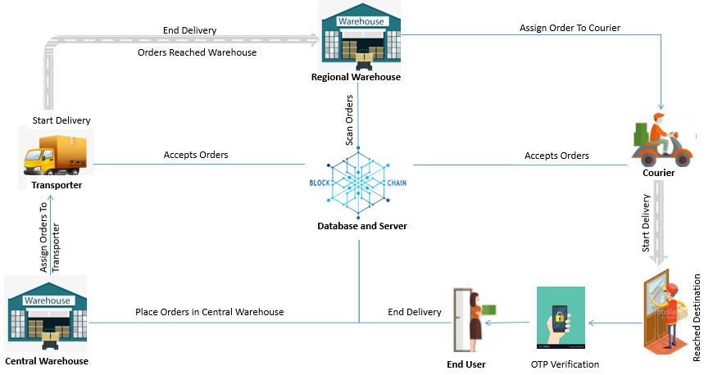
OVERVIEW-LAST MILE DELIVERY
Communication between Hub and Warehouse and between warehouses is taken care of by transporter, while that between warehouse and customer is handled by the courier company.

Slide 6
USER ROLES
Courier
Accepts orders from regional warehouse(s)
Starts delivery for a single order at a time
End delivery with OTP verification
Can only see orders assigned to them
Transporter
Accepts orders for delivery
Start/Ends delivery to regional warehouse(s)
Views orders assigned to them
Warehouse
Scan orders
Assigns orders to transporter/courier
Can only see orders within warehouse
Hub
Can see all orders anytime
Can assign orders to transporter

Slide 7
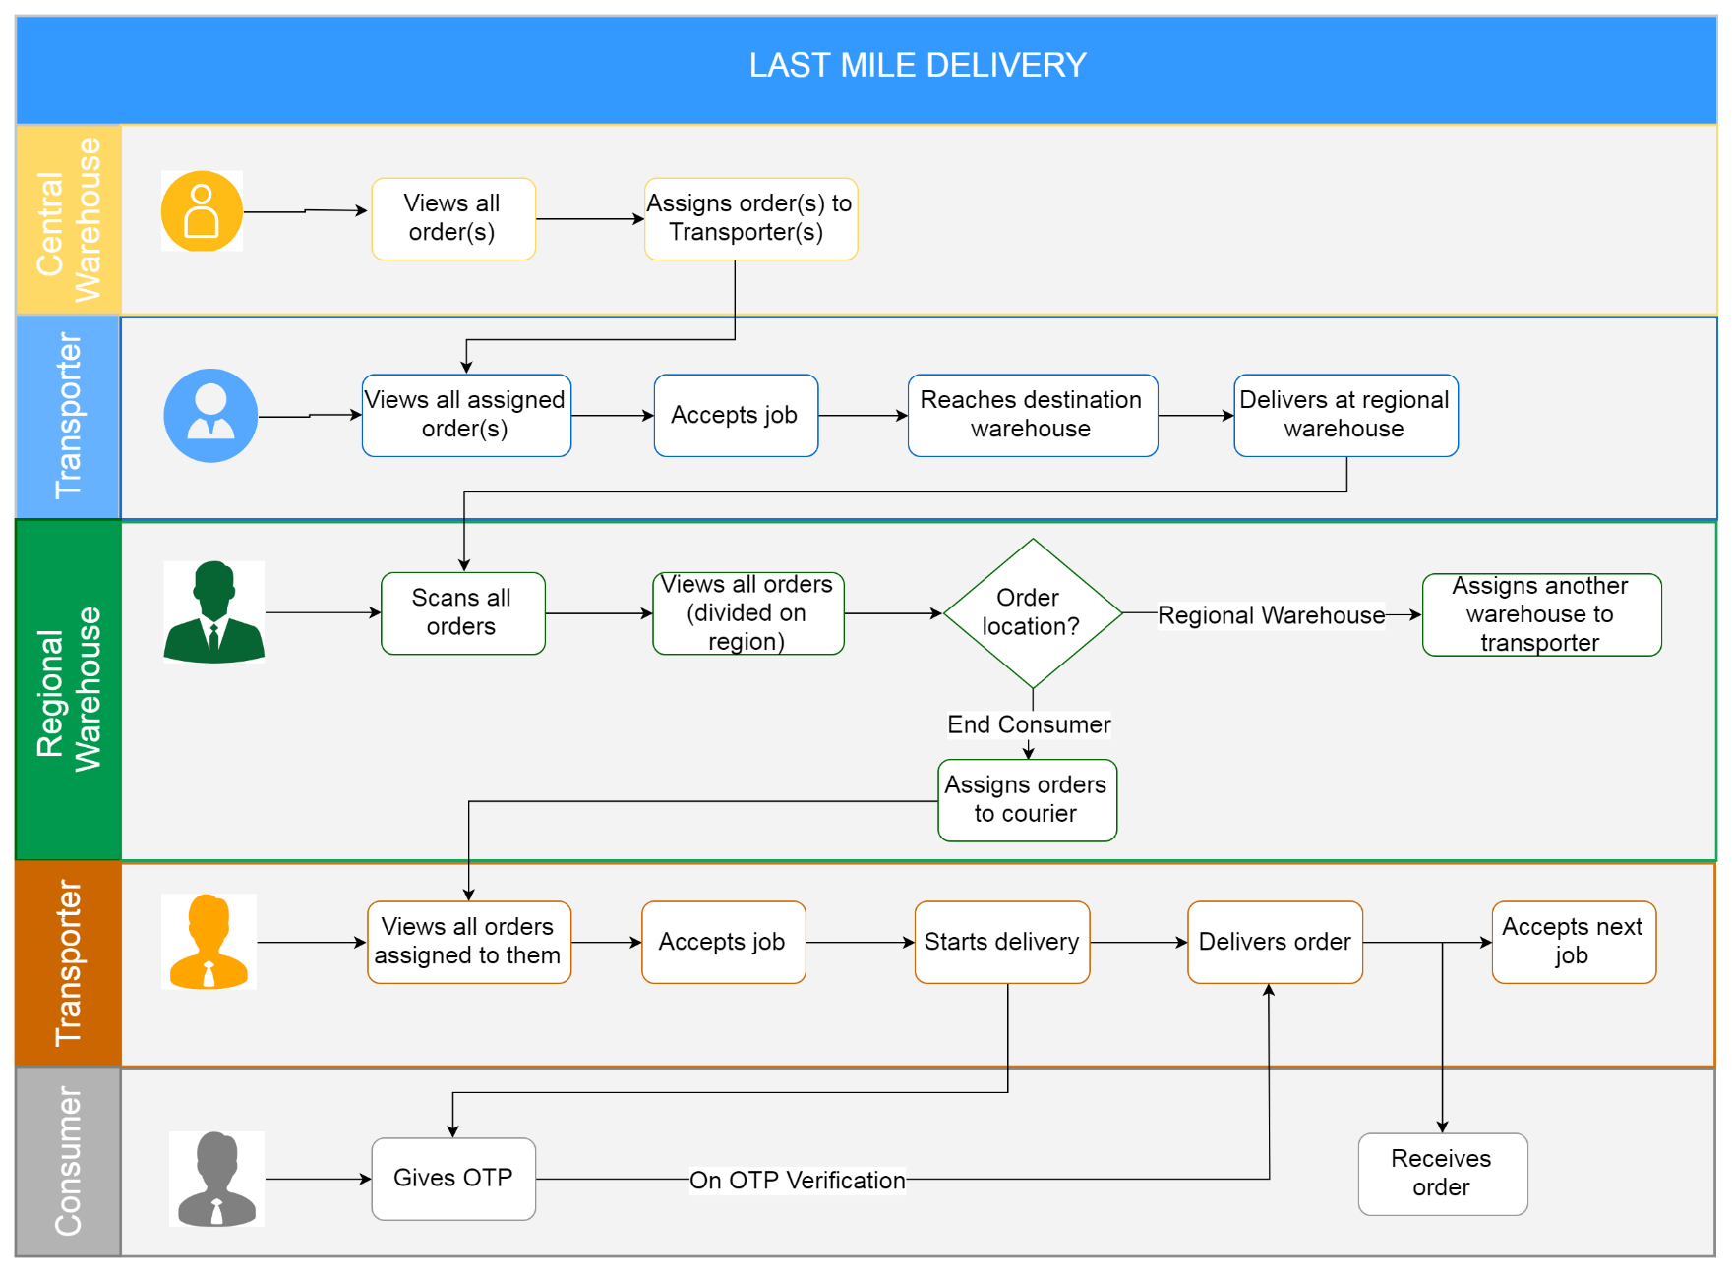
APPLICATION WORKFLOW

Slide 8
POC FEATURES
Last Mile Delivery POC Offerings
Order Management
Freight Tracking
Report Generation
Decentralized (Global Peer) Network
Immutable Record Keeping
Real Time Status Update

Slide 9
HOW BLOCKCHAIN HELPS
Improving Transparency
Smart Contracts
Strengths clear communication between all involved parties
Maintains history of transactions
Ensures compliance of the smart contract using digitized documents and real-time shipment information
Greater Security
Ensures ambiguity free repackaged products
No counterfeit practices; Complete transparency of movement of package
Digital Asset Tracking
Data Mining
Gather information regarding the precise location of the package
Provides evidence of tampering
Blockchain, with the help of innovations in IoT, can be useful for capacity monitoring
Records all documentation throughout the process on a blockchain ledger, such as bills of lading and customs forms.

Slide 10
THANK YOU

