Slide 1

Q3 technologies
Building Quality Software

Slide 2
Last Mile Delivery Application
Problem Statement
The authenticity of the product origin is usually compromised during the transit from the manufacturer to the consumer.
The consumer wishes to track the shipment from source to destination.
Proposed Solution
Using a Blockchain network for tracking the product from origin to end user.
The proposed solution will allow the consumer to check if the product has been received from an authentic hub/manufacturer by scanning the product at every checkpoint.
It will help the consumer to track the shipment status of the product from source to destination.
The following slides shows the product flow in the application network, underlying architecture of the application and describe the API’s used in implementing the solution.

Slide 3
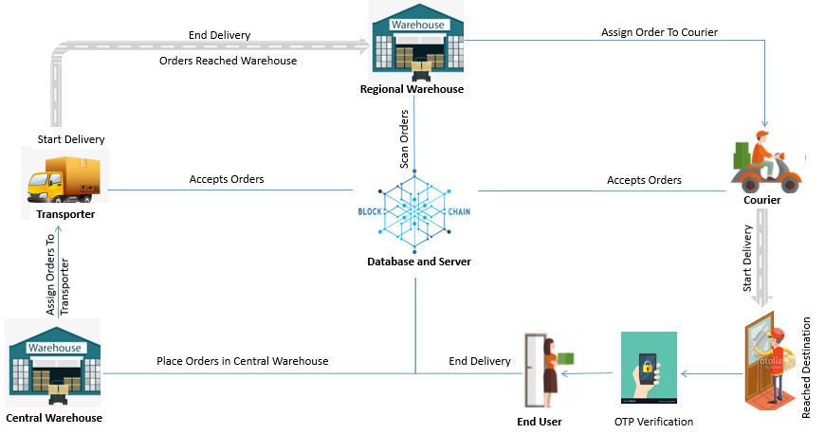
Product Flow In The Application

Slide 4
Last Mile Delivery Application APIs
Warehouse API’s
Get All Orders
Get All Transporter
Assign Orders To Transporter / Courier
Scan QR code of Order
Transporter API’s
Get All Orders with a Transporter
Get Warehouse Details Transporter is going
Accept Orders
Start Delivery
Deliver orders at Warehouse
Courier API’s
Accept Orders For Courier
Start Delivery For Courier
Deliver Order to End Customer with OTP verification
Order API’s
Get Order History

Slide 5
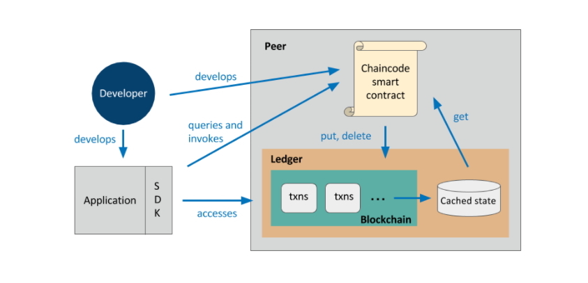
Hyperledger Fabric Architecture
The underlying blockchain technology used in the provided solution is Hyperledger Fabric.
Basic Structure of a Hyperledger Fabric Application
Image source: https://medium.com/coinmonks/hyperledger-fabric-the-most-complete-b5ed0aa6e7b9

Slide 6
Warehouse API’s
Get All Orders
Request Type: Get
Request URL: http://localhost:3001/api/delivery.Order
Response Code: 200

Slide 7
Warehouse API’s
Get All Orders
Response Body: [ { "$class": "delivery.Order",
"holder": "resource:delivery.Warehouse#WarehouseGurgaon",
"orderId": "OrderJaipur1",
"id": 1,
"pincode": "305001",
"buyerRegion": "North",
"buyerState": "Rajasthan",
"orderNo": "ORD000AJ1",
"statusId": 2,
"orderDateTime": 1551353278451,
"orderLocationLat": 28.422572,
"orderLocationLng": 77.000422,
"orderLocationAddress": "38/6, Delhi - Jaipur Expy, Mohammed Pur, Khandsha, Sector 37, Gurugram, Haryana 122004",
"description": "This is a sample order",
"
"qrCodeText": "q6",
"buyerName": "Splash Mobile Shop",
"buyerAddress": "Opp Elite Restaurant, Station Road, Ajmer, Rajasthan 305001",
"shipperName": "Jai Durga Electronics",
"shipperAddress": "",
"sellerCity": "Gurugram, Hariyana",
"buyerCity": "Ajmer",
"sellerAddress": "Khandsa Road, Near HDFC Bank, Vishwakarma Nagar, Sector 10A, Gurugram, Haryana 122018",
"sellerLocationLng": 28.439874,
"sellerLocationLat": 77.00658,
"shippingService": "Standard",
"contactNo": "9876543210",
"currentLocationReached": "North Warehouse"
... }, …]

Slide 8
Warehouse API’s
Get All Transporter
Request Type: Get
Request URL: http://localhost:3001/api/delivery.Transporter
Response Code: 200

Slide 9
Warehouse API’s
Get All Transporter
Response Body:
[ {
"$class": "delivery.Transporter",
"DriverFirstName": "Raj",
"DriverLastName": "Mehta",
"TransporterName": "Balaji Ltd.",
"VehicleNumber": "Vn1234",
"VehicleId": "V123",
"emailId": "trans1@q3.com",
"DeliveryId": "", "orders": [],
"deliveredOrders":[],
"StatusId": 0, "location": "",
"holderId": "GurgaonToJaipur“ },...]

Slide 10
Warehouse API’s
Assign Orders To Transporter / Courier
Request Type: Post
Request URL: http://localhost:3001/api/delivery.AssignTransporter

Slide 11
Warehouse API’s
Assign Orders To Transporter / Courier
Request Body:
{
"$class": "delivery.AssignTransporter",
"currentLatitude": 26.78,
"currentLongitude": 75.89,
"DeliveryId": "DEL01",
"EstimatedTime": 1551425519973,
"historys": [
"resource:delivery.OrderHistory#OrderJaipur1",
"resource:delivery.OrderHistory#OrderJaipur2",
"resource:delivery.OrderHistory#OrderJaipur3",
"resource:delivery.OrderHistory#OrderAjmer1",
"resource:delivery.OrderHistory#OrderAjmer2"
],
"orders": [
"resource:delivery.Order#OrderJaipur1",
"resource:delivery.Order#OrderJaipur2",
"resource:delivery.Order#OrderJaipur3",
"resource:delivery.Order#OrderAjmer1",
"resource:delivery.Order#OrderAjmer2"
],
"ToLocation": "Jaipur Warehouse",
"transporter": "resource:delivery.Transporter#GurgaonToJaipur"
}

Slide 12
Warehouse API’s
Assign Orders To Transporter / Courier
Response Code: 200
Response Body:
{
"$class": "delivery.AssignTransporter",
"DeliveryId": "DEL01",
"transporter": "resource:delivery.Transporter#GurgaonToJaipur",
"EstimatedTime": "1551425519973",
"ToLocation": "Jaipur Warehouse",
"currentLongitude": 75.89,
"currentLatitude": 26.78,
"orders": [
"resource:delivery.Order#OrderJaipur1",
"resource:delivery.Order#OrderJaipur2",
"resource:delivery.Order#OrderJaipur3",
"resource:delivery.Order#OrderAjmer1",
"resource:delivery.Order#OrderAjmer2" ],
"historys": [
"resource:delivery.OrderHistory#OrderJaipur1",
"resource:delivery.OrderHistory#OrderJaipur2",
"resource:delivery.OrderHistory#OrderJaipur3",
"resource:delivery.OrderHistory#OrderAjmer1",
"resource:delivery.OrderHistory#OrderAjmer2"
],
"transactionId": "c1a98dcb8e6f2f32fa69d7fc35a4a0fbe5a92973915ecbe13442b9b22a6da8a1"
}

Slide 13
Warehouse API’s
Scan QR code of Order
Request Type: Post
Request URL: http://localhost:3001/api/delivery.ScanProductsInWarehouse

Slide 14
Warehouse API’s
Scan QR code of Order
Request Body:
{
"$class": "delivery.ScanProductsInWarehouse",
"currentLongitude": 75.89,
"currentLatitude": 26.78,
"warehouse": "resource:delivery.Warehouse#WarehouseJaipur",
"orders": [
"resource:delivery.Order#OrderAjmer1",
"resource:delivery.Order#OrderAjmer2",
"resource:delivery.Order#OrderJaipur1",
"resource:delivery.Order#OrderJaipur2",
"resource:delivery.Order#OrderJaipur3"
],
"historys": [
"resource:delivery.OrderHistory#OrderAjmer1",
"resource:delivery.OrderHistory#OrderAjmer2",
"resource:delivery.OrderHistory#OrderJaipur1",
"resource:delivery.OrderHistory#OrderJaipur2",
"resource:delivery.OrderHistory#OrderJaipur3"
]
}

Slide 15
Warehouse API’s
Scan QR code of Order
Response Code: 200
Response Body:
{
"$class": "delivery.ScanProductsInWarehouse",
"currentLongitude": 75.89,
"currentLatitude": 26.78,
"warehouse": "resource:delivery.Warehouse#WarehouseJaipur",
"orders": [
"resource:delivery.Order#OrderAjmer1",
"resource:delivery.Order#OrderAjmer2",
"resource:delivery.Order#OrderJaipur1",
"resource:delivery.Order#OrderJaipur2",
"resource:delivery.Order#OrderJaipur3"
],
"historys": [
"resource:delivery.OrderHistory#OrderAjmer1",
"resource:delivery.OrderHistory#OrderAjmer2",
"resource:delivery.OrderHistory#OrderJaipur1",
"resource:delivery.OrderHistory#OrderJaipur2",
"resource:delivery.OrderHistory#OrderJaipur3"
],
"transactionId": "abd4d6fb154d78c13f4285984b8e79c2007b967882213c9c06837b8e97140d28"
}

Slide 16
Transporter API’s
Get All Orders with a Transporter
Request Type: Get
Request URL: http://localhost:3001/api/queries/viewOrderswithHolder?holder=resource%3Adelivery.Transporter%23GurgaonToJaipur
Response Code: 200

Slide 17
Transporter API’s
Get All Orders with a Transporter
Response Body:
[ { "$class": "delivery.Order",
"holder": "resource:delivery.Transporter#GurgaonToJaipur",
"orderId": "OrderJaipur1",
"id": 1,
"pincode": "305001",
"buyerRegion": "North",
"buyerState": "Rajasthan",
"orderNo": "ORD000AJ1",
"statusId": 2,
"orderDateTime": 1551353278451,
"orderLocationLat": 28.422572,
"orderLocationLng": 77.000422,
"orderLocationAddress": "38/6, Delhi - Jaipur Expy, Mohammed Pur, Khandsha, Sector 37, Gurugram, Haryana 122004",
"description": "This is a sample order",
"qrCodeText": "q6",
"buyerName": "Splash Mobile Shop",
"buyerAddress": "Opp Elite Restaurant, Station Road, Ajmer, Rajasthan 305001",
"shipperName": "Jai Durga Electronics",
"shipperAddress": "",
"sellerCity": "Gurugram, Hariyana",
"buyerCity": "Ajmer",
"sellerAddress": "Khandsa Road, Near HDFC Bank, Vishwakarma Nagar, Sector 10A, Gurugram, Haryana 122018",
"sellerLocationLng": 28.439874,
"sellerLocationLat": 77.00658,
"shippingService": "Standard",
"contactNo": "9876543210",
"currentLocationReached": "GurgaonToJaipur"
… },…]

Slide 18
Transporter API’s
Get Warehouse Details Transporter is going
Request Type: Get
Request URL: http://localhost:3001/api/queries/getWarehouseDetailsForTransporter?transporter=GurgaonToJaipur
Response Code: 200

Slide 19
Transporter API’s
Get Warehouse Details Transporter is going
Response Body:
[ {
"$class": "delivery.WarehouseForTransporter",
"EstimatedTimeForDelivery": "1551425519973",
"TransporterName": "GurgaonToJaipur",
"id": 3,
"userId": 6,
"name": "Rajasthan Warehouse",
"address": "Bhawani Singh Road, Jaipur, Rajasthan 302001",
"latitude": 26.901152,
"longitude": 75.795674,
"number": "9876543210",
"holderId": "WarehouseJaipur"
}]

Slide 20
Transporter API’s
Accept Orders
Request Type: Post
Request URL: http://localhost:3001/api/delivery.AcceptOrder
Request Body:
{
"$class": "delivery.AcceptOrder",
"currentLongitude": 75.89,
"currentLatitude": 26.78,
"transporter": "resource:delivery.Transporter#GurgaonToJaipur",
"historys": [
"resource:delivery.OrderHistory#OrderAjmer1",
"resource:delivery.OrderHistory#OrderAjmer2",
"resource:delivery.OrderHistory#OrderJaipur1",
"resource:delivery.OrderHistory#OrderJaipur2",
"resource:delivery.OrderHistory#OrderJaipur3"
]
}

Slide 21
Transporter API’s
Accept Orders
Response Code: 200 Response Body:
{
"$class": "delivery.AcceptOrder",
"currentLongitude": 75.89,
"currentLatitude": 26.78,
"transporter": "resource:delivery.Transporter#GurgaonToJaipur",
"historys": [
"resource:delivery.OrderHistory#OrderAjmer1",
"resource:delivery.OrderHistory#OrderAjmer2",
"resource:delivery.OrderHistory#OrderJaipur1",
"resource:delivery.OrderHistory#OrderJaipur2",
"resource:delivery.OrderHistory#OrderJaipur3"
],
"transactionId": "9c43019f3d9970c6c7ace2e234e0ed4a1300049c2ddcf90fd6ce1c35a7acfff2"
}

Slide 22
Transporter API’s
Start Delivery For Transporter
Request Type: Post
Request URL: http://localhost:3001/api/delivery.StartDeliveryTransporter
Request Body:
{
"$class": "delivery.StartDeliveryTransporter",
"currentLongitude": 75.89,
"currentLatitude": 26.78,
"transporter": "resource:delivery.Transporter#GurgaonToJaipur",
"historys": [
"resource:delivery.OrderHistory#OrderAjmer1",
"resource:delivery.OrderHistory#OrderAjmer2",
"resource:delivery.OrderHistory#OrderJaipur1",
"resource:delivery.OrderHistory#OrderJaipur2",
"resource:delivery.OrderHistory#OrderJaipur3"
]
}

Slide 23
Transporter API’s
Start Delivery For Transporter
Response Code: 200 Response Body:
{
"$class": "delivery.StartDeliveryTransporter",
"currentLongitude": 75.89,
"currentLatitude": 26.78,
"transporter": "resource:delivery.Transporter#GurgaonToJaipur",
"historys": [
"resource:delivery.OrderHistory#OrderAjmer1",
"resource:delivery.OrderHistory#OrderAjmer2",
"resource:delivery.OrderHistory#OrderJaipur1",
"resource:delivery.OrderHistory#OrderJaipur2",
"resource:delivery.OrderHistory#OrderJaipur3"
],
"transactionId": "971facab220196faae1b2617ffa061a0793f00ff00345eb3721ccc895bfbd6d1
}

Slide 24
Transporter API’s
Deliver Orders at Warehouse
Request Type: Post
Request URL: http://localhost:3001/api/delivery.DeliverOrder
Request Body:
{
"$class": "delivery.DeliverOrder",
"currentLongitude": 75.8268,
"currentLatitude": 26.8938,
"transporter": "resource:delivery.Transporter#GurgaonToJaipur",
"productHolder": "resource:delivery.Warehouse#WarehouseJaipur",
"historys": [
"resource:delivery.OrderHistory#OrderAjmer1",
"resource:delivery.OrderHistory#OrderAjmer2",
"resource:delivery.OrderHistory#OrderJaipur1",
"resource:delivery.OrderHistory#OrderJaipur2",
"resource:delivery.OrderHistory#OrderJaipur3"
] }

Slide 25
Transporter API’s
Deliver Orders at Warehouse
Response Code: 200 Response Body:
{
"$class": "delivery.DeliverOrder",
"currentLongitude": 75.8268,
"currentLatitude": 26.8938,
"transporter": "resource:delivery.Transporter#GurgaonToJaipur",
"productHolder": "resource:delivery.Warehouse#WarehouseJaipur",
"historys": [
"resource:delivery.OrderHistory#OrderAjmer1",
"resource:delivery.OrderHistory#OrderAjmer2",
"resource:delivery.OrderHistory#OrderJaipur1",
"resource:delivery.OrderHistory#OrderJaipur2",
"resource:delivery.OrderHistory#OrderJaipur3"
],
"transactionId": "12dd514d5ed2b79461bfa182f7ab2be756d25b8349e1f06d510646dcea7121ec" }

Slide 26
Courier API’s
Accept Orders
Request Type: Post
Request URL: http://localhost:3001/api/delivery.AcceptOrder
Request Body:
{
"$class": "delivery.AcceptOrder",
"currentLongitude": 75.89,
"currentLatitude": 26.78,
"transporter": "resource:delivery.Transporter#JaipurToCustomer",
"historys": [
"resource:delivery.OrderHistory#OrderJaipur1",
"resource:delivery.OrderHistory#OrderJaipur2",
"resource:delivery.OrderHistory#OrderJaipur3"
]
}

Slide 27
Courier API’s
Accept Orders
Response Code: 200 Response Body:
{
"$class": "delivery.AcceptOrder",
"currentLongitude": 75.89,
"currentLatitude": 26.78,
"transporter": "resource:delivery.Transporter#JaipurToCustomer",
"historys": [
"resource:delivery.OrderHistory#OrderJaipur1",
"resource:delivery.OrderHistory#OrderJaipur2",
"resource:delivery.OrderHistory#OrderJaipur3"
],
"transactionId": "9c43019f3d9970c6c7ace2e234e0ed4a1300049c2ddcf90fd6ce1c35a7acfff2"
}

Slide 28
Courier API’s
Start Delivery For Courier
Request Type: Post
Request URL: http://localhost:3001/api/delivery.StartDeliveryTransporter
Request Body:
{
"$class": "delivery.StartDeliveryTransporter",
"currentLongitude": 75.89,
"currentLatitude": 26.78,
"transporter": "resource:delivery.Transporter#JaipurToCustomer",
"historys": [
"resource:delivery.OrderHistory#OrderJaipur1"
]
}

Slide 29
Courier API’s
Start Delivery For Courier
Response Code: 200 Response Body:
{
"$class": "delivery.StartDeliveryTransporter",
"currentLongitude": 75.89,
"currentLatitude": 26.78,
"transporter": "resource:delivery.Transporter#JaipurToCustomer",
"historys": [
"resource:delivery.OrderHistory#OrderJaipur1"
],
"transactionId": "971facab220196faae1b2617ffa061a0793f00ff00345eb3721ccc895bfbd6d1
}

Slide 30
Courier API’s
Deliver Order to End Customer with OTP verification
Request Type: Post Request URL: http://localhost:3001/api/delivery.DeliverToCustomer Request Body:
{
"$class": "delivery.DeliverToCustomer",
"OTP": "1111",
"currentLongitude": 75.8268,
"currentLatitude": 26.8938,
"courier": "resource:delivery.Transporter#JaipurToCustomer",
"order": "resource:delivery.Order#OrderJaipur1"
}

Slide 31
Courier API’s
Deliver Order to End Customer with OTP verification
Response when incorrect OTP given
Response Code: 500
Response Body:
{
"error": {
"statusCode": 500,
"name": "Error",
"message": "Error trying invoke business network. Error: No valid responses from any peers.\nResponse from attempted peer comms was an error: Error: chaincode error (status: 500, message: wrong OTP, please try again)\n",
"stack": "Error: Error trying invoke business network. Error: No valid responses from any peers.\nResponse from attempted peer comms was an error: Error: chaincode error (status: 500, message: wrong OTP, please try again)\n\n at _initializeChannel.then.then.then.then.catch (/home/q3/.nvm/versions/node/v8.12.0/lib/node_modules/composer-rest-server/node_modules/composer-connector-hlfv1/lib/hlfconnection.js:916:34)\n at <anonymous>"
} }

Slide 32
Courier API’s
Deliver Order to End Customer with OTP verification
Response when correct OTP given
Response Code: 200
Response Body:
{
"$class": "delivery.DeliverToCustomer",
"OTP": "1111",
"currentLongitude": 75.8268,
"currentLatitude": 26.8938,
"courier": "resource:delivery.Transporter#JaipurToCustomer",
"order": "resource:delivery.Order#OrderJaipur1",
"transactionId": "11b006b496a4a44102e3c297df37bda32edc7c3cf77fa3f0cbc9be3458d8e40a"
}

Slide 33
Order API’s
Get Order History
Request Type: Get
Request URL: http://localhost:3001/api/queries/getOrderHistory?orderId=OrderJaipur1
Response Code: 200

Slide 34
Order API’s
Get Order History
Response Body:
[
“historyId”: ”OrderJaipur1”
{
"$class": "delivery.OrderHistory",
"history": [
{
"$class": "delivery.HistoryFields",
"description": "Order placed and packed",
"location": "North Warehouse",
"datetime": 1552545907337,
"level": 1,
"isCurrentStatus": false
},
{
"$class": "delivery.HistoryFields",
"description": "Order assigned to transporter GurgaonToJaipur",
"location": "GurgaonToJaipur",
"currentLongitude": 75.8268,
"currentLatitude": 26.8938,
"datetime": 1552546074436,
"level": 2,
"isCurrentStatus": false
},
…
]

Slide 35
THANK YOU

