Slide 1
Roxie Review Insights Report
DAIMYO
09 Sep - 15 Sep 2024
Total Reviews | 68
Average Rating | 4.74
Historic Average | 4.62

Slide 2
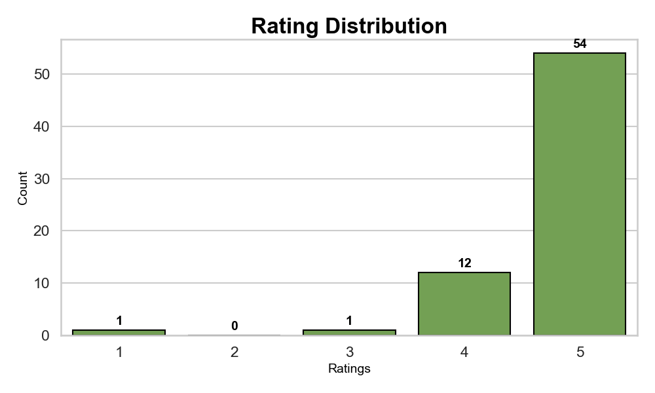
Review Breakdown
DAIMYO
Total Reviews | 68
Average Customer Rating | 4.74
Food Rating | 4.63
Service Rating | 4.80
Atmosphere Rating | 4.88
Rating Distribution Insights for Roxie: 1. 5 stars is the most common rating (54 of 68 reviews). 2. High ratings (4-5 stars): 97.1% of all reviews. 3. Low ratings (1-2 stars): 1.5% of all reviews.

Slide 3
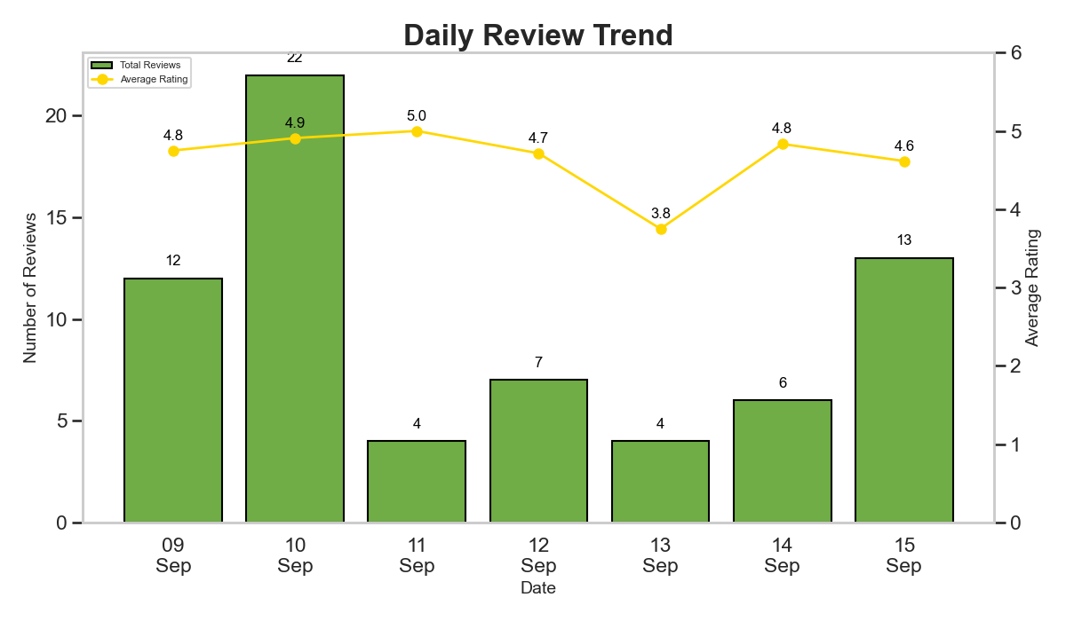
Reviews Trend
DAIMYO
Daily Review Trend Insights for Roxie: 1. The highest number of reviews (22) occurred on 10 Sep, with an average rating of 4.9 stars. 2. The lowest number of reviews (4) occurred on 11 Sep, with an average rating of 5.0 stars. 3. Overall, the daily average ratings fluctuated, reaching a low of 3.8 stars and peaking at 5.0 stars.

Slide 4
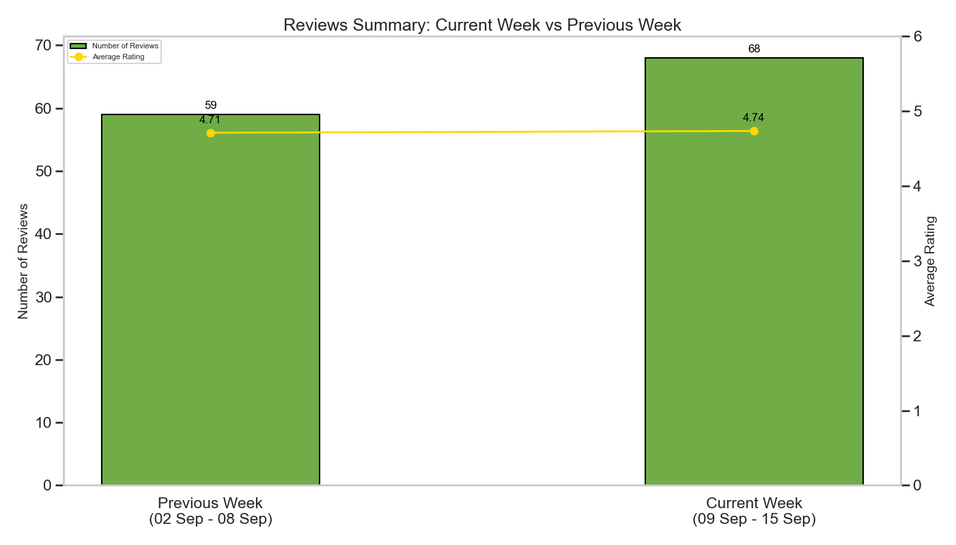
Weekly Comparison
DAIMYO
Weekly Comparison Trend Insights for Roxie: 1. Number of reviews increased from 59 to 68. 2. Average rating increased from 4.71 to 4.74. 3. Both the number of reviews and the average rating increased, indicating improved customer satisfaction.

Slide 5
Positive Reviews Sentiment Analysis
DAIMYO
Positive Reviews Summary: Roxie Place is a fantastic restaurant with a stunning ambiance, live music, and excellent food. The food and drinks are top-notch, offering a great selection of delicious dishes and creative cocktails. The service and staff are also excellent, providing a warm and friendly atmosphere. Overall, Roxie is an amazing venue with a unique vibe, live music, and excellent food, making it a must-visit spot for a fun evening in Sarjapur.

Slide 6
Negative Reviews Sentiment Analysis
DAIMYO
Negative Reviews Summary: The dining experience at this establishment is great, with a great ambience and delicious food. However, the service is subpar, with wait times for beer service that can be up to 30 minutes. The Lotus Biscoff Cheesecake is a bit denser than desired, but the Tiramisu is good. Overall, the pizzas are a must try, but be aware of the long wait times for service.

Slide 7
THANK YOU!
Crafted with care by Daimyo
DAIMYO

