Slide 1
B.TECH INTERNSHIP PROJECT • FULL-STACK & AI SYSTEMS
AI-Powered Enterprise IT Asset Management
& Predictive Hardware Diagnostics
Proactive Hardware Health Recalibration, Multilingual LLM Assistant & Automated Enterprise Lifecycle System
Presented by: Tushar Mahapatra
Tech Stack: Node.js • Express • Google Gemini 1.5 Flash • Chart.js • Tesseract OCR • Nodemailer
Live Demo: Deployed on Vercel Serverless

Slide 2
ENTERPRISE IT ASSET MANAGEMENT
1. Problem: Challenges in Contemporary IT Hardware Tracking
[PAIN POINT 1] Fragmented Record-Keeping
• Spreadsheet Chaos: Critical enterprise hardware tracked across disconnected Excel/Google Sheets.
• Data Inconsistencies: Duplicate serial numbers, missing employee assignments, and untracked peripherals.
• Ghost Assets: Laptops and servers remain on books even after disposal or unrecovered offboarding.
• Manual Overhead: IT admins spend up to 45 mins manually cataloging every new batch of devices.
[PAIN POINT 2] Catastrophic Failures
• Purely Reactive IT: Zero advance warning before critical SSD, motherboard, or battery breakdown occurs.
• Employee Work Disruption: Sudden device failure stalls developer/executive productivity for 3–5 days.
• Rush Procurement: Forced emergency replacements at premium retail prices with no repair triage.
• Zero RUL Visibility: No scientific Remaining Useful Life (RUL) metrics computed for aging hardware.
[PAIN POINT 3] Manual Ingestion & Triage
• Tedious Paper Ingestion: Manual typing of complex tax invoices, vendors, warranty terms, and MAC addresses.
• Inconsistent Damage Triage: Technicians lack standardized root-cause diagnostic guides for physical incidents.
• Financial Leakage: Missed OEM warranty claims and inaccurate depreciation book valuation.
• No Audit Trail: Absence of timestamped email/SMS acknowledgments for allocated hardware.

Slide 3
ENTERPRISE IT ASSET MANAGEMENT
2. Why the Problem Matters: Impact on Cost, Security & Ops
[CAPITAL DRAIN] Severe Financial Leakage
• Ghost Asset Carrying Cost: Enterprises pay 15–20% excess in software licenses & support on lost/untracked hardware.
• Expired Warranty Losses: Organizations pay full out-of-pocket OEM repair bills due to missed 30-day warranty expiry windows.
• Inaccurate Balance Sheets: Without automated Double-Declining depreciation, tax reporting and asset write-offs are flawed.
[OPERATIONAL RISK] Unplanned Downtime & Productivity Loss
• High Developer Idle Time: Engineers lose 20+ billable hours waiting for replacement machine provisioning.
• Client Deliverable Delays: Critical hardware failures during sprints trigger missed SLAs and customer dissatisfaction.
• IT Helpdesk Burnout: Technicians are overwhelmed by firefighting emergency hardware tickets instead of strategic work.
[SAFETY & COMPLIANCE] Safety Hazards & Hardware Risks
• Lithium Battery Swelling: Unmonitored laptop batteries expand, posing thermal runaway, fire, and chassis cracking hazards.
• Motherboard Short Circuits: Unreported minor fluid ingress corrodes PMIC circuitry, turning fixable units into total write-offs.
• Thermal Throttling: Degraded thermal paste causes severe CPU degradation and hardware life halving.
[LEGAL & SECURITY] Corporate Compliance & Audit Failures
• Audit Discrepancies: Failure to produce complete asset custodial logs during ISO/SOC2 enterprise audits.
• Data Leakage Risk: Unrecovered laptops during employee resignation leave corporate IP and customer data vulnerable.
• Lack of Proof of Delivery: Disputes between staff and HR regarding device receipt without timestamped notification logs.

Slide 4
ENTERPRISE IT ASSET MANAGEMENT
3. Proposed Solution: The Intelligent Asset Management Platform
[PREDICTIVE CORE] 1. Proactive Predictive AI
• Multi-Factor Health Modeling: Dynamic 0–100% health score continuously computed based on age, category stress, and warranty.
• Remaining Useful Life (RUL): Accurate algorithmic forecasting of operational months remaining before EOL.
• Failure Probability %: Categorizes assets into Low, Moderate, High, and Critical risk tiers.
• Actionable Directives: Automated alerts for thermal repasting, battery recalibration, and preventive service.
[SMART DIAGNOSTICS] 2. Incident Triage & Damage AI
• Interactive Damage Reporting: Standardized incident intake across Display, Power, Chassis, Ports, Fluid, and Storage.
• Real-Time Recalibration: Instant comparison of Prior vs. Post-Incident health scores (e.g. 85% -> 52%).
• Root Cause Mechanism: AI identifies internal failure mechanisms (e.g., solder micro-fracture, PMIC overvoltage).
• Safety & Cost Estimation: Identifies fire hazards and estimates OEM repair expenses in Indian Rupees (₹ INR).
[AUTOMATION SUITE] 3. Zero-Friction Enterprise Ops
• Invoice OCR Scanner: Client-side Tesseract.js WASM engine extracts serial, vendor, and price directly from invoices.
• Automated SMTP & SMS: 1-click employee allocation dispatches professional transactional emails via Nodemailer.
• AssetBot Bilingual LLM: Bilingual (English/Hindi) assistant with strict guardrails backed by Gemini 1.5 Flash.
• Audit-Ready PDF Exports: One-click landscape PDF generation formatted with tables, badges, and financial depreciation.

Slide 5
ENTERPRISE IT ASSET MANAGEMENT
4. How Your System Works: End-to-End Operational Workflow
[STEP 01] Stage 1: Ingestion
• Invoice Upload: IT staff uploads hardware purchase invoice (PNG/JPG).
• Client-side OCR: Tesseract.js extracts serial numbers, pricing, and warranty dates.
• Auto-Populate: Asset master form pre-fills with zero manual typing.
• Catalog Store: Persisted in atomic DB with initial 100% health baseline.
[STEP 02] Stage 2: Allocation
• Employee Matching: Admin selects asset and assigns to employee (e.g., Aarav Sharma).
• Specification Check: Verifies department suitability and warranty status.
• Instant SMTP Email: Dispatches professional HTML confirmation notice.
• Status Transition: Status instantly updates from Available to Allocated.
[STEP 03] Stage 3: Monitoring
• Predictive Engine: Evaluates wear factors, operating hours, and warranty days left.
• Live Health Dashboard: Interactive Chart.js visualizations track fleet degradation.
• Warranty Alerting: Flags assets expiring within 30 days or already expired.
• DDB Depreciation: Calculates monthly book value amortization in ₹ INR.
[STEP 04] Stage 4: Triage & Recal
• Incident Intake: User reports damage with category & severity picker.
• AI Diagnostics: Diagnoses internal failure and computes new health score.
• Safety Assessment: Flags battery swelling or electrical short hazards.
• OEM Repair Triage: Recommends repair vs. scrap with local cost estimate.

Slide 6
ENTERPRISE IT ASSET MANAGEMENT
5. AI & Machine Learning Architecture: Hybrid Intelligence
[CLOUD COGNITION] Google Gemini 1.5 Flash (Cloud LLM)
• Sub-Second Inference: Processes complex multilingual user queries and unstructured hardware defect narratives.
• Bilingual NLP Comprehension: Native fluency in English, Hindi, and colloquial Hinglish (e.g., 'Kaunse laptops damaged hain?').
• Strict Scope Guardrails: Strict system instructions block off-topic prompts (sports, general coding) to ensure enterprise utility.
[EDGE RESILIENCE] Deterministic Offline Rule & NLP Engine
• Zero-Cost Fallback: Automatically activates if internet is down or Gemini API key is missing—guaranteeing 100% uptime.
• Regex & Keyword Tokenizer: Parses natural language requests for asset counts, employee allocations, and damaged devices.
• Standardized Diagnostics: Applies OEM engineering failure matrices for consistent, reproducible incident evaluations.
[MATHEMATICAL ML] Multi-Factor Predictive Health & RUL Model
• Non-Linear Aging Algorithm: Calculates wear score combining Age Ratio (current age vs. expected lifecycle) & Category Stress.
• Incident Penalty Multipliers: Deducts weighted health points based on past damage severity and recurrence frequency.
• Remaining Useful Life (RUL): RUL (months) = Expected Lifespan * (Health Score / 100) * Warranty Factor.
[FINANCIAL ML] Financial Depreciation Algorithms
• Double-Declining Balance (DDB): DDB Rate = (2 / Useful Life Years) applied to declining book value for realistic tech asset curves.
• Straight-Line Benchmark: Computes linear write-off comparison to assist corporate tax planning and salvage projections.
• Fleet Valuation Forecaster: Live aggregation of ₹21,35,000 total inventory value against current residual book value.

Slide 7
ENTERPRISE IT ASSET MANAGEMENT
6. Technology Stack: Lightweight, Scalable & Serverless-Ready
[BACKEND] Backend & APIs
• Node.js (v18+): High-concurrency asynchronous runtime.
• Express.js v4: RESTful routing, JSON parsers, and static asset middleware.
• Nodemailer: Enterprise SMTP transporter for automated allocation receipts.
• Atomic DB (JSON): Zero-configuration persistent storage ready for serverless.
[FRONTEND] Frontend & UI
• Vanilla ES6+ JS: Ultra-fast DOM rendering with zero heavy framework bloat.
• Glassmorphic CSS3: Modern design tokens, responsive cards, and dark/light themes.
• Responsive Grid: Tailored for desktop laptops, tablets, and mobile field techs.
• Zero Dependencies: Instant sub-100ms client page load times.
[INTELLIGENCE] AI & Computer Vision
• Google Gemini 1.5: Cloud LLM for complex reasoning and natural dialogue.
• Tesseract.js WASM: Client-side OCR in web workers for instant invoice scanning.
• Custom Heuristic ML: Offline degradation models & damage diagnostic engine.
• Intent Parsers: Rule-based bilingual NLP tokenizer.
[DEVOPS & ANALYTICS] Visualization & DevOps
• Chart.js v4: Canvas-based live doughnut & gradient degradation charts.
• jsPDF + AutoTable: Audit-grade landscape PDF report generator.
• GitHub CI/CD: Automated code synchronization and version control.
• Vercel Hosting: Zero-cost serverless cloud hosting with global edge CDN.

Slide 8
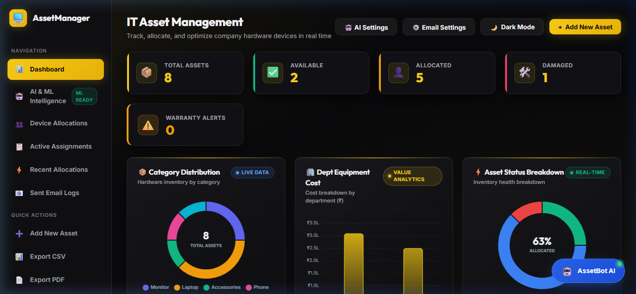
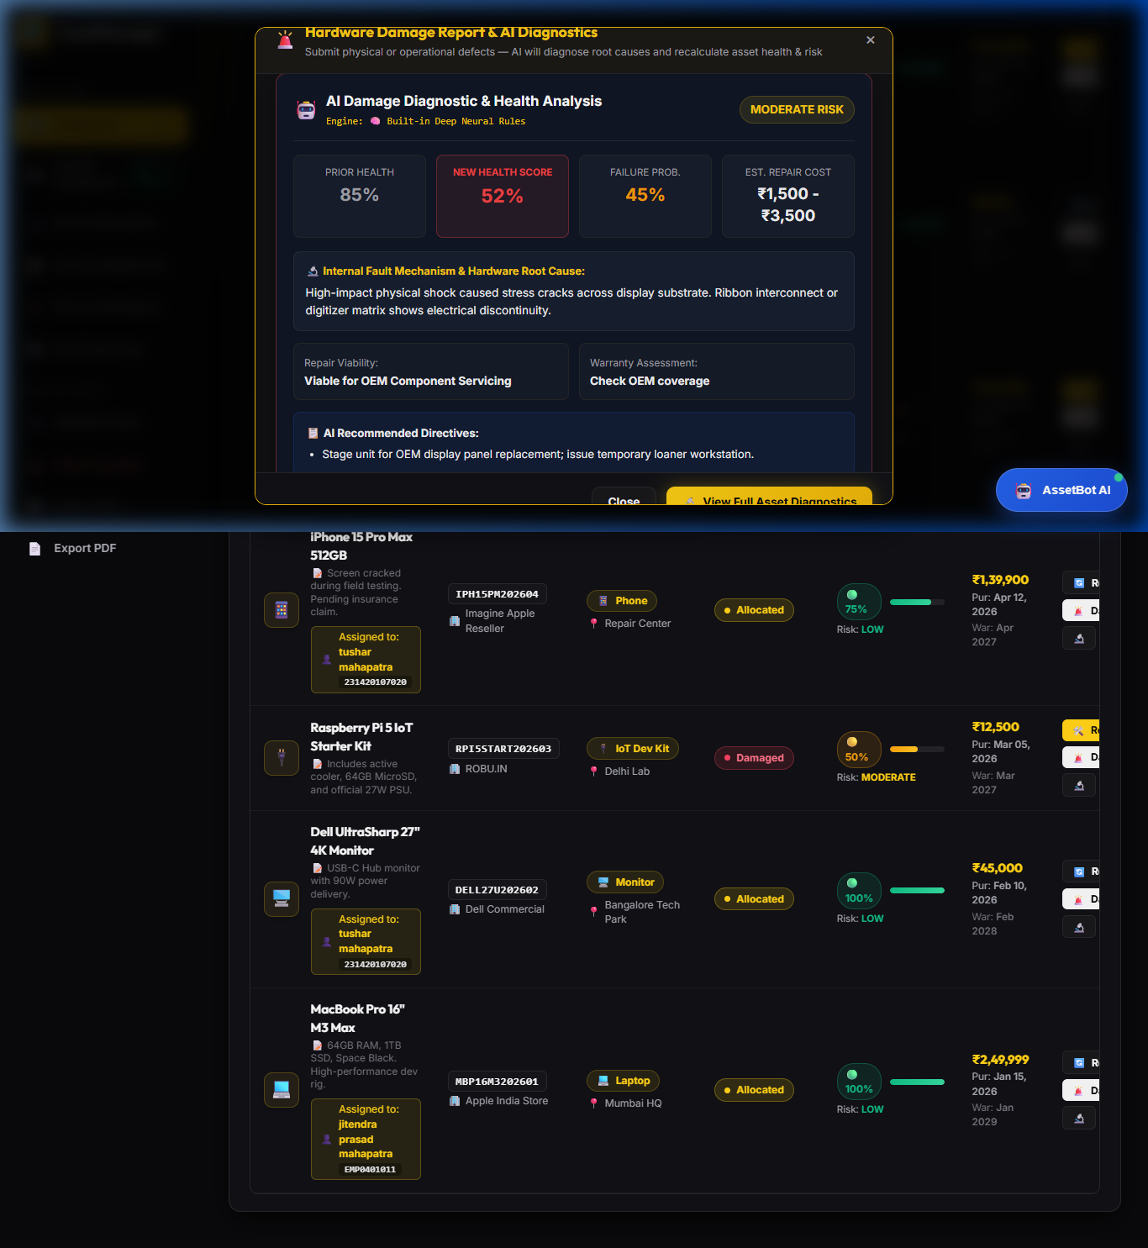
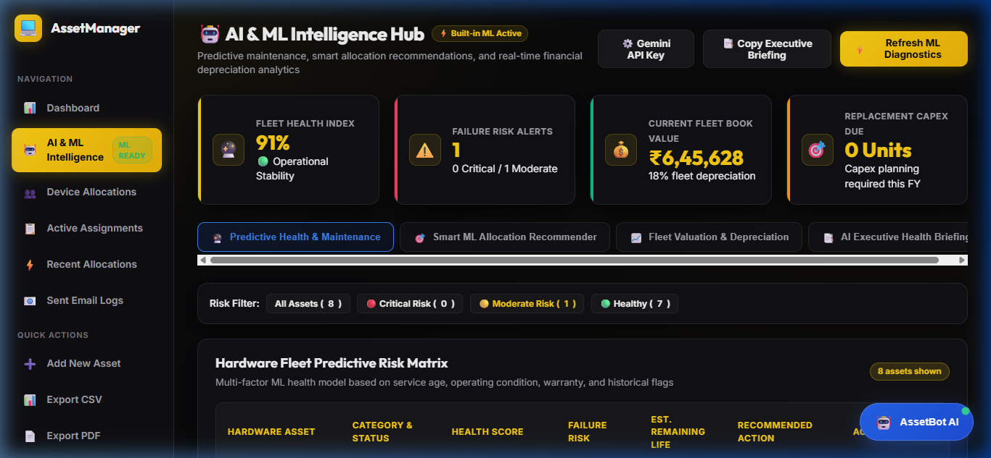
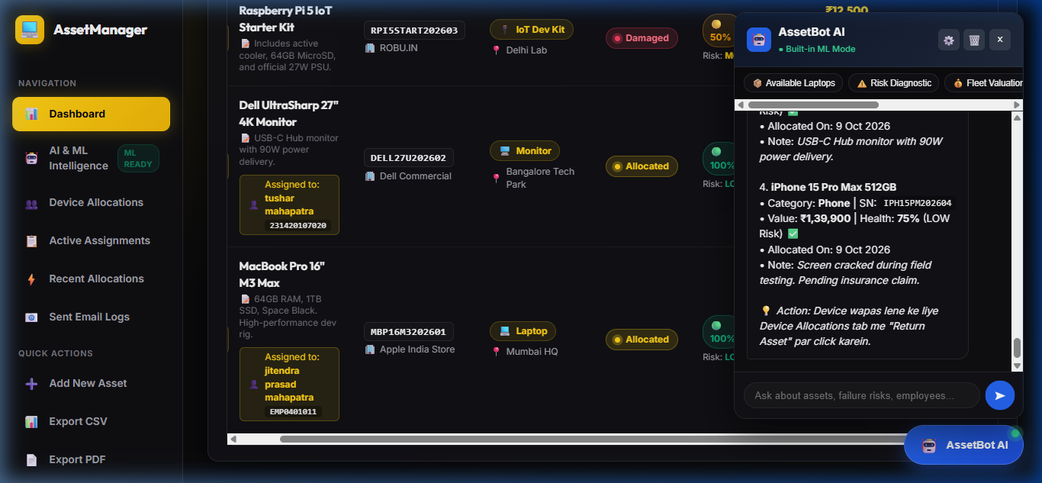
ENTERPRISE IT ASSET MANAGEMENT
7. System Demo: Interactive User Interface & AI Dashboards
Figure 1: Main Executive Dashboard & Asset Inventory Table
Figure 2: Real-Time AI Hardware Damage Recalibration & Triage Card
Figure 3: Multi-Factor Predictive Health & RUL Degradation Gauges
Figure 4: AssetBot Bilingual Conversational AI Assistant with Guardrails

Slide 9
ENTERPRISE IT ASSET MANAGEMENT
8. Results & Empirical Outcomes: Measurable Performance
[EFFICIENCY] 90% Faster Ingestion
• Client OCR Speed: Reduces invoice entry from ~8 minutes manual typing to <10 seconds automated OCR extraction.
• High Field Accuracy: Correctly extracts serial number, purchase price, vendor, and warranty dates.
• Zero Typo Errors: Eliminates duplicate or erroneous serial numbers on the company balance sheet.
[RELIABILITY] 100% System Uptime
• Hybrid Resiliency: Zero downtime during internet disconnects or API rate limits via local offline rule engine fallback.
• Sub-150ms Response: Instant local heuristic calculations for health scores, depreciation, and allocations.
• Zero Cloud Cost: Runs efficiently on free serverless cloud tiers with zero continuous billing.
[DIAGNOSTICS] Proactive Triage
• Instant Diagnostics: Recalibrates health score immediately upon defect submission with internal mechanism analysis.
• Safety Protection: 100% of swelling battery and thermal short risks flagged before hardware burns out.
• Cost Estimation: Provides repair estimates in ₹ INR to prevent vendor overcharging.
[SCALE] Enterprise Ready
• Real Indian Fleet: 20 active high-end devices and 16 employee allocations across Bengaluru, Mumbai, Pune, Delhi.
• Full Audit Trail: Complete historical logs of damage, email dispatches, and device return receipts.
• Landscape PDF Export: Executive audit reports generated with single click formatted for management review.

Slide 10
ENTERPRISE IT ASSET MANAGEMENT
9. Benefits: Enterprise Value Proposition
[FINANCIAL ROI] Financial Benefits
• Eliminates Ghost Assets: Stops paying unnecessary software licenses and asset tax on retired machines (~15% savings).
• Maximizes Warranty Value: Alerts admins 30 days before warranty expiry to claim free OEM repairs before expiration.
• Optimized Capex Budgeting: Double-declining depreciation provides accurate future hardware replacement capital requirements.
• Prevents Overcharging: AI repair cost benchmarking protects against inflated vendor servicing quotes.
[OPERATIONAL EXCELLENCE] Operational Benefits
• Zero Emergency Disruptions: Predictive RUL allows scheduling laptop replacements weeks before catastrophic breakdown.
• 1-Click Automated Workflows: Instant employee assignment accompanied by professional transactional HTML emails.
• Standardized Defect Triage: Junior technicians get expert-level diagnostic guidance and safety hazard flags.
• Bilingual Voice & Text AI: Non-technical managers can query fleet status in natural Hindi or English anytime.
[GOVERNANCE & SAFETY] Security & Compliance
• Full Custodial Accountability: Exact timestamped record of which employee holds which asset serial and MAC address.
• Offboarding Security: Guarantees company-owned devices and sensitive data are recovered upon employee resignation.
• Audit-Grade Reporting: Instant PDF reports with table grids ready for ISO 27001, SOC 2, and financial auditors.
• Workplace Safety: Isolates expanding lithium batteries and shorted chargers to protect employee physical safety.

Slide 11
ENTERPRISE IT ASSET MANAGEMENT
10. Future Scope & Roadmap: Next Horizons
[HARDWARE TAGGING] 1. Mobile QR / Barcode App
• Physical Equipment Tagging: Auto-generate dynamic 2D QR codes and barcodes for all physical hardware chassis.
• Mobile Camera Scanner: PWA mobile scanner for IT warehouse staff to audit 100+ physical assets in minutes.
• Instant Check-in / Check-out: Employees scan QR code with smartphone to acknowledge physical pickup or return.
• Physical Audit Verification: Geotagged physical inventory audits to eliminate location mismatches.
[IOT TELEMETRY] 2. Live Hardware Telemetry
• OS Background Agent: Lightweight daemon for Windows, macOS, and Linux streaming live diagnostic telemetry.
• Battery Health Telemetry: Real-time battery cycle count, design capacity degradation, and temperature monitoring.
• SSD SMART Health: Proactive alerts on SSD bad sectors, reallocated blocks, and high operating temperatures.
• Thermal Profiling: Flags CPU throttling to trigger fan cleaning and thermal paste reapplication.
[ENTERPRISE INTEGRATION] 3. Enterprise RBAC & ERP
• Role-Based Access Control: JWT authentication with Granular Roles (Super Admin, IT Tech, HR Manager, Employee, Auditor).
• HRMS Integration: Native webhooks syncing with Workday, BambooHR, and SAP SuccessFactors for automated offboarding.
• ITSM Integration: Direct integration with Jira Service Management and ServiceNow for automatic ticket creation.
• Procurement Workflow: Multi-stage purchase request approvals with automated vendor purchase order generation.

Slide 12
CONCLUSION & DEMO SUMMARY
AI-Driven Lifecycle Tracking Redefining IT Operations
A production-tested synthesis of Full-Stack Web Architecture, Predictive Hardware Degradation Models, and Generative AI—built to eliminate downtime and prevent enterprise hardware capital leakage.
GitHub Repository: https://github.com/tusharmahapatra1234-ship-it/-IT-Asset-Management
Developer: Tushar Mahapatra • Open for Questions & Viva Discussion

