Slide 1
Small Business Accounting
Projecting and Evaluating Performance

Slide 2
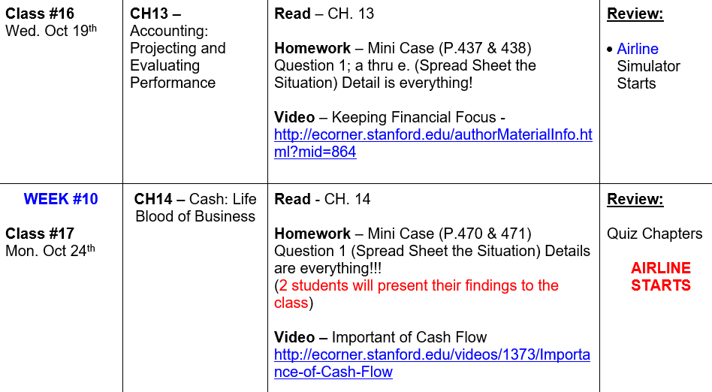
What’s Happening this Week

Slide 3
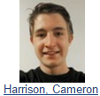

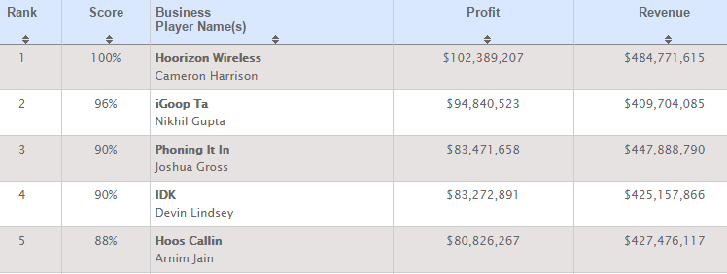
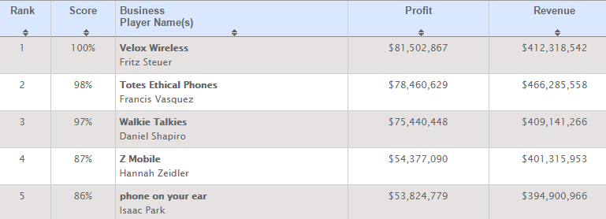
Cell Phone Simulator
-CHAMPIONS-
TEAM 1
TEAM 2

Slide 4
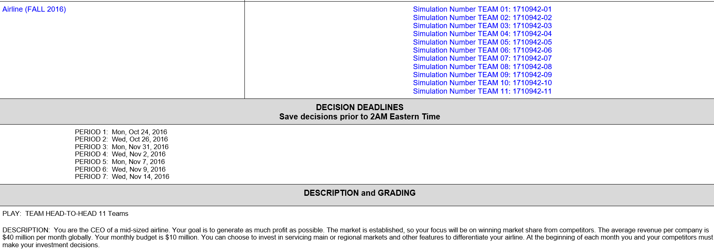
Airline Simulator

Slide 5
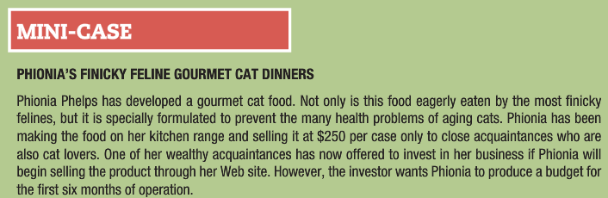
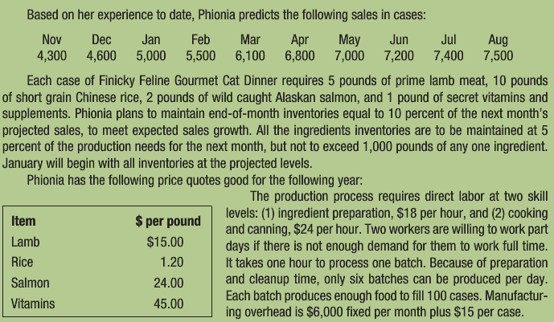
Homework Assignment
SALES
COGS
Indirect Cost
COGS

Slide 6
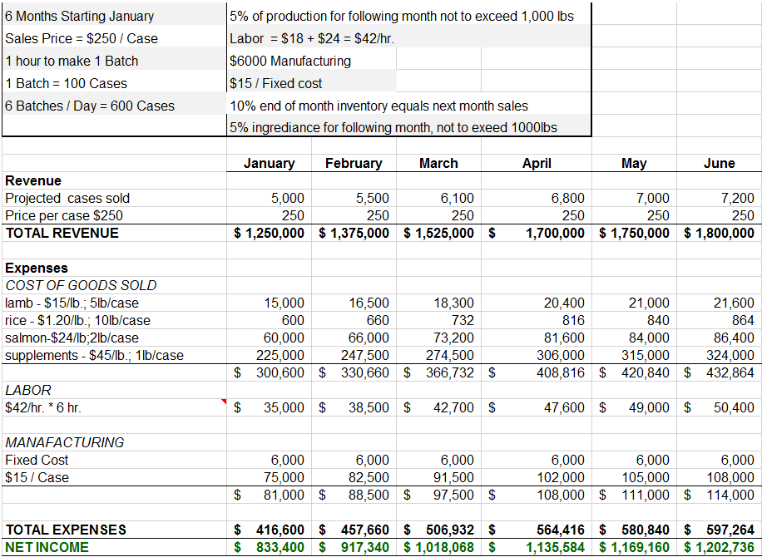

Homework Assignment

Slide 7
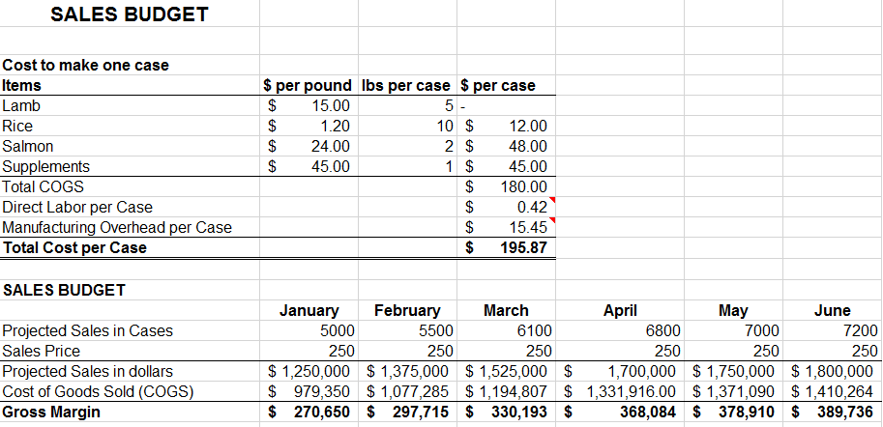
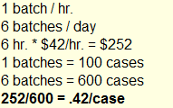

Homework Assignment

Slide 8

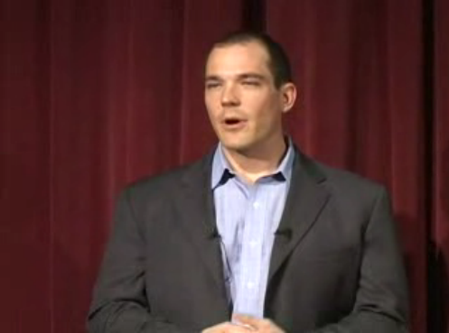
Keeping a Financial Focus
What is the Biggest Pit Falls for Tech Entrepreneurs?
Loss the primary focus of the business metrics with drives success
  Reorders
  Margins
  Price Erosion

Slide 9
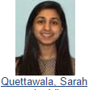
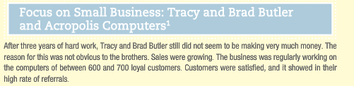

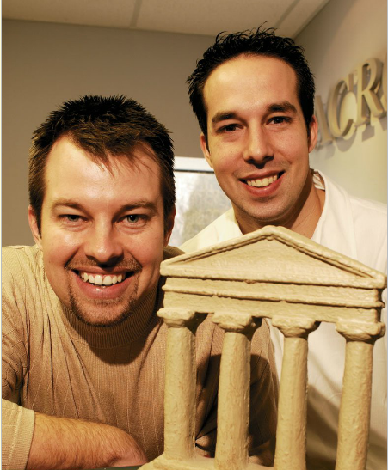
Acropolis Tech
What did they do Wrong?
They did not know the relationship between Cost, Revenue and Profit
No mark up on parts
No consideration of inventory cost
No charge for travel time
Changed Business model from B to C / B to B

Slide 10

Acropolis Tech
What is the nature of the "…relationship between costs, revenues, and profits…" that Tracy and Brad Butler did not understand?
  They did not understand that buying and holding inventory has costs that must be recovered through markups when it is sold.(Balance Sheet/Cash Flow)
  They did not understand that all of the time used in the business has a cost that must be recovered.
  They did not understand the concepts of fixed costs, such as the cost of owning a service van, and variable costs, such as the cost of operating the van.
  They did not understand that there is a cost to providing service to customers, and some customers cost more than others. (B to C / B to B)

Slide 11
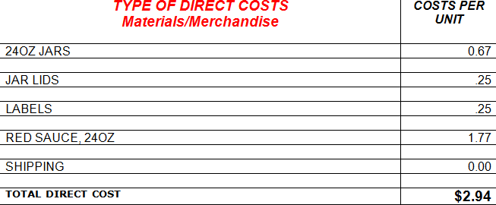
What are my Direct Cost?
STEP 1:

Slide 12
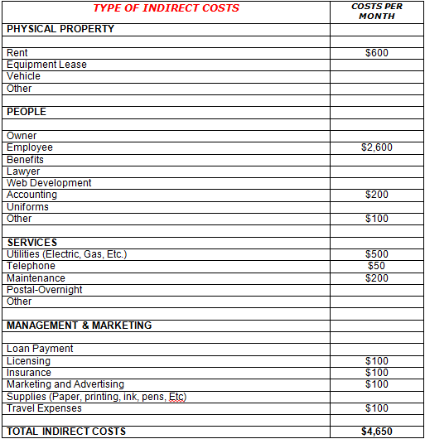
What are my Indirect Cost
STEP 2:

Slide 13
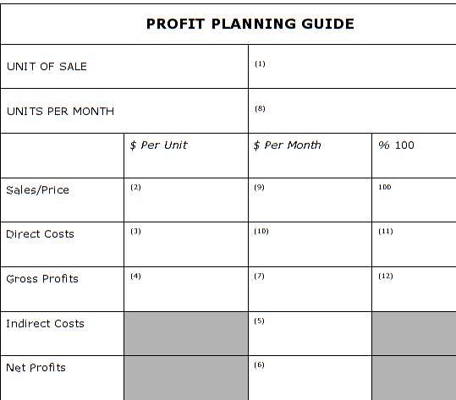
What is my Break Even?
STEP 3:
ONE JAR
BREAK EVEN
1,545
$5.95
$9,192.75
100%
$2.94
$4,542.30
49%
$3.01
$4,650.45
51%
$4,650.45
$0.00
$4,650 ÷ $3.01 = 1,545 Units

Slide 14
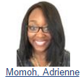
Why Accounting Matters
Proves what your business did financially
Shows how much your business is worth
Banks, creditors, development agencies, and investors require it
Provides easy-to-understand plans for business operations and how much to charge
You can’t know how your business is doing without it

Slide 15
Accounting Systems for Small Business
Quick Books - Computerized systems simplify the accounting process by providing automatic error checking, entry screens that look like the common business forms, and automatic production of financial statements and management reports.

Slide 16
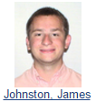
Financial Reports
Financial Statements
  Formal summaries of the content of an accounting system’s records of transactions
What are the 3 Common Financial Statements
  Income statement
  Balance sheet
  Cash flow statement

Slide 17
Financial Reports
Income statement – What does this show?
  A statement that lists revenues and expenses and shows the amount of profit a business makes for a specified period of time.
  Revenues – Expenses = Net Income

Slide 18
Financial Reports
Balance sheet – What does this show?
  - A statement of what a business owns (assets), what it owes to others (liabilities), and how much value the owners have invested in it (equity).
Assets = Liability + Equity

Slide 19
The Accounting Equation
(Balance Sheet)
Asset
Liability
Owners’ equity
  Something the business owns that will have value in the future
  Long Term - > 1 year
  Short Term - < 1 year
A legal obligation to pay some amount at a time in the future
Long Term
Short Term
Whatever value is left after all liabilities have been paid.

Slide 20
Cash Flow Statement
Cash Flow Statement
GAAP
  A statement of the sources and uses of cash in a business for a specific period of time.
  Generally Accepted Accounting Principles are the standardized rules for accounting procedures
  Used in all audits and submissions of accounting reports to the government.

Slide 21
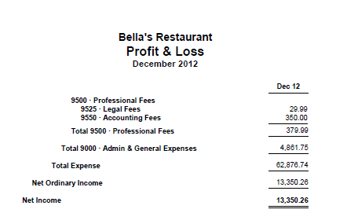
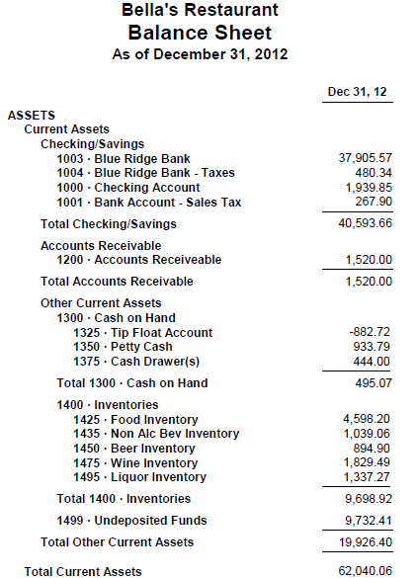
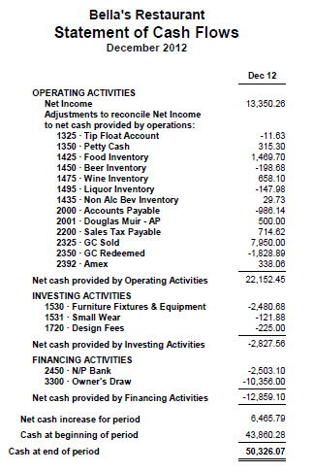
Flow of Information in
Financial Statements
13-<number>
BONUSES

Slide 22
Decision Making
To make good decisions we need:
Good information – Junk in; Junk out
Efficient ways to condense information so it is understandable - Spread sheets
Methods to help compare alternatives.
What are some methods one can use to compare Information?

Slide 23
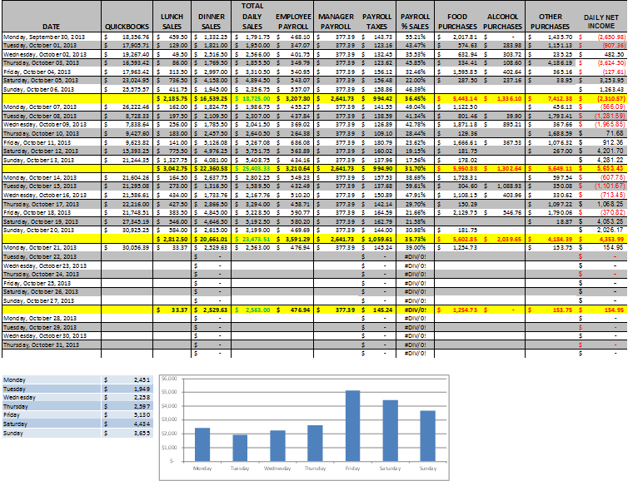
Daily Monitoring

Slide 24
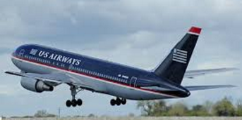
Break Up into Teams

