Slide 1
Voltage Divider Design
By Jake Clatterbuck (jhc5wf)

Slide 2
Objectives
To gain beginner experience for designing a circuit
To learn about the function of voltage dividers
To learn about electrical loads and how to account for them in a design

Slide 3
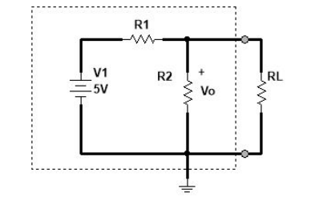
The circuit
Constraints:
Vo should be between 3.15V and 2.85V
With or without the load of a 10k resistor
Power should never exceed 1/8 of a Watt
R1 and R2 must be selected such that the
circuit fulfills both constraints with and without RL in parallel with R2

Slide 4
Power Limit
The maximum allowed power was 1/8 of a Watt
P=IV, where in our case V=5
Therefore I=P/V = (1/8)/5 = 1/40 = .025A
This is the maximum allowed current for the circuit to remain within constraints

Slide 5
Resistor CHoices
The minimum the total resistance can be is found by V=IR
5V= (.025A) R, R = 200 Ohms
In a voltage divider, the percentage of total voltage across a resistor is equal to fraction of the resistor divided by the total resistance.
Therefore to have 3V across a resistor in this circuit, a resistance of 3/5 of the total resistance (200) is needed (120 Ohms)
The other resistor, R1, must therefore hold the remaining 80 Ohms

Slide 6
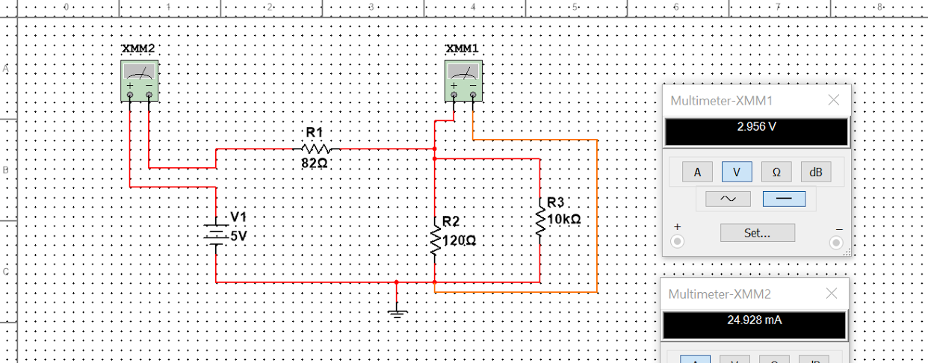
Multisim

Slide 7
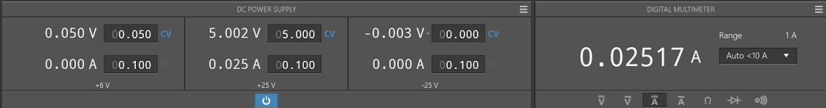
Caution
With the current resistor values, the power will be at or near the max allowed power, with the load resistor possibly pushing the power over the limit when included in parallel.
With R1 = 82 Ohms and R2 = 120 Ohms, the current can be seen to go above the derived limit of .025 amps both with and without the load.
With no load (RL = infinite ohms)

Slide 8
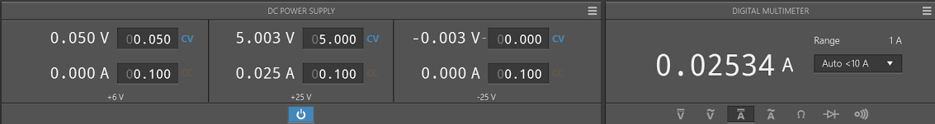
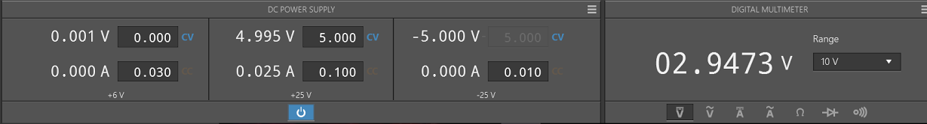
Caution
With RL = 10k Ohms:
Note that the Vo values are still very much so within parameters:

Slide 9
An Explanation and Solution
This failure to meet the power requirement is due to lack of precision in the resistors and to resistor values too close to the minimum allowed
This can be fixed by doubling each resistor value by connecting a resistor of the same value in series. After both R1 and R2 are doubled, the ratio remains the same, though less power is used. This will, however, cause the load resistor to change Vo to a greater degree.

Slide 10
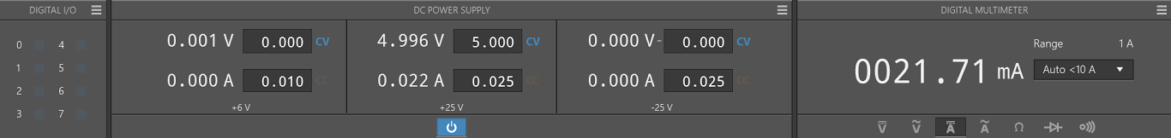
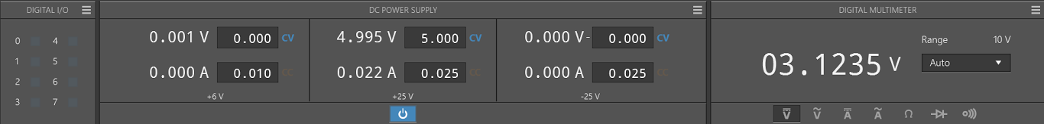
Revised Resistor Values
With R1 = 164 and R2 = 240, new measurements were recorded, now with both within the requirements.

Slide 11
Parameter Confimation
2.85V < 3.12V < 3.15V
P = IV = (.0217)(5V) = .1085 Watts < .125 Watts

Slide 12
Varying Load
When the load is not present, the max R2 (in our circuit) is 240 Ohms
With the load in parallel, the min R2 = 240*10000/(240+10000) = 234.4 Ohms

Slide 13
Power optimization
The earlier resistor values resulted in a power output near max and a voltage output near the ideal
To optimize for minimal power instead, the resistors must be chosen to be as large as possible while keeping Vo within acceptable tolerances both with and without the load resistance

Slide 14
Optimization Calculations
When the resistors are large, RL will decrease Vo by a larger amount.
To maximize for power, RL should decrease Vo from 3.15V (the maximum allowable voltage) to 2.85V (the minimum allowable voltage)
To achieve a voltage of 3.15 without the load, the resistors should be R1=1.85x and R2 = 3.15x, where x is any constant.
Additionally, when the load is added in parallel, the combined resistance of R2 and RL is found to be 2.45x so that Vo will equal 2.85 by the following ratio equation:
1.85/(1.85+y)=2.15/5, y=2.45

Slide 15
Optimization Calculations Cont.
Therefore, 2.45x is equal to the parallel resistance of a resistor of value 3.15x and 10k ohms.
2.45x=(3.15x*10000)/(3.15x+10000), x = 907 Ohms
R1 max = 1.85x = 1678 Ohms
R2 max = 3.15x = 2857 Ohms

