Slide 1

STOCK PREDICTION USING
MACHINE LEARNING
Machine Learning is a very powerful process which if provided with proper datasets with a specified training algorithms can proved to be a boon for humans. So, this project aims at training the Machine Learning Model with the Live Stock data to forecast the approximate prices with minimum errors providing the Maximum Accuracy.

Slide 2
STOCK PREDICTION USING
MACHINE LEARNING
Machine Learning is a very powerful process which if provided with proper datasets with a specified training algorithms can proved to be a boon for humans. So, this project aims at training the Machine Learning Model with the Live Stock data to forecast the approximate prices with minimum errors providing the Maximum Accuracy.

Slide 3
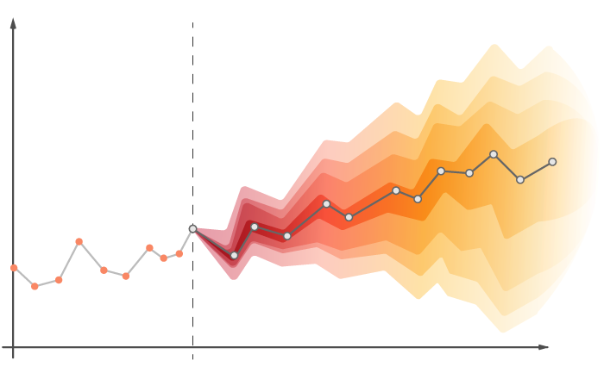
SARIMAX
(Seasonal Autoregressive Integrated Moving Average with Exogenous Variables)
ACTUAL DATA
PREDICTED DATA

Slide 4
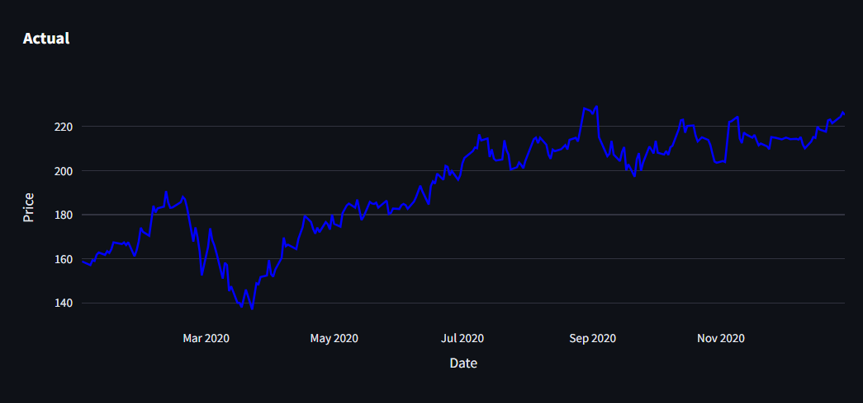
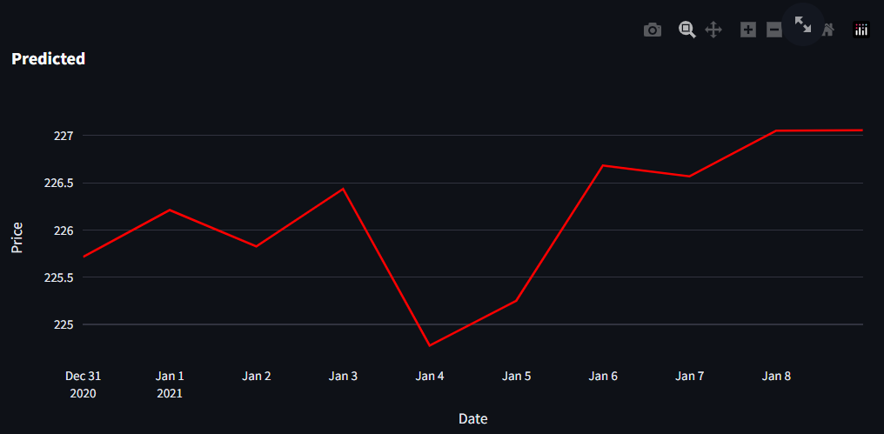
Inputs required for Training Model
Stock Selection
No. of Days to be Predicted
Date Range (To-From)
SARIMAX Inputs

Slide 5
Inputs required for Training Model
Stock Selection
No. of Days to be Predicted
ACTUAL DATA
PREDICTED DATA
Next
THANK YOU
This is the predicted data based on the Machine Learning Model trained on the Moving Averages. The Line Plot will show the predicted data points where the probability of Stock’s price is likely to fall.
It includes all the actual recorded data which is scrapted from the Websites including it’s Open, Close, High, Low and Total Volume recorded on each date. This data is then processed under the Machine Learning Model for the prediction.
Inputs required for Training Model
Stock Selection
No. of Days to be Predicted
Date Range (To-From)
SARIMAX Inputs

Slide 6

ACTUAL DATA
It includes all the actual recorded data which is scrapted from the Websites including it’s Open, Close, High, Low and Total Volume recorded on each date. This data is then processed under the Machine Learning Model for the prediction.
THANK YOU

Slide 7
PREDICTED DATA
It includes all the actual recorded data which is scrapted from the Websites including it’s Open, Close, High, Low and Total Volume recorded on each date. This data is then processed under the Machine Learning Model for the prediction.
This is the predicted data based on the Machine Learning Model trained on the Moving Averages. The Line Plot will show the predicted data points where the probability of Stock’s price is likely to fall.
THANK YOU
It includes all the actual recorded data which is scrapted from the Websites including it’s Open, Close, High, Low and Total Volume recorded on each date. This data is then processed under the Machine Learning Model for the prediction.

Slide 8
THANK YOU

