Slide 1

Marketplace Performance
Analysis
Business Data Analyst Portfolio Project
Dataset: 60 Sellers | 600 Orders | Jan 2023 - Dec 2025
Tools: PostgreSQL | Excel | Power BI | PowerPoint
Analyst: Tushar Kumar

Slide 2
PROJECT OVERVIEW
BUSINESS CONTEXT
5 BUSINESS QUESTIONS ANSWERED
Back Market is a two-sided marketplace for refurbished electronics, connecting individual buyers with professional refurbishers across Europe and North America.
This project simulates the analytical work of a Business Data Analyst inside Back Market - using real marketplace KPIs and business logic to answer practical commercial questions.
Q1
Which product categories generate the most revenue?
Q2
Which countries drive the most orders and revenue?
Q3
Which sellers have the highest return rates?
Q4
Which categories have the most returned orders?
Q5
Which sellers had the highest completed order volume?
2

Slide 3
Q1 - REVENUE BY PRODUCT CATEGORY
PostgreSQL + Excel
€199.96K
493
€323.50
Total Revenue
Completed Orders
Avg Order Value
KEY INSIGHTS
Laptops lead revenue at €71K despite fewer orders (97) than Smartphones (152)
Laptops avg order value (€676) is nearly 2× Smartphones (€355)
Top 2 categories (Laptops + Smartphones) = 67% of total revenue
Headphones drive lowest revenue at €10K - lowest priority category
▶ Prioritise Laptop category investment - highest revenue per transaction
3

Slide 4
Q2 - GEOGRAPHIC PERFORMANCE
PostgreSQL + Power BI
🇧🇪 Belgium
#1 Market
58 orders
€23.7K revenue
🇩🇪 Germany
#2 Market
55 orders
€22.0K revenue
🇪🇸 Spain
Hidden Gem
48 orders
€21.6K revenue
Highest AOV: €380
🇫🇷 France
#10 by orders
44 orders
€16.3K revenue
▶ Spain ranks 6th by orders but 3rd by revenue - Spanish customers skew toward premium products. Opportunity for targeted premium marketing.
4

Slide 5
Q3 - SELLER QUALITY & RETURN RISK
PostgreSQL + Excel
83
3.87
70%
Total Returns
Avg Seller Rating
(Top Returners)
Bronze Tier
Among Top Returners
RISK SIGNALS
7 of top 10 returners are Bronze tier sellers
All Bronze sellers have avg rating below 4.0
Japan has 3 sellers in the top 10 - geographic cluster
ChipSaver_US_15 is Silver tier but still top returner - anomaly to investigate
▶ Flag Bronze sellers with 3+ returns for quality review or listing restrictions
5

Slide 6
Q4 - RETURN RATE BY PRODUCT CATEGORY
PostgreSQL + Excel
CRITICAL FINDING
Laptops - The Double Risk
Laptops are the #1 revenue category (€71K) but also carry the highest return rate at 24.7% - nearly 1 in 4 laptops is returned.
Implication:
Revenue is overstated if returns are not factored into net GMV calculations. The effective revenue contribution of Laptops may be closer to €53K after returns.
Category | Returns | Orders | Return Rate
Laptops | 24 | 97 | 24.7%
Headphones | 10 | 58 | 17.2%
Tablets | 10 | 63 | 15.9%
Smartphones | 22 | 152 | 14.5%
Game Consoles | 9 | 64 | 14.1%
Smartwatches | 8 | 59 | 13.6%
▶ Investigate Laptop return reasons - likely linked to specific Bronze sellers or Fair-grade listings
6

Slide 7
Q5 - TOP SELLER PERFORMANCE (2023-2025)
PostgreSQL + Power BI
GOLD
62 orders (51%)
SILVER
36 orders (30%)
BRONZE
24 orders (19%)
RISK FLAG
ReStore_BE_48 & EcoTech_JA_20 are Bronze sellers in the top 10 by volume - high output but elevated return risk requiring closer monitoring.
7

Slide 8
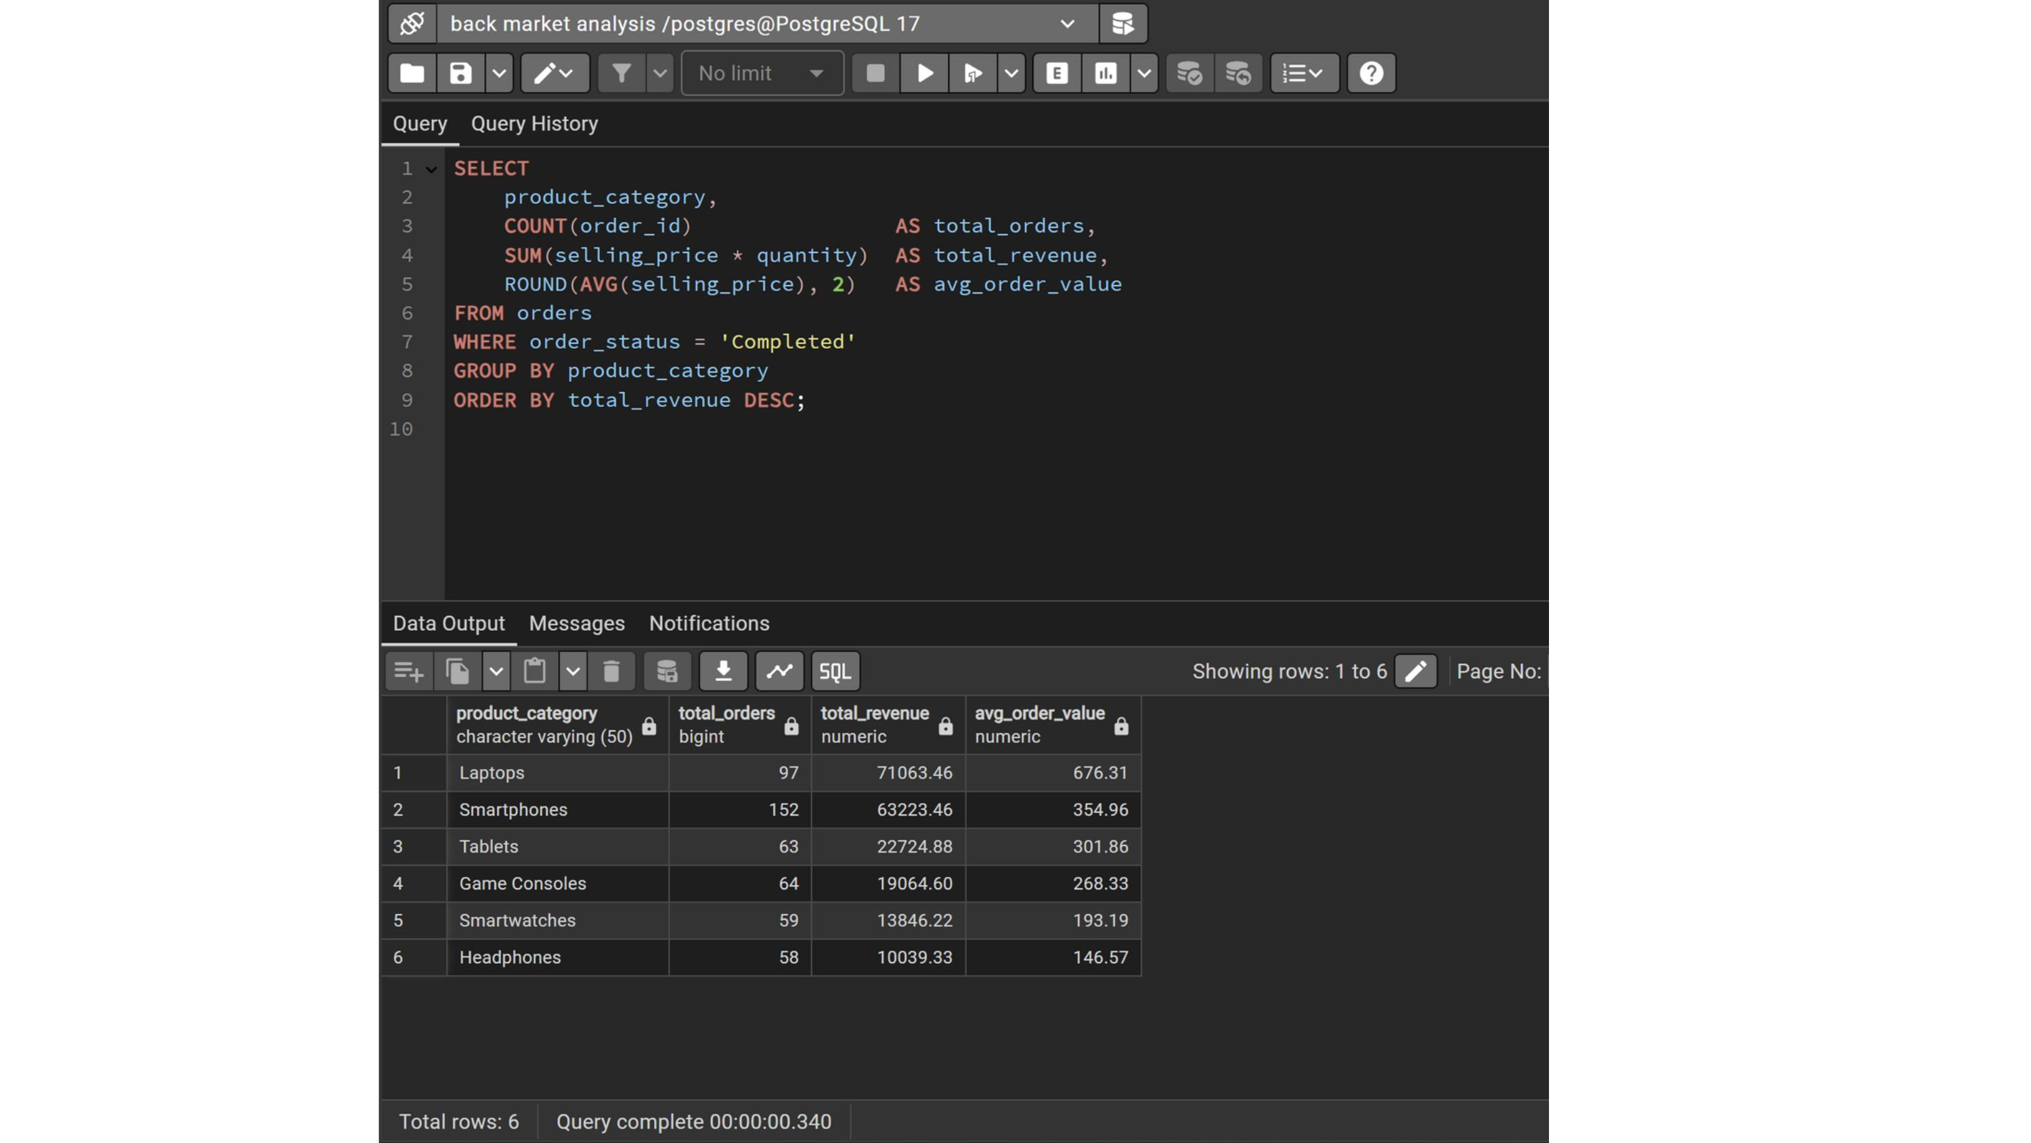
SQL IN ACTION - Q1 - REVENUE BY PRODUCT CATEGORY
Query 1 of 5

Slide 9
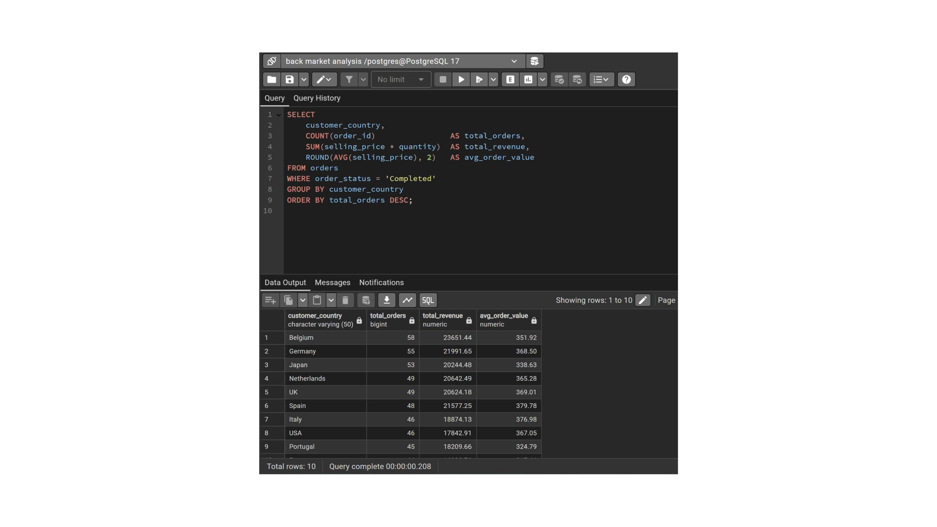
SQL IN ACTION - Q2 - GEOGRAPHIC PERFORMANCE
Query 2 of 5

Slide 10
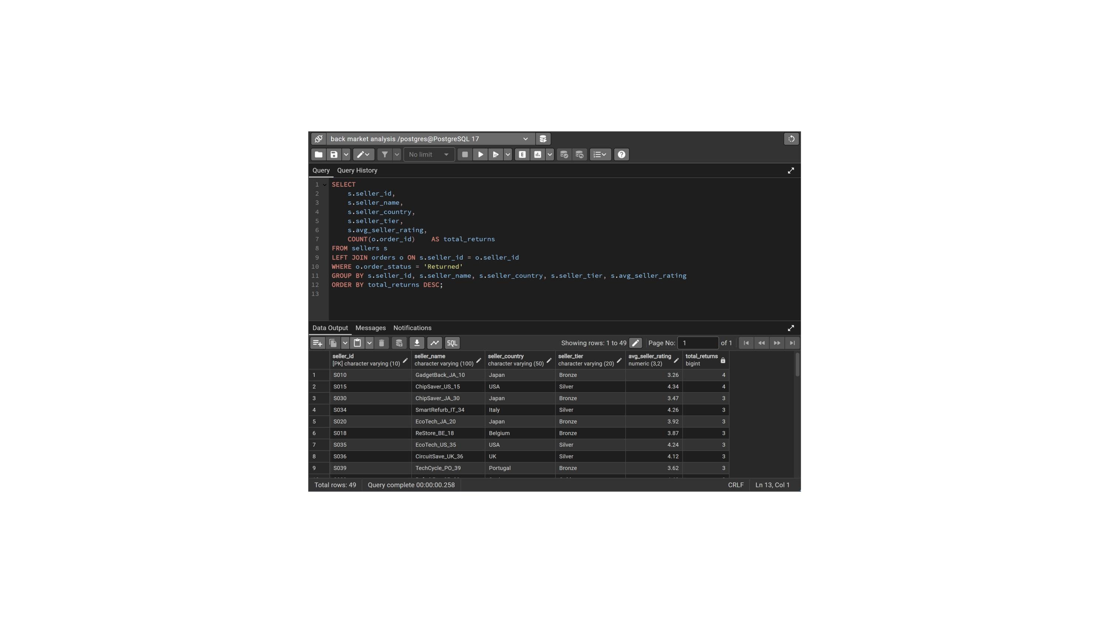
SQL IN ACTION - Q3 - SELLER RETURNS
Query 3 of 5

Slide 11
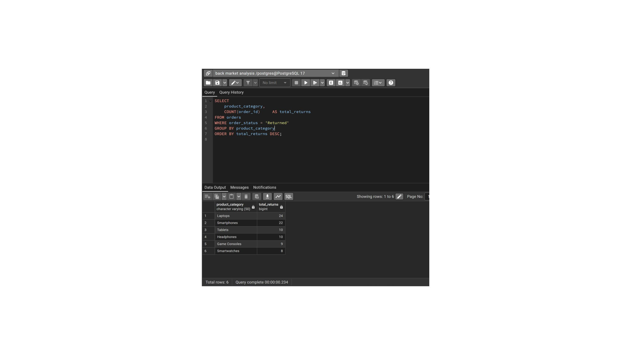
SQL IN ACTION - Q4 - CATEGORY RETURNS
Query 4 of 5

Slide 12
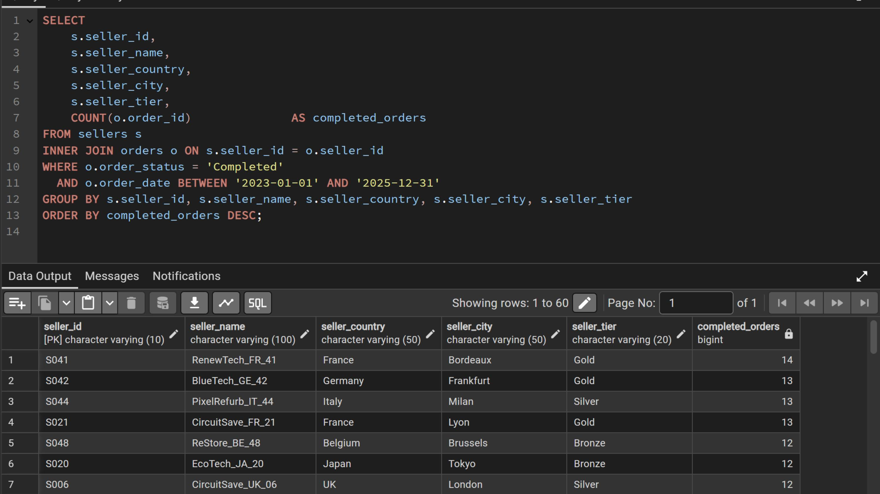
SQL IN ACTION - Q5 - TOP SELLER PERFORMANCE
Query 5 of 5

Slide 13
RECOMMENDATIONS & NEXT STEPS
01
Prioritise Laptop Category
02
Seller Quality Intervention
Laptops generate the highest revenue per transaction (€676 AOV). Back Market should invest in seller recruitment, listing quality, and marketing for this category. However, the 24.7% return rate must be addressed first through grade-quality enforcement.
Bronze tier sellers account for 70% of the highest-returning sellers. Implement mandatory quality audits for Bronze sellers with 3+ returns, consider temporary listing restrictions, and create incentive programmes to upgrade seller tier through performance improvement.
03
Target Spain for Premium Growth
04
Monitor Bronze Sellers in Top 10
Spain ranks 6th by orders but 3rd by revenue with the highest avg order value (€380). This signals a customer base that skews toward premium products. Dedicated Spanish-language marketing campaigns focused on Laptops and Smartphones could significantly increase GMV.
ReStore_BE_48 and EcoTech_JA_20 are Bronze tier sellers appearing in the top 10 by volume. High volume combined with elevated return risk creates significant GMV leakage. These sellers require enhanced monitoring and quality coaching.
8

Slide 14
TOOLS & METHODOLOGY
PostgreSQL
Built 2-table schema (sellers + orders) with 60 sellers and 600 orders across 2023-2025. Wrote 5 business queries using SELECT, COUNT, SUM, LEFT JOIN, INNER JOIN, WHERE, GROUP BY, ORDER BY, and BETWEEN to answer real marketplace questions.
Excel
Imported SQL query results into 5 structured worksheets. Applied VLOOKUP, INDEX/MATCH, SUMIF, COUNTIF, RANK, and IF formulas. Used conditional formatting - data bars, color scales, and highlight rules - to surface patterns and communicate findings visually.
Power BI
Built a 4-page interactive dashboard covering Revenue, Geography, Returns, and Seller Performance. Applied Power Query for data transformation, set correct data types, and used slicers and cross-filtering for interactivity.
PowerPoint
Translated data insights into an executive-ready presentation. Structured each slide around a business question with insight, implication, and recommendation - reflecting real analyst communication standards.
9

Slide 15
Thank You
Tushar Kumar
Business Data Analyst Portfolio - Back Market Project
5 SQL queries answering real marketplace business questions
Excel analysis with formulas, conditional formatting, and cross-query insights
4-page Power BI dashboard with KPIs, charts, and geographic analysis
Executive presentation structured around insight → implication → recommendation
Built with PostgreSQL | Excel | Power BI | PowerPoint

