Slide 1


Digital Guitar Tuner using Matlab

Slide 2
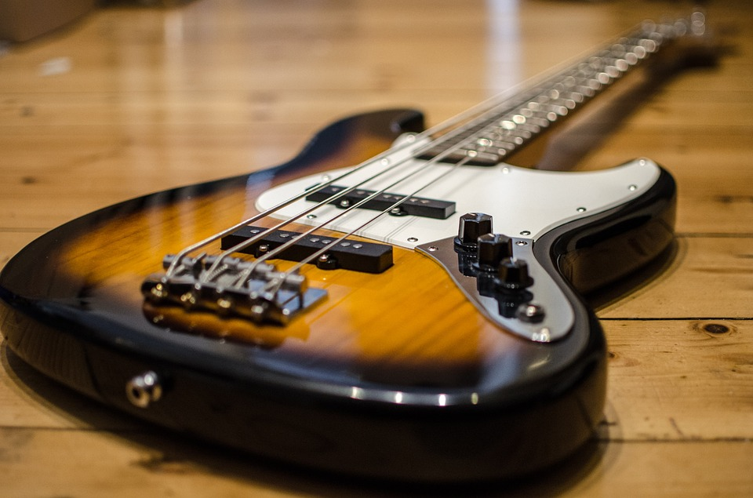
INTRODUCTION
There are two approaches for the most important part, frequency detection. First one is frequency domain detection. We use this algorithm to implement the tuner for computer user in MATLAB . The second one is pitch detection in time domain. The guitar tuner for traditional platform is based on this algorithm.

Slide 3
Abstract
The objective of this project is to understand the critical parameters that need to be addressed while designing a guitar tuner. The focus of the design lies in developing a suitable algorithm to accurately detect the fundamental frequency of a plucked guitar string from its frequency spectrum. A user-friendly graphical interface is developed using Matlab to allow any user to easily tune his guitar using the developed program.

Slide 4
Methodology
There are two methods for frequency detection, which is core part of this project, are used in guitar tuner implementation, one is in frequency domain, another one is in time domain. For pitch detection in frequency domain, the input signal is transferred to frequency domain from time domain by Fourier transform first.

Slide 5
Algorithm
Step 1: Start
Step 2: Enter the frequency range of each strings.
Step 3: Enter the string that you want to tune.
Step 4: Take the input of the string you are adjusting.
Step 5: Read the frequency of the played string.
Step 6: Instruct the user to increase or decrease the frequency.
Step 7: Plot the frequency graph of the played string.
Step 8: Stop.

Slide 6
How guitar tuner works?
In music, an electronic tuner is a device that detects and displays the pitch of musical notes played on a musical instrument. "Pitch" is the highness or lowness of a musical note, which is typically measured in Hertz. Simple tuners indicate—typically with an analog needle-dial, LEDs, or an LCD screen—whether a pitch is lower, higher, or equal to the desired pitch.

Slide 7
Main functions used in code
1. Assign the frequency values
ghighE=1318.1505;
gB=987.7669;
gG=783.9911;
gD=587.3297;
gA=440;
glowE=329.6277;

Slide 8
2. Record the sound and plays the sound
RecordObject=audiorecorder(Fs,16,1);
record(RecordObject,2);
pause(3);
I=getaudiodata(RecordObject,'double');
display ('This is how the input signal sounds. ');

Slide 9
3.The input frequency and whether we should increase it or decrease.
elseif w>K (find (J==max (J)))
display ('Input frequency should be increased');
akr=num2str(K(find(J==max(J))))
disp (['The frequency of the input signal is, %d Hz',akr]);
elseif w<K (J==max (J)),
display ('Input frequency should be decreased');
disp (['The frequency of the input signal is, ',num2str (K (find(J==max (J)))) 'Hz.']);

Slide 10
USES OF TUNER
We can tune any acoustic guitar and if we want to tune any other device we can adjust the input values assigned to the code and run the following code. Therefore ,this can be used to tune any instrument if the input frequency is known.

Slide 11
Disadvantages
Sometimes noise can be there while recording the input.
May not be perfectly accurate.
It may not work if you don’t know the frequency assigned for respected string.

Slide 12
THANK YOU

