Slide 1
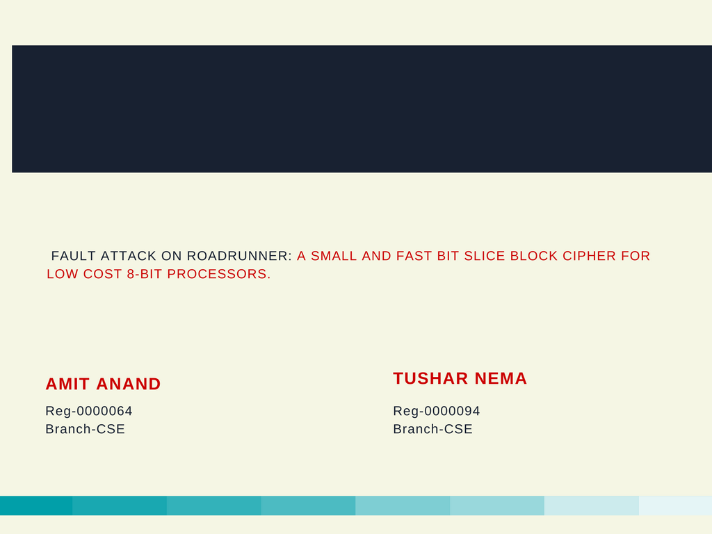
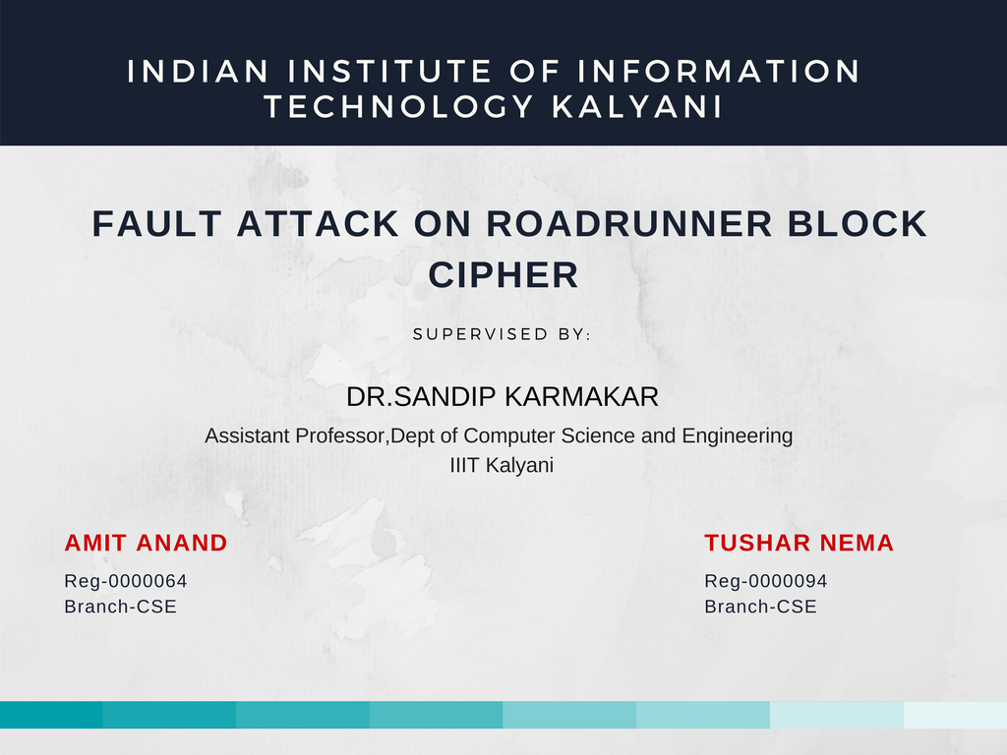
INDIAN INSTITUTE OF INFORMATION TECHNOLOGY KALYANI
Fault Attack On RoadRunneR Block Cipher
Roll-15009
Roll-15039

Slide 2
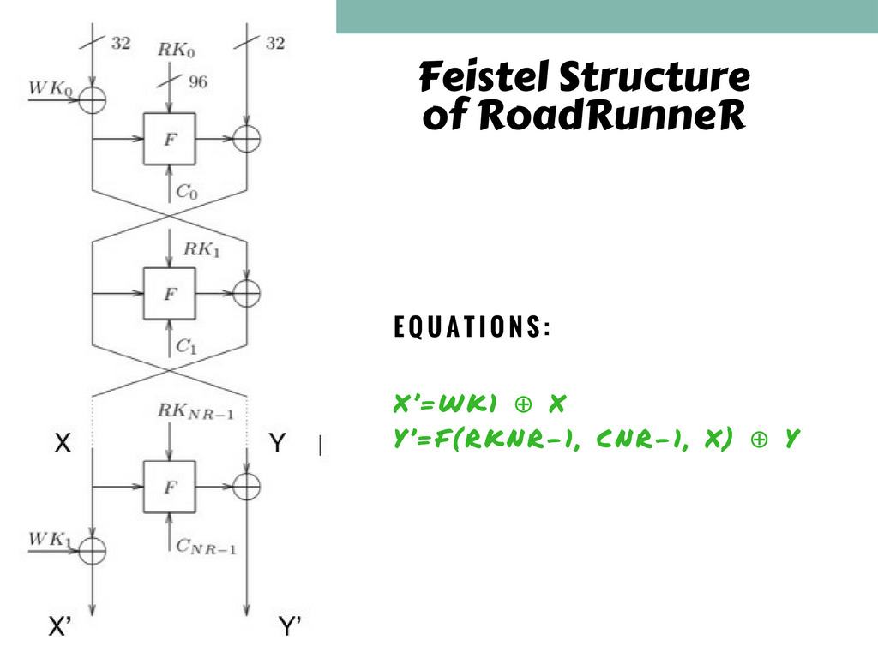
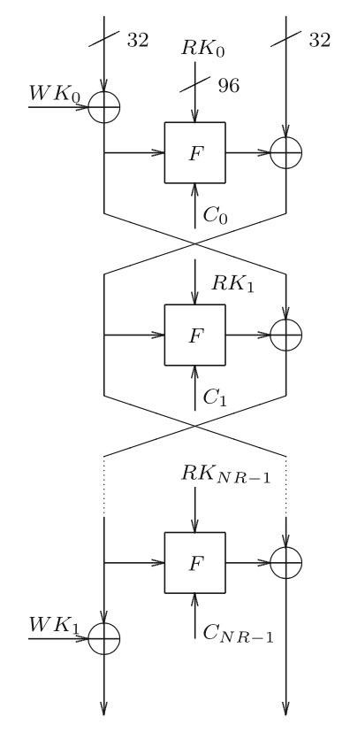
1
X
Y
2
X’
Y’

Slide 3
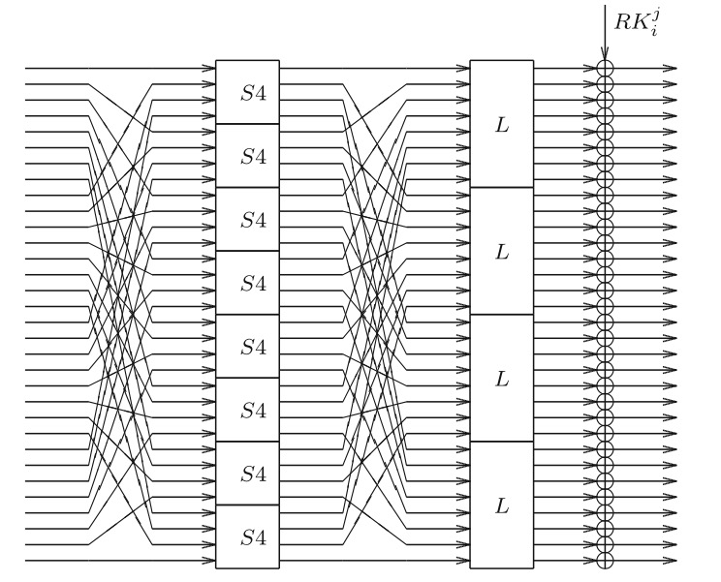
SLK STRUCTURE
S(L(S(L(S(L(S(L(S(X))⊕RK⁰i ))⊕RK¹i))⊕Ci))⊕RK²i)=F(X,RKNR-1,CNR-1)
3

Slide 4
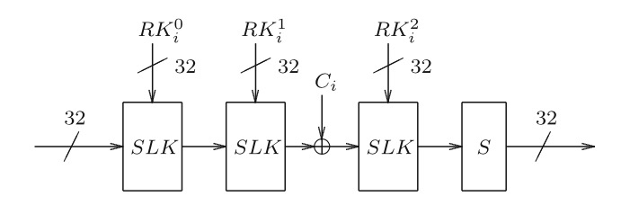
This is the F Function Of the Feistel Structure
What Ci represents?
Ci represents the round constant and Ci =NR-i
NR: No. of Rounds
i=0,1,2,……….,NR-1

Slide 5
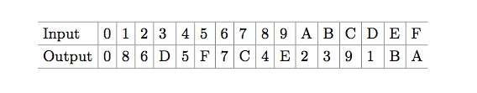
Substitution
The bits(permutation) gets substituted according to the S-box and a new permutation is formed after coming out from the S-box.
Diffusion
L(x) = (x ≪ i)⊕(x ≪ j)⊕(x ≪ k)
x ≪ i represents i-bit rotation of the CPU word x to the left.

Slide 6
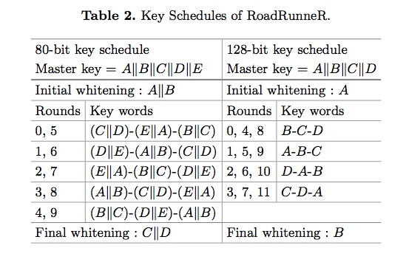
Key Addition:
In the 0th round
RK⁰i represents B
RK¹i represents C
RK²i represents D
WK0 represents A

Slide 7
Fault in Y
Y’f=F(RKNR-1, CNR-1, X) ⊕ Yf
4
Fault in X
X’f=WK1 ⊕ Xf
Y’’f=F(RKNR-1, CNR-1, Xf) ⊕ Y
5
6
Xoring equation 1 and 4:
X’ ⊕ X’f = X ⊕ Xf
7
Now we get 4 different values of 32 bit each
Y’ ⊕ Y’f = Y ⊕ Yf
8
Same is what we get from equation 7

Slide 8
We have 4 different values of Function F(X,RKNR-1,CNR-1) as we get from equation 4
S(L(S(L(S(L(S(L(S(X))⊕RK⁰i ))⊕RK¹i))⊕Ci))⊕RK²i)=F(X,RKNR-1,CNR-1)
L(S(L(S(L(S(L(S(X))⊕RK⁰i ))⊕RK¹i))⊕Ci))⊕RK²i=S⁻¹(F(X,RKNR-1,CNR-1))
RK²i
16 different values
L(S(L(S(L(S(L(S(X))⊕RK⁰i ))⊕RK¹i))⊕Ci))
16 different values
L(S(L(S(X))⊕RK⁰i ))
64 different values
RK¹i
64 different values
RK⁰i
256 different values

Slide 9
Final Conclusion:
RK⁰i
256 different values
RK¹i
64 different values
RK²i
16 different values
From equation 5 we can imply that WK1 has 4 different values.
Total no. of different keys = 2⁸ x 2⁶ x 2⁴ x 2²
Now we reduce the exhaustive search space for possible keys of RoadRunneR:
2²⁰ x No. of rounds ≈ 2²³

Slide 10
Future Work
We have derived an algorithm to find the key by doing Fault attack on RoadRunneR and thus we are on the way of implementing a program which can find out the key of the block cipher when it receive a cipher text.
Additionally we have also initialized writing our first research paper providing a relevant and substantial thesis of the Fault attack we did on the block cipher.

Slide 11


