Slide 1
Reading the Forex Market with PCA
Which currency relationships hold, which fail, and when not to trade them
Hourly data, 9 currencies + gold + silver, 2010 – 2026
Notes:
Project: using Principal Component Analysis to understand how currencies move together, test whether the leftover relationships between pairs pull back, and build a daily gauge that tells us when those relationships are unreliable.

Slide 2
The answer in three numbers
49%
3×
69%
of all currency movement comes from one common force: the US dollar
more pair breakdowns when that common force weakens (7.7% vs 2.3%)
of trading days PCA marks as safe for pair trading (2011 – 2026)
Conclusion: PCA tells us when not to rely on relationships between currency pairs.
Gold vs silver was tested the same way and fails: its relationship trends instead of pulling back.
Notes:
Main message first. 49% = average share of the first PCA factor. 3x = stretched cross pairs break further 7.7% of the time in low-concentration periods vs 2.3% in high. 69% = days marked tradable by the live rule.

Slide 3
Data used
What
9 currencies, each priced in US dollars: EUR, GBP, AUD, NZD, CAD, CHF, JPY, NOK, SEK
Gold (XAU) and silver (XAG)
23 cross pairs, e.g. EURGBP, AUDNZD, EURJPY
Where from
HistData.com: hourly prices, Jan 2010 – Oct 2026 (~100,000 hours)
Vantage MT5: real spreads and swaps 2019 – 2026
Daily candles closing 17:00 New York, like brokers
Checks
Time zones converted to UTC and validated against MT5 and Yahoo
Second source compared: OANDA vs HistData correlation 0.998
Missing AUDJPY 2012 rebuilt from AUDUSD × USDJPY
EURUSD
GBPUSD
AUDUSD
NZDUSD
USDCAD
USDCHF
USDJPY
USDNOK
USDSEK
XAUUSD
XAGUSD
The 11 instruments the PCA is built from (USDxxx pairs are inverted so every series is “value in US dollars”).

Slide 4
Step 1 · Scale the data before PCA
Why scale?
Silver moves 4.5× more than the Canadian dollar. Unscaled, PCA would mostly describe silver.
How (same as StandardScaler)
1. Prices → hourly % changes (log returns)
2. Standardise each series: z = (return − mean) / std
3. Mean and std come from the past window only (480 hours / 120 days), so no future data leaks in
4. Every series now has variance 1 → total variance = 11; PCA on this = PCA on the correlation matrix
Notes:
We do scale: the model standardises every window before PCA, and the daily gauge uses the correlation matrix, which is mathematically the same as PCA on StandardScaler output. We do not fit one scaler on 2010-2026 because that would use future information.

Slide 5
Step 2 · PCA finds the market's “dance moves”
Eigenvector = a dance move
A pattern of movement shared by the currencies, e.g. “everyone steps left together” (all currencies move against the dollar).
Example with 2 currencies (EUR and GBP, correlation 0.8)
Factor | Recipe (EUR, GBP) | Meaning | Eigenvalue | Share
PC1 | +0.71, +0.71 | move together | 1.8 | 90%
PC2 | +0.71, −0.71 | move apart | 0.2 | 10%
Total |  |  | 2.0 | 100%
Eigenvalue = how much that move is used
The amount of total movement (variance) explained by that pattern. Eigenvalues add up to the number of series: 11.
PC2 is the EURGBP “leftover”: the small part where the two move apart. This is what pair analysis studies.
With our 11 series: share of the first factor = largest eigenvalue / 11.
Notes:
Two-year-old version: 11 kids dance; most of the time they all copy the teacher (the dollar). PCA finds the dance moves (eigenvectors) and how much each was used (eigenvalues). For two series the eigenvalues are 1 + correlation and 1 - correlation.

Slide 6
Step 3 · The pullback: stretch, then return
Reading the wave
Gold lines ±2.5: stretched far from normal → open a trade
Red: s above +2.5 → SELL the pair, expecting it to fall back
Green: s below −2.5 → BUY the pair, expecting it to rise back
Grey lines ±0.5: back near normal → take profit
Beyond ±4 the rubber band has snapped → exit (stop)
Notes:
This is an idealised wave to show the idea. Real pairs are noisier (next slides). The pullback is the leftover returning toward its middle; a trade is opened at the stretch and closed on the return.

Slide 7
How the s-score is built
1
2
3
4
Leftover
PCA removes the common forces. EURGBP leftover = euro's own move − pound's own move
Running total X
Add the leftover up day by day: the “rubber band” line
Pull-back model
Ornstein–Uhlenbeck fit on the last 120 days: X tomorrow = a + b·X today + noise. Needs 0 < b < 1
s-score
s = (X − middle) / normal stretch. Middle m = a/(1−b), half-life = ln2 / −ln b
Why Ornstein–Uhlenbeck?
Simplest model of “pulled back to a middle”: 3 parameters fit reliably on 120 days, gives middle, speed and normal stretch, and is the standard in PCA statistical arbitrage (Avellaneda & Lee, 2010). Alternatives: rolling z-score, cointegration tests, Kalman filter.
Notes:
If b is not between 0 and 1 there is no pullback, so no s-score and no trade. The s-score is like a z-score for the pair's leftover: how many normal stretches away from the middle.

Slide 8
Real example: a pullback trade on EURGBP
The trade
31 Oct 2024: s = +2.91. After removing the dollar, the euro is unusually expensive against the pound
SELL EURGBP at 0.8435 (expected half-life 6.2 days)
6 Nov 2024: s back to +0.3 → close at 0.8329
Held 4 days, price −1.26%
Result +1.46% of the account after costs (0.025%)
Same days: EUR -1.44% and GBP -0.16% against the dollar (US election week). PCA removed that dollar move; only euro vs pound was traded.
Notes:
Actual trade from the 2019-2026 test, daily model (window 120 days, entry 2.5, exit 0.5). The rubber band stretched on 31 Oct and pulled back within 4 trading days.

Slide 9
Step 4 · Testing the pullback: variance ratio
VR = 1 · no leash
Random walk. Wanders 10× as much in 10 days as in 1 day.
VR < 1 · on a leash
Moves get undone → pulls back. ✓
VR > 1 · chasing a squirrel
Moves keep adding up → trends. ✗
VR(k) = variance of k-day moves ÷ (k × variance of 1-day moves)
Why variance, and why it matters
For a random walk, variance grows exactly in proportion to time, so any departure shows pull-back (<1) or trend (>1)
No model is fitted, so it independently checks the OU s-score (Lo & MacKinlay, 1988)
Notes:
Example: daily leftover variance 1. Random walk: 10-day variance 10, VR = 1. EURSEK measured 7.9, VR 0.79. Gold/silver measured 12, VR 1.20.

Slide 10
Part 1 · Gold and silver
Why the PCA pullback fails for metals

Slide 11
Gold and silver share most of their movement
PC1 · 68%
Gold (0.63) and silver (0.62) rise when the dollar (−0.46) falls
PC2 · 24%
The dollar moving on its own (0.89)
PC3 · 8%
Silver vs gold (+0.72 / −0.69). The only leftover to trade, and it is small

Slide 12
The gold/silver ratio trends instead of returning
32 → 122
Low in 2011, high in the 2020 COVID crash
105 → 46
Collapse in 2025 – 26 as silver surged
5.2%
Typical distance from its 1-year average (forex crosses: 1.4 – 3.9%)

Slide 13
No pullback: variance ratio above 1 and rising
Trading the leftover anyway (costs included)
Year | Trades | Win % | Return %
2019 | 9 | 56 | -0.2
2020 | 17 | 41 | -5.3
2021 | 16 | 56 | +1.5
2022 | 22 | 68 | -0.2
2023 | 9 | 33 | -3.8
2024 | 10 | 60 | -0.3
2025 | 12 | 50 | -5.0
2026 | 9 | 44 | -4.1
104 trades · Sharpe −0.61 · 7 of 8 years negative
Notes:
The longer we wait, the further the silver-vs-gold leftover drifts (1.20 at 10 days, 1.48 at 20). Even 2022 with a 68% win rate lost money because the few losing trades were large: the ratio kept trending.

Slide 14
Part 2 · Forex cross pairs
Where the pullback works

Slide 15
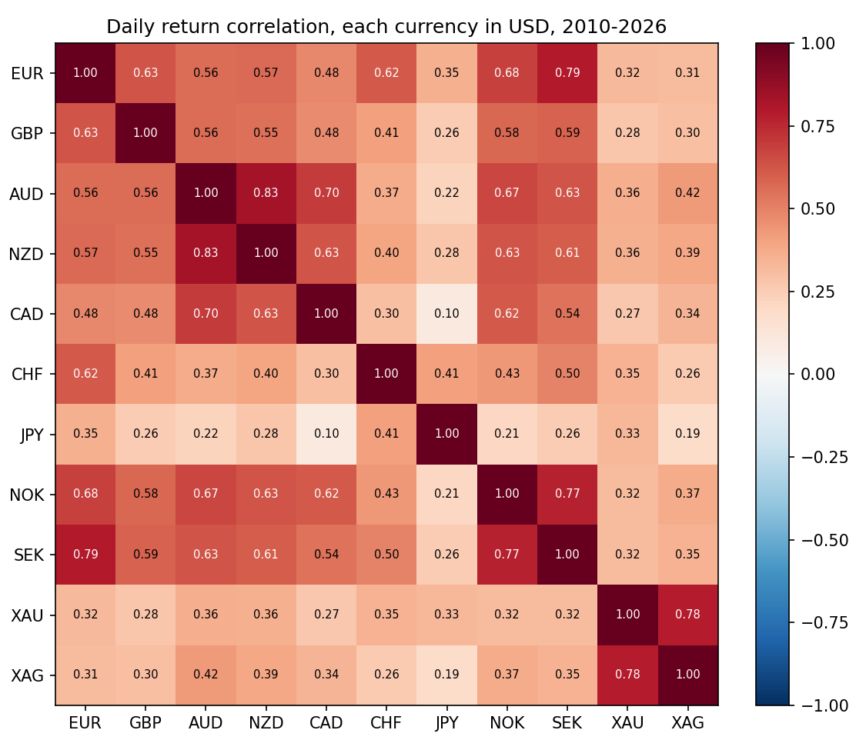
Currencies move together, mostly through the dollar
Strongest links
EUR–SEK 0.79, AUD–NZD 0.83, NOK–SEK 0.77: neighbouring economies
Weakest link: JPY
0.10 – 0.41 with others. The yen is a safe haven with its own story
Metals
Gold–silver 0.78 together, but only 0.19 – 0.42 with currencies
Notes:
Daily returns of each currency priced in US dollars. Every correlation is positive because the dollar moves all of them together.

Slide 16
Three forces explain 72% of all movement
PC1 · 49% · the dollar
Every currency moves the same way against USD
PC2 · 13% · metals
Gold and silver vs the currencies
PC3 · 10% · risk mood
AUD, NZD, CAD vs safe havens JPY, CHF

Slide 17
Forex leftovers pull back; gold/silver doesn't
15 of 23
crosses below 1
0.79 · EURSEK
strongest pullback
1.20 · gold/silver
worst of all 24

Slide 18
Trading the pullback, 2010 – 2026
TRAIN 2010 – 2018 · settings chosen here
TEST 2019 – 2026 · untouched
1.10
train Sharpe
8.1%/yr
Year | Trades | Win % | Return %
2010 | 16 | 56 | +6.2
2011 | 32 | 62 | +7.6
2012 | 14 | 50 | +1.6
2013 | 37 | 62 | +4.6
2014 | 34 | 79 | +14.2
2015 | 29 | 69 | +16.5
2016 | 31 | 65 | +9.4
2017 | 32 | 78 | +18.3
2018 | 24 | 50 | -3.5
Year | Trades | Win % | Return %
2019 | 25 | 56 | -2.2
2020 | 33 | 61 | +9.4
2021 | 34 | 56 | -5.8
2022 | 33 | 64 | +1.8
2023 | 27 | 74 | +6.5
2024 | 22 | 73 | +5.7
2025 | 37 | 70 | +5.2
2026 | 28 | 79 | +13.9
0.58
test Sharpe
4.4%/yr
13 cross pairs, daily candles, entry |s| ≥ 2.5, exit at 0.5. Costs = Vantage spreads + commission, swap-free account. Supporting evidence only.

Slide 19
Part 3 · When not to trade
A daily PCA gauge of how much one force drives the market

Slide 20
The daily gauge: share of the first factor
1
2
3
4
Collect
Last 480 hourly returns (≈ 20 days) of the 11 instruments
Scale
Correlation matrix 11 × 11 (each series variance 1)
PCA
11 eigenvalues, adding up to 11
Share
Largest eigenvalue ÷ 11
Example · 16 Oct 2026
Eigenvalues: 6.45, 1.23, 0.89, 0.58 … 0.11 (sum 11.0)
Share = 6.45 ÷ 11 = 58.6%
Cut-off 47.5% → tradable day ✓
Rule (uses past data only)
Cut-off = the level that one third of all previous days fell below (33rd percentile)
Share ≤ cut-off → no-trade day: currencies are moving on their own news

Slide 21
The gauge, 2010 – 2026
When | Event | Share | Cut-off | Gauge
2011-08 | US downgrade | 43.1% | 48.3% | no-trade
2015-01 | SNB drops CHF floor | 37% | 45.3% | no-trade
2016-06 | Brexit vote | 55.6% | 44.5% | trade
2020-03 | COVID crash | 38.1% | 44.3% | no-trade
2022-09 | UK gilt crisis | 68.6% | 46.2% | trade
2025-04 | US tariff shock | 42.1% | 46.9% | no-trade
Gauge one week after each shock. Crises that split currencies into safe vs risky (COVID, SNB, US downgrade) push the share DOWN; dollar-driven episodes (UK gilt crisis) push it up.

Slide 22
When the gauge is low, pair relationships break
Break rate, low vs high gauge
Period | Low | High
2010-14 | 9.0% | 3.4%
2015-18 | 6.1% | 2.6%
2019-22 | 7.5% | 3.1%
2023-26 | 8.2% | 1.3%
3×
more breaks in low periods (7.7% vs 2.3%), 3,345 events
22 of 23
pairs break more when the gauge is low
Notes:
Low gauge = no single boss; each currency follows its own news (rate surprises, safe-haven flows), so the rubber bands between them snap. Holds in every period. Only AUDNZD is the exception.

Slide 23
Days PCA marks as safe, per year
69%
of days tradable on average (≈ 180 per year)
31 – 33%
2013 – 14: Abenomics, central banks diverging
~10 days
typical no-trade spell; the warning stays on for a while

Slide 24
Check on real trades
Trades opened on | Trades | Win % | Stopped out % | Avg net per trade %
2010 – 26 · no-trade days | 186 | 66 | 13.4 | 0.26
2010 – 26 · trade days | 286 | 66 | 8.0 | 0.19
2010 – 18 · no-trade days | 122 | 69 | 12.3 | 0.38
2010 – 18 · trade days | 111 | 63 | 7.2 | 0.22
2019 – 26 · no-trade days | 64 | 59 | 15.6 | 0.04
2019 – 26 · trade days | 175 | 69 | 8.6 | 0.17
Supports the conclusion
Stop-losses hit 1.7× more often on no-trade days (13.4% vs 8.0%)
2019 – 26: 0.04% vs 0.17% per trade
Honest limit
2010 – 18: no-trade days earned more (bigger moves, bigger winners)
So the gauge is a risk warning, not a profit rule

Slide 25
Limits of this study
Not every pair pulls back
8 of 23 crosses have a variance ratio above 1 (e.g. AUDNZD 1.14)
Breakdowns are the tail
The gauge changes the break rate a lot; the chance of pulling back only moves 39 – 45%
Trading costs
Results are swap-free. With worst-case swap the 2019 – 26 test was about flat
Scope
Tested on 23 cross pairs. USD pairs themselves, exotics, indices and crypto not tested
Per-pair numbers are small
About 2 – 15 breaks per pair. The evidence is the pattern across all 23 together

Slide 26
PCA tells us when not to trust pair relationships
Forex cross leftovers pull back; gold/silver trends and fails
When one common force explains less of the market than on two-thirds of past days, stretched pairs break about 3× more often
A simple daily PCA gauge, using past data only, flags those periods: about one-third of days

