Slide 1

DOCTOR-A SOCIAL NETWORKING PLATFORM Project Synopsis Presentation Date:15-01-2021
PROJECT CODE
(MCAP 506)
MCA
Project Guide:
Ms.Monika Belwal
Group:
Yogesh Bhatt(201809014)
Tushar Agrawal(201809013)

Slide 2
INTRODUCTION
The “DOCTOR” project is an innovative thought to simplified way to connect professionals from different field to share their research give comment on a particular topic or to review patients. In the present Scenario, there is no effective or efficient way for doctors to publish their research or to interact with multiple professionals to share their experience.
Large gap time between the query and their solution.
Single professional can interact only with a particular patient.
Needed to provide all the record in written format.
2

Slide 3
Technologies and Tools to be used
1.Software Platform
Front-end:- NetBeans IDE
Back-end:- MySQL Server
Xampp Server
2.Hardware Platform
Intel i-3 Core processor and above.
Ram 2 GB and above.
HDD 20 GB Hard Disk and above.
3
T002/ Version 1.0

Slide 4
Advantages of this Project
This system allows users to login into the system which is password protected and hence, prevents any unauthorized access.
The user can view the manage his details and manage them accordingly.
Provide the detailed diagnosis of the problem and give its solution.
Less time consuming.
User Friendly.
Good platform to share research among professional practitioner.

Slide 5
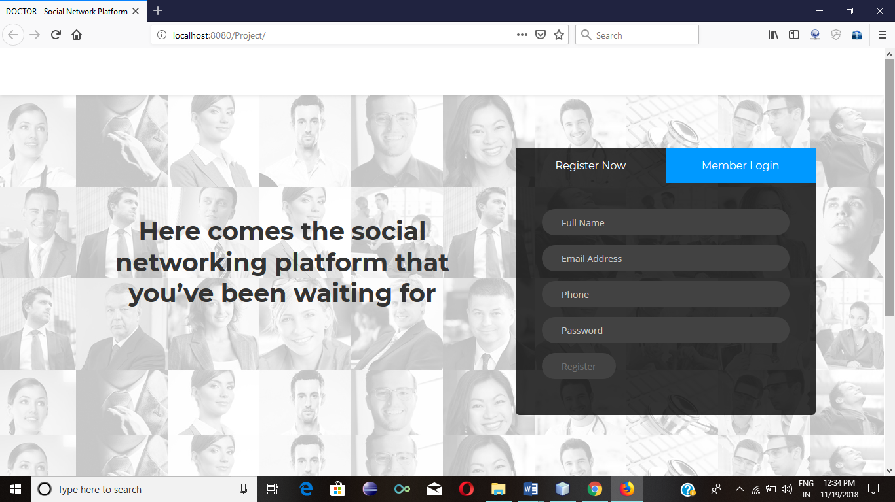
5

Slide 6
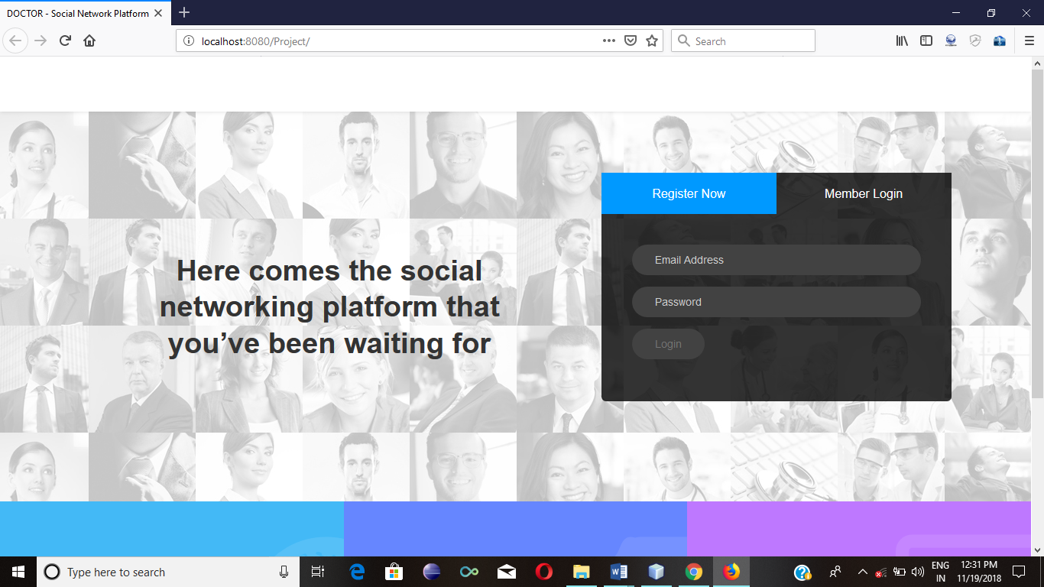

Slide 7
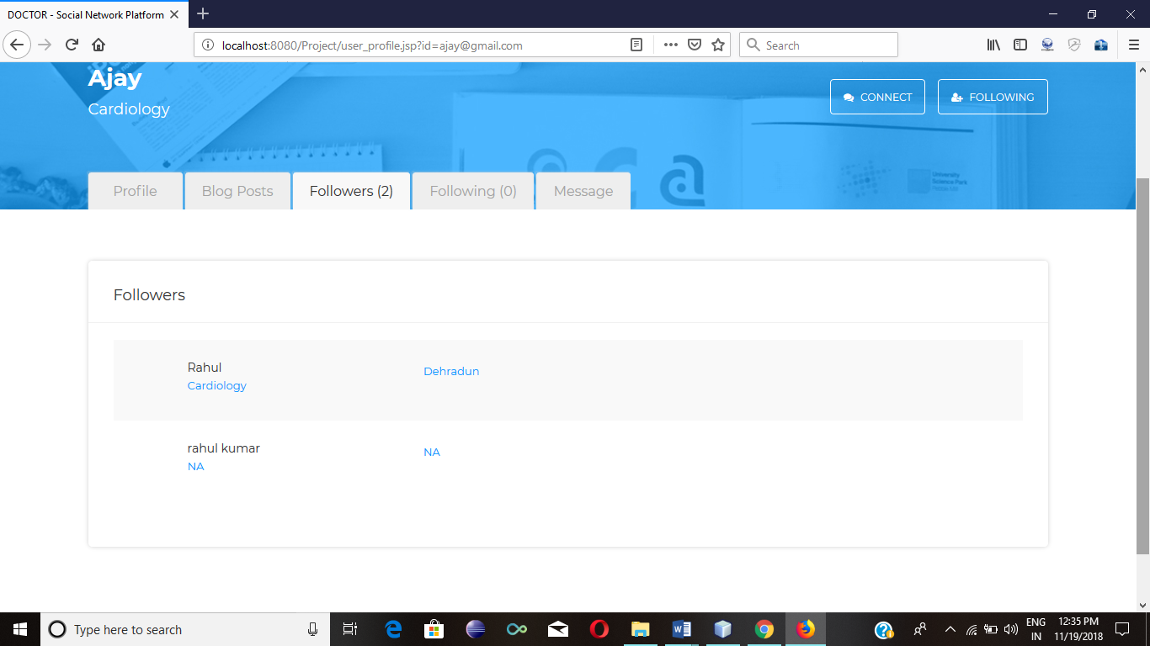

Slide 8
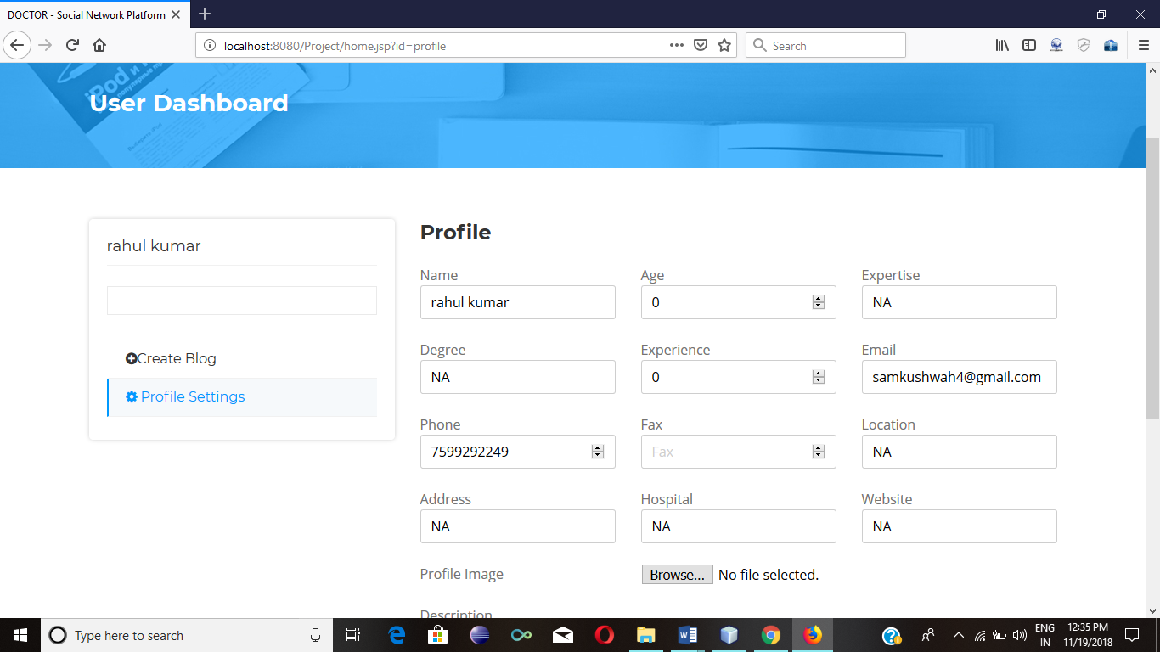

Slide 9
THANKS

