Slide 1
Policy Endorsement System(ePES)
Group Number 2
Notes:
Add instructor notes here.

Slide 2
Objectives
Project Understanding
Approach used
Project Execution
Modules
Opportunity for improvement
Demo and Code Walkthrough
Q&A
Notes:
Add instructor notes here.

Slide 3
Project Understanding
Policy Endorsement System is basically a management system regarding Policy Endorsement.
A life insurance endorsement is a document that is used in order to make some type of change to the original life insurance policy.
This is typically a piece of paper that is attached to the original document. You will be able to read the document and see exactly what has been changed from the original policy that was used by the insurance company.
Notes:
Add instructor notes here.

Slide 4
Project Understanding(contd…)
Customer can search his/her policy details by entering Customer ID or Name, Policy Number and Date of birth. Those details will be displayed in a data grid.
After searching the policy details Customer can view his/her personal details by clicking on view details. Those details will be in non-editable format.
Customer can update his/her details but he/she has to submit any supporting documents regarding that updation.
The request will be sent to the Admin, and only Admin has the right to approve or reject the request raised by the customer.
Customer can view the status of his/her endorsement in view endorsement status option.
Notes:
Add instructor notes here.

Slide 5
Approach used :
ASP .NET MVC is a Microsoft framework for builder web application that uses a model- view-controller pattern.
It supports functionalities like caching, Master Page, HTML Handlers, Membership and Customer Provider.
It doesn’t replace web form. Its an alternate project type.
It achieve clean URLs and clean HTML
We can extend the framework using pluggable view engines and controller factories.
MVC maintain a strict separation of concerns.
Notes:
Add the notes here.
Add instructor notes here.

Slide 6
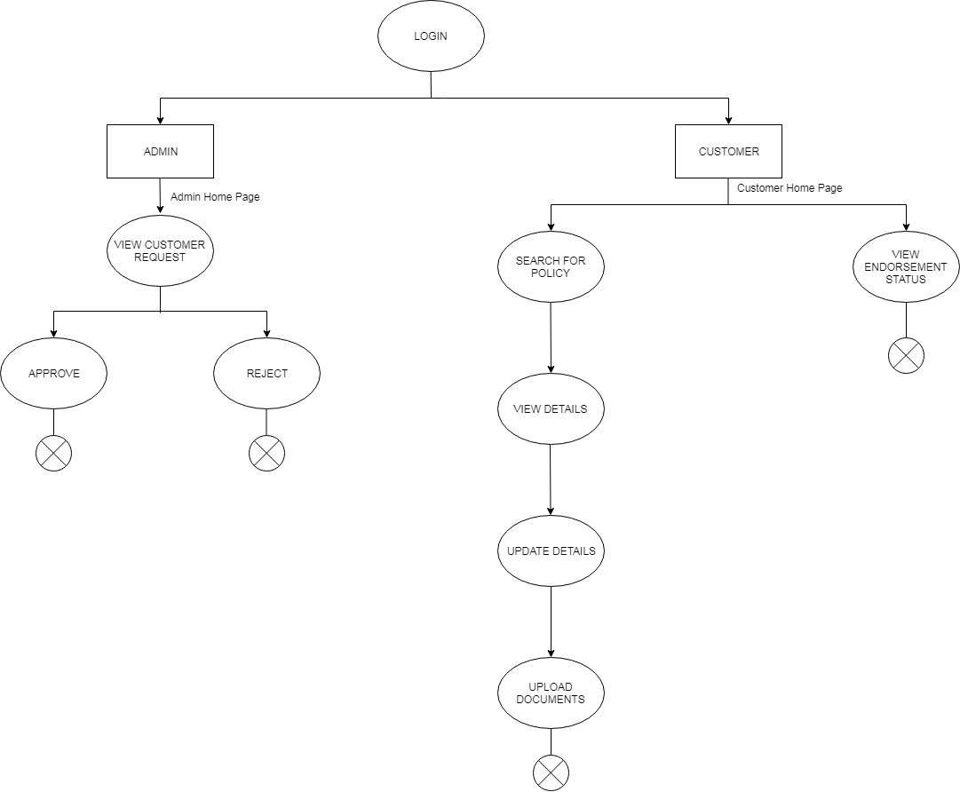
Project Execution
Notes:
Add the notes here.
Add instructor notes here.

Slide 7
Modules
ADMIN Module
When Admin log into the application he will be redirected to the admin home page where he has option to view all the endorsement request by all the customers.
Those request will be shown in a data grid and by clicking on a specific entry the details will be shown in form view and the admin can view the document regarding that entry and based on that document the admin will approve or reject the endorsement request raised by customer.
Notes:
Add the notes here.
Add instructor notes here.

Slide 8
Modules(contd…)
If the admin approved that request then that data will be saved in the permanent details table otherwise its status will be changed to rejected from the temporary table. That status will be reflected in the customer view endorsement request option.

Slide 9
Opportunity for improvement
For Future purpose we can add some other functionalities in the application, such as:
Customer can register themselves for a new policy.
Customer can pay their premium from the application.
Customer can get notification about their premium frequency.
Notes:
Add the notes here.
Add instructor notes here.

Slide 10
Any
Questions?
Notes:
Add the notes here.
Add instructor notes here.

Slide 11
Thank You
Notes:
Add the notes here.
Add instructor notes here.

