Slide 1
Chapter Outline
9.1 General Constraints as Assertions
9.2 Views in SQL
9.3 Database Programming
9.4 Embedded SQL
9.5 Functions Calls, SQL/CLI
9.6 Stored Procedures, SQL/PSM
9.7 Summary
Slide 9- <number>

Slide 2
Chapter Objectives
Specification of more general constraints via assertions
SQL facilities for defining views (virtual tables)
Various techniques for accessing and manipulating a database via programs in general-purpose languages
  E.g., Java, C++, etc.
Slide 9- <number>

Slide 3
Constraints as Assertions
General constraints: constraints that do not fit in the basic SQL categories (presented in chapter 8)
Mechanism: CREAT ASSERTION
  Components include:
    a constraint name,
    followed by CHECK,
    followed by a condition
Slide 9- <number>

Slide 4
Assertions: An Example
“The salary of an employee must not be greater than the salary of the manager of the department that the employee works for’’
CREAT ASSERTION SALARY_CONSTRAINT
CHECK (NOT EXISTS (SELECT *
FROM EMPLOYEE E, EMPLOYEE M, DEPARTMENT D
WHERE E.SALARY > M.SALARY AND
E.DNO=D.NUMBER AND D.MGRSSN=M.SSN))
    constraint name,
    CHECK,
    condition
Slide 9- <number>

Slide 5
Using General Assertions
Specify a query that violates the condition; include inside a NOT EXISTS clause
Query result must be empty
  if the query result is not empty, the assertion has been violated
Slide 9- <number>

Slide 6
SQL Triggers
Objective: to monitor a database and take initiate action when a condition occurs
Triggers are expressed in a syntax similar to assertions and include the following:
  Event
    Such as an insert, deleted, or update operation
  Condition
  Action
    To be taken when the condition is satisfied
Slide 9- <number>

Slide 7
SQL Triggers: An Example
A trigger to compare an employee’s salary to his/her supervisor during insert or update operations:
CREATE TRIGGER INFORM_SUPERVISOR
BEFORE INSERT OR UPDATE OF
SALARY, SUPERVISOR_SSN ON EMPLOYEE
FOR EACH ROW
WHEN
(NEW.SALARY> (SELECT SALARY FROM EMPLOYEE
WHERE SSN=NEW.SUPERVISOR_SSN))
INFORM_SUPERVISOR (NEW.SUPERVISOR_SSN,NEW.SSN);
Slide 9- <number>

Slide 8
Views in SQL
A view is a “virtual” table that is derived from other tables
Allows for limited update operations
  Since the table may not physically be stored
Allows full query operations
A convenience for expressing certain operations
Slide 9- <number>

Slide 9
Specification of Views
SQL command: CREATE VIEW
  a table (view) name
  a possible list of attribute names (for example, when arithmetic operations are specified or when we want the names to be different from the attributes in the base relations)
  a query to specify the table contents
Slide 9- <number>

Slide 10
SQL Views: An Example
Specify a different WORKS_ON table
CREATE VIEW WORKS_ON_NEW AS
SELECT FNAME, LNAME, PNAME, HOURS
FROM EMPLOYEE, PROJECT, WORKS_ON
WHERE SSN=ESSN AND PNO=PNUMBER
GROUP BY PNAME;
Slide 9- <number>

Slide 11
Using a Virtual Table
We can specify SQL queries on a newly create table (view):
SELECT FNAME, LNAME
FROM WORKS_ON_NEW
WHERE PNAME=‘Admin’;
When no longer needed, a view can be dropped:
DROP WORKS_ON_NEW;
Slide 9- <number>

Slide 12
Efficient View Implementation
Query modification:
  Present the view query in terms of a query on the underlying base tables
Disadvantage:
  Inefficient for views defined via complex queries
    Especially if additional queries are to be applied to the view within a short time period
Slide 9- <number>

Slide 13
Efficient View Implementation
View materialization:
  Involves physically creating and keeping a temporary table
Assumption:
  Other queries on the view will follow
Concerns:
  Maintaining correspondence between the base table and the view when the base table is updated
Strategy:
  Incremental update
Slide 9- <number>

Slide 14
Update Views
Update on a single view without aggregate operations:
  Update may map to an update on the underlying base table
Views involving joins:
  An update may map to an update on the underlying base relations
    Not always possible
Slide 9- <number>

Slide 15
Un-updatable Views
Views defined using groups and aggregate functions are not updateable
Views defined on multiple tables using joins are generally not updateable
WITH CHECK OPTION: must be added to the definition of a view if the view is to be updated
  To allow check for updatability and to plan for an execution strategy
Slide 9- <number>

Slide 16
Database Programming
Objective:
  To access a database from an application program (as opposed to interactive interfaces)
Why?
  An interactive interface is convenient but not sufficient
    A majority of database operations are made thru application programs (increasingly thru web applications)
Slide 9- <number>

Slide 17
Database Programming Approaches
Embedded commands:
  Database commands are embedded in a general-purpose programming language
Library of database functions:
  Available to the host language for database calls; known as an API
    API standards for Application Program Interface
A brand new, full-fledged language
  Minimizes impedance mismatch
Slide 9- <number>

Slide 18
Impedance Mismatch
Incompatibilities between a host programming language and the database model, e.g.,
  type mismatch and incompatibilities; requires a new binding for each language
  set vs. record-at-a-time processing
    need special iterators to loop over query results and manipulate individual values
Slide 9- <number>

Slide 19
Steps in Database Programming
Client program opens a connection to the database server
Client program submits queries to and/or updates the database
When database access is no longer needed, client program closes (terminates) the connection
Slide 9- <number>

Slide 20
Embedded SQL
Most SQL statements can be embedded in a general-purpose host programming language such as COBOL, C, Java
An embedded SQL statement is distinguished from the host language statements by enclosing it between EXEC SQL or EXEC SQL BEGIN and a matching END-EXEC or EXEC SQL END (or semicolon)
  Syntax may vary with language
  Shared variables (used in both languages) usually prefixed with a colon (:) in SQL
Slide 9- <number>

Slide 21
Example: Variable Declaration in Language C
Variables inside DECLARE are shared and can appear (while prefixed by a colon) in SQL statements
SQLCODE is used to communicate errors/exceptions between the database and the program
int loop;
EXEC SQL BEGIN DECLARE SECTION;
varchar dname[16], fname[16], …;
char ssn[10], bdate[11], …;
int dno, dnumber, SQLCODE, …;
EXEC SQL END DECLARE SECTION;
Slide 9- <number>

Slide 22
SQL Commands for
Connecting to a Database
Connection (multiple connections are possible but only one is active)
CONNECT TO server-name AS connection-name
AUTHORIZATION user-account-info;
Change from an active connection to another one
SET CONNECTION connection-name;
Disconnection
DISCONNECT connection-name;
Slide 9- <number>

Slide 23
Embedded SQL in C
Programming Examples
loop = 1;
while (loop) {
prompt (“Enter SSN: “, ssn);
EXEC SQL
select FNAME, LNAME, ADDRESS, SALARY
into :fname, :lname, :address, :salary
from EMPLOYEE where SSN == :ssn;
if (SQLCODE == 0) printf(fname, …);
else printf(“SSN does not exist: “, ssn);
prompt(“More SSN? (1=yes, 0=no): “, loop);
END-EXEC
}
Slide 9- <number>

Slide 24
Embedded SQL in C Programming Examples
A cursor (iterator) is needed to process multiple tuples
FETCH commands move the cursor to the next tuple
CLOSE CURSOR indicates that the processing of query results has been completed
Slide 9- <number>

Slide 25
Dynamic SQL
Objective:
  Composing and executing new (not previously compiled) SQL statements at run-time
    a program accepts SQL statements from the keyboard at run-time
    a point-and-click operation translates to certain SQL query
Dynamic update is relatively simple; dynamic query can be complex
  because the type and number of retrieved attributes are unknown at compile time
Slide 9- <number>

Slide 26
Dynamic SQL: An Example
EXEC SQL BEGIN DECLARE SECTION;
varchar sqlupdatestring[256];
EXEC SQL END DECLARE SECTION;
…
prompt (“Enter update command:“, sqlupdatestring);
EXEC SQL PREPARE sqlcommand FROM :sqlupdatestring;
EXEC SQL EXECUTE sqlcommand;
Slide 9- <number>

Slide 27
Embedded SQL in Java
SQLJ: a standard for embedding SQL in Java
An SQLJ translator converts SQL statements into Java
  These are executed thru the JDBC interface
Certain classes have to be imported
  E.g., java.sql
Slide 9- <number>

Slide 28
Java Database Connectivity
JDBC:
  SQL connection function calls for Java programming
A Java program with JDBC functions can access any relational DBMS that has a JDBC driver
JDBC allows a program to connect to several databases (known as data sources)
Slide 9- <number>

Slide 29
Steps in JDBC Database Access
Import JDBC library (java.sql.*)
Load JDBC driver: Class.forname(“oracle.jdbc.driver.OracleDriver”)
Define appropriate variables
Create a connect object (via getConnection)
Create a statement object from the Statement class:
  1. PreparedStatment 2. CallableStatement
Identify statement parameters (designated by question marks)
Bound parameters to program variables
Execute SQL statement (referenced by an object) via JDBC’s executeQuery
Process query results (returned in an object of type ResultSet)
  ResultSet is a 2-dimentional table
Slide 9- <number>

Slide 30
Embedded SQL in Java:An Example
ssn = readEntry("Enter a SSN: ");
try {
#sql{select FNAME, LNAME, ADDRESS, SALARY
into :fname, :lname, :address, :salary
from EMPLOYEE where SSN = :ssn};
}
catch (SQLException se) {
System.out.println("SSN does not exist: ",+ssn);
return;
}
System.out.println(fname + " " + lname + … );
Slide 9- <number>

Slide 31
Multiple Tuples in SQLJ
SQLJ supports two types of iterators:
  named iterator: associated with a query result
  positional iterator: lists only attribute types in a query result
A FETCH operation retrieves the next tuple in a query result:
fetch iterator-variable into program-variable
Slide 9- <number>

Slide 32
Database Programming with Functional Calls
Embedded SQL provides static database programming
API: Dynamic database programming with a library of functions
  Advantage:
    No preprocessor needed (thus more flexible)
  Disadvantage:
    SQL syntax checks to be done at run-time
Slide 9- <number>

Slide 33
SQL Call Level Interface
A part of the SQL standard
Provides easy access to several databases within the same program
Certain libraries (e.g., sqlcli.h for C) have to be installed and available
SQL statements are dynamically created and passed as string parameters in the calls
Slide 9- <number>

Slide 34
Components of SQL/CLI
Environment record:
  Keeps track of database connections
Connection record:
  Keep tracks of info needed for a particular connection
Statement record:
  Keeps track of info needed for one SQL statement
Description record:
  Keeps track of tuples
Slide 9- <number>

Slide 35
Steps in C and SQL/CLI Programming
Load SQL/CLI libraries
Declare record handle variables for the above components (called: SQLHSTMT, SQLHDBC, SQLHENV, SQLHDEC)
Set up an environment record using SQLAllocHandle
Set up a connection record using SQLAllocHandle
Set up a statement record using SQLAllocHandle
Prepare a statement using SQL/CLI function SQLPrepare
Bound parameters to program variables
Execute SQL statement via SQLExecute
Bound query columns to a C variable via SQLBindCol
Use SQLFetch to retrieve column values into C variables
Slide 9- <number>

Slide 36
Database Stored Procedures
Persistent procedures/functions (modules) are stored locally and executed by the database server
  As opposed to execution by clients
Advantages:
  If the procedure is needed by many applications, it can be invoked by any of them (thus reduce duplications)
  Execution by the server reduces communication costs
  Enhance the modeling power of views
Disadvantages:
  Every DBMS has its own syntax and this can make the system less portable
Slide 9- <number>

Slide 37
Stored Procedure Constructs
A stored procedure
CREATE PROCEDURE procedure-name (params)
local-declarations
procedure-body;
A stored function
CREATE FUNCTION fun-name (params) RETRUNS return-type
local-declarations
function-body;
Calling a procedure or function
CALL procedure-name/fun-name (arguments);
Slide 9- <number>

Slide 38
SQL Persistent Stored Modules
SQL/PSM:
  Part of the SQL standard for writing persistent stored modules
SQL + stored procedures/functions + additional programming constructs
  E.g., branching and looping statements
  Enhance the power of SQL
Slide 9- <number>

Slide 39
SQL/PSM: An Example
CREATE FUNCTION DEPT_SIZE (IN deptno INTEGER)
RETURNS VARCHAR[7]
DECLARE TOT_EMPS INTEGER;
SELECT COUNT (*) INTO TOT_EMPS
FROM SELECT EMPLOYEE WHERE DNO = deptno;
IF TOT_EMPS > 100 THEN RETURN “HUGE”
ELSEIF TOT_EMPS > 50 THEN RETURN “LARGE”
ELSEIF TOT_EMPS > 30 THEN RETURN “MEDIUM”
ELSE RETURN “SMALL”
ENDIF;
Slide 9- <number>

Slide 40
Parameter Mode & Description
IN
An IN parameter lets you pass a value to the subprogram.
It is a read-only parameter. Inside the subprogram, an IN parameter acts like a constant. It cannot be assigned a value. You can pass a constant, literal, initialized variable, or expression as an IN parameter. You can also initialize it to a default value; however, in that case, it is omitted from the subprogram call.
It is the default mode of parameter passing. Parameters are passed by reference.
Slide 9- <number>

Slide 41
OUT
An OUT parameter returns a value to the calling program. Inside the subprogram, an OUT parameter acts like a variable. You can change its value and reference the value after assigning it. The actual parameter must be variable and it is passed by value.
Slide 9- <number>

Slide 42
IN OUT
An IN OUT parameter passes an initial value to a subprogram and returns an updated value to the caller. It can be assigned a value and the value can be read.
The actual parameter corresponding to an IN OUT formal parameter must be a variable, not a constant or an expression. Formal parameter must be assigned a value. Actual parameter is passed by value.
Slide 9- <number>

Slide 43
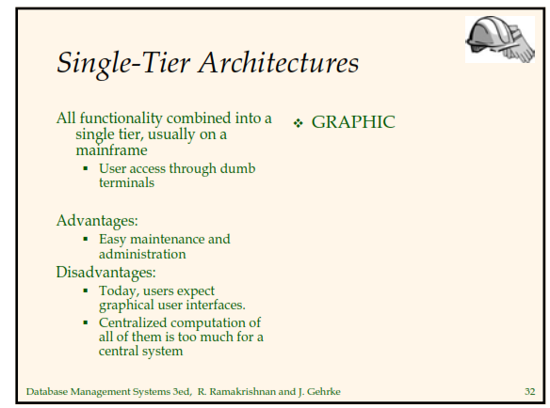
Slide 9- <number>

Slide 44
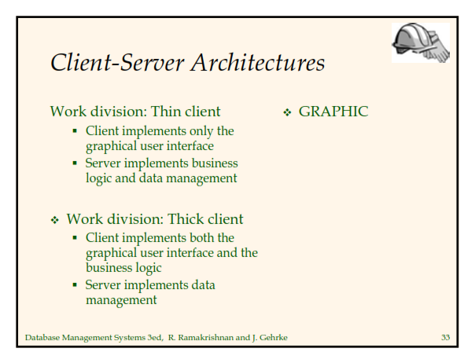
Slide 9- <number>

Slide 45
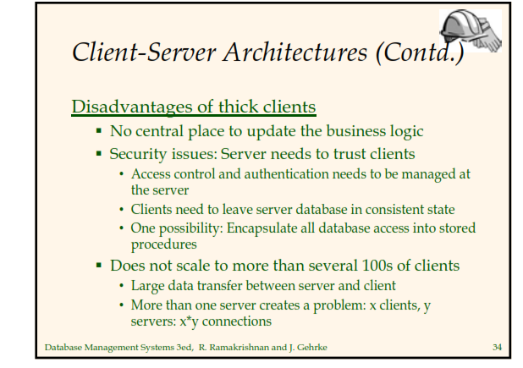
Slide 9- <number>

Slide 46
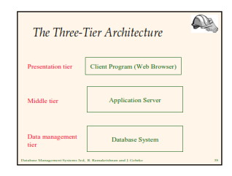
Slide 9- <number>

Slide 47
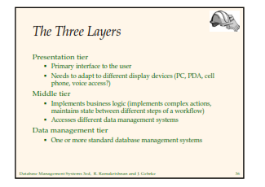
Slide 9- <number>

Slide 48
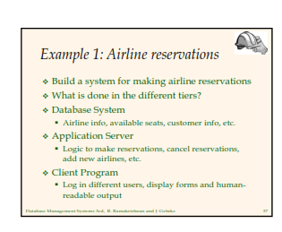
Slide 9- <number>

Slide 49
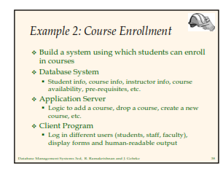
Slide 9- <number>

Slide 50
Summary
Assertions provide a means to specify additional constraints
Triggers are assertions that define actions to be automatically taken when certain conditions occur
Views create temporary (virtual) tables
A database may be accessed in an interactive mode
Most often, however, data in a database is manipulate via application programs
Several methods of database programming:
  Embedded SQL
  Dynamic SQL
  Stored procedure and function
Slide 9- <number>

Slide 51
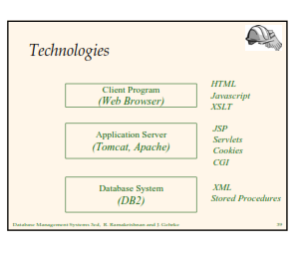
Slide 9- <number>

Slide 52
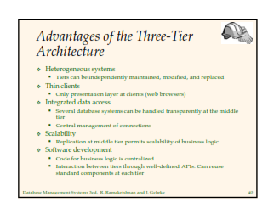
Slide 9- <number>

