Slide 1
open
UNIT 3 UNIX FILE APIs
This is used to establish a connection between a process and a file
i.e. it is used to open an existing file for data transfer function or else it may be also be used to create a new file.
The returned value of the open system call is the file descriptor (row number of the file table), which contains the inode information.
The prototype of open function is #include<sys/types.h> #include<sys/fcntl.h>
int open(const char *pathname, int accessmode, mode_t permission);

Slide 2
open
UNIT 3 UNIX FILE APIs
If successful, open returns a nonnegative integer representing the open file descriptor.If unsuccessful, open() returns –1.
The first argument is the name of the file to be created or opened.
This may be an absolute pathname or relative pathname.
If the given pathname is symbolic link, the open function will resolve the symbolic link reference to a non symbolic link file to which it refers.
The second argument is access modes, which is an integer value that specifies how actually the file should be accessed by the calling process.
:
54

Slide 3
UNIT 3 UNIX FILE APIs
open
Generally the access modes are specified in <fcntl.h>. Various access modes are:
Sl. No | Flag | Meaning
1 | O_RDONLY | open for reading file only
2 | O_WRONLY | open for writing file only
3 | O_RDWR | opens for reading and writing file
There are other access modes, which are termed as access modifier flags, and one or more of the following can be specified by bitwise-ORing them with one of the above access mode flags to alter the access mechanism of the file.

Slide 4
open
access modifier flags
UNIT 3 UNIX FILE APIs
S.No | Flag | Meaning
1 | O_APPEND | Append data to the end of file.
2 | O_CREAT | Create the file if it doesn’t exist
3 | O_EXCL | Generate an error if O_CREAT is also specified and the file already exists.
4 | O_TRUNC | If file exists discard the file content and set the file size to zero bytes.
5 | O_NONBLOCK | Specify subsequent read or write on the file should be non-blocking.
6 | O_NOCTTY | Specify not to use terminal device file as the calling process control terminal.

Slide 5
open
To illustrate the use of the above flags, the following example statement opens a file called /usr/syed/usp for read and write in append mode:
UNIT 3 UNIX FILE APIs
int fd=open(“/usr/cse/usp”, O_RDWR | O_APPEND,0);
If the file is opened in read only, then no other modifier flags can be used.
If a file is opened in write only or read write, then we are allowed to use any modifier flags along with them.
The third argument is used only when a new file is being created.

Slide 6
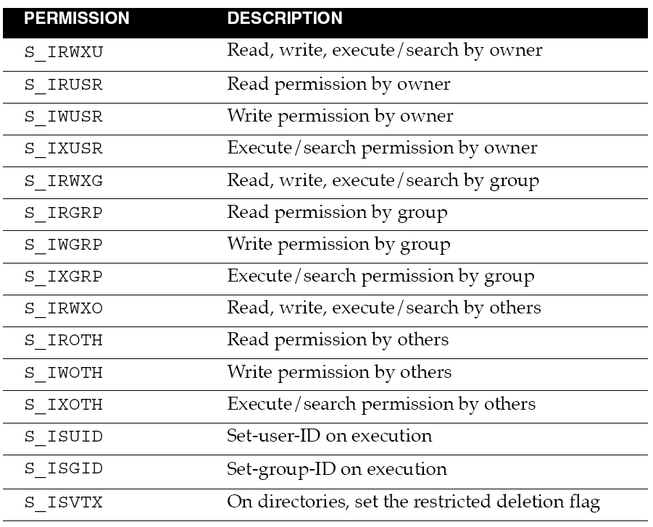
UNIT 3 UNIX FILE APIs
open
58

Slide 7
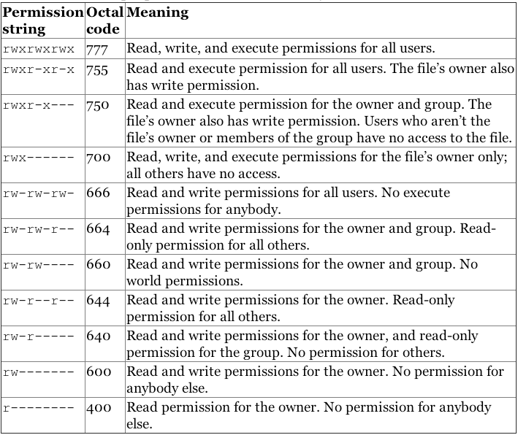
UNIT 3 UNIX FILE APIs
open

Slide 8
UNIT 3 UNIX FILE APIs
open

Slide 9
UNIT 3 UNIX FILE APIs
open
To open "sample.txt" in the current working directory for appending or create it, if it
does not exist, with read, write and execute permissions for owner only:
fd = open(“sample.txt", O_WRONLY|O_APPEND|O_CREAT, S_IRWXU); fd = open(“sample.txt", O_WRONLY|O_APPEND|O_CREAT, 0700);
fd = open(“sample.txt", O_WRONLY|O_CREAT|O_EXCL,
S_IRWXU|S_IROTH|S_IWOTH);
fd = open(“sample.txt", O_WRONLY|O_CREAT|O_EXCL,0706);
fd = open(“sample.txt", O_WRONLY|O_CREAT|O_TRUNC,0706);

Slide 10

UNIT 3 UNIX FILE APIs
open
Tag | Description
EACCES | The requested access to the file is not allowed, or search permission is denied for one of the directories in the path prefix of pathname, or the file did not exist yet and write access to the parent directory is not allowed.
EEXIST | pathname already exists and O_CREAT and O_EXCL were used.
EFAULT | pathname points outside accessible address space.
ENOENT | O_CREAT is not set and the named file does not exist. Or, a directory component in pathname does not exist or is a dangling symbolic link.
ENOMEM | Insufficient kernel memory was available.

Slide 11
creat ( )
UNIT 3 UNIX FILE APIs
This system call is used to create new regular files.
#include <sys/types.h> #include<unistd.h>
int creat(const char *pathname, mode_t mode);
Returns: file descriptor opened for write-only if OK, -1 on error.
The first argument pathname specifies name of the file to be created.
The second argument mode_t, specifies permission of a file to be accessed by owner group and others.
The creat function can be implemented using open function as:
#define creat(path_name, mode)
open (pathname, O_WRONLY | O_CREAT | O_TRUNC, mode);

Slide 12
UNIT 3 UNIX FILE APIs
read ( )
The read function fetches a fixed size of block of data from a file referenced by a
given file descriptor.
The prototype of read function is:
#include<sys/types.h> #include<unistd.h>
size_t read(int fdesc, void *buf, size_t nbyte);
If successful, read returns the no. of bytes actually read, on error it returns –1.
The first argument is an integer, fdesc that refers to an opened file.
The second argument, buf is the address of a buffer holding any data read.
The third argument specifies how many bytes of data are to be read from the file.
The size_t data type is defined in the <sys/types.h> header and should be the
same as unsigned int.

Slide 13
UNIT 3 UNIX FILE APIs
read ( )
There are several cases in which the number of bytes actually read is less than the amount requested:
When reading from a regular file, if the end of file is reached before the requested number of bytes has been read.
For example, if 30 bytes remain until the end of file and we try to read 100 bytes, read returns 30. The next time we call read, it will return 0 (end of file).
When reading from a terminal device. Normally, up to one line is read at a time.
When reading from a network. Buffering within the network may cause less than the requested amount to be returned.
When reading from a pipe or FIFO. If the pipe contains fewer bytes than requested, read will return only what is available.

Slide 14
UNIT 3 UNIX FILE APIs
read ( )- Errors
Tag | Description
EAGAIN | Non-blocking I/O has been selected using O_NONBLOCK and no data was immediately available for reading.
EBADF | fd is not a valid file descriptor or is not open for reading.
EFAULT | buf is outside your accessible address space.
EINTR | The call was interrupted by a signal before any data was read.
EINVAL | fd is attached to an object which is unsuitable for reading; or the file was opened with the O_DIRECT flag, and either the address specified in buf, the value specified in count, or the current file offset is not suitably aligned.
EIO | I/O error. This will happen for example when the process is in a background process group, tries to read from its controlling tty, and either it is ignoring or blocking SIGTTIN or its process group is orphaned. It may also occur when there is a low-level I/O error while reading from a disk or tape.
EISDIR | fd refers to a directory.

Slide 15
UNIT 3 UNIX FILE APIs
write( )
The write system call is used to write data into a file
The write function puts data to a file in the form of fixed block size referred by a given file.
The prototype of read function is:
#include<sys/types.h> #include<unistd.h>
ssize_t write(int fdesc, const void *buf, size_t size);
If successful, write returns the number of bytes actually written.
If unsuccessful, write returns –1.
The first argument, fdesc is an integer that refers to an opened file.
The second argument, buf is the address of a buffer that contains data to be written.
The third argument, size specifies how many bytes of data are in the buf argument.
The return value is usually equal to the number of bytes of data successfully written to a file.
(size value)

Slide 16
UNIT 3 UNIX FILE APIs
write( )-Errors
 | Error Code | Description
 | EAGAIN | Non-blocking I/O has been selected using O_NONBLOCK and the write would block.
 | EBADF | fd is not a valid file descriptor or is not open for writing.
 | EFAULT | buf is outside your accessible address space.
 | EFBIG | An attempt was made to write a file that exceeds the implementation-defined maximum file size or the process’ file size limit, or to write at a position past the maximum allowed offset.
 | EINTR | The call was interrupted by a signal before any data was written.
 | EINVAL | fd is attached to an object which is unsuitable for writing; or the file was opened with the O_DIRECT flag, and either the address specified in buf, the value specified in count, or the current file offset is not suitably aligned.
 | EIO | A low-level I/O error occurred while modifying the inode.
 | EPIPE | fd is connected to a pipe or socket whose reading end is closed. When this happens the writing process will also receive a SIGPIPE signal. (Thus, the write return value is seen only if the program catches, blocks or ignores this signal.)
 |  | 69

Slide 17
UNIT 3 UNIX FILE APIs
close( )
The close system call is used to terminate the connection to a file from a process.
The prototype of the close() is
#include<unistd.h> int close(int fdesc);
If successful, close returns 0.
If unsuccessful, close returns –1.
The argument fdesc refers to an opened file.
Close function frees the unused file descriptors so that they can be reused to reference other files. This is important because a process may open up to OPEN_MAX files at any time and the close function allows a process to reuse file descriptors to access more than OPEN_MAX files in the course of its execution.
The close function de-allocates system resources like file table entry and memory buffer allocated to hold the read/write.

Slide 18
UNIT 3 UNIX FILE APIs
close( ) - Errors
Tag | Description
EBADF | fd isn’t a valid open file descriptor.
EINTR | The close() call was interrupted by a signal.
EIO | An I/O error occurred.

Slide 19
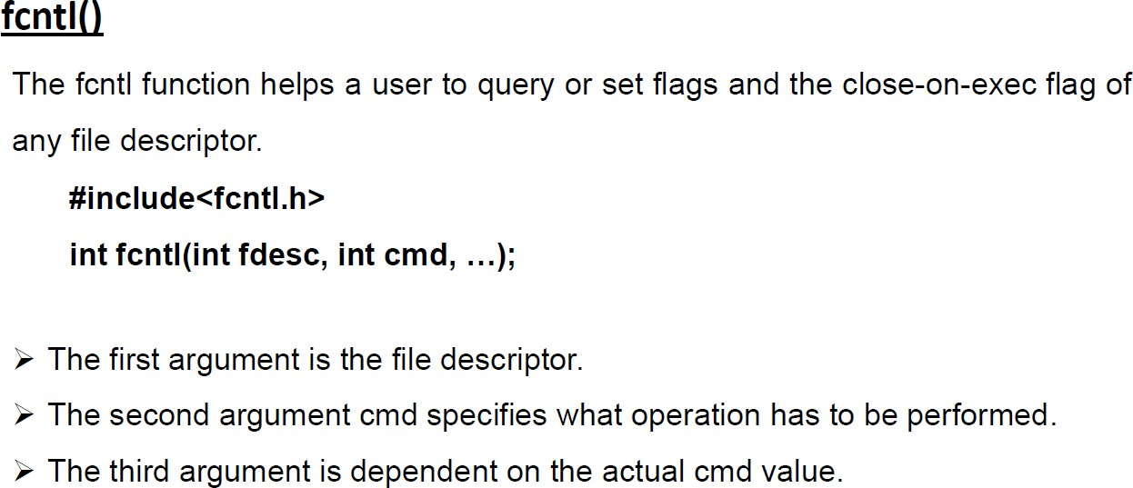
UNIT 3 UNIX FILE APIs

Slide 20
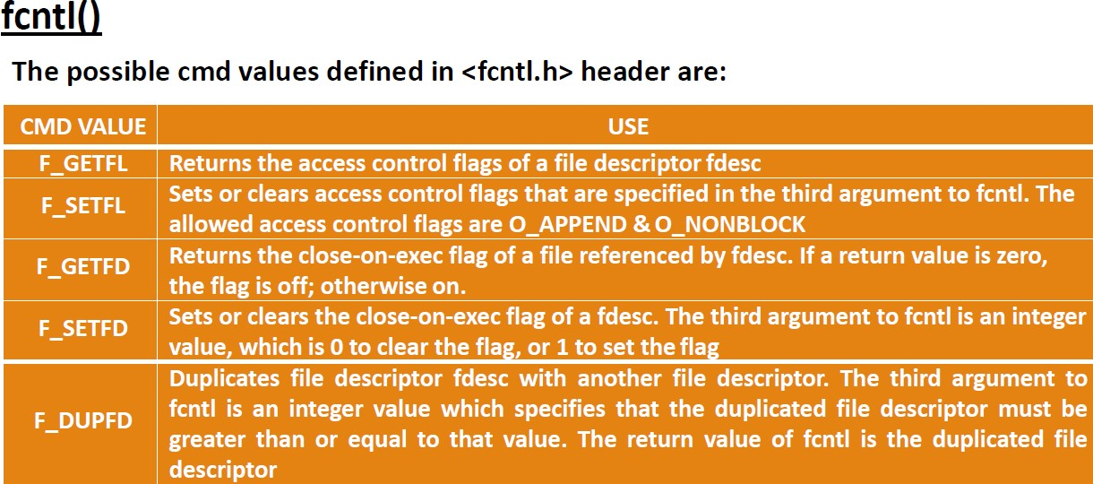
UNIT 3 UNIX FILE APIs

Slide 21
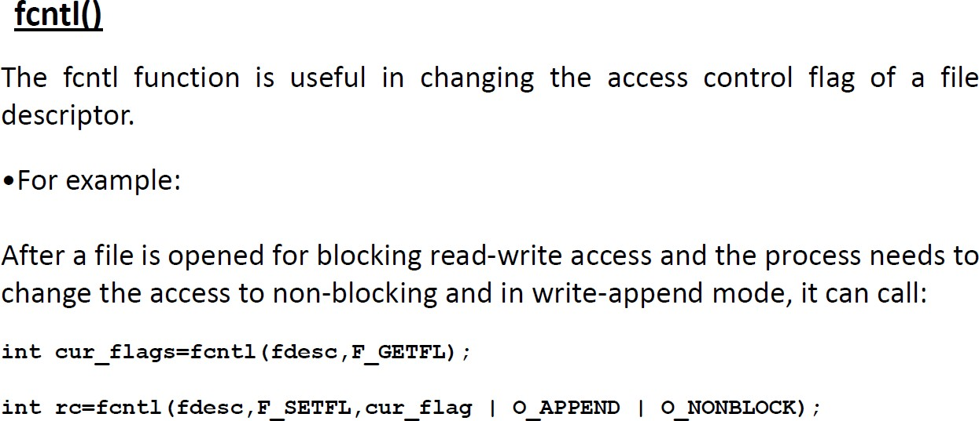
UNIT 3 UNIX FILE APIs

Slide 22
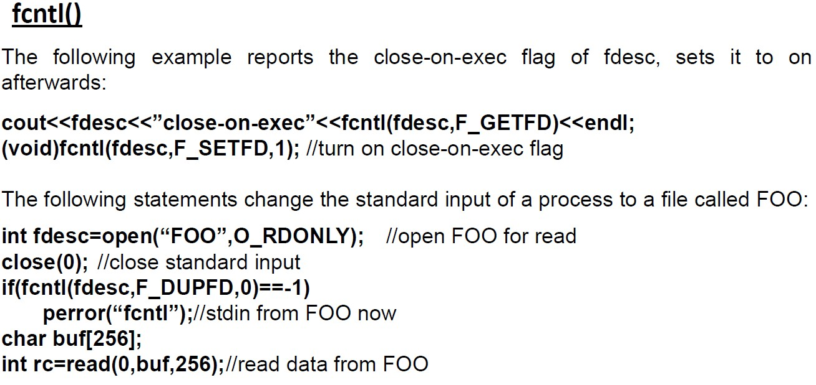
UNIT 3 UNIX FILE APIs

Slide 23
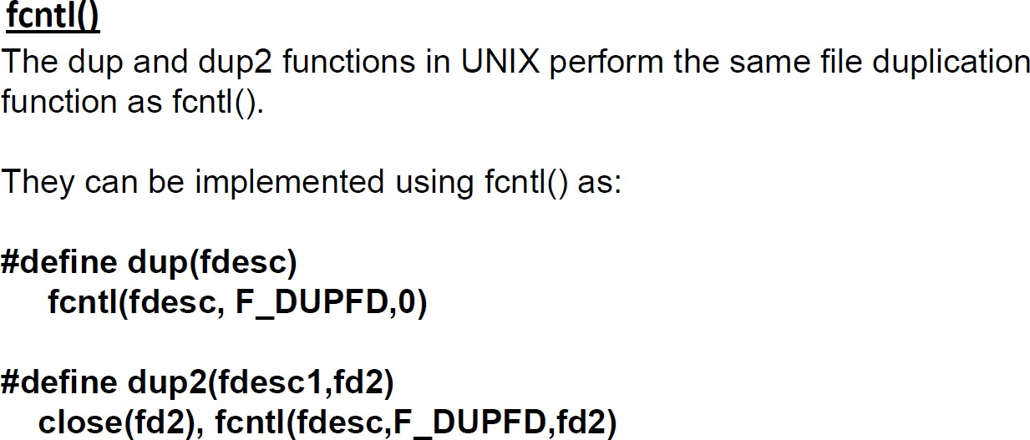
UNIT 3 UNIX FILE APIs

Slide 24
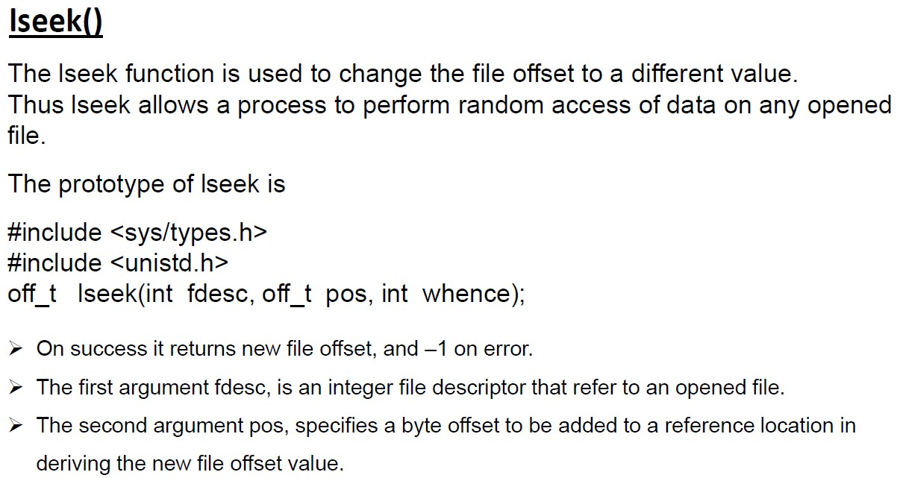
UNIT 3 UNIX FILE APIs

Slide 25
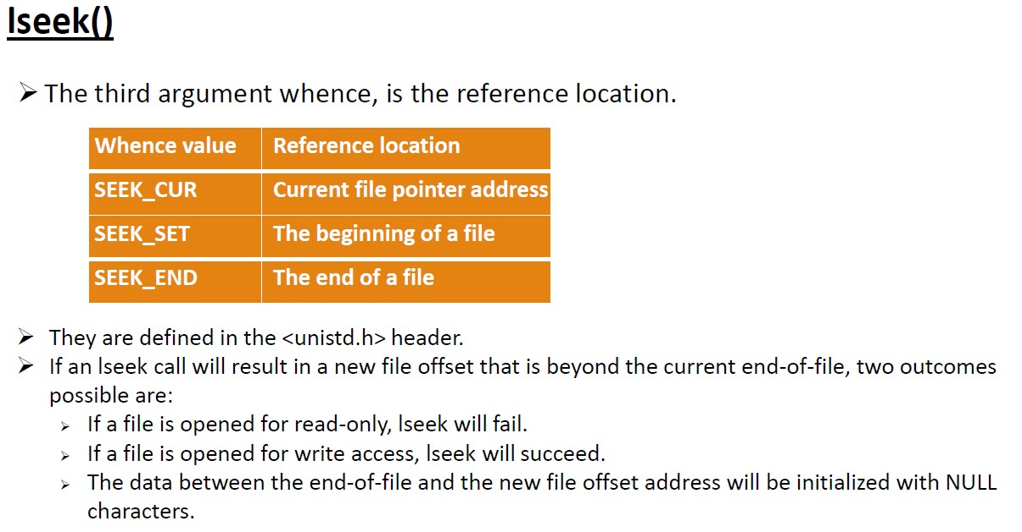
UNIT 3 UNIX FILE APIs

Slide 26
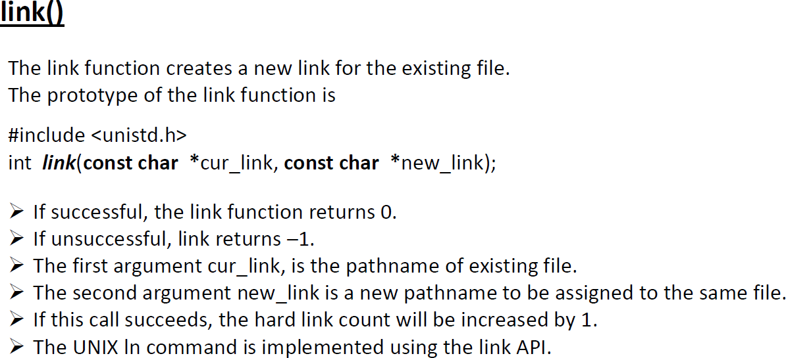
UNIT 3 UNIX FILE APIs

Slide 27
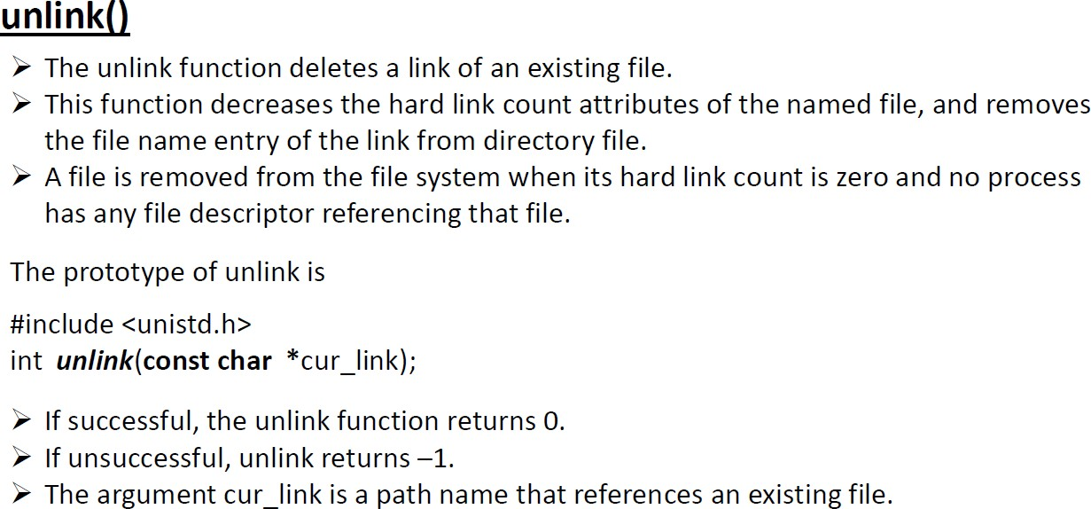
UNIT 3 UNIX FILE APIs

Slide 28
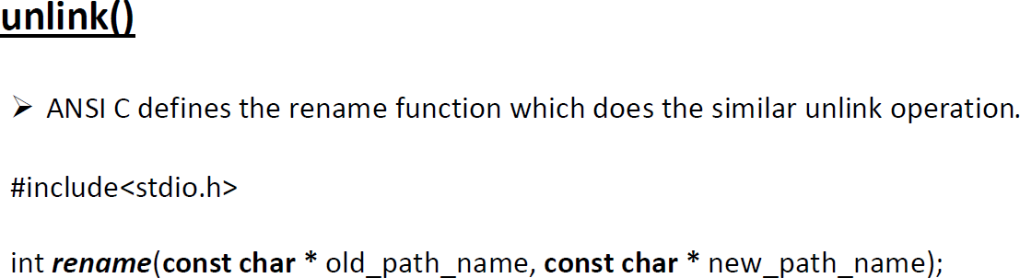
UNIT 3 UNIX FILE APIs

Slide 29
UNIT 3 UNIX FILE APIs
Chown(), fchown(), lchown()
The chown functions changes the user ID and group ID of files. The prototypes of these functions are:
#include<unistd.h> #include<sys/types.h>
int chown(const char *path_name, uid_t uid, gid_t gid); int fchown(int fdesc, uid_t uid, gid_t gid);
int lchown(const char *path_name, uid_t uid, gid_t gid);
The path_name argument is the path name of a file.
The uid argument specifies the new user ID to be assigned to the file. The gid argument specifies the new group ID to be assigned to the file.

Slide 30
UNIT 3 UNIX FILE APIs
Chmod(), fchmod()
The chmod and fchmod functions change file access permissions for owner, group & others as well as the set_UID, set_GID and sticky flags.
A process must have the effective UID of either the super-user/owner of the file.
The prototypes of these functions are
#include<sys/types.h> #include<sys/stat.h> #include<unistd.h>
int chmod(const char *pathname, mode_t flag); int fchmod(int fdesc, mode_t flag);

Slide 31
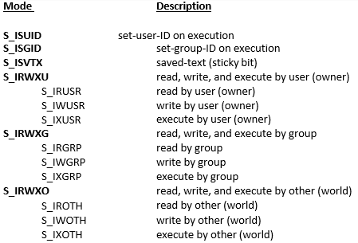
UNIT 3 UNIX FILE APIs
Chmod(), fchmod()
The pathname argument of chmod is the path name of a file whereas the fdesc argument of fchmod is
the file descriptor of a file.
The chmod function operates on the specified file, whereas the fchmod() function operates on a file that has already been opened.
To change the permission bits of a file, the effective user ID of the process must be equal to the owner ID of the file, or the process must have super-user permissions. The mode is specified as the bitwise OR of the constants shown below
90

Slide 32
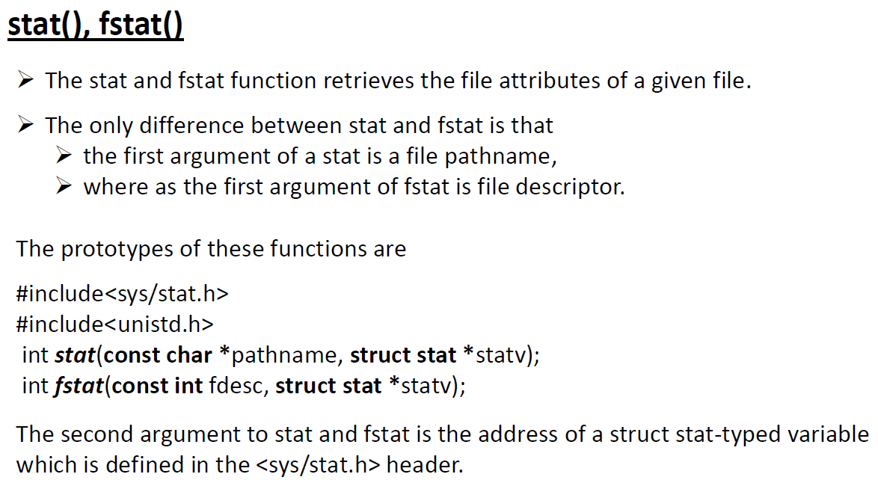
UNIT 3 UNIX FILE APIs

Slide 33
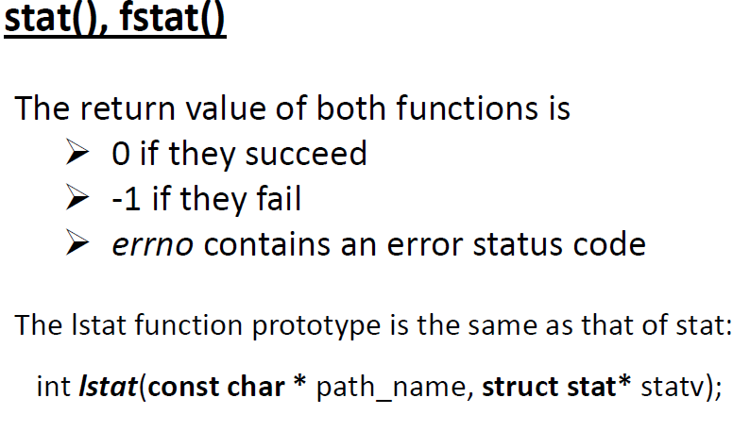
UNIT 3 UNIX FILE APIs

Slide 34
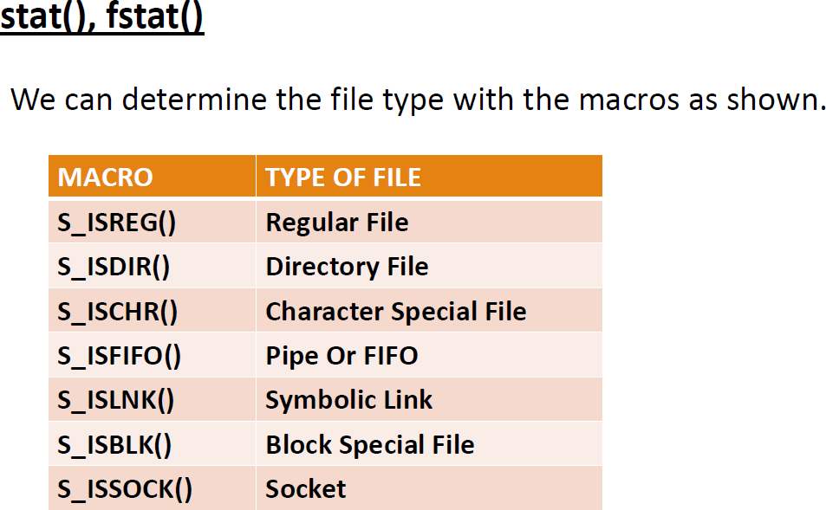
UNIT 3 UNIX FILE APIs

Slide 35
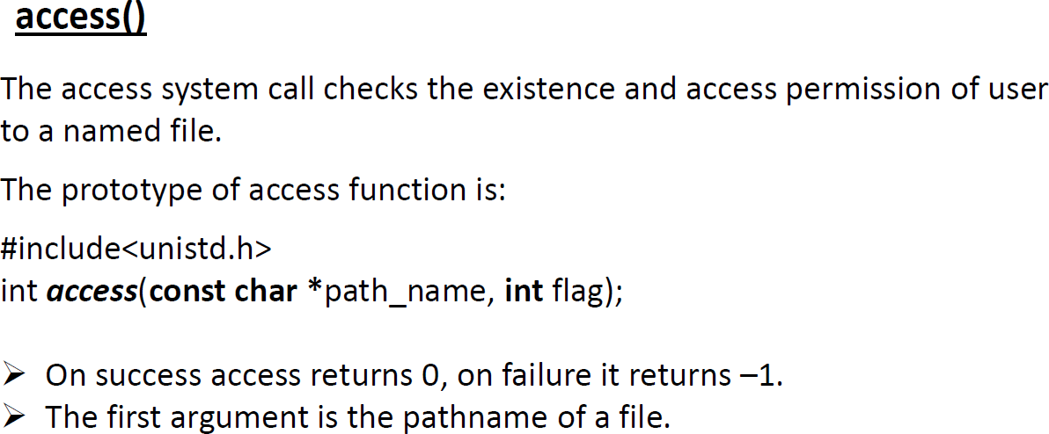
UNIT 3 UNIX FILE APIs

Slide 36
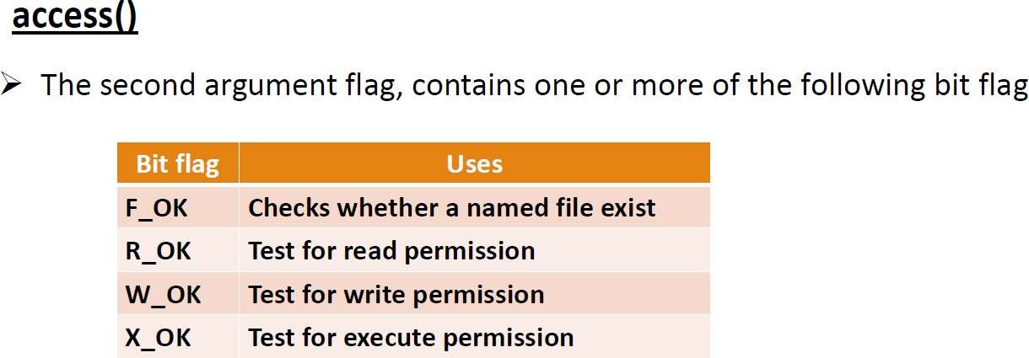
UNIT 3 UNIX FILE APIs

Slide 37
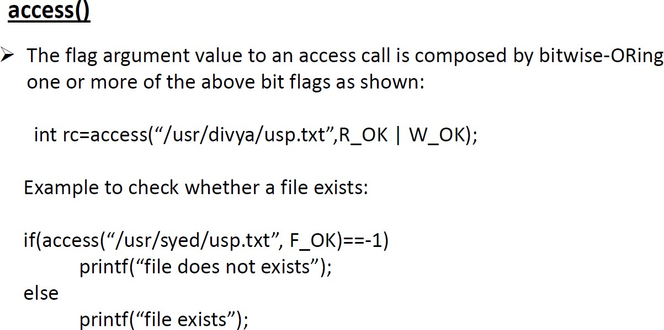
UNIT 3 UNIX FILE APIs

Slide 38
UNIT 3 UNIX FILE APIs

