Slide 1
Yoga Poses Classiﬁcation
Kratika Gupta Tushar Rao
Chaetenya Sharma
Under the supervision
of
Prof. Parimala Kancharla

Slide 2







MOTIVATION
Explosion of online ﬁtness trend during COIVD-19
Rise in need of AI based yoga instructors

Slide 3

PROJECT GOAL
First Phase
Create model to correctly classify ﬁve yoga poses

Slide 4

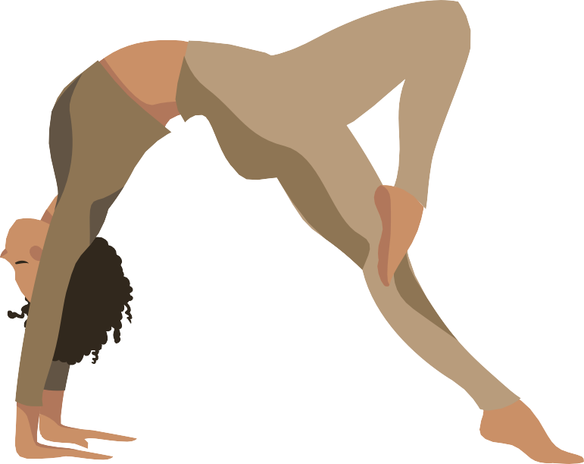


DATASET
The dataset obtained from Kaggle contained the following:
1,547 Total Images
5 Poses/Classes
The dataset can be found at: https://www.kaggle.com/datasets/niharika41298/yoga-poses-dataset

Slide 5

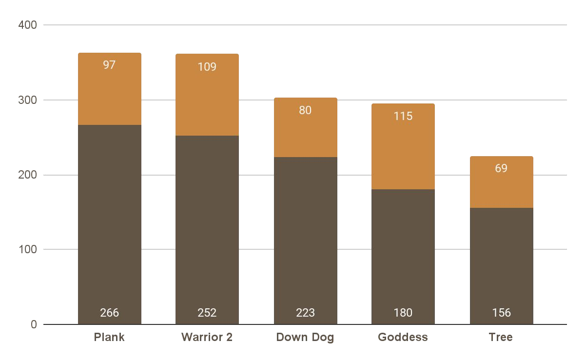



Yoga Pose Image Distribution
Test Set
470 Images
Train Set
1077 Images

Slide 6

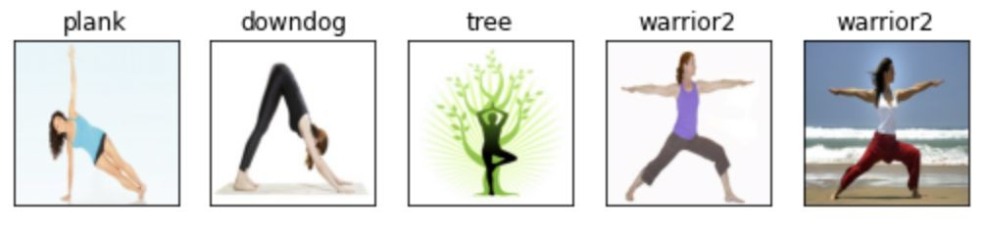
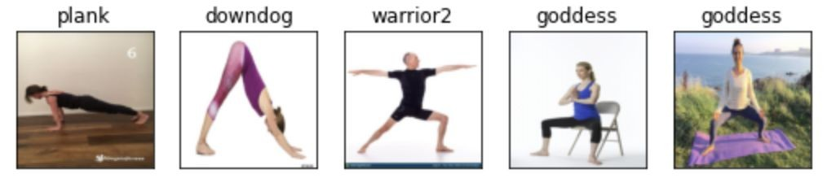
Sample Images from the Dataset

Slide 7





Logistic Regression Baseline Model
01 02
PCA
Decreased number of features down to 2
Logistic Regression
Using 2 principal components and 5 classes
03
04
Results
Accuracy = .23
Discussion
Deep learning using neural networks should produce better results.

Slide 8

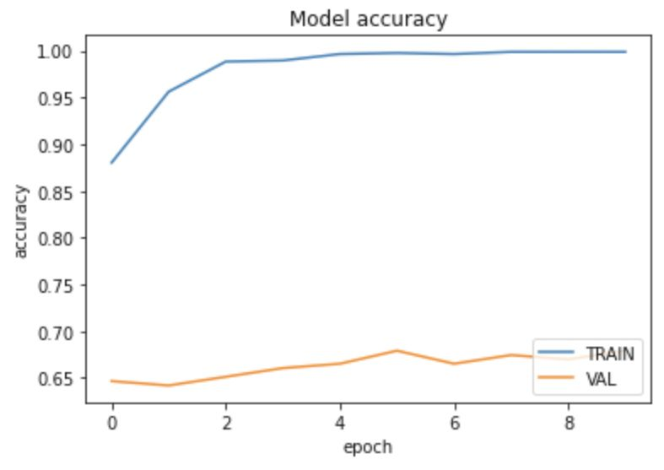
Convolutional Neural Network
Baseline CNN
Training Accuracy: 0.9908
Validation Accuracy: 0.6355
Model is overﬁtting
Improved accuracy over logistic regression model.

Slide 9

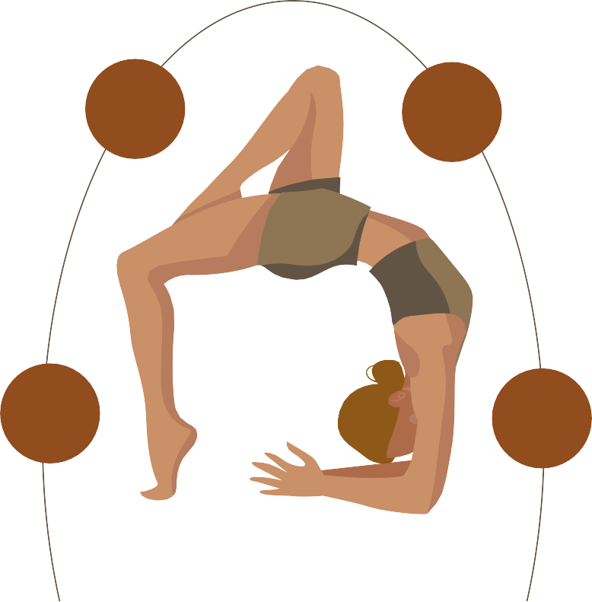
OVERFITTING SOLUTIONS
EARLY STOPPING
TRAIN: 0.9183
VALID: 0.4884
IMAGE AUGMENTATION
TRAIN: 0.2670
VALID: 0.2837
02
03
DROPOUT LAYERS
TRAIN: 0.7296
VALID: 0.4372
TRANSFER LEARNING
To be determined…
01
04

Slide 10






TRANSFER LEARNING
Using the VGG16 model

Slide 11
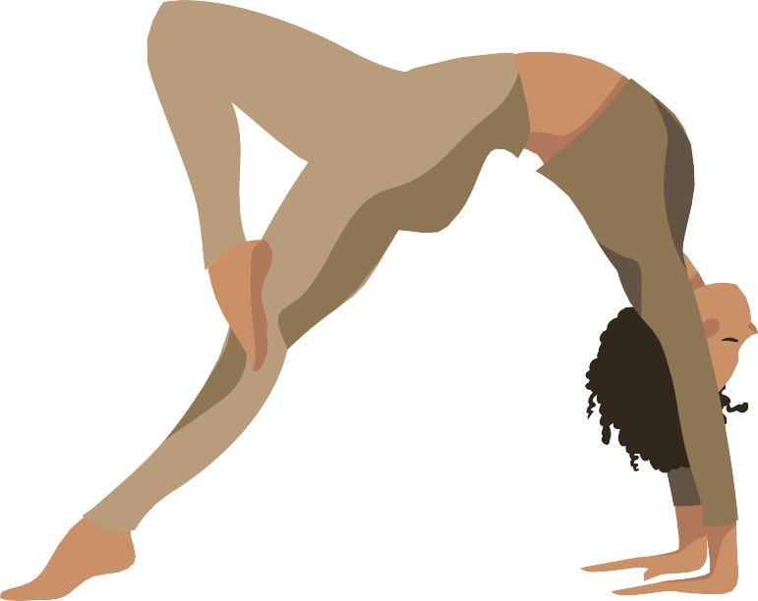
Transfer Learning Results
CNN with VGG16
Training Accuracy: 0.8462
Validation Accuracy: 0.7991
Improved accuracy over CNN without transfer learning
Can it be improved?

Slide 12


TRANSFER LEARNING
Using TensorFlow’s
MoveNet Model

Slide 13
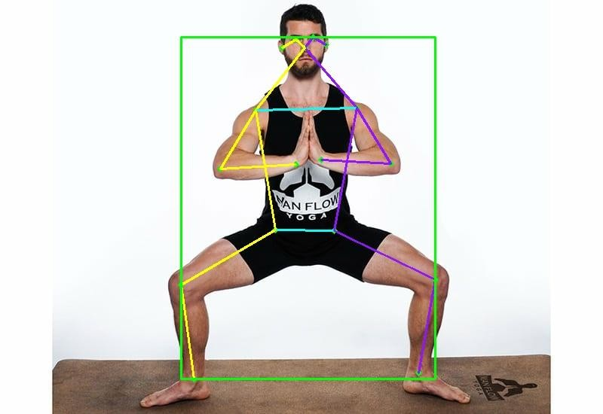
Transfer Learning
MoveNet Model
Pose detection model
Maps 17 keypoints of body positioning
Trained on COCO and an internal Google Dataset called Active
Uses TensorFlow.js and TensorFlow.lite for deployment across many applications

Slide 14
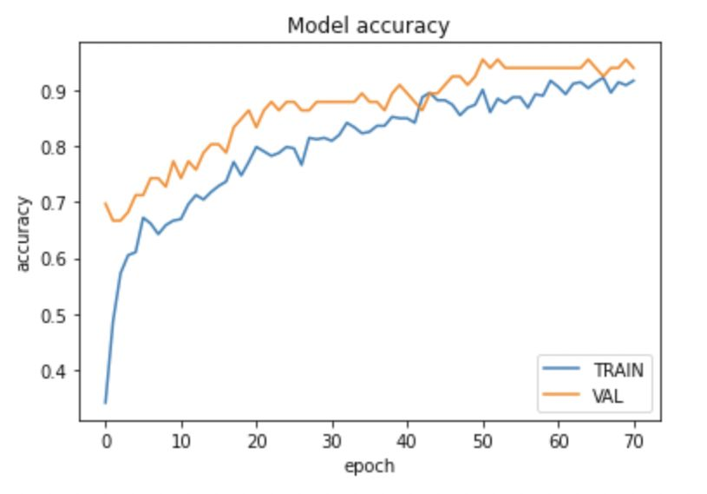
Transfer Learning Results
CNN with MoveNet
Testing Accuracy: 0.9680
Improved accuracy over all previous models
Warrior 2 & Goddess caused majority of incorrect classiﬁcations

Slide 15

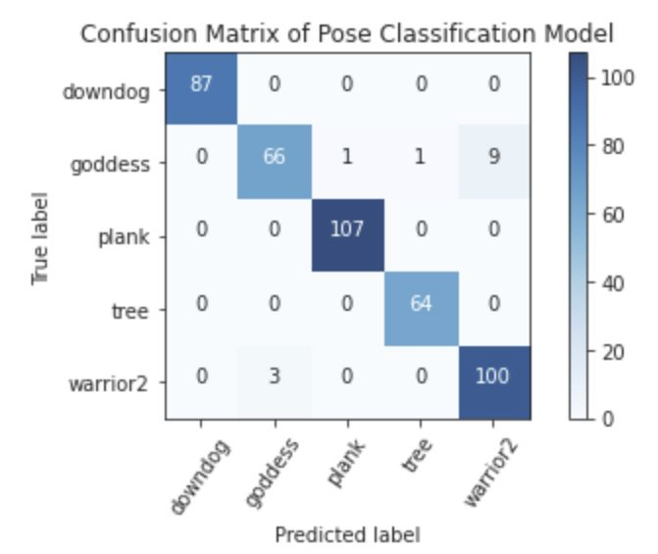
Transfer Learning Results
Confusion Matrix:
Shows nearly perfect results with the only exception of Goddess Pose

Slide 16
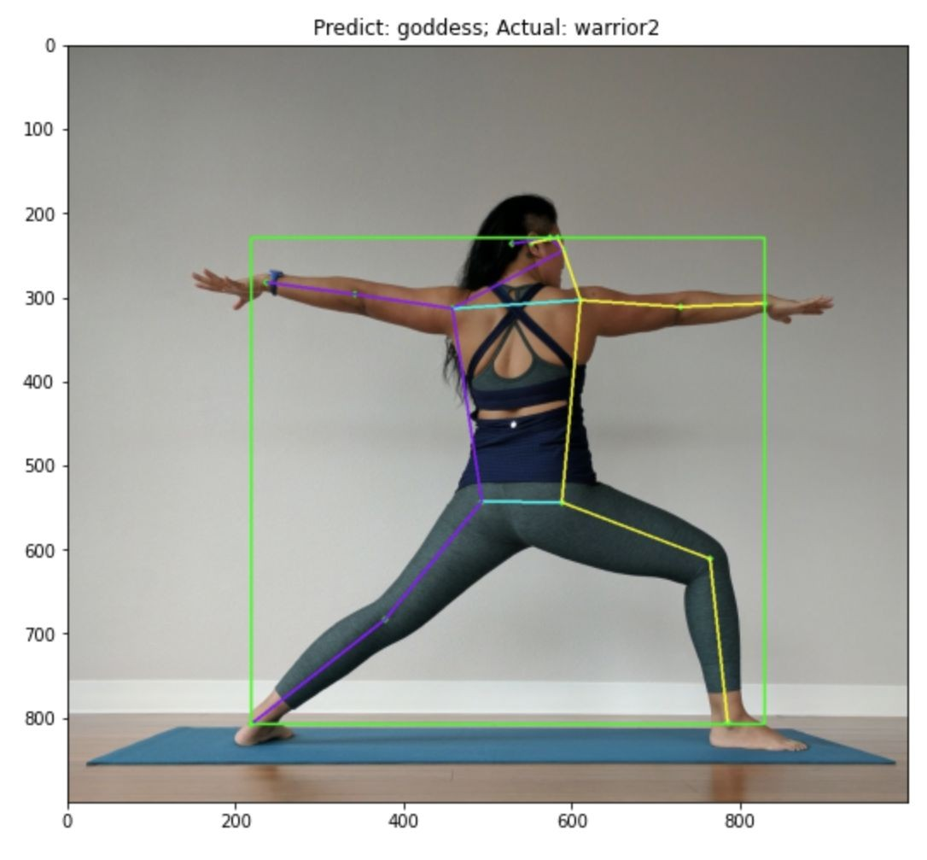
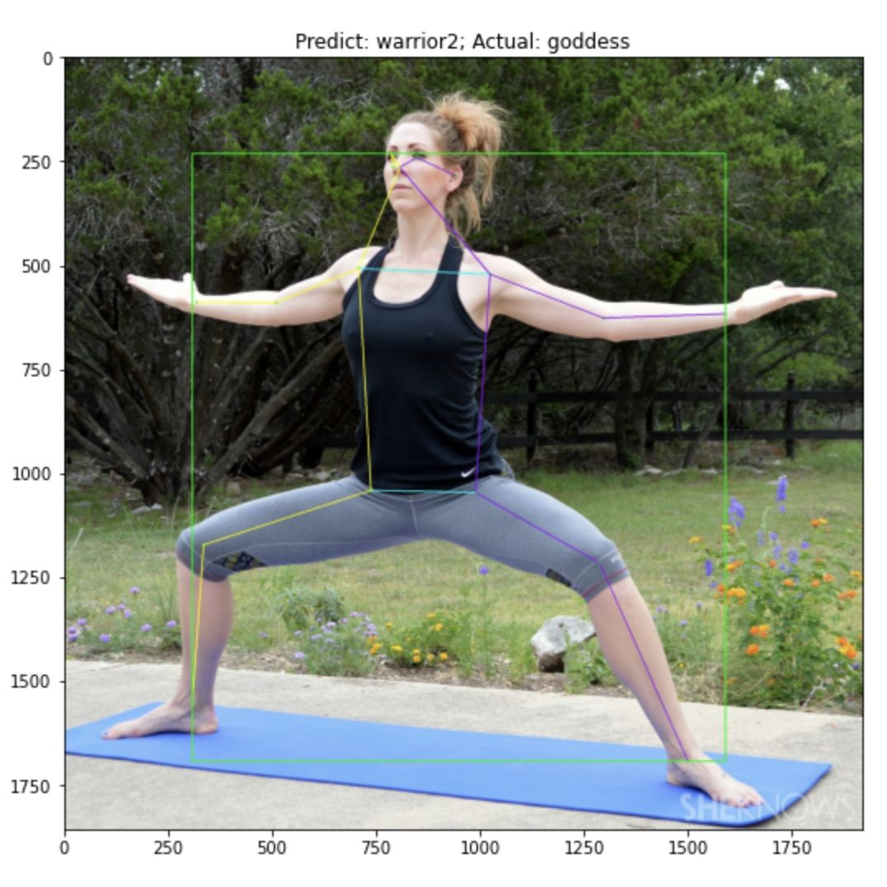
Incorrectly Classiﬁed Images

Slide 17
FUTURE WORK
01
DEPLOY APPLICATION
Using Flutter and TensorFlow Lite to detect pose from user’s webcam
03
SHOW EXPECTED FORM
Highlight expected keypoint locations for selected pose
02
EXTEND CLASSES/POSES
Train model on more yoga poses
04
PROVIDE FEEDBACK
Inform user how to improve alignment

Slide 18


THANKS
Email: leah.j.nagy@gmail.com
https://medium.com/@leahnagy/yoga-pose-classification-with-tensorflows-movenet-model-3e5771fda292
LinkedIn: www.linkedin.com/in/leah-j-nagy/

Slide 19


APPENDIX

Slide 20
Reference Sources
TensorFlow SinglePose Demo: https://colab.research.google.com/github/tensorﬂow/hub/blob/master/examples/col ab/movenet.ipynb#scrollTo=zeGHgANcT7a1
DeepLizard Transfer Learning with VGG16: https://deeplizard.com/learn/video/oDHpqu52soI

Slide 21

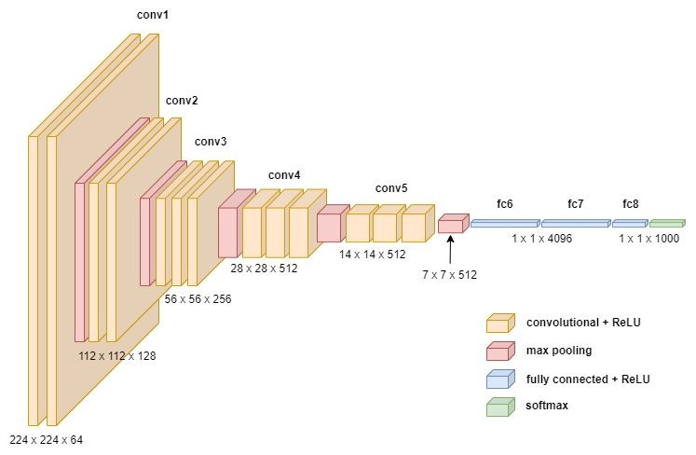
VGG16 Architecture

Slide 22
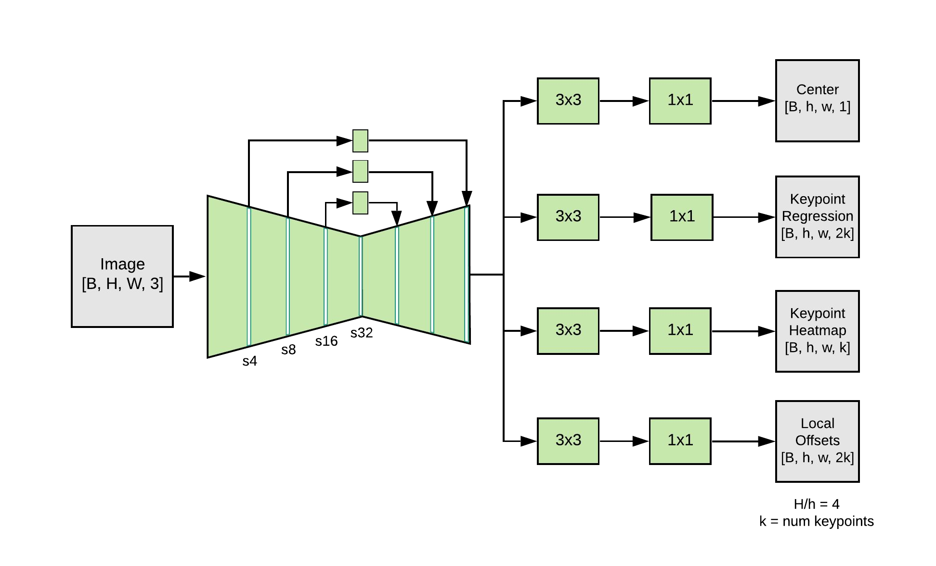
MoveNet Architecture

Slide 23
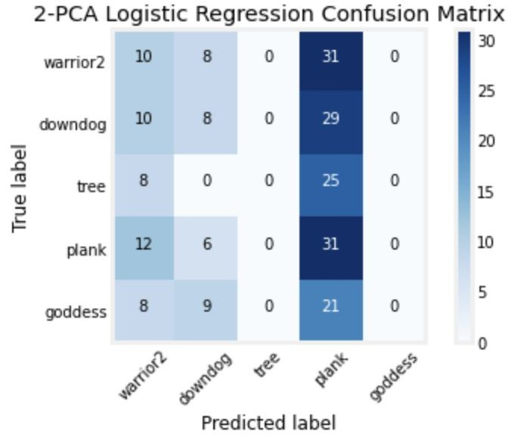
Logistic Regression Confusion Matrix

Slide 24
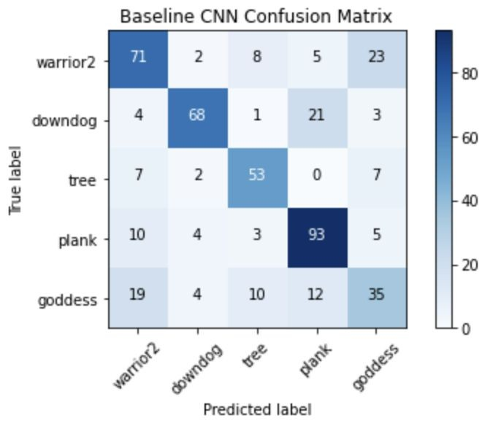
CNN - Baseline Confusion Matrix

Slide 25
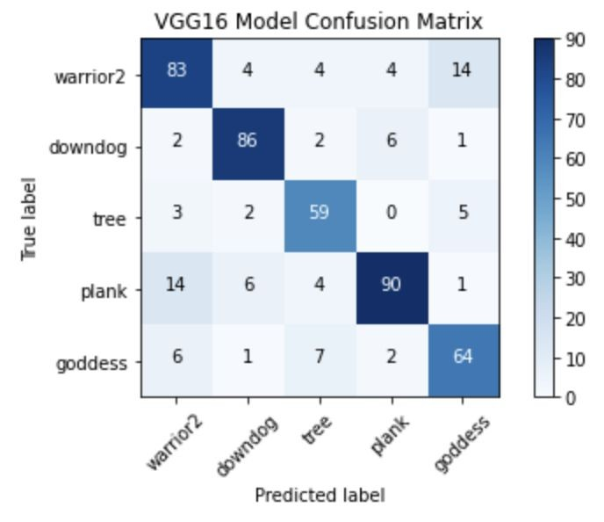
CNN - VGG16 Confusion Matrix

