Slide 1

DATA ANALYST PORTFOLIO PROJECT
End-to-End E-Commerce Sales Analytics
Superstore Sales Dataset (2015–2018) · Python | MySQL | Power BI
Tushar Parihar — Data Analyst Portfolio Project

Slide 2






01 · BUSINESS PROBLEM
Project Objectives
Analyze four years of Superstore sales data to uncover trends, identify top performers, and deliver actionable insights that support smarter business decisions.
Sales Trend Analysis
Top Products & Customers
Identify four-year sales growth patterns and directional shifts.
Find best-selling products and highest-value customer segments.
Regional Performance
Seasonal Patterns
Compare sales performance across all four U.S. regions.
Discover peak sales months and seasonal demand cycles.
Business Decisions
Strategic Growth
Support data-driven decisions with clear, evidence-based insights.
Identify opportunities to optimize inventory and revenue.

Slide 3
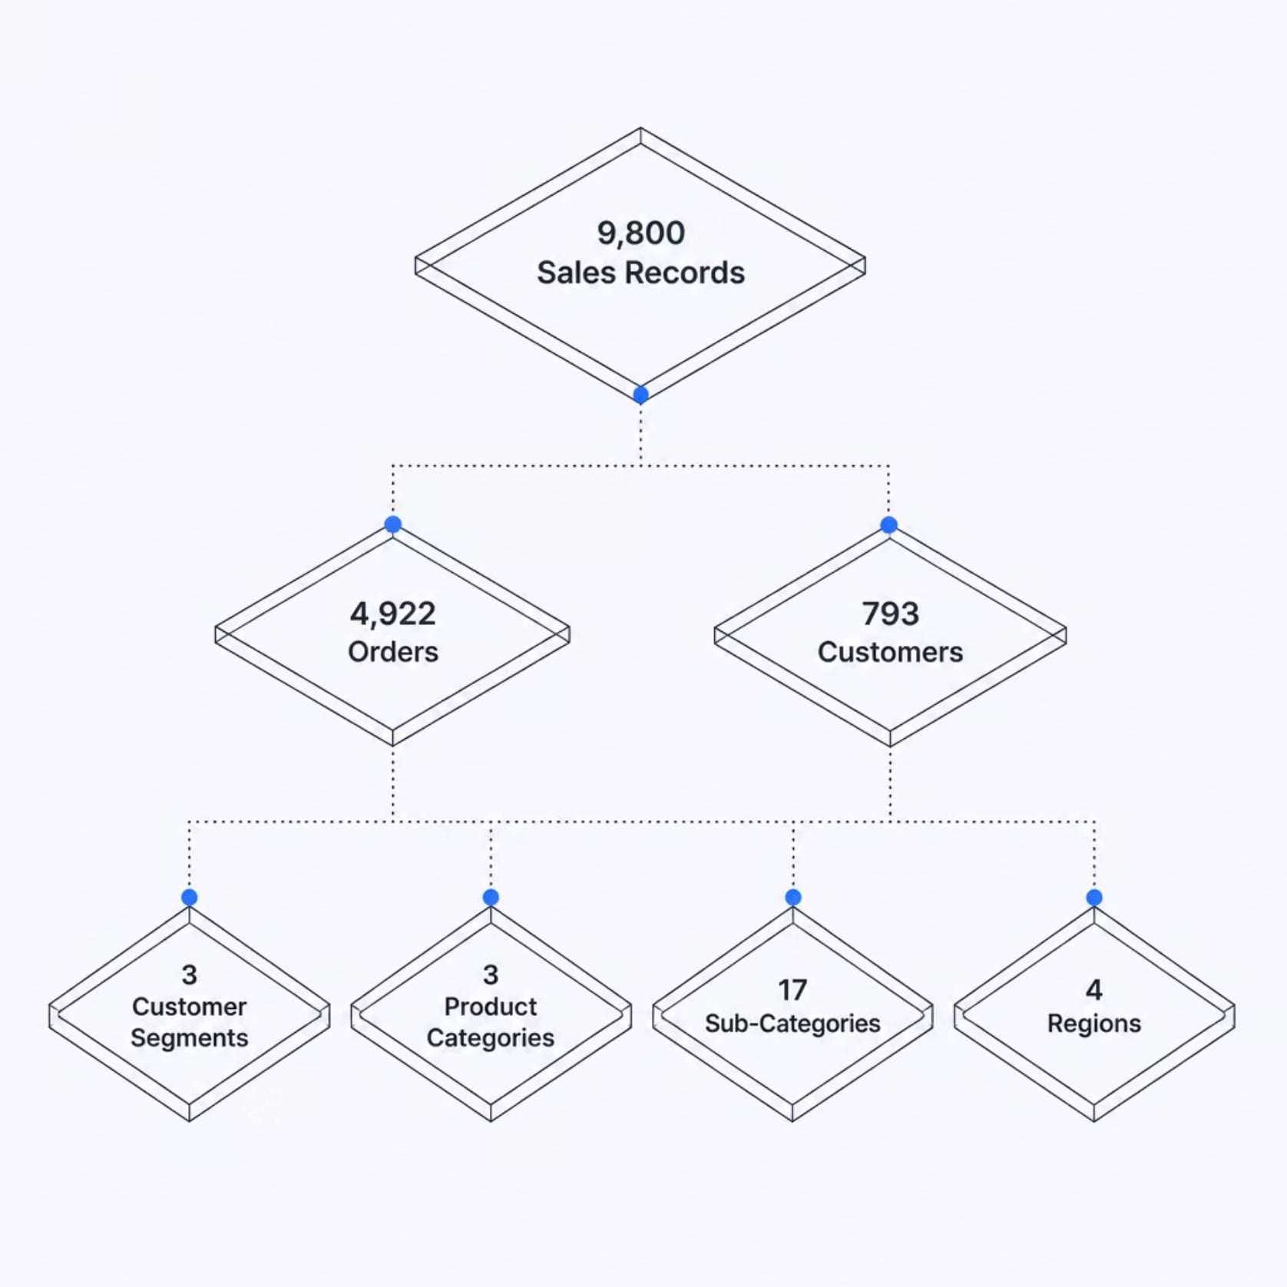
02 · DATASET OVERVIEW
Superstore Sales Dataset (2015–2018)
A comprehensive retail dataset spanning four years of transactions, covering customer segments, product categories, and regional markets across the United States.
Key characteristics:
Transaction-level sales records from 2015 to 2018
Three distinct customer segments and product categories
Geographic coverage across four U.S. regions
Rich attributes for product, customer, and order analysis

Slide 4

03 · PROJECT WORKFLOW
End-to-End Analytics Pipeline
Business Problem
Dataset Collection
Python Cleaning
Feature Engineering
A structured pipeline from raw data collection through Python cleaning, SQL analysis, and Power BI visualization — culminating in actionable business insights ready for stakeholder review.

Slide 5
04 · DATA PREPARATION & SQL ANALYSIS
Python Cleaning & SQL Analysis
Python — Data Preparation
MySQL — Business Analysis
Data Cleaning
Loaded Clean Data
20 SQL Queries
Removed duplicates and handled inconsistent formatting across all fields.
Imported the Python-cleaned dataset into a structured MySQL database.
Authored 20 analytical queries covering aggregations, joins, and window functions.
Missing Value Handling
Imputed or dropped missing records to ensure dataset integrity.
10 Business Questions
Business Metrics
Answered 10 key business questions on sales, customers, and regional performance.
Generated KPIs including total sales, growth rates, and category-level performance.
Date Formatting
Standardized order dates for time-series analysis and seasonal trend detection.
Feature Engineering
Created derived fields including order month, year, and profit margins.
Export Clean Dataset
Exported the cleaned dataset for MySQL ingestion and downstream analysis.

Slide 6
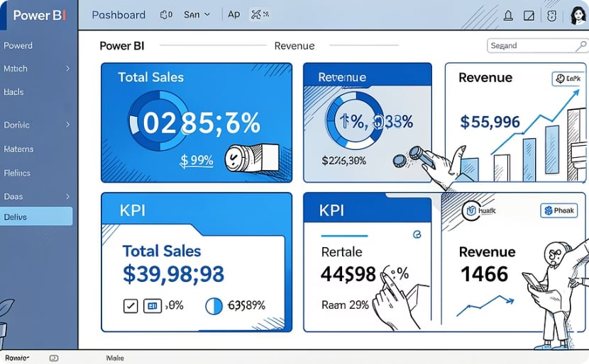
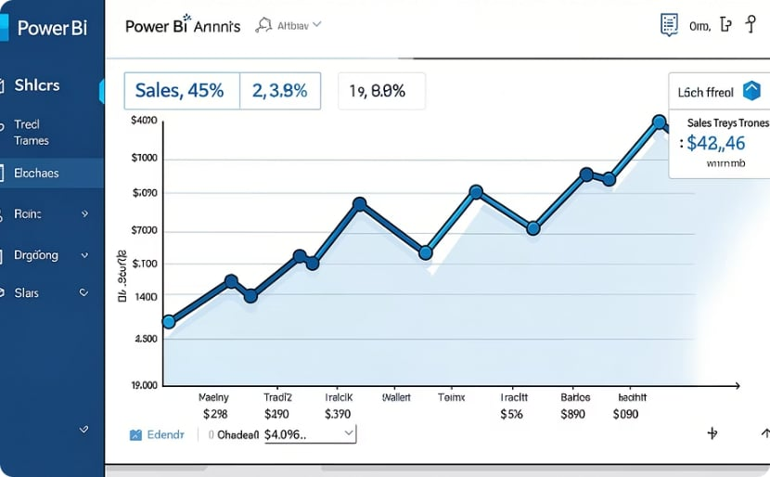
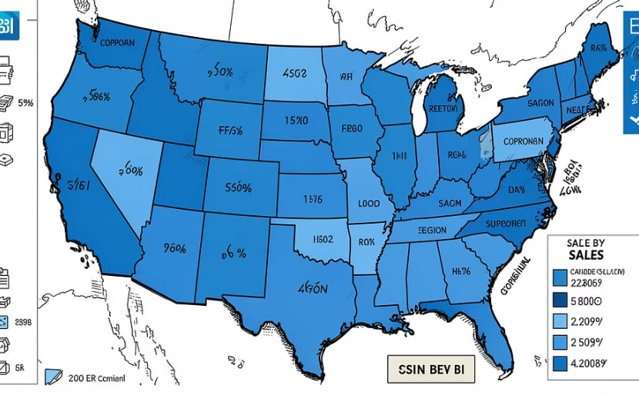
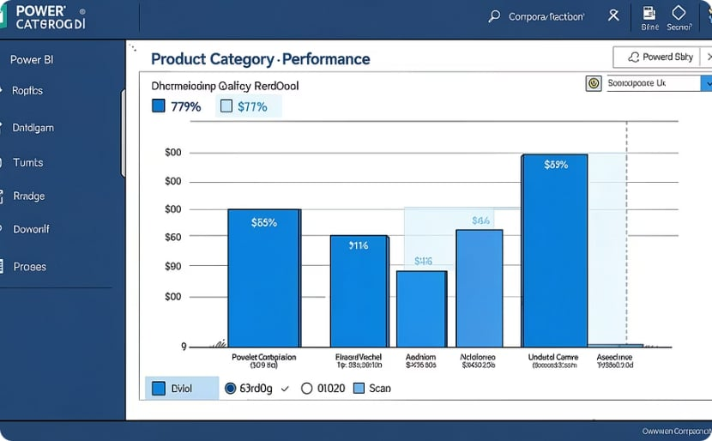
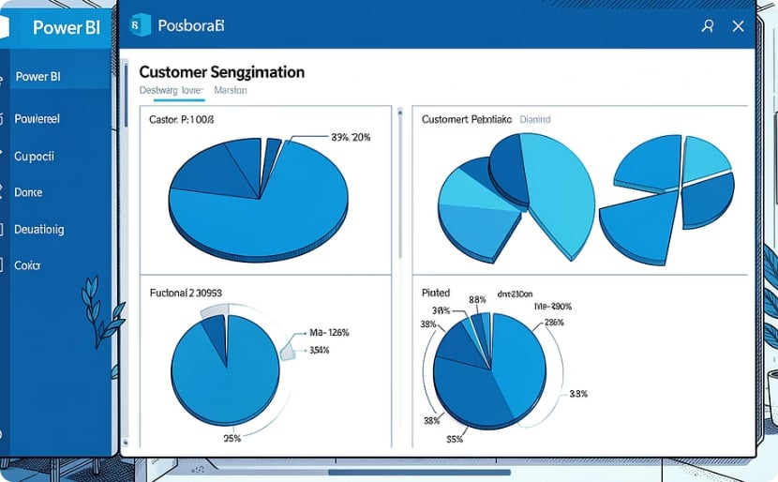
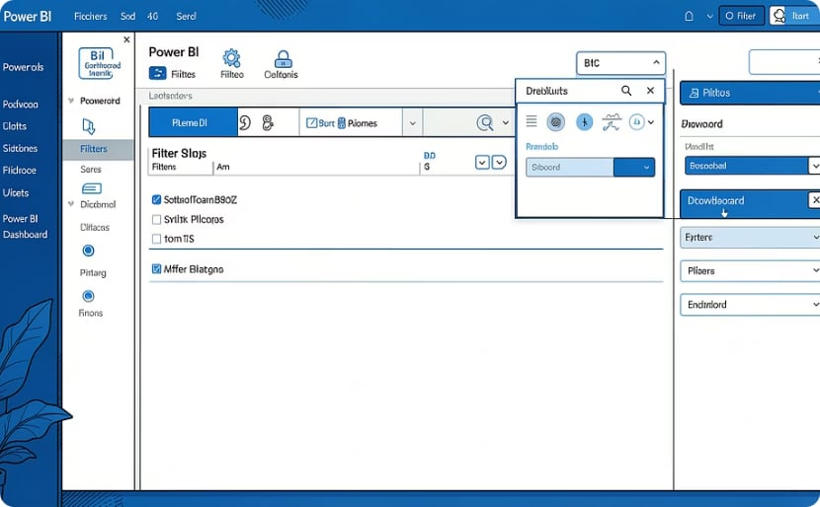
05 · POWER BI DASHBOARD
Interactive Dashboard Design
A multi-page Power BI report with KPI cards, trend lines, regional maps, and product performance visuals — all linked through interactive filters and slicers.
KPI Cards
Sales Trend
Regional Analysis
Product Performance
High-level metrics for total sales, profit, and order volume at a glance.
Year-over-year and month-over-month sales trend visualizations.
Geographic map visual comparing performance across all four regions.
Category and sub-category breakdowns ranked by sales and profit.
Customer Analysis
Filters & Slicers
Segment-level revenue contribution and customer value insights.
Interactive controls for year, region, category, and segment filtering.

Slide 7
06 · KEY INSIGHTS
What the Data Revealed
$2.26M
4
Total Sales
Years of Growth
Cumulative revenue across all four years of transactions.
Sales grew overall from 2015 through 2018 with a brief 2016 dip.
#1
West
Top Category
Top Region
Technology led all product categories in total sales revenue.
The West region generated the highest sales across the period.
Nov–Dec
Consumer
Peak Season
Top Segment
November and December consistently recorded the highest monthly sales.
The Consumer segment contributed the most revenue overall.

Slide 8


07 · BUSINESS RECOMMENDATIONS
Actionable Recommendations
Boost South Region Sales
Pre-Holiday Inventory Buildup
Focus on Top Products
Targeted marketing campaigns and promotions to close the regional performance gap.
Prioritize high-performing products with proven revenue and profit margins.
Increase stock levels before November and December to meet seasonal demand spikes.
Review Low Sellers
Investigate 2016 Decline
Evaluate underperforming products for discontinuation or strategic repositioning.
Conduct root-cause analysis on the 2016 sales dip to prevent future occurrences.

Slide 9

08 · SKILLS DEMONSTRATED
Technical Skills Showcase
An end-to-end data analytics workflow spanning data preparation, database analysis, visualization, and business intelligence.
Python
Pandas
Data Cleaning
Feature Engineering
Scripting & automation
Data manipulation
Quality assurance
Derived metrics
MySQL
SQL
Power BI
Data Visualization
Database design
Query writing
Dashboard creation
Visual storytelling
Business Analysis
Dashboard Design
Insight generation
UX & layout
This project demonstrates an end-to-end data analytics workflow — from raw data cleaning and SQL analysis to interactive dashboard development and business insight delivery.

Slide 10
CONCLUSION
Thank You
This project demonstrates an end-to-end data analytics workflow — from data cleaning and SQL analysis to dashboard development and business insights. It highlights practical skills used in real-world data analyst projects.
LinkedIn
GitHub
Email
linkedin.com/in/alexmorgan
github.com/alexmorgan
alex.morgan@email.com
Questions?

