Slide 1
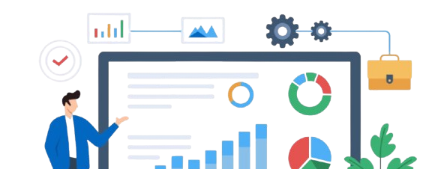





CHURN ANALYSIS – SUMMARY
Overview of customer churn performance and key insights
DEMOGRAPHIC
ACCOUNT INFO

Slide 2


CHURN ANALYSIS – PREDICTION

