Slide 1
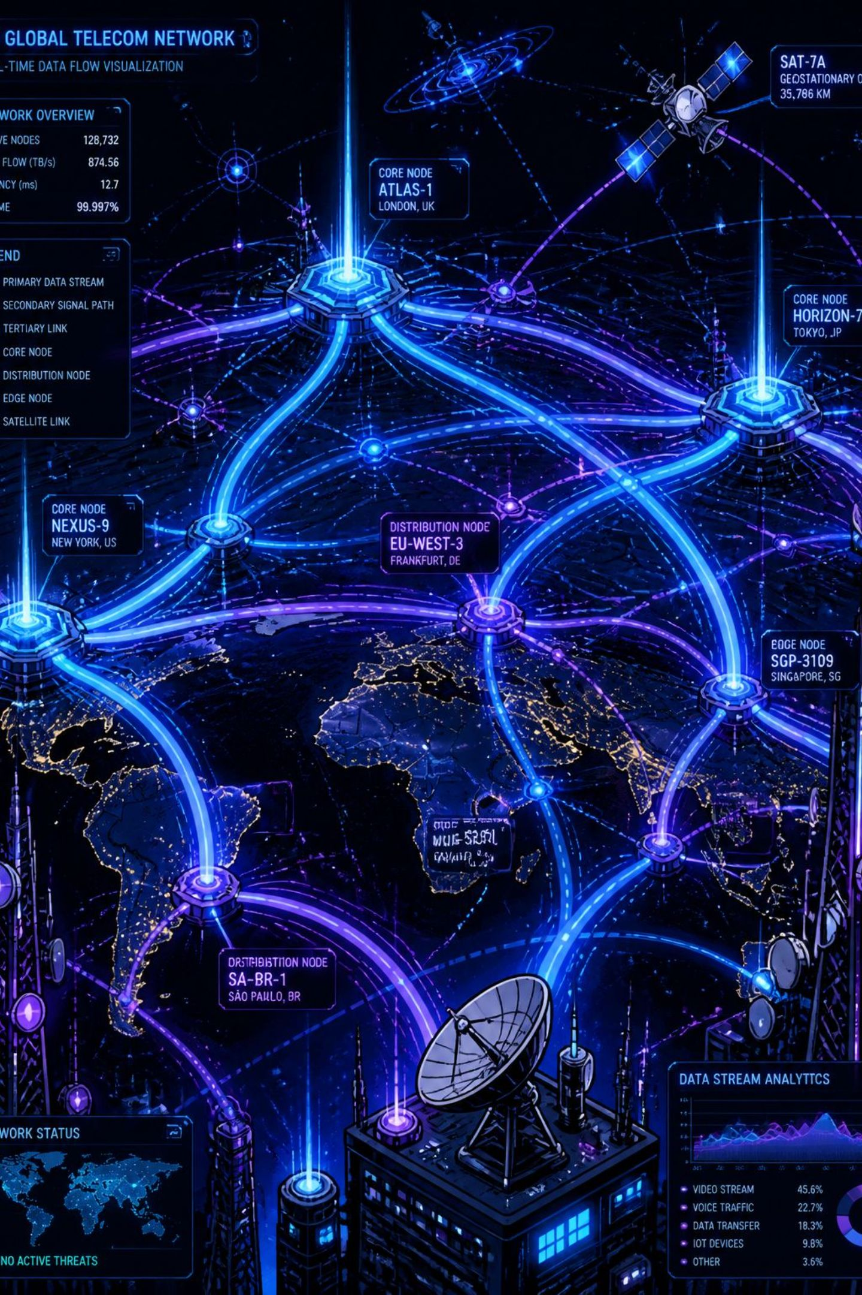

Telecom Customer Churn: Analysis & Prediction
End-to-end analytics project — SQL ETL, Power BI dashboarding, and machine learning churn prediction.
6,563 customers analyzed | 26.3% churn rate | 538 at-risk customers identified.

Slide 2
Executive Summary
6,563
1,727
Total Customers
Churned
26.3%
561
Churn Rate
New Customers
A Random Forest model trained on historical churn data reaches 85% accuracy and flags 538 of 561 new customers as at-risk, driven mainly by month-to-month contracts and competitor pressure.

Slide 3

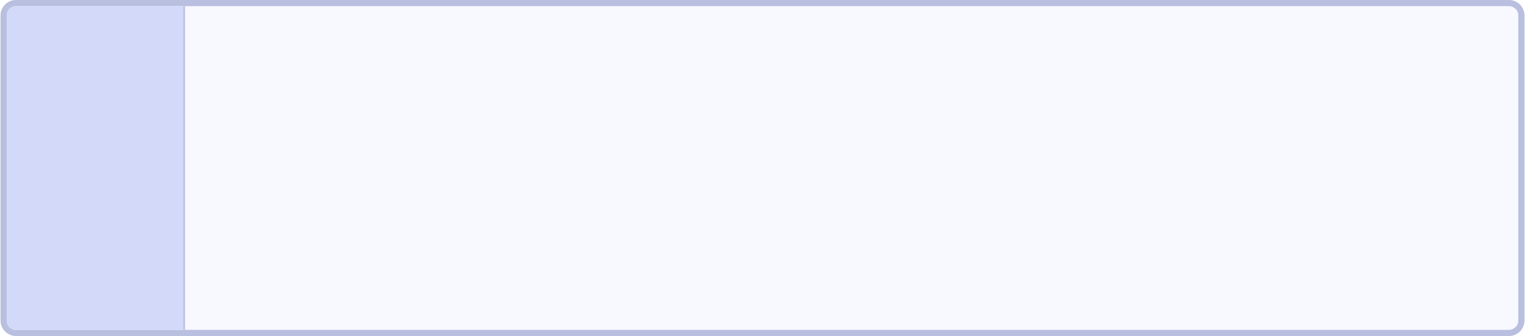

Project Objectives
Build an ETL Pipeline
1
Build an ETL pipeline to clean and load customer data into a database.
Build an Interactive Power BI Dashboard
2
Build an interactive Power BI dashboard covering demographics, geography, account details, payment methods, and services.
Predict Customer Churn
3
Predict which customers are likely to churn using machine learning, so the business can act before they leave.

Slide 4
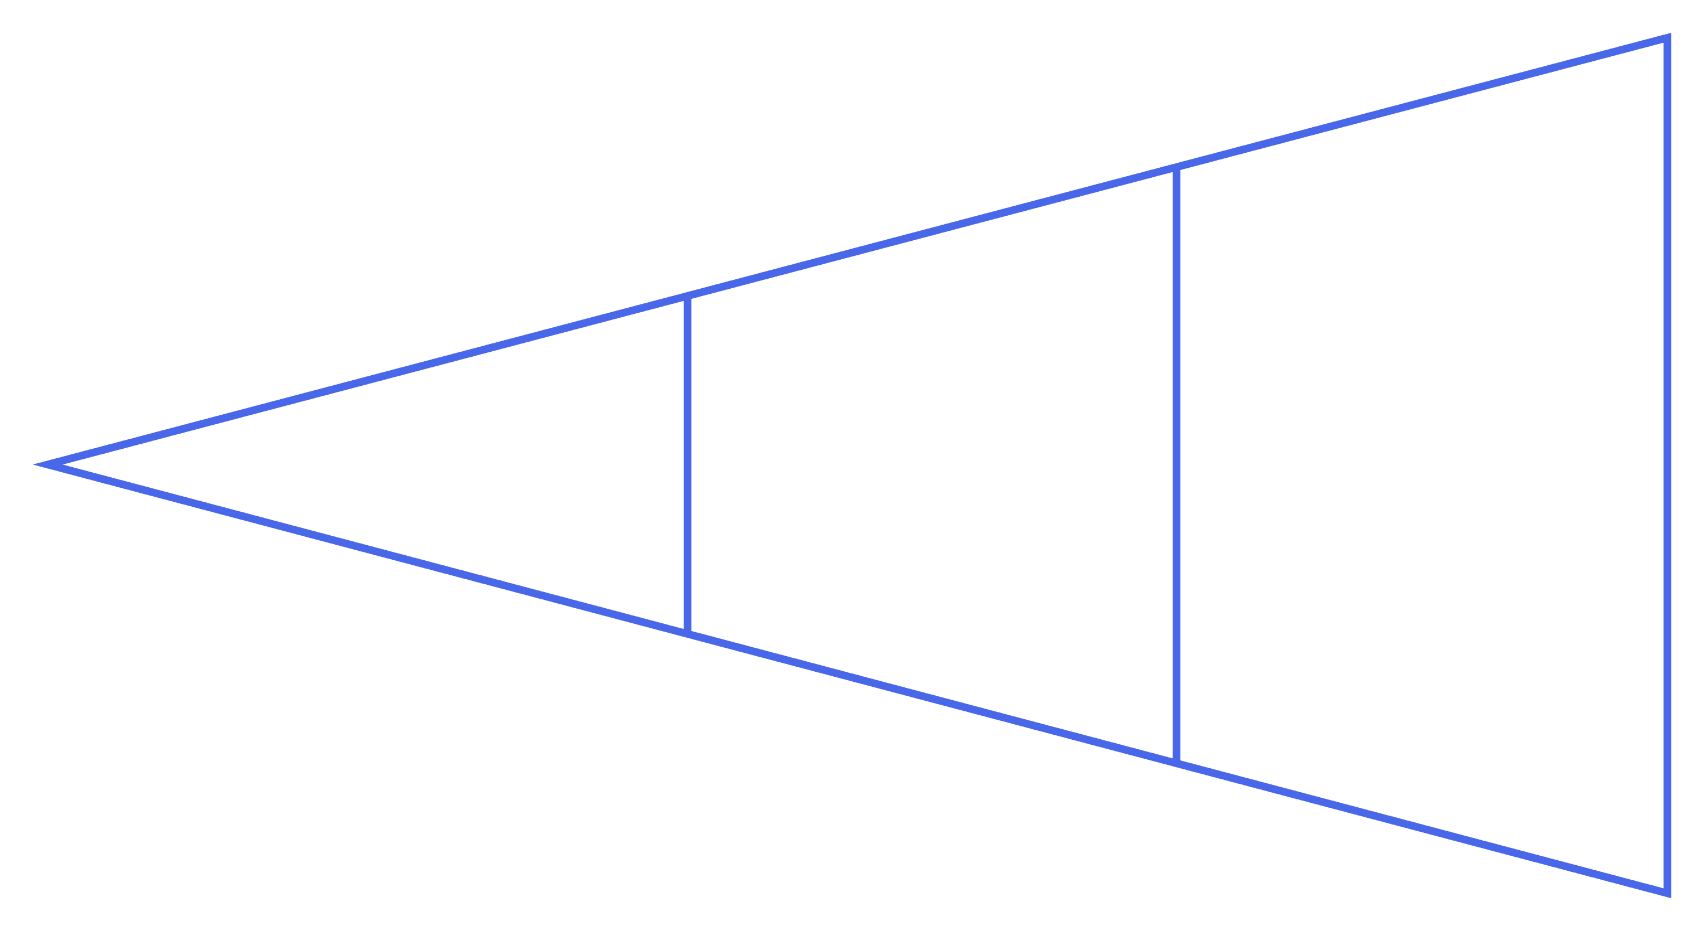
Data & Methodology
Raw Data Loaded
Cleaned & Views
Quality Checks
Raw data (6,563 records, 32 fields) loaded into SQL Server → null/quality checks across every field → cleaning with COALESCE defaults (e.g., missing add-on subscriptions set to "No") → two views created: vw_ChurnData (6,003 historical records: Churned/Stayed, used for analysis and model training) and vw_JoinData (561 new customers, used for prediction).

Slide 5
Who Is Churning: Demographics & Geography
Demographics
Top 5 Churn-Rate States
Churn rises with age — 22.2% (18-25) vs 36.4% (over 60)
Gender split of churners: ~56% female, ~44% male
Fiber Optic customers churn at 40.6%, the highest of any internet type, despite being the premium product
All above the 26.3% average:
Jammu & Kashmir — 56.0%
Assam — 36.6%
Jharkhand — 33.1%
Delhi — 28.8%
Odisha — 27.3%

Slide 6
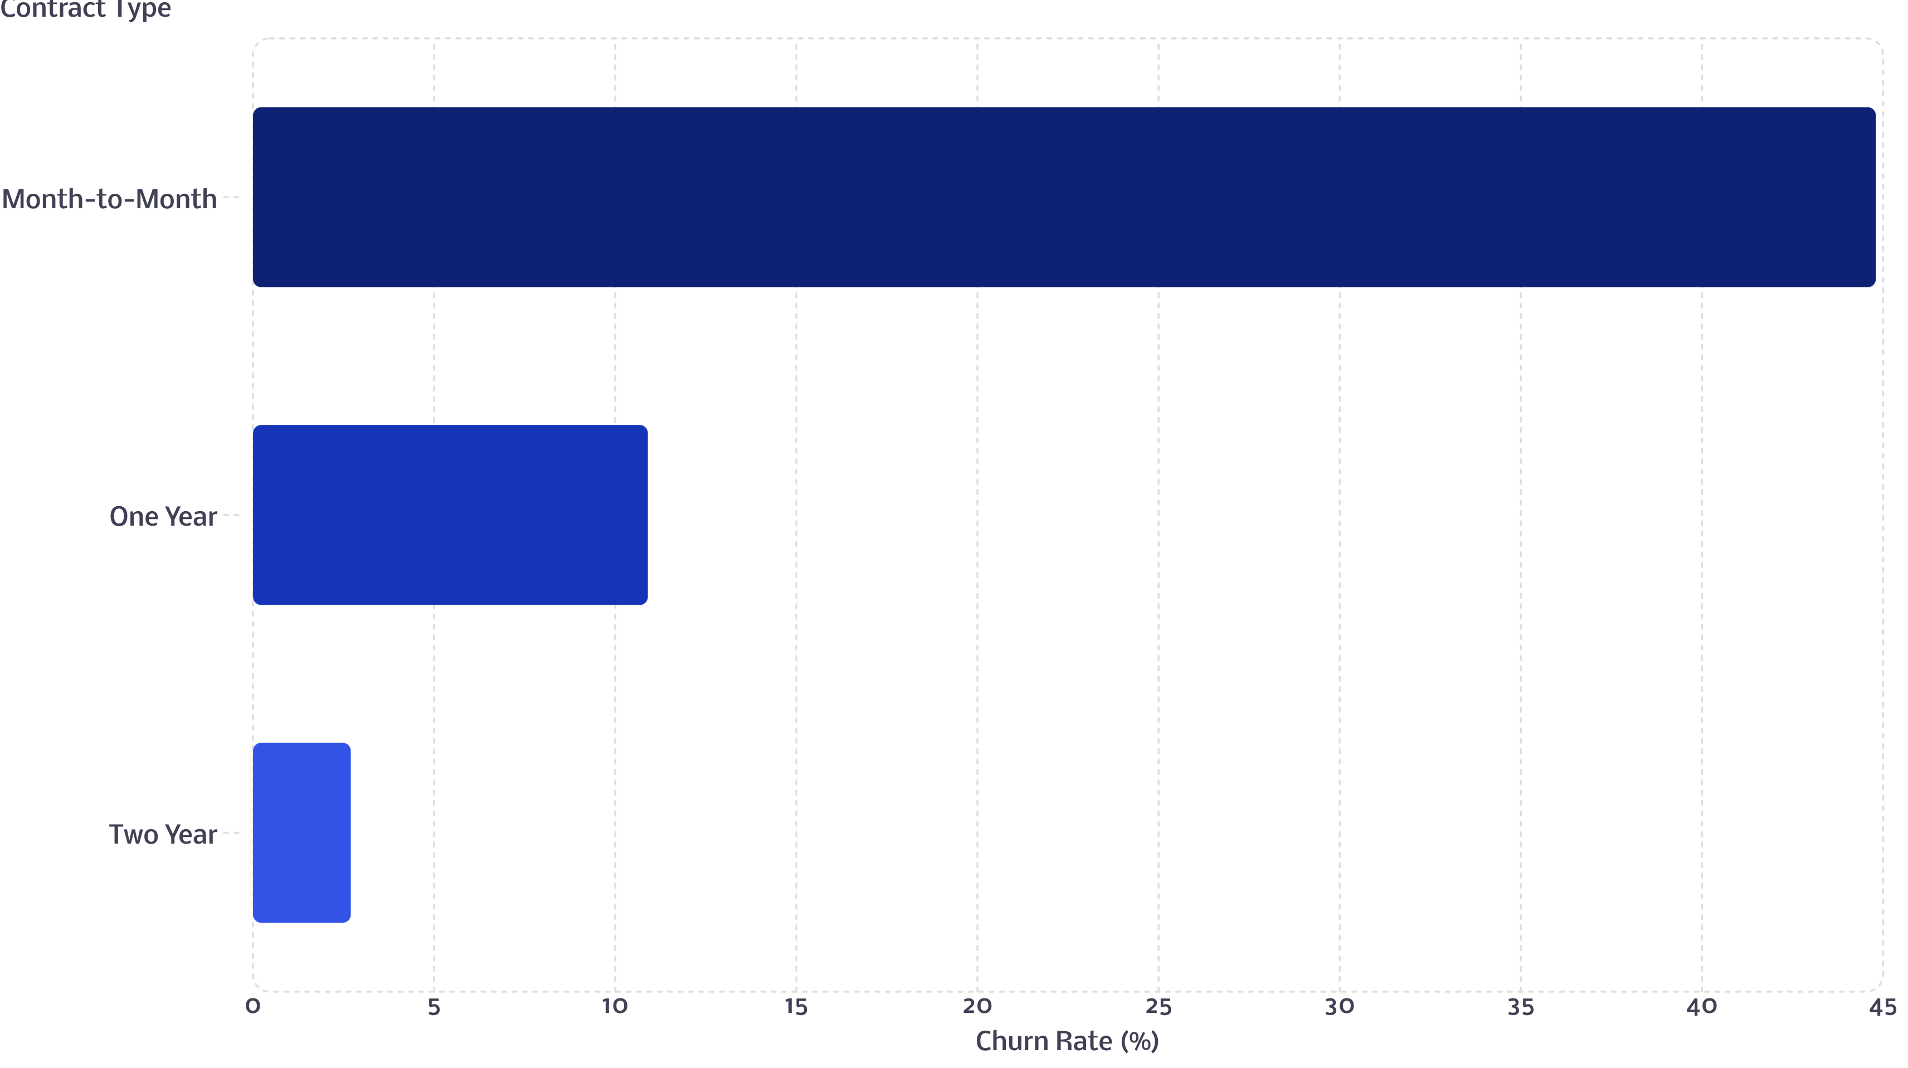
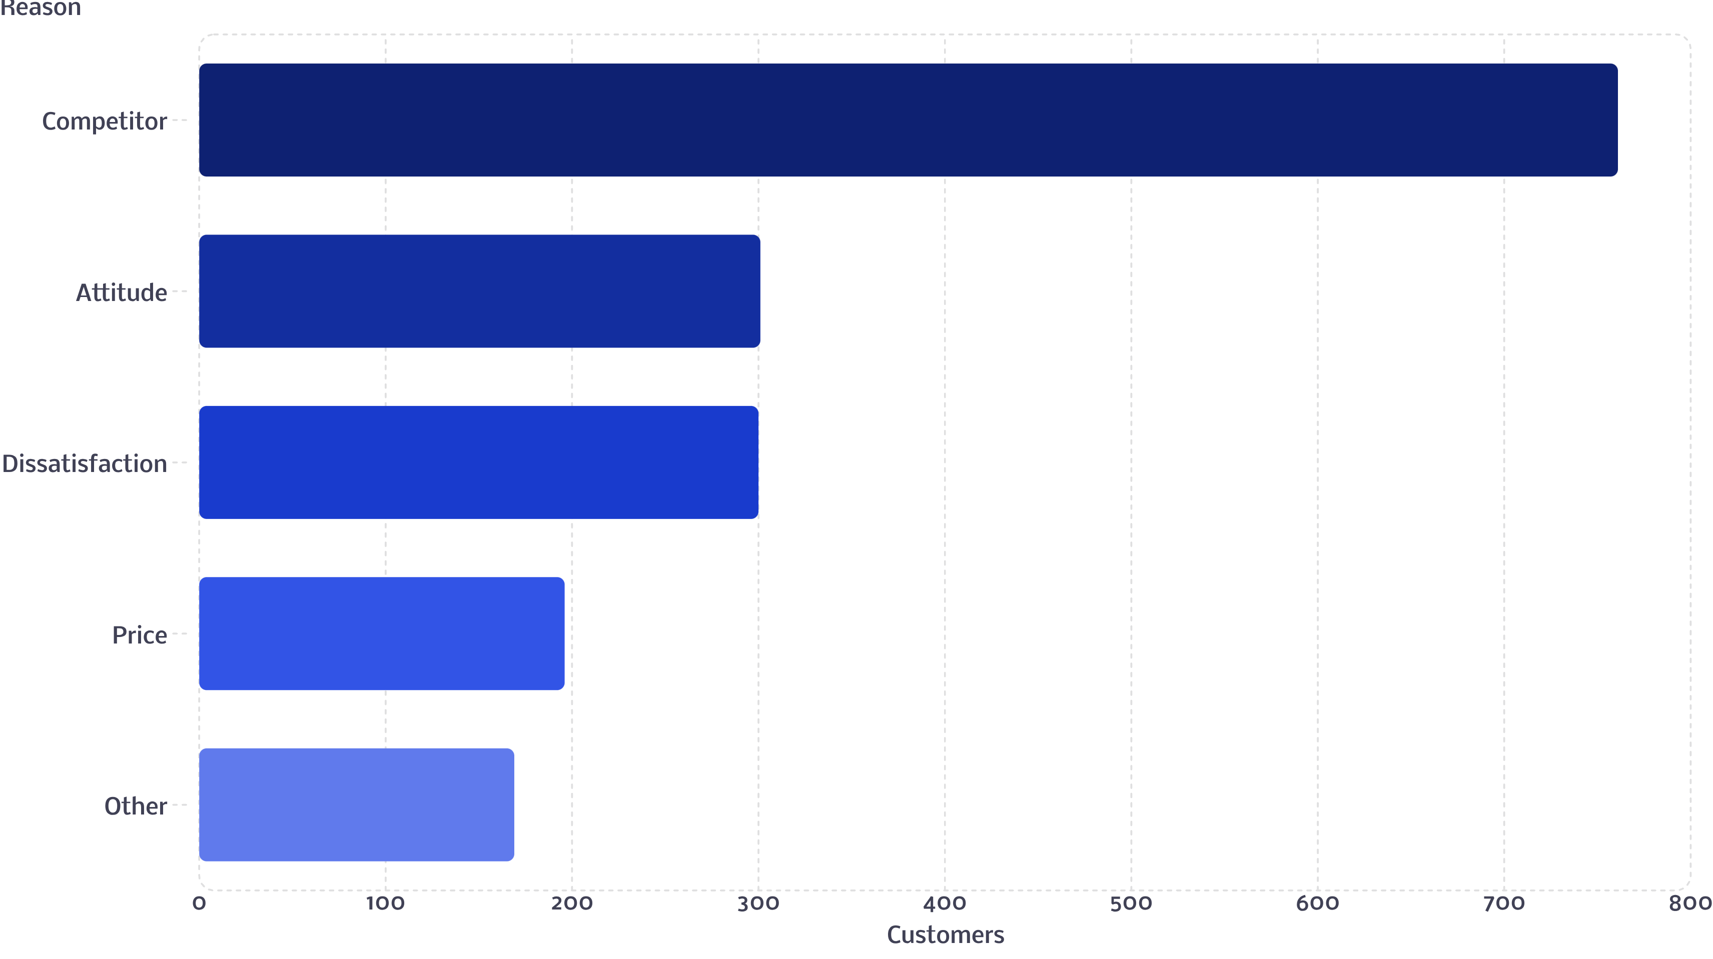
Why Customers Leave: Contracts & Competition
Contract Type — The Strongest Driver
Month-to-month 44.8% churn vs One Year 10.9% vs Two Year 2.7%.
Churn Reason Breakdown
Competitor 761, Attitude 301, Dissatisfaction 300, Price 196, Other 169 (total 1,727). Competitor-driven churn (44% of all churn) is led by "better devices" (289) and "better offers" (274).

Slide 7
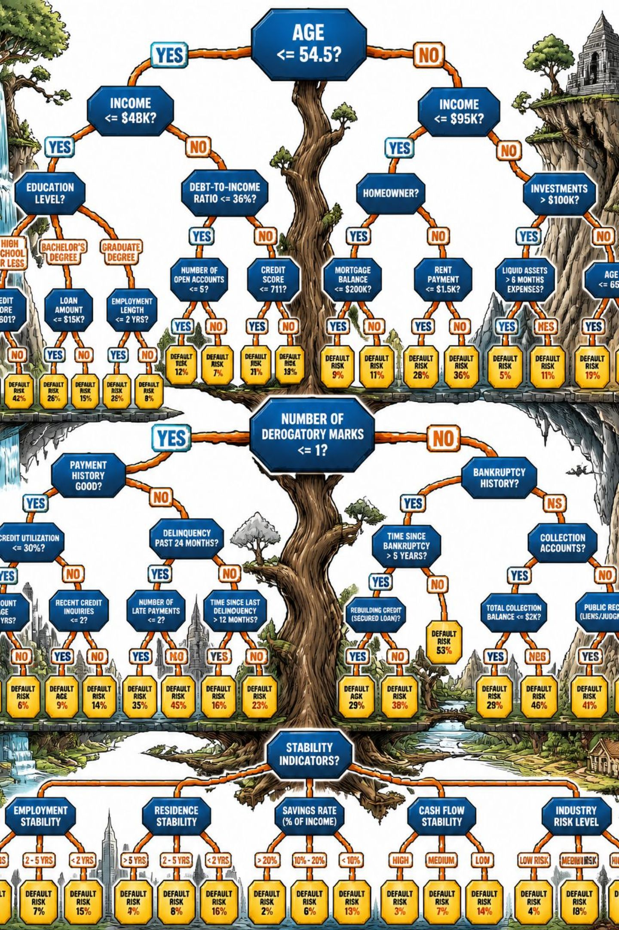

Predictive Model: Approach
A Random Forest model was trained on 6,003 historical customers (80% train / 20% test) using demographics, account, and service data to learn churn patterns. It was then applied to 561 brand-new customers with no known outcome yet, to flag who is likely to churn next.
A Random Forest combines many decision rules to make one prediction.

Slide 8
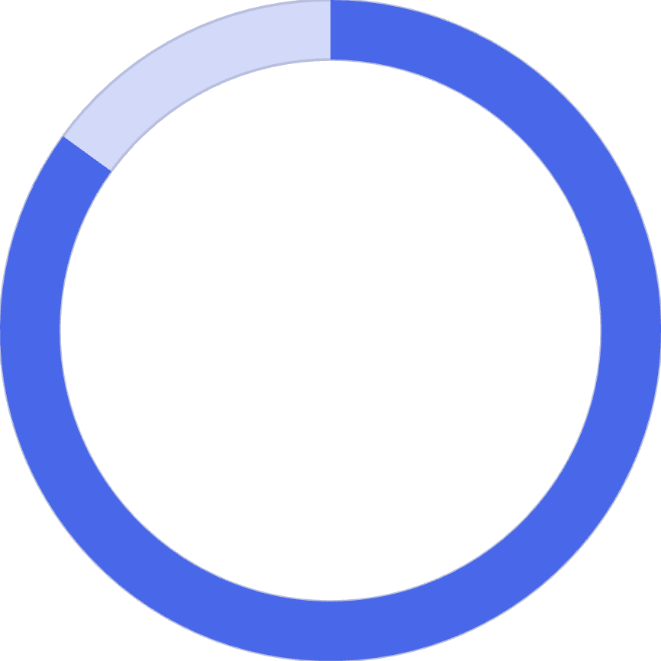
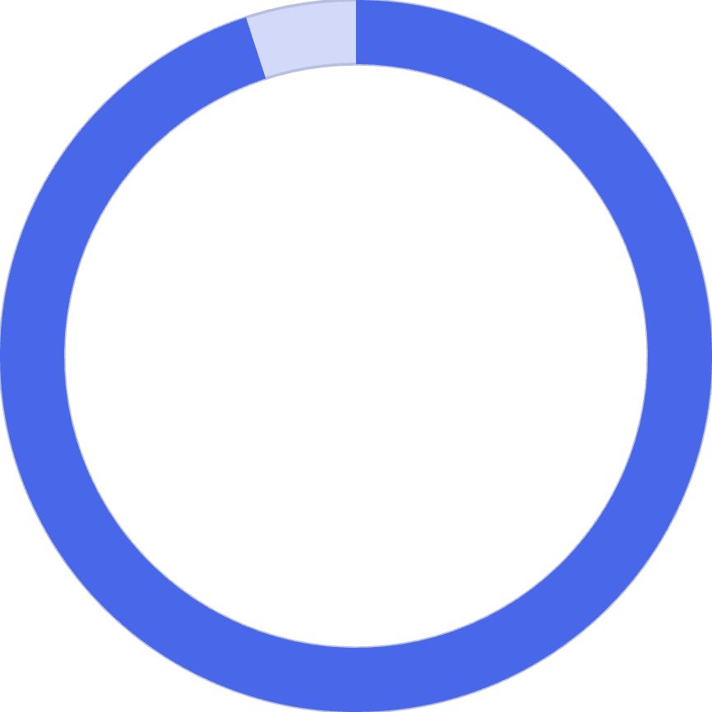
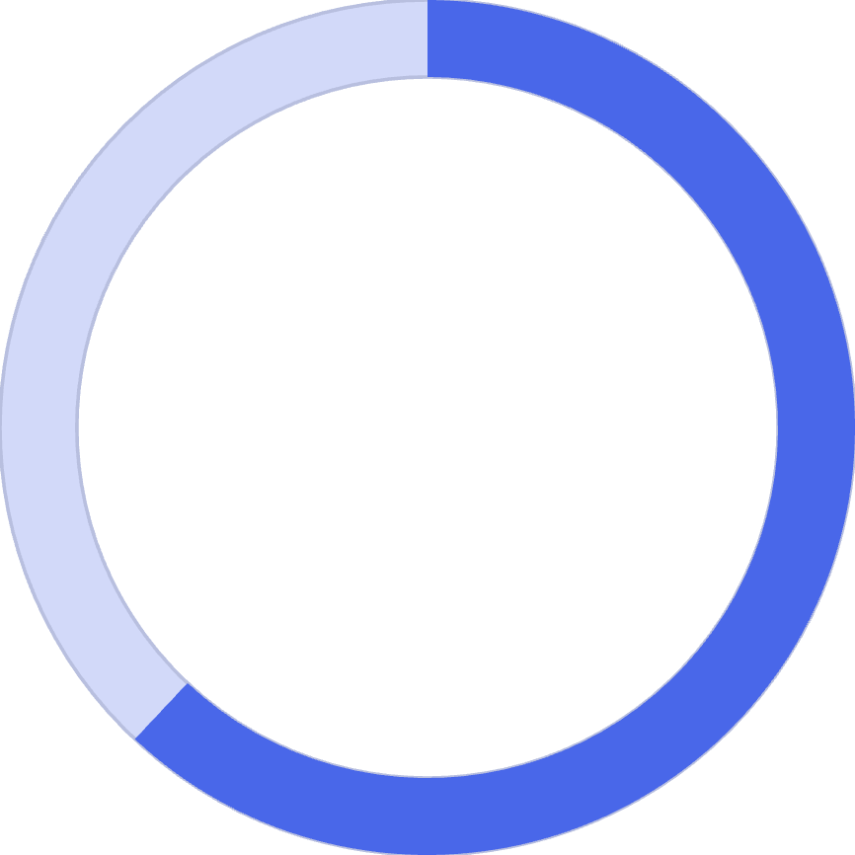

Model Performance: Strengths and Limits
85%
95%
62%
Overall Accuracy
Correctly Identifies Customers Who Will Stay
Correctly Catches Customers Who Will Churn
The model is reliable at confirming loyal customers, but currently misses roughly 1 in 3 actual churners — recall on the churn class needs improvement before this drives an unsupervised retention program.

Slide 9
At-Risk Customers: Who to Target
Of 561 new customers, 538 are flagged at risk.
At-Risk Profile
Recommendation
89% are on month-to-month contracts
Largest group by tenure: under 6 months (213 customers)
Age concentration: 36-50 years (193 customers)
Gender: 340 female, 198 male
Given the model's recall limits, prioritize this list further by monthly charge, tenure, and referral count rather than treating all 538 as equal priority.

Slide 10
Recommendations & Next Steps
1
Target Month-to-Month Contract Holders
Target month-to-month contract holders with incentives to switch to annual plans.
2
Investigate the Fiber Optic Churn Spike
Investigate the Fiber Optic churn spike — likely pricing or reliability issue, not a demand problem.
3
Strengthen Competitive Positioning
Strengthen competitive positioning on devices and offers, especially in Jammu & Kashmir, Assam, and Jharkhand.
4
Bundle Protective Add-Ons at Onboarding
Bundle protective add-ons (online security, premium support) into onboarding rather than selling them later.
5
Improve Model Recall
Improve model recall (class weighting or resampling) before scaling the prediction program to full production use.

