Slide 1
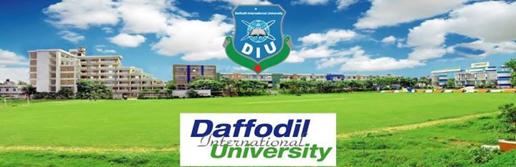

Slide 2
Presentation topic: Happening Now in Diu
Presented by: Nurbinta Sultana (161-35-1444)
Tushar Roy (161-35-1485)

Slide 3
Project Overview
Introduction: Happening Now In DIU is a social website for the newly admitted student.
Features of the Project:
1. For Students
1.1-Can register any program from here.
1.2-Home page is available for any user.
2.For Admin
2.1-Can add, delete and update any program.

Slide 4
Project overview
Purpose of the project:
1.Stockholder- DIU, Students and Organizers.
2.Goal of the project- To make easy for any student of DIU to attend any program organized by DIU .(Specially for the newly admitted student).
Motivation of the project: For the students of new student who are not aware of what’s going in DIU and the motivated student.
The scope of the work:
1.The current student- Use case , Class diagram, Sequence diagram, Website view(UI model)and coding have been done .
2.The context of the work- Help for new student and make easy for any teacher to book a hall.

Slide 5
Project overview
Contribution
1.Designing.
2.Programming.
3.Data collecting
Beneficiaries: Students and Organizer.
Development platform
1.Application Frontend- Laravel.
2.Application Backend-MY Sql server.
3.Develpoment environment-Notepad, Command prompt and Composser.

Slide 6
Use case Description
1.Use case name: | Event service (Happening in DIU) web base application.
2.Description: | Students see the events and teacher book a hall for any program.
3.Actors: | Primary: Admin, Students, Teachers.
4.Goals: | Students successfully can see the event, register for the event and teacher can book a hall for the Program.
5.Precondition: | User need to go to the site and see the events.
6.Post-Condition : | Teacher book a hall and Students register for events and programs.

Slide 7
7.Stakeholder : | DIU, Parents, Students And Teachers.
8.Trigger: | By registering for the event successfully.
9.Alternative ways: | If site got down the Admin has to manually do it.

Slide 8
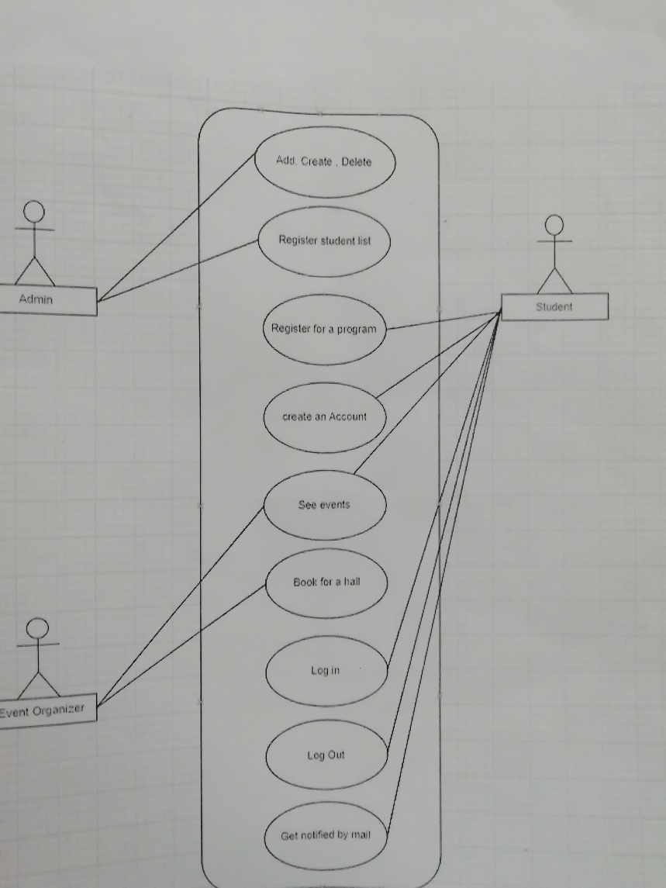
Use case Model

Slide 9
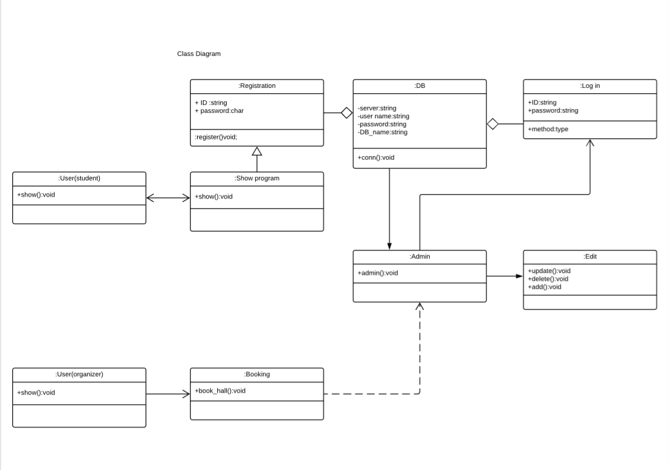
Class diagram

Slide 10
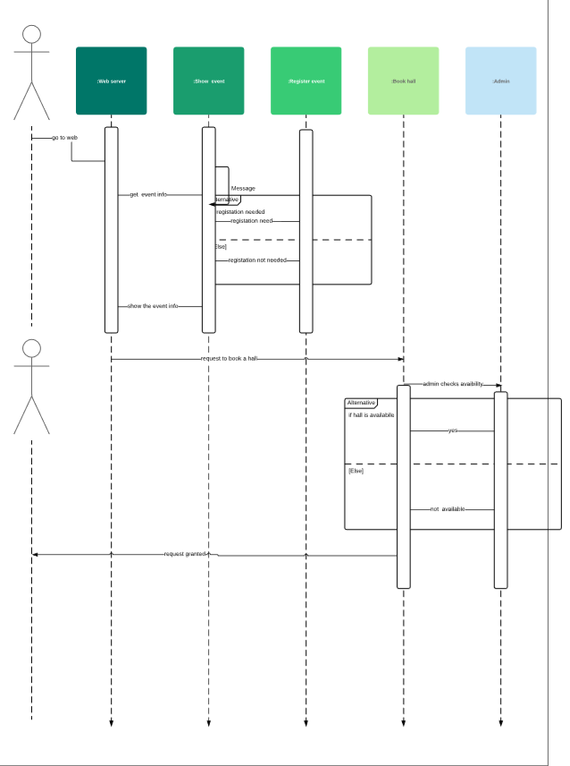
Sequence Diagram

Slide 11


