Slide 1
Management Information System
Author: Tushar Verma (46005803)
Batch: Cloud and Automation
Date: 07-FEB-2020
Location: Tvaksa, STP, Bangalore, India

Slide 2
Contents
Lab Learning
01
Setup and Documentation
02
Technical Performance
03
SLA Performance
04
Highlights
05
Areas of Improvement
06
Self Rating
07

Slide 3
Lab Learning
Technical
Personal
Learnt about Azure PowerShell commands.
Learnt about Hyper-V PowerShell commands.
Learnt about modules in python.
Time management.
Pressure handling.
Communication with client.
Planning of tasks.
Document formation.
Maintain positive behavior.
Read requests properly.

Slide 4
Setup and Documentation
SETUP
DOCUMENTATION
 | HOST MACHINE | VIRTUAL MACHINE
Hostname | CR01-A20 | STU-AD20
OS | Windows Server 2012R2 Datacenter | Windows Server 2012R2
IP | 192.168.21.200 | 172.21.1.10
Hard Disk | 1TB | 20GB
RAM | 16GB | 2GB
Applications/Critical Services | Slack, Chrome, Python, Microsoft Office 2013 | ADDS
Asset Inventory
Server Docket

Slide 5
Technical Performance
 | Max Marks | Marks Obtained | No of Tickets
Azure | 180 | 168 | 6
Python | 270 | 243 | 11
PowerShell | 390 | 314 | 15

Slide 6
SLA Performance
 | Met SLA | Breached SLA | Total SLA
Azure | 6 | 0 | 6
Python | 8 | 3 | 11
PowerShell | 8 | 7 | 15

Slide 7
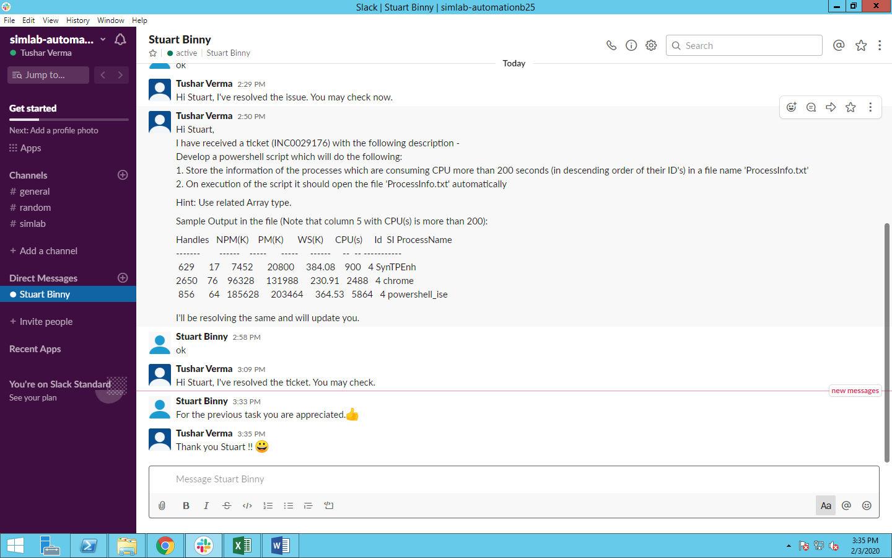
Highlights
SELF
SIMLAB
Got appreciation from the client.
Good time management.
Good technical Skills.
Vast knowledge of the concepts.
Learnt a new concept and resolved a ticket within half the SLA time.

Slide 8
Areas of Improvement
SELF
SIMLAB
Time management.
More positive environment could be kept.

Slide 9
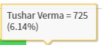
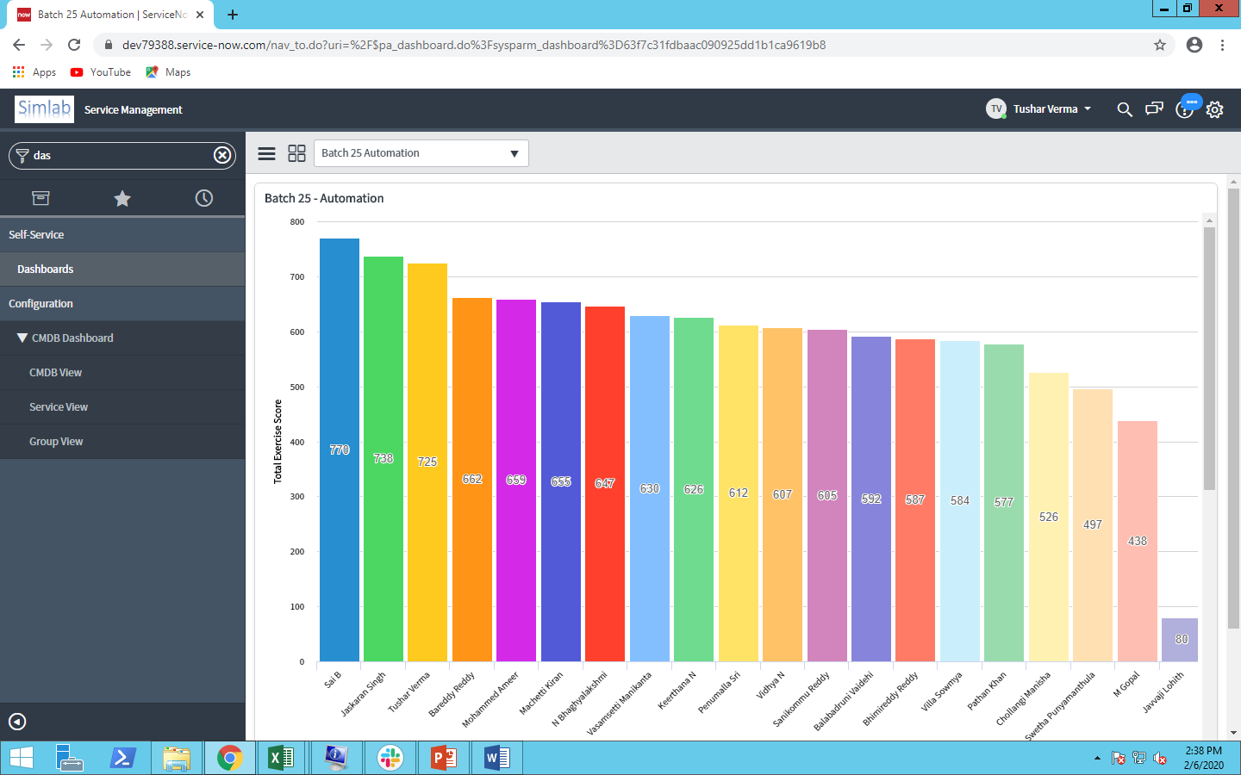
Self Rating
I rate myself as 2 out of 5.

Slide 10
THANK YOU !

