Slide 1

I.O.C.R.
Intellectually Organised Crime Records
Team

Slide 2
The Problem
Fight against the increasing crime in the country with an efficient and smart way.

Slide 3
A smart and efficient approach to organise criminal records and applying modern technologies to help the officials to increase their performance.
Provides exact GPS location of the missing person found by the CCTV camera.
Using the previous data makes a heat map representing the most affected areas by crime.
IDEA
I.O.C.R.

Slide 4
IDEA
It gives the police the exact location of the missing person. Enabling them to find them, hassle free.
The heat map can be used to see the most affected regions by crime, so that the police can increase the security at these places.
Along with that trends of the heat map can be used to predict the most likely operational hubs of criminals indulged in these kidnapping and human trafficking activities.
I.O.C.R.
Why is this a
good idea?

Slide 5
IDEA
The app requires the PIS ID for enabling the services offered by I.O.C.R.
It leads directly to a page where the policeman can file F.I.R reports regarding missing person along with a photo of the missing person to recognize them.
Whenever any CCTV catches a match with the database of missing persons. It immediately alerts the nearest police station by sending the details and GPS location of the missing.
The police can see the real time heat map anytime at the web portal.
I.O.C.R.
How does the
application
work?

Slide 6
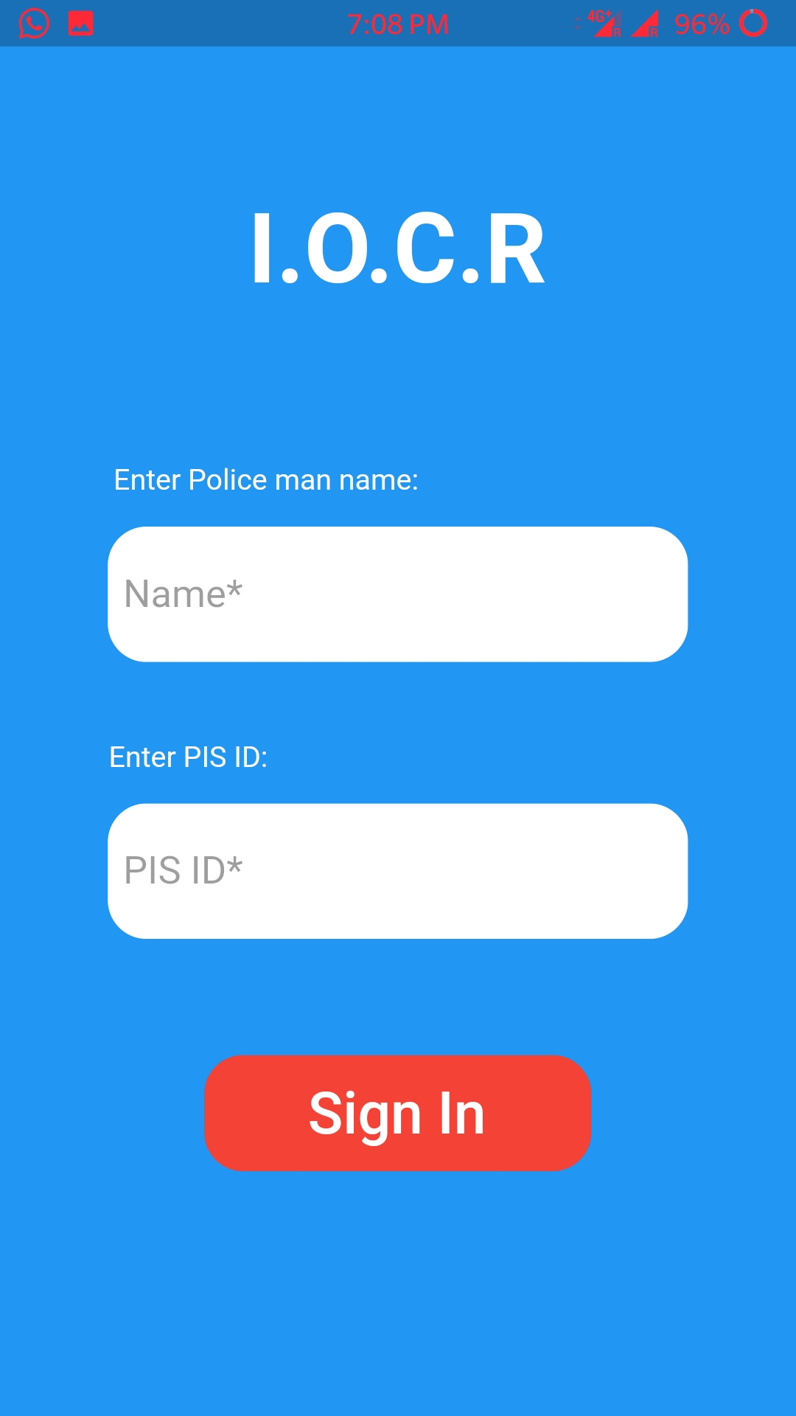
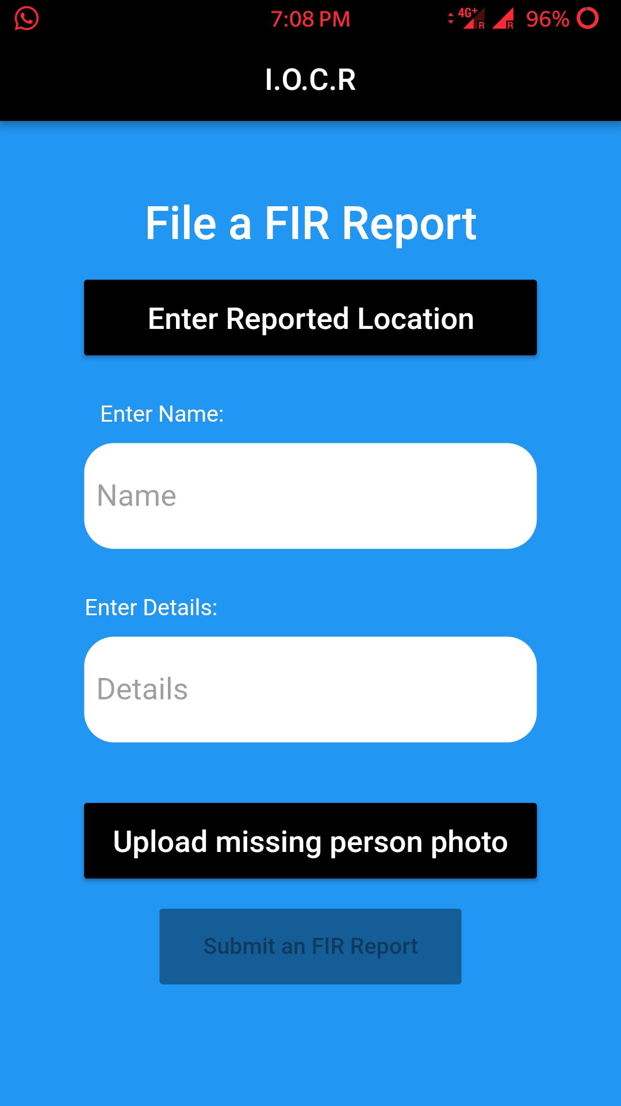
Execution
Login Screen
Mobile Application
Registering a F.I.R.

Slide 7
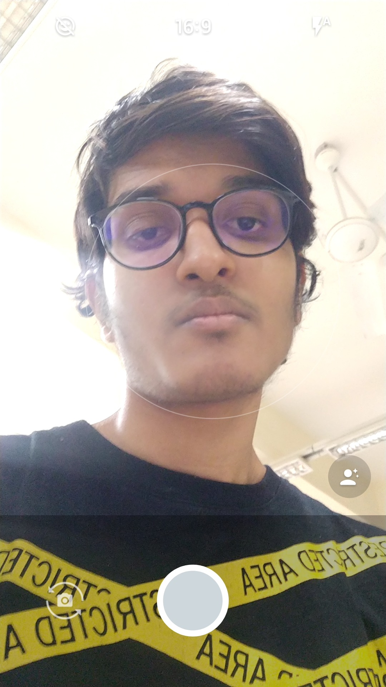
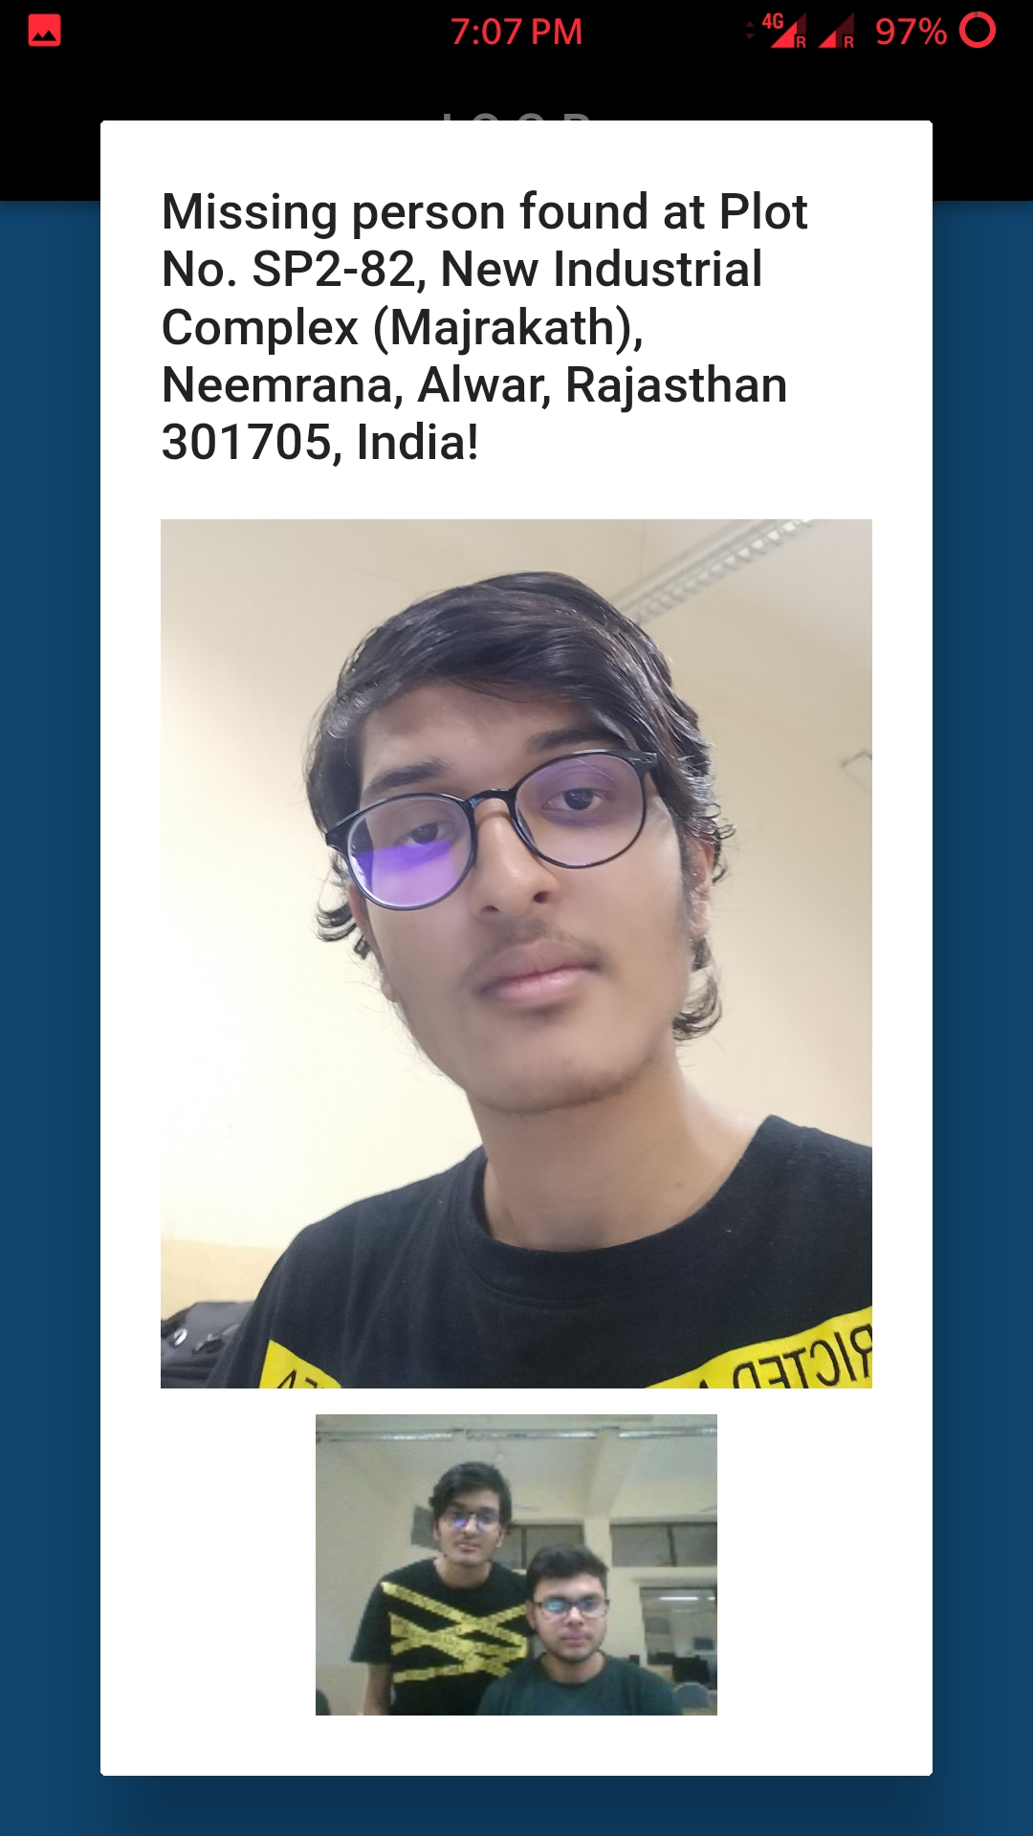
Execution
Photo of the missing
person in database
Mobile Application
Missing person found by a CCTV camera

Slide 8
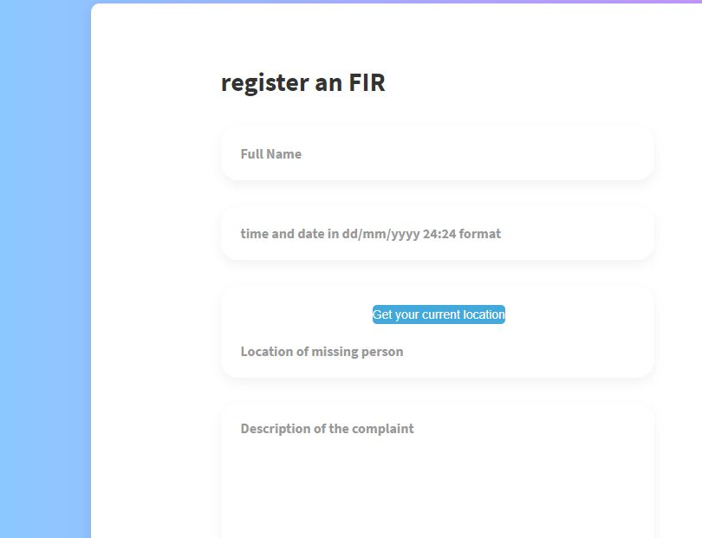
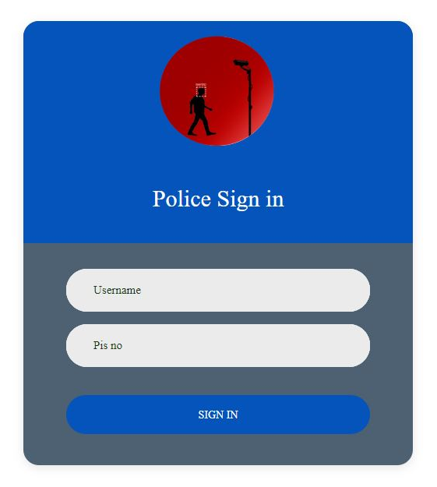
Execution
FIR Page
Web Application
Sign Up Page

Slide 9
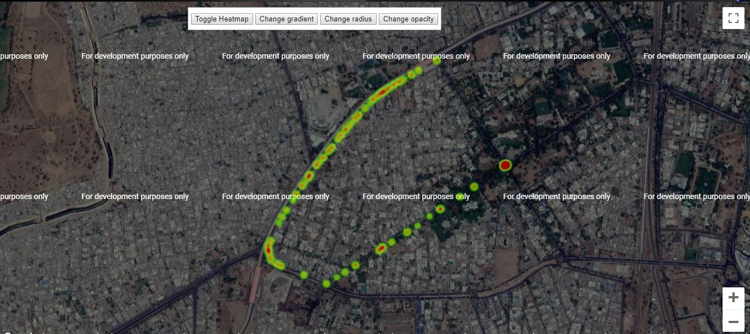
Execution
FIR Page
Crime Intensity Heat Map
Sign Up Page

Slide 10
IDEA
This app will contain 3 Tiers of Policemen.
Tier 1:
This is the highest post of police officers, using the portal they can allot a police station to a S.H.O.
Tier 2:
These are the S.H.O, using which they can allot a case to sub inspector in the police station.
Tier 3:
This is the lowest post of police officers, and they can see all the cases and information about it.
I.O.C.R.
Transparency

Slide 11
IDEA
The setup and maintenance cost of the whole system will be very expensive due to high performance requirements.
I.O.C.R.
Roadblocks

Slide 12
IDEA
Flutter | HTML, CSS, JavaScript | Python – Machine Learning | Firebase
Flutter - Cross-Platform mobile application development framework is used here to make the application work on both Android and iOS devices.
HTML, CSS, JavaScript used to make the Web Portal to show the heat map.
Python – Machine Learning used for facial recognition and predicting expected operational hubs of criminals.
Firebase, a NoSQL Database used to make the central database to store the photographs of the missing people, FIR report and Location of the crime and found person.
I.O.C.R.
Additional
Support
Information

Slide 13
IDEA
The above model will get better with time. The more and more data we gather, the better heat map we can generate, which will make it easier and broad to identify the patterns of criminals.
Collaboration pitch to government agencies (Rajasthan Police), to implement this model for the efficient working of police department with being extremely helpful in solving cases.
Moreover, in later stages, the model can be trained to identify criminals, and might detect anomalies in public.
I.O.C.R.
Future Of
The Service

Slide 14
Thank You

