Slide 1
Compare Support Vector Machines to 3 layer Neural Networks on the Titanic Dataset
Tushar Saini
AI Technology and Systems

Slide 2
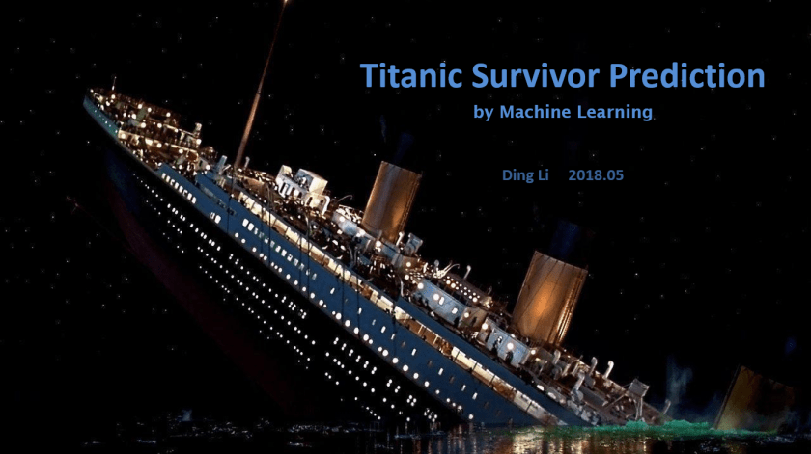
Problem Description
In this Presentation I am going to show you about the Comparision between support Vector Machines and 3 layer Neural Network on the Titanic dataset ,dataset is extracted from the Kaggle there are 2 datasets CSV files test.csv and train.csv which is used in prediction. Python provide many libraries for Machine learning using this inbuilt libraries project is done.

Slide 3
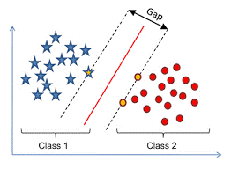
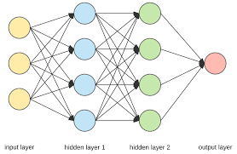
Proposed Solution
For comparing Support Vector Machines learning(SVM) and 3 layer Neural Network Python is used because Python provides inbuilt libraries and easy to code also we used Keras for 3 layer Neural network
and find the highest accuracy score and we predict the titanic survival by the algorithm which give Highest Accuracy score.
Support Vector Machines(SVM)
Neural Network

Slide 4
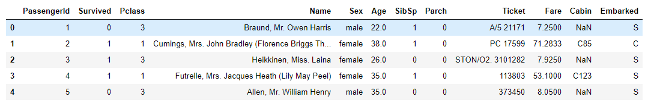
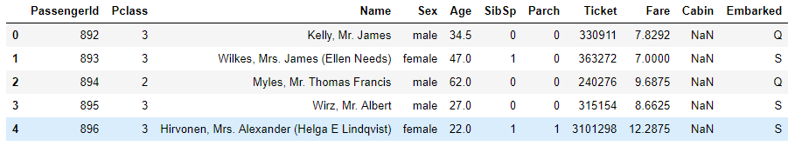
Dataset used
It is the first real step of machine learning-Gathering Data. This step is very crucial as the quality and quantity of data gathered will directly determine how good the predictive model will turn out to be. The Dataset is extracted from Kaggle. The data has been split into two groups.
Training Dataset (train.csv)
Test Dataset (test.csv)

Slide 5
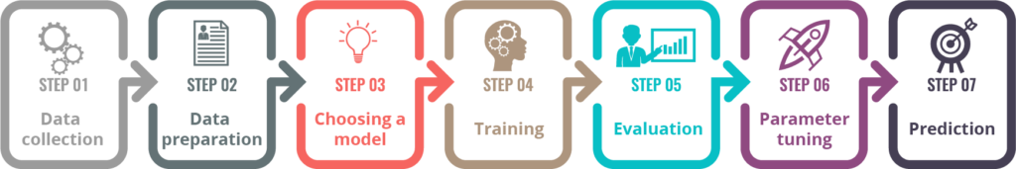
Solution Discussion
The solution of any kind of machine learning solution based on 7 major steps . We can compare support vector machines and 3 layer neural network according to there accuracy score . The algorithm which give higher accuracy between Support vector Machines and 3 layer Neural network will be used for prediction of titanic survival.
Seven Steps to solve any Machine learning based problem

Slide 6

Challenges
The most challenging task in comparing support vector machines and 3 layer neural network of titanic data first we want accurate data because we trained the model by which data if our data is accurate then our model give high accuracy and predict correctly after that we have to clean the data and make prediction.
Cleaning Irrelevant data

Slide 7
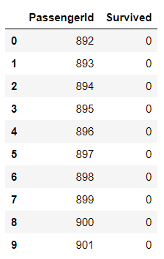
Results
After performing the support vector Machines and 3 layer neural network we get to know that Support vector Machine provide highest accuracy score so we predict the survival of titanic passenger by support vector machines and store that data(2 columns PassengerId ,Survived) in submission.csv file.
Accuracy Score
Support Vector Machines : 90.12%
3 layer Neural Network : 77.54%
Submission.csv

Slide 8

Future work
Accuracy of model can be increase although we get 90.12% accuracy score by Support vector Machines Learning but we can increase it more and more by which we get nearly exact result of titanic survival.
Future work

Slide 9
Summary
Support vector Machines gives 90.12% accuracy score on titanic data and 3 layer neural network gives 77.54% accuracy score so we used support vector machines learning algorithm to predict titanic survival.
Support Vector Machines
3 Layer Neural Network
Accuracy Score : 90.12%
Accuracy Score : 77.54%
90.12% > 77.54%
Support vector Machines accuracy score > 3 Layer neural network accuracy score

Slide 10


