Slide 1
ESP-IDF: IoT Development Framework
Presentation By T Tushar Shenoy
Notes:
Good morning everyone. Thank you for joining me today.""My name is Tushar Shenoy, and I’m excited to present to you on the topic of 'ESP-IDF: IoT Development Framework and Exploring ESP-NOW and FreeRTOS'."

Slide 2
Circuit Guide
Introduction to ESP-IDF
Why ESP-IDF?
Project Workflow
Key Concepts
Getting Started with ESP-IDF Environment
Exploring ESP-NOW
Exploring FreeRTOS

Slide 3
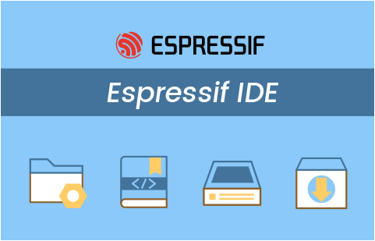
Introduction to ESP-IDF
ESP-IDF (Espressif IoT Development Framework) is the official development framework for the ESP32 and ESP8266 microcontrollers from Espressif Systems
Provides a comprehensive set of tools, libraries and components for developing IoT applications
IDF Supports
Languages: C/C++ and Python Tooling
Debugging & Testing: GDB Support and other
debugging features

Slide 4
Why ESP-IDF?
Comprehensive SDK:
> Software development kit with libraries, tools and example applications
> Supports various peripherals like GPIO, I2C, SPI, UART, PWM, ADC, DAC
Modular Architecture:
> Allows developers to include the components they need, making the firmware
lightweight and efficient
> Easy to integrate third-party libraries and components.
Extensive Documentation and Community Support:
> Well-documented API references, guides and tutorials
> Active community forums and GitHub repository for support and collaboration
Real-Time Operating System (FreeRTOS):
> Comes with FreeRTOS for multitasking and efficient resource management
> Enables real-time capabilities and improved performance for complex applications

Slide 5
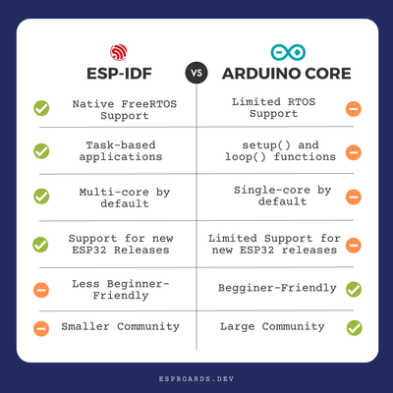
Why ESP-IDF?

Slide 6
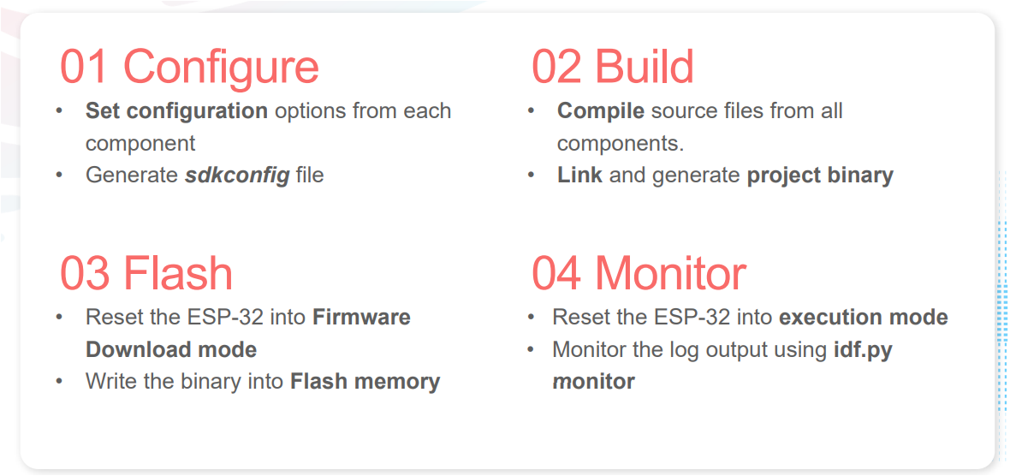
Project Workflow

Slide 7
Key Concepts
1) ESP32 Architecture
Dual-core Processor: ESP32 features a dual-core Xtensa 32-bit LX6 CPU, which allows concurrent execution of multiple tasks.
Memory: There are ROM, SRAM, and external flash memory to store programs and data. Knowing how memory is divided is crucial for memory-intensive applications.
Peripherals: ESP32 has a range of peripherals including:
GPIO (Digital Input/Output)
ADC/DAC (Analog to Digital, Digital to Analog Conversion)
SPI, I2C, UART, PWM, etc.
Wireless Connectivity: Integrated Wi-Fi (802.11b/g/n) and Bluetooth (Classic & BLE).
2) Project Structure in ESP-IDF
Main Directory: Contains the main application code (e.g., main.c or app_main()).
Components: Reusable modules/libraries within the project.
Partition Table: Defines how memory (flash) is allocated for different components such as application code, OTA partitions, NVS (Non-Volatile Storage), etc.
CMake/Makefiles: Build system configuration files used to compile the code.

Slide 8
Key Concepts
3. Component-based Development
ESP-IDF is highly modular and organized into components.
Components can be system libraries (e.g., FreeRTOS, Wi-Fi, SPI) or user-defined ones.
A component is essentially a reusable piece of software. You can include third-party components or create your own and share them across projects.
4. Menuconfig Tool
menuconfig is a configuration tool that allows you to configure various system settings and hardware components for your project.
It provides an interactive interface where you can enable or disable features like Wi-Fi, BLE, Power management, logging level, and much more.
Run idf.py menuconfig to open this configuration utility.Settings configured through menuconfig are saved in the sdkconfig file.

Slide 9
Key Concepts
5. FreeRTOS in ESP-IDF
FreeRTOS is a real-time operating system that’s deeply integrated into ESP-IDF for multitasking.
Key Concepts:
Tasks: Each task is like a mini program that runs independently.
Queues and Semaphores: Used for task communication and synchronization.
Task Priorities: Allow scheduling based on task importance.
Examples: Creating tasks using xTaskCreate() Managing delays with vTaskDelay()
6. Wi-Fi and Bluetooth
Wi-Fi Station (STA) and Access Point (AP) modes:
Station Mode: ESP32 connects to a Wi-Fi network.
Access Point Mode: ESP32 creates its own network.
Wi-Fi Functions: Scanning networks, connecting/disconnecting, handling events like disconnections.
Bluetooth Classic and BLE: Classic Bluetooth for high-speed communication.
BLE for low-power applications, especially IoT devices (advertising and connection).

Slide 10
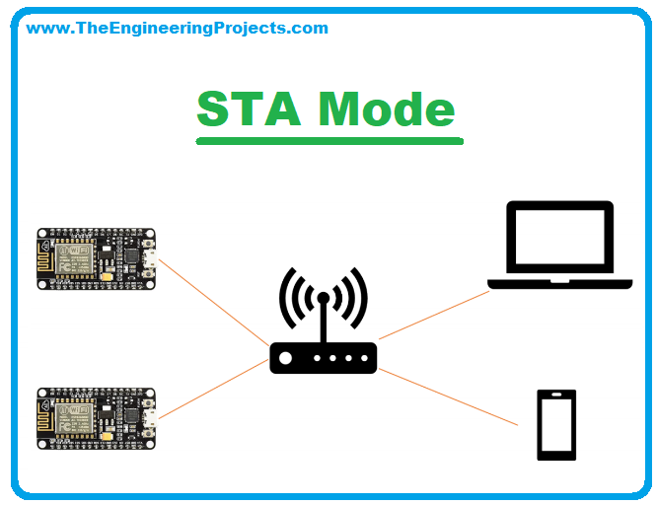
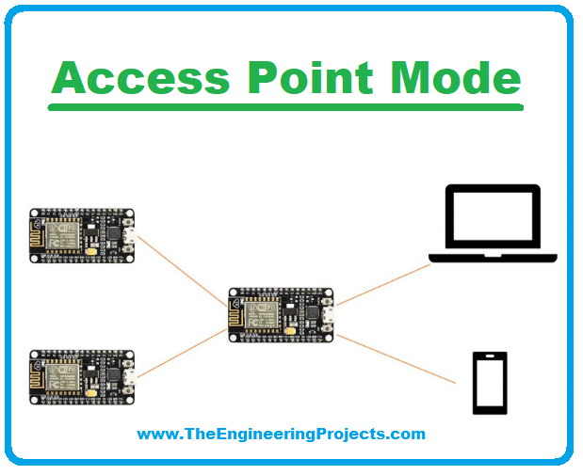
Key Concepts

Slide 11
Key Concepts
7. Peripheral Drivers
ESP-IDF provides a rich set of drivers for interacting with hardware peripherals:
GPIO (General Purpose Input/Output):Control digital I/O pins using gpio_set_level() and read using gpio_get_level().
ADC/DAC (Analog Input/Output):Use ADC to read analog values from sensors or potentiometers.
Use DAC to output analog values (waveforms).
SPI (Serial Peripheral Interface):Communication with sensors, displays, and other SPI devices using spi_master and spi_slave drivers.
I2C (Inter-Integrated Circuit):Communication with sensors or EEPROMs using the I2C protocol.
UART (Universal Asynchronous Receiver-Transmitter):Serial communication between the ESP32 and other devices such as PCs, or other microcontrollers.

Slide 12
Key Concepts
8. ESP-NOW Protocol
ESP-NOW is a proprietary, low-power, and efficient wireless communication protocol that enables peer-to-peer communication without the need for a router.
It’s ideal for IoT devices, low-latency, and low-power applications.
Devices can send packets to multiple peers with reduced overhead compared to traditional Wi-Fi communication.
9. Over-The-Air (OTA) Updates
OTA allows you to update the firmware of the ESP32 remotely via Wi-Fi.
Useful for deploying updates to devices in the field without physical access.
You can define multiple OTA partitions to switch between firmwares during updates.

Slide 13
Key Concepts
What is a Firmware?
Firmware is a type of software that provides low-level control for a device's specific hardware. Unlike general-purpose software, which can be changed or updated more frequently, firmware is typically designed to be embedded directly into a device's non-volatile memory (such as flash memory) and often interacts directly with the hardware components.
What is a Driver?
Drivers are essential pieces of software that enable the operating system (OS) and applications to communicate with and control specific hardware devices. Without drivers, the OS would not know how to interact with the hardware, making it non-functional for its intended tasks.

Slide 14
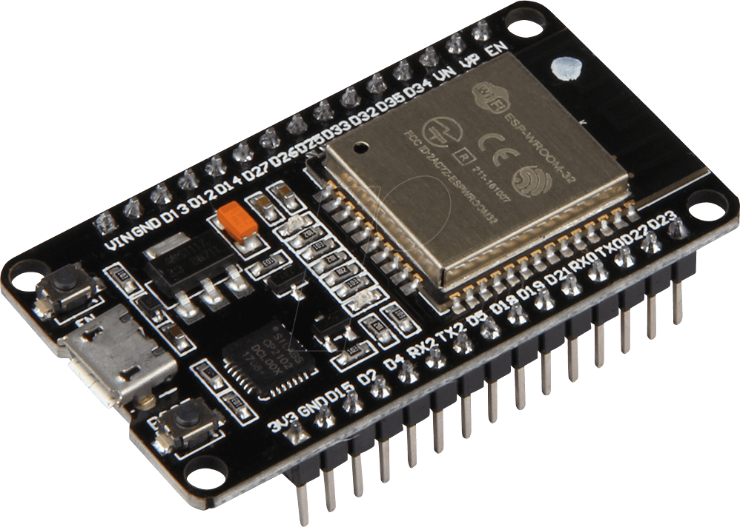
Getting Started with ESP-IDF Environment
Hardware Requirement
#include <stdio.h>
#include "freertos/FreeRTOS.h"
#include "freertos/task.h"
#include "driver/gpio.h"
#include "esp_log.h"
#include "sdkconfig.h"
static const char *TAG = "ETX_BLINKY";
#define BLINK_GPIO 4
void app_main(void)
{
/* Reset the pin */
gpio_reset_pin(BLINK_GPIO);
/* Set the GPIOs to Output mode */
gpio_set_direction(BLINK_GPIO, GPIO_MODE_OUTPUT);
while (1)
{
gpio_set_level(BLINK_GPIO, 1);
ESP_LOGI(TAG, "Turning the LED %s!","ON");
vTaskDelay(500 / portTICK_PERIOD_MS);
gpio_set_level(BLINK_GPIO, 0);
ESP_LOGI(TAG, "Turning the LED %s!","OFF");
vTaskDelay(500 / portTICK_PERIOD_MS);
}
}
Lets Try
“Hello World” Program : Blinking an LED
Espressif IDE Demonstration

Slide 15
Exploring ESP-NOW
What is ESP-NOW?
Definition: Connectionless communication protocol by Espressif for ESP32 and ESP8266
devices
Purpose: Enables low-latency, peer-to-peer communication without Wi-Fi or Bluetooth
pairing
Key Features
Low Latency: Quick message transmission with minimal delay Connectionless Protocol: No need for establishing a connection Low Power Consumption: Ideal for battery-powered devices
Peer-to-Peer Communication: Direct communication between devices
Broadcast and Unicast: Send messages to all devices or specific devices

Slide 16
Implementing ESP-NOW in IDF
Sender Side code Explanation
Initialization: Sets up NVS for storage, initializes Wi-Fi in station mode and initializes ESP-NOW for communication
Callback Function: Defines on_data_sent to log the status of the last sent message (success or failure)
Peer Registration: Configures and registers the receiver with its MAC address and sets up peer information
Message Structure: Defines a structure struct_message to hold the data and initializes it with "Hello from ESP32“
Message Sending Loop: Continuously sends the message every 2 seconds, logging success or failure and incrementing a counter for each message sent.

Slide 17
Implementing ESP-NOW in IDF
Sender Side code Explanation
Initialization: Sets up NVS for storage, initializes Wi-Fi in station mode and initializes ESP-NOW for communication
Callback Function: Defines on_data_recv to handle incoming messages, copying the data to myData, incrementing a message counter and logging the received message and total count
Wi-Fi Configuration: Initializes the network interface and event loop, configures Wi-Fi, and starts it in station mode.
ESP-NOW Setup: Initializes ESP-NOW and registers the receive callback function to handle incoming messages
Main Loop: Runs an infinite loop with a delay of 1 second, keeping the program running to continuously receive messages.

Slide 18
Exploring FreeRTOS
What is FreeRTOS?
> Popular RTOS (Real Time Operating System)
> Integrated into ESP-IDF (central to programming model)
> Allows multi-threading (known as tasks)
FreeRTOS Features
Real-Time Scheduling:
> Ensures that critical tasks are executed within a predictable time frame
> Supports multiple priority levels, allowing high-priority tasks to pre-empt lower-priority tasks
Task Management:
> Allows multiple tasks to run seemingly simultaneously by managing their execution
> Provides APIs to create, delete, and manage tasks

Slide 19
Exploring FreeRTOS
Task Synchronization:
> Includes mechanisms like semaphores, queues, and mutexes for inter-task
communication and synchronization
Memory Management:
> Supports dynamic memory allocation and deallocation
> It also offers static memory allocation for systems with limited memory resources
Inter-Task Communication:
> Queues: Enables tasks to send and receive messages
> Semaphores and Mutexes: Ensures resource sharing without conflicts
Timers and Delays:
> Software Timers: Allows tasks to be executed at specific intervals
> Delays: Provides APIs for task delays and timeouts

Slide 20
Thank You

