Slide 1
Churn analysis project

Slide 2
Does Failing a level increases the risk of churn ?
AIM -
To find if failing in the level is the cause of the players to leaving the game .
OBJECTIVES -
To find number of players failing and immediately quitting the game.
But some players might have failed anytime in the last session , int the last stage or in the last level they played and quit the game. So, need to find players who failed at least once in the above times.
To find number of players failing at least once in their last session played.
To find number of players failing at least once in the last level / stage they played.
Observe the levels in which players are mostly failing and quitting.
Explore failing patterns by levels and days played.

Slide 3
METHODOLOGY
Exploratory data analysis
Performed initial exploration on players and level_progress dataset so as to discover patterns and relationships between data.
Find the relationship of failing players on platform and system memory.
Count the no. of players who never played the game.
Calculate the daily new users.
Calculate the mean DAU (daily active players).
Calculate the ratio of fails on levels and their corresponding stage.
Discovered the maximum levels most players played up to.
Discovered the maximum days most players played the game.

Slide 4
Descriptive data analysis
Quantitively described the failing factors of the players who quit the game.
Find number and percentage of players quitting the game who failed based on following factors -
Failed and quit immediately
Failed on last session and quit
Failed on last level and quit
Failed on last stage and quit
Find the levels on which people where mostly failing and quitting.
Find the number of attempts people are giving in their last stage played.

Slide 5
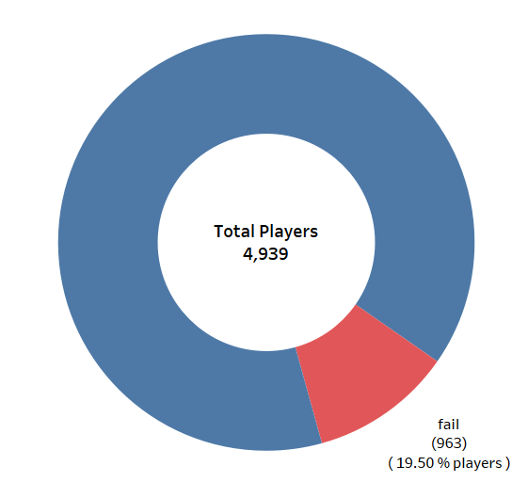
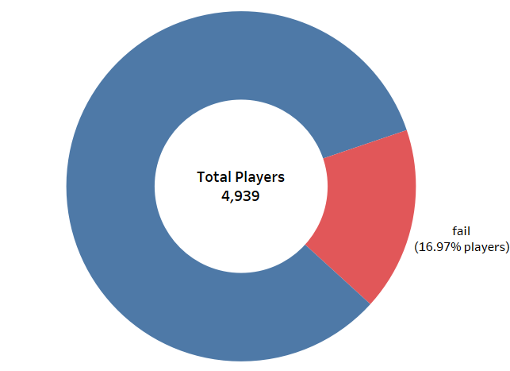
RESULTS
Failing and quitting of players -
1.On last event_datetime
2. On last session
16.9% players quit the game immediately after failing
But 83.1% people quit the game immediately without failing
19.5% players quit the game immediately after failing
But 80.5% people quit the game immediately without failing

Slide 6
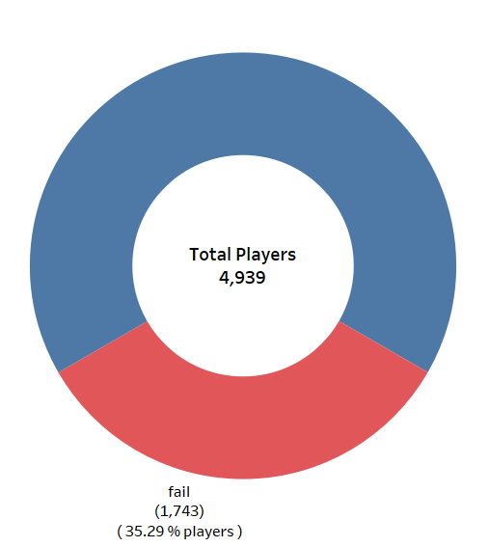
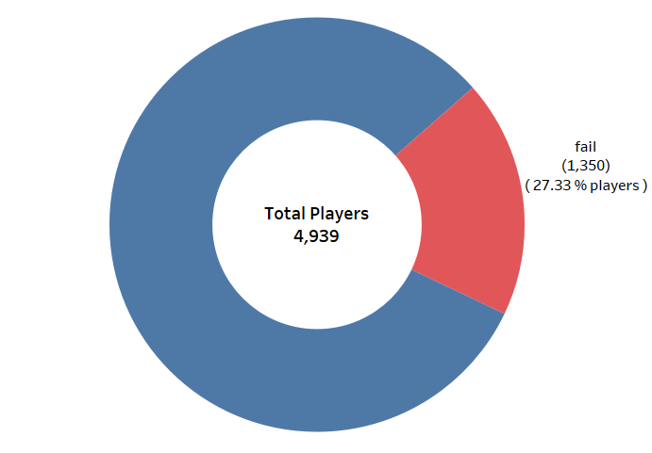
3. On last stage
4. On last level
27.3% players quit the game immediately after failing
But 72.6% people quit the game immediately without failing
35.2% players quit the game immediately after failing
But 64.7% people quit the game immediately without failing

Slide 7
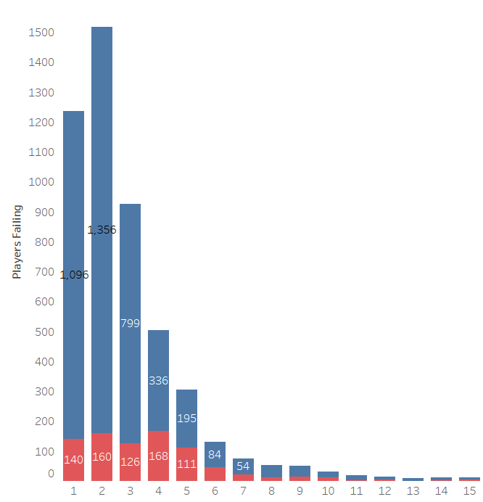
Number of Players quitting by levels -
This split bar chart shows the number of players failing and quitting on which levels.
Here with this bar chart we can also discover that % of players failing and quitting on 4th level increases among players who are playing level 4.
Also we can see difference of players quitting without failing and players quitting without failing on particular level.
Players quitting without failing
Players quitting without failing

Slide 8
Failing ratio -
No. of fails per levels -
Level_no | Stage_no | Total_fails | Total_starts | Fails_ratio
1 | 1 | 996 | 6130 | 16.25 %
1 | 2 | 260 | 4873 | 5.34 %
2 | 1 | 539 | 4410 | 12.22 %
2 | 2 | 413 | 3715 | 11.12 %
2 | 3 | 291 | 3266 | 8.91 %
3 | 1 | 309 | 2645 | 11.68 %
3 | 2 | 287 | 2188 | 13.12 %
3 | 3 | 242 | 1851 | 13.07 %
4 | 1 | 491 | 1790 | 27.43 %
4 | 2 | 728 | 1695 | 42.95 %
4 | 3 | 404 | 1281 | 31.54 %
5 | 1 | 497 | 1188 | 41.84 %
5 | 2 | 343 | 998 | 34.37 %
5 | 3 | 304 | 907 | 33.52 %
Level no. | Total fails
4 | 1623
1 | 1256
2 | 1243
5 | 1144
3 | 838
6 | 498
7 | 279
8 | 255
9 | 175
11 | 145
10 | 125
14 | 73
12 | 59
Here we can see that failing ratio increases after level 3, so risk of quitting after failing increases after level 3.

Slide 9
Key RESULTS & TAKEAWAYS
Number of players failed at least once and quit in their last game -
Failed and immediately quit – 16% (rest players quit wihtout failing)
Failed at least once and quit on the last session they played – 19%
Failed at least once and quit on the last level stage they played – 27%
Failed at least once and quit on the last level they played – 34%
Mean of above percentages is (16+19+27+34)/4 = 24
So, most players (60% to 70%) quit the game without failing in the level.
Also failing ratio increases a lot after level 3 as shown in the table in previous slide.
Most players quit the game in 1st and 2nd levels where the failing ratio is quite low.
Most players play the game for only 1 or 2 days maximum.

Slide 10
ConCLusions
So, with these results we can conclude that most players (60% to 70%) quit the game without failing a level
Failing increase the risk of churn approximately by 24% (mean of failing and quitting percentages of players in their last game). Rest players quit without failing.
Failing and quitting varies differently according the levels
Quitting after a fail is quite low before 4th level.
Quitting after a fail in higher after 3rd level.
So failing is not the significant factor for players leaving the game because most people leave the game within 1st or 2nd level.

Slide 11
Further analysis
We can discover the session time of users which can help to give some personalized updates to users
We can observe the behavior of retained players to see patterns of players who keep playing the game.
With these data we can further calculate the number of attempts on particular levels or its stage.
We can calculate the average playtime of users in hours.
If there were column related to the ads data along with the data given, we could get more insights of ads effects on churn or players behaviour.

Slide 12
THANK YOU
Tushar Shirsat
tusharshirsat72@gmail.com

