Slide 1
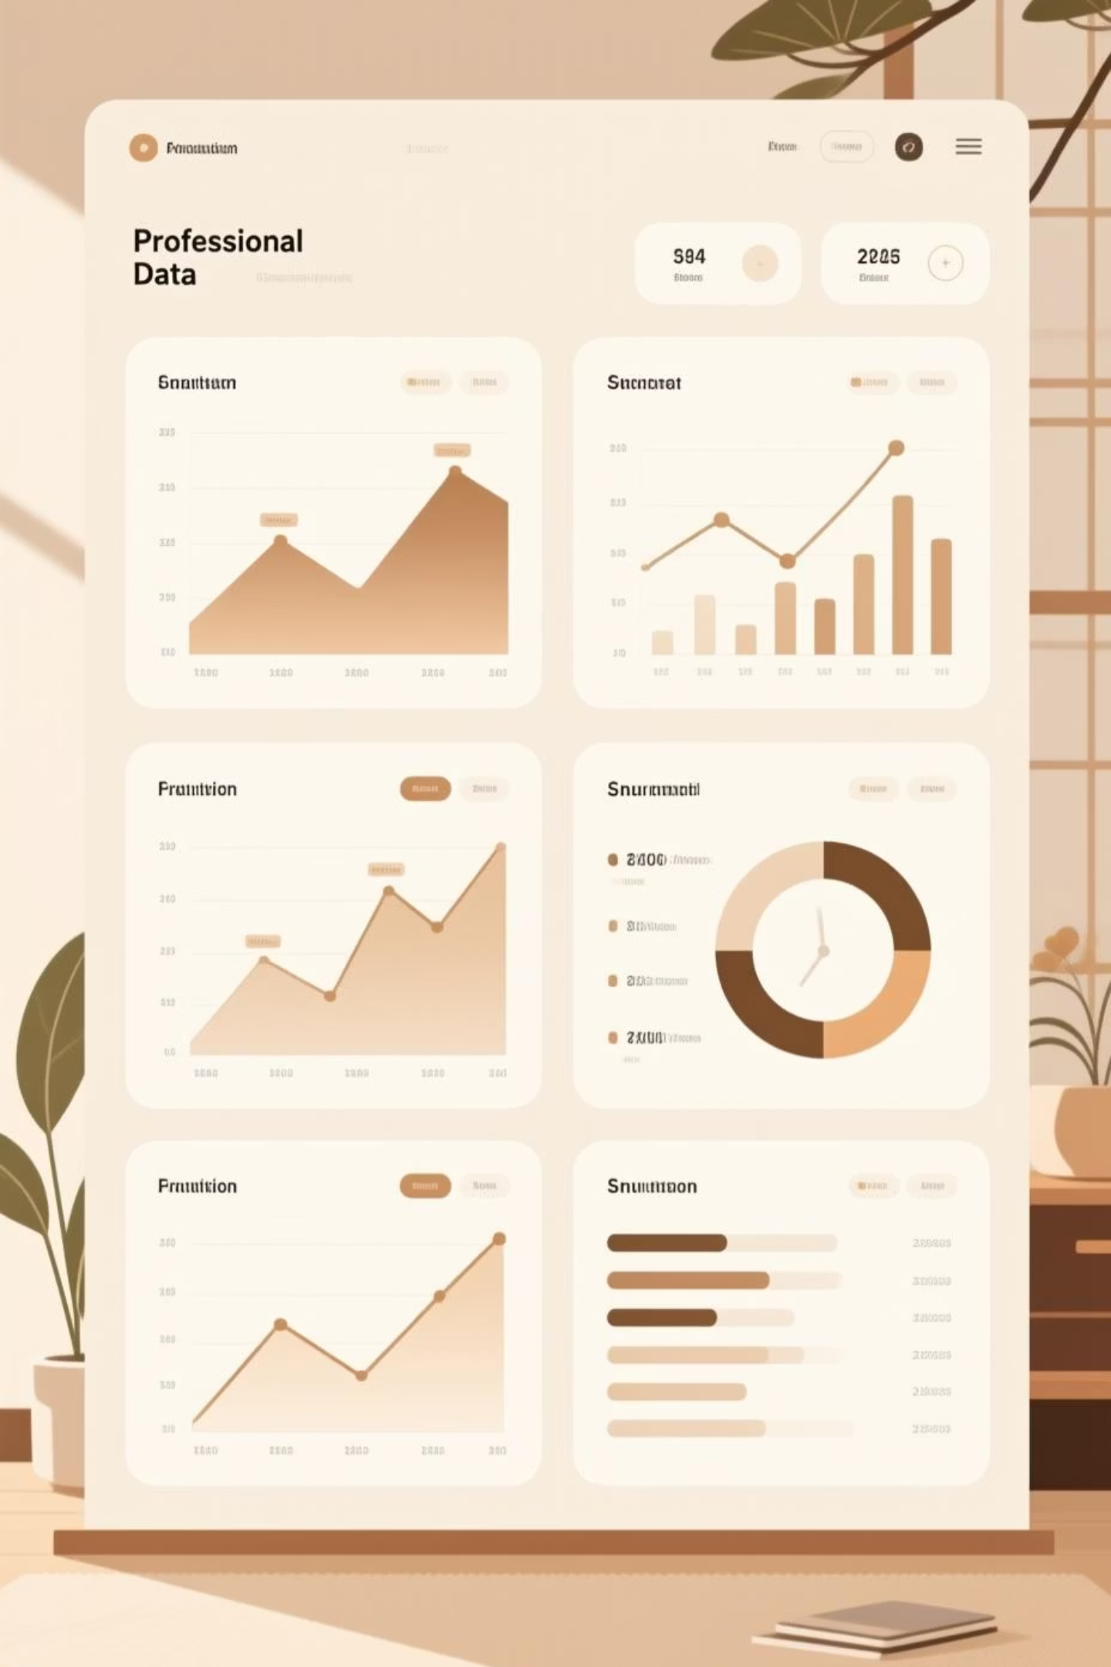
Job Application Tracker
SQL & Python Project
Tracking and analyzing job applications using data visualization
By Tushar Shukla

Slide 2
Project Objective
Analyze & Track
Track job applications
Drive Insights
Using SQL and Python, I wanted to see patterns in the application process, like which companies receive the most applications or where rejections happen most often.
The goal was to build a simple system to record and organize all job applications — including company names, job roles, dates, and current status.
Visualize performance data to understand personal progress, spot areas to improve, and make better choices in future applications

Slide 3
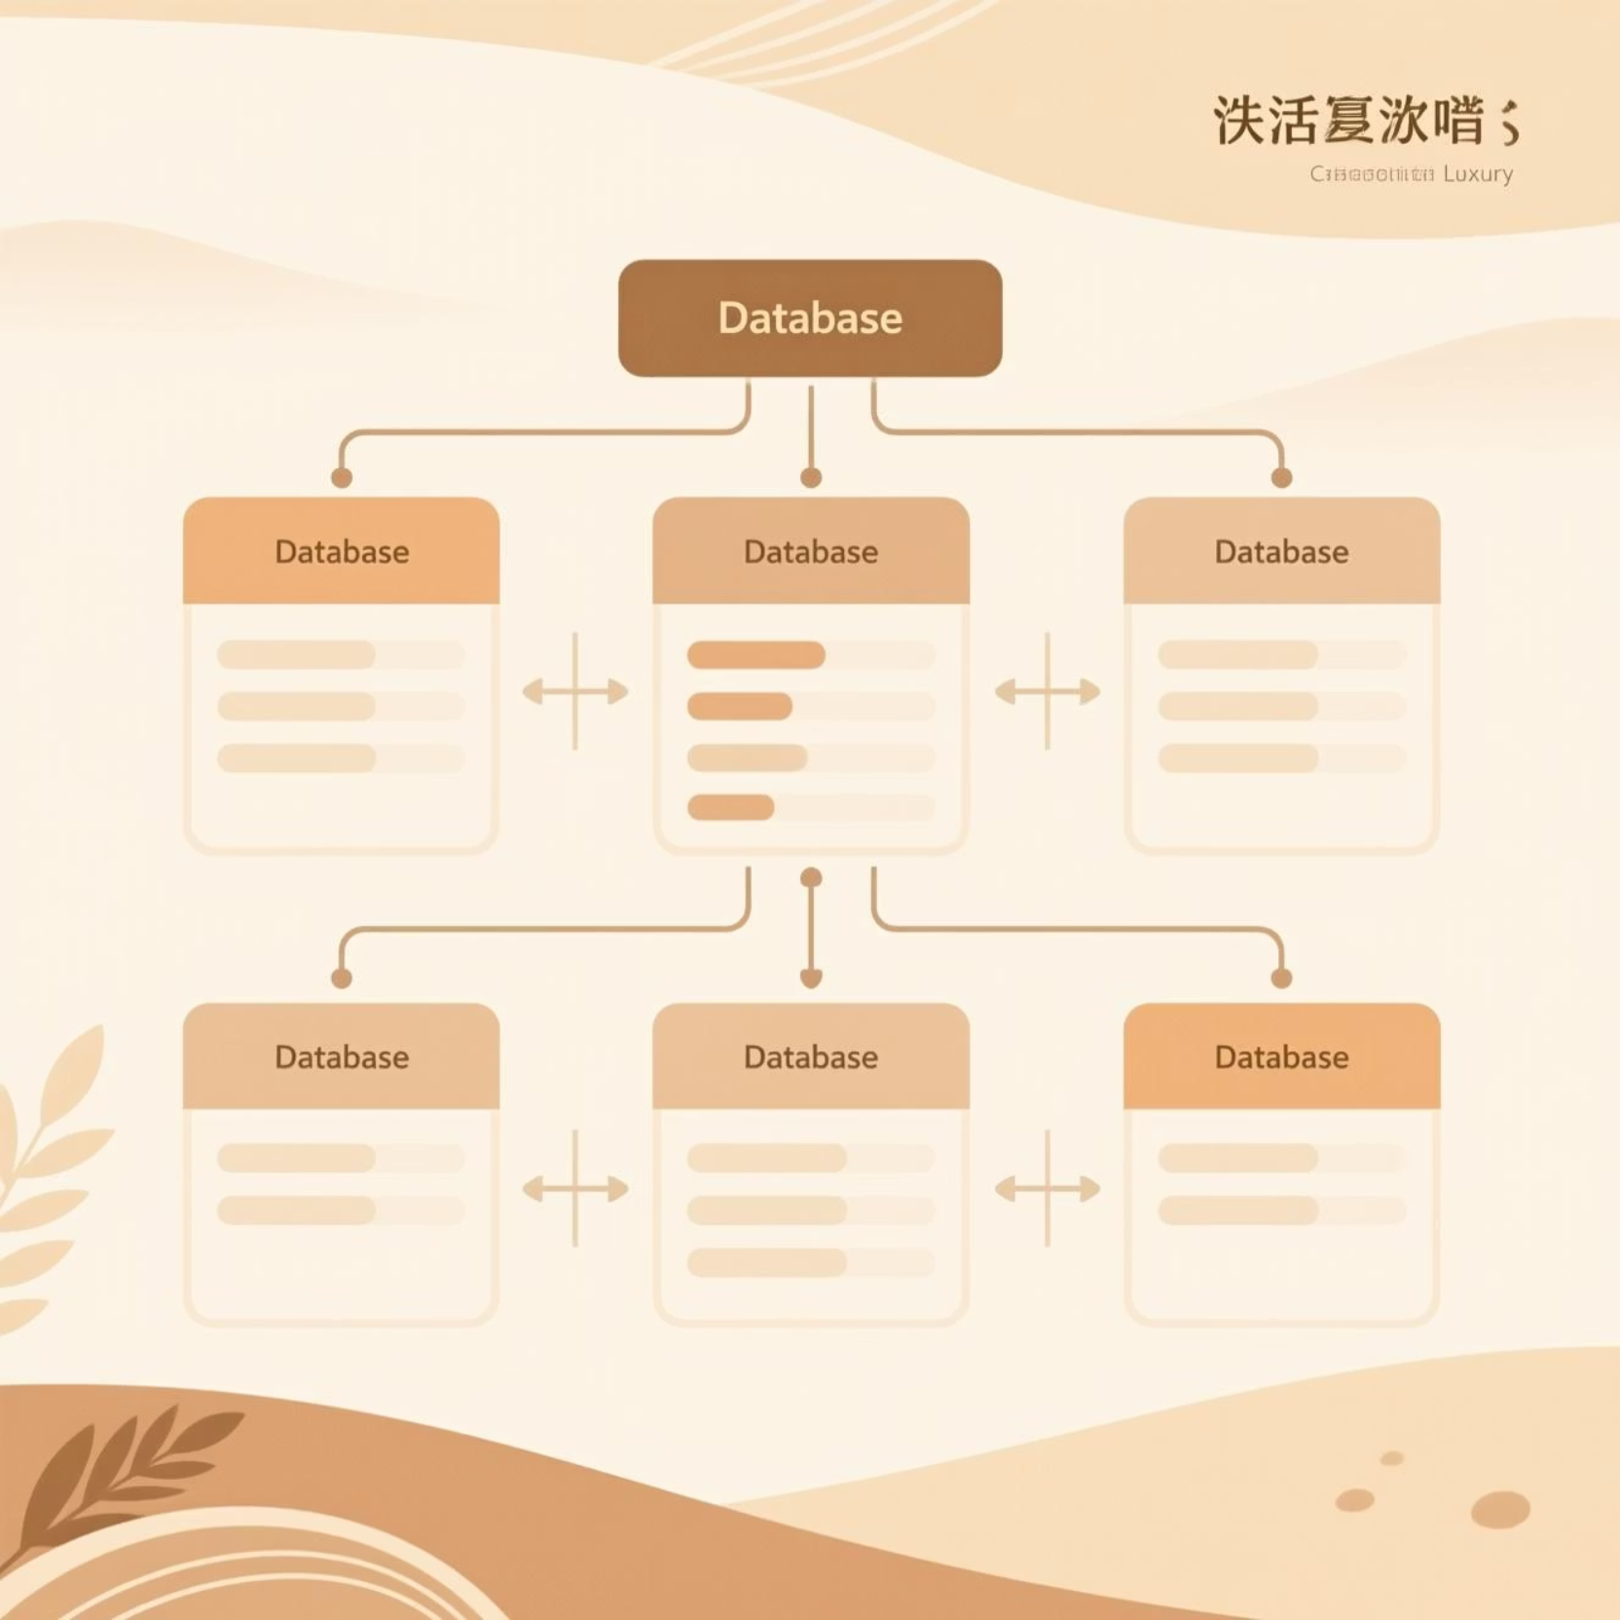
Database Architecture
Core Tables
applicants – Candidate profiles and details
applications – Job submissions with timestamps
interviews – Interview scheduling and outcomes
These three tables form the foundation of our data model, capturing the complete applicant journey from submission through interview.

Slide 4

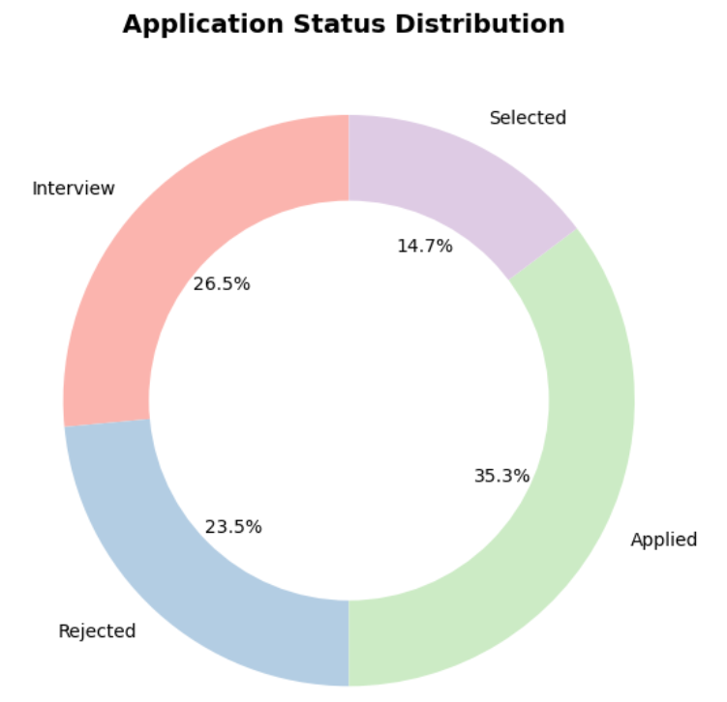
SQL Query: Total number of applications by status
select status, count(*) as Count_of_status
from applications
group by status;
Key Finding : Most applications are still in progress, mainly in “Applied” or “Interview” stages.
Applied
Interview
Rejected
Offer
Key Insight: 45 applications remain in progress, while 28 rejections indicate competitive screening processes requiring strategic focus.

Slide 5
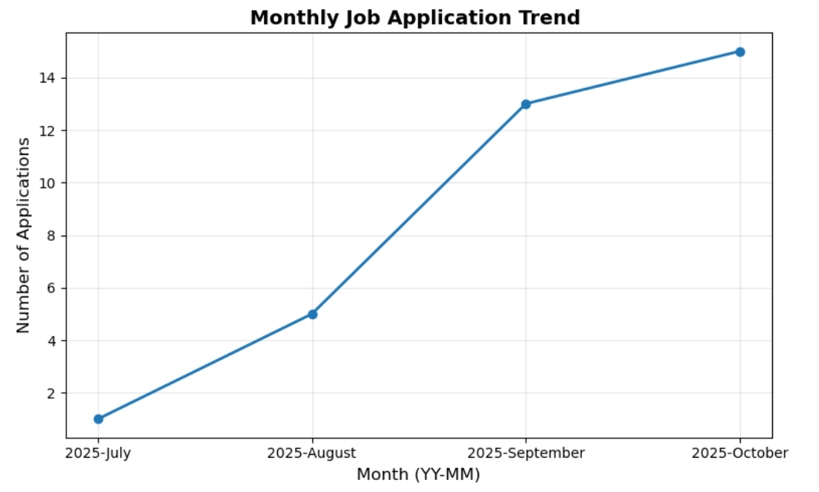
SQL Query: Applications per month
select date_format(date_applied , '%Y-%M') as month, count(app_id) as Total_application_per_month
from applications
group by month
order by min(date_applied);
Key Finding : Applications peaked in September and October, aligning with major hiring periods
Applied
Interview
Rejected
Offer
Key Insight: 45 applications remain in progress, while 28 rejections indicate competitive screening processes requiring strategic focus.

Slide 6
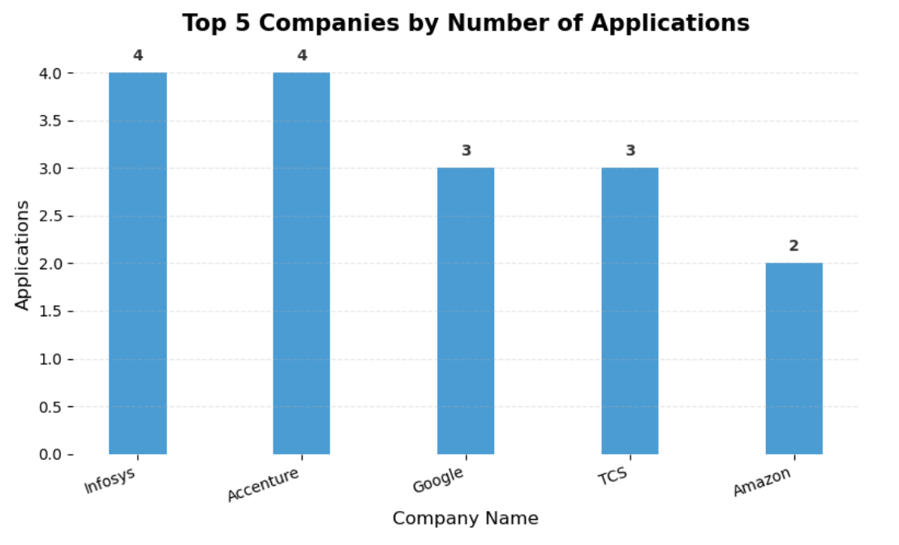
SQL Query: Top 5 companies with the highest number of applications
select company_name, count(app_id) as Number_of_application
from applications
group by company_name
order by Number_of_application desc limit 5 ;
Key Finding : Infosys and Accenture received the highest number of applications.
Applied
Interview
Rejected
Offer
Key Insight: 45 applications remain in progress, while 28 rejections indicate competitive screening processes requiring strategic focus.

Slide 7
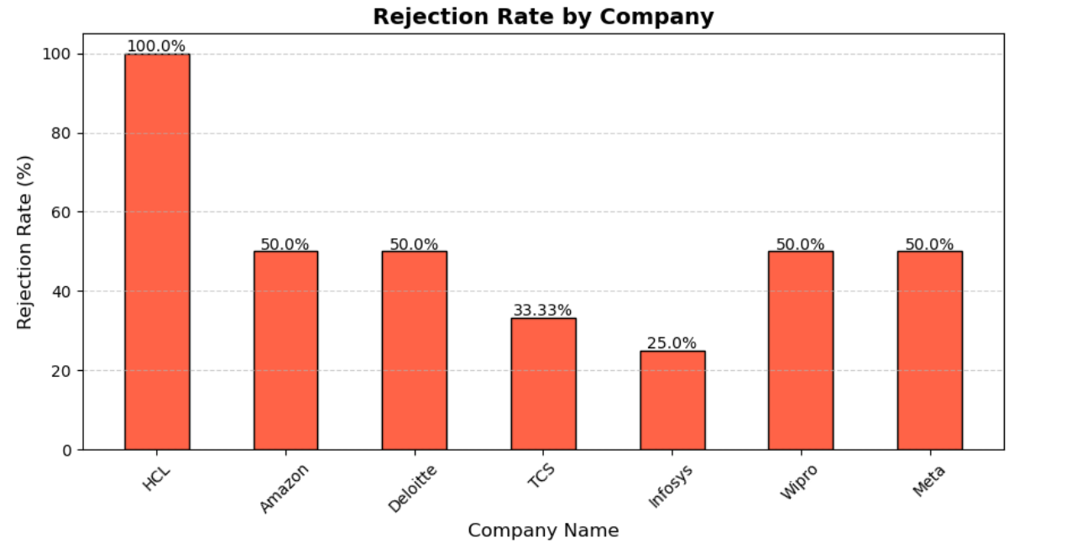
SQL Query: Rejection rate per company
select company_name,count(*) as Number_of_rejected,
ROUND(COUNT(*) * 100.0 / (SELECT COUNT(*) FROM applications WHERE company_name = a.company_name), 2) AS Rejection_Rate_Percent
from applications a
where status = 'rejected'
group by company_name
order by Number_of_rejected desc;
Key Finding : Big firms reject more candidates, while mid-sized ones are more selective.

Slide 8
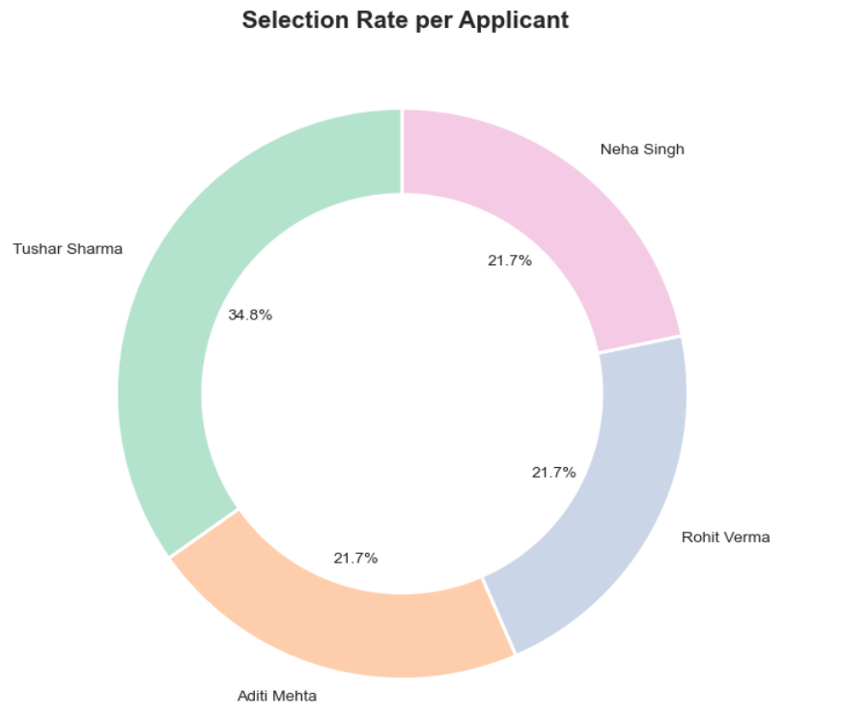
SQL Query: Selection rate per applicant
select a.name, count(case when app.status = 'selected' then 1 end) as selected_count, count(*) as total_applications,
round(count(case when app.status = 'selected' then 1 end) * 100.0 / count(*),2 ) as selection_rate_percent
from applicants a
join applications app on a.applicant_id = app.applicant_id
group by a.name
order by selection_rate_percent desc;
Key Finding : Tushar and Rohit achieved the highest selection rates.
Applied
Interview
Rejected
Offer
Key Insight: 45 applications remain in progress, while 28 rejections indicate competitive screening processes requiring strategic focus.

Slide 9
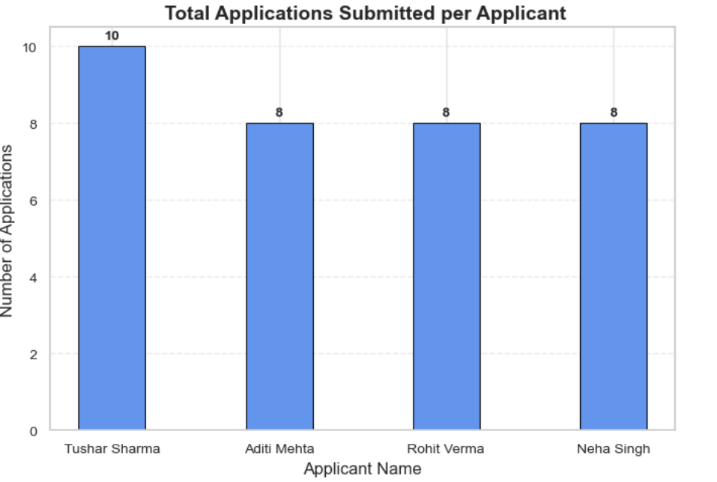
SQL Query: Total applications submitted per applicant
select a.name, count(*) as number_of_applications
from applicants a
join applications app
on a.applicant_id = app.applicant_id
group by a.name;
Key Finding : Tushar applied to the most companies, showing strong consistency.
Applied
Interview
Rejected
Offer
Key Insight: 45 applications remain in progress, while 28 rejections indicate competitive screening processes requiring strategic focus.

Slide 10
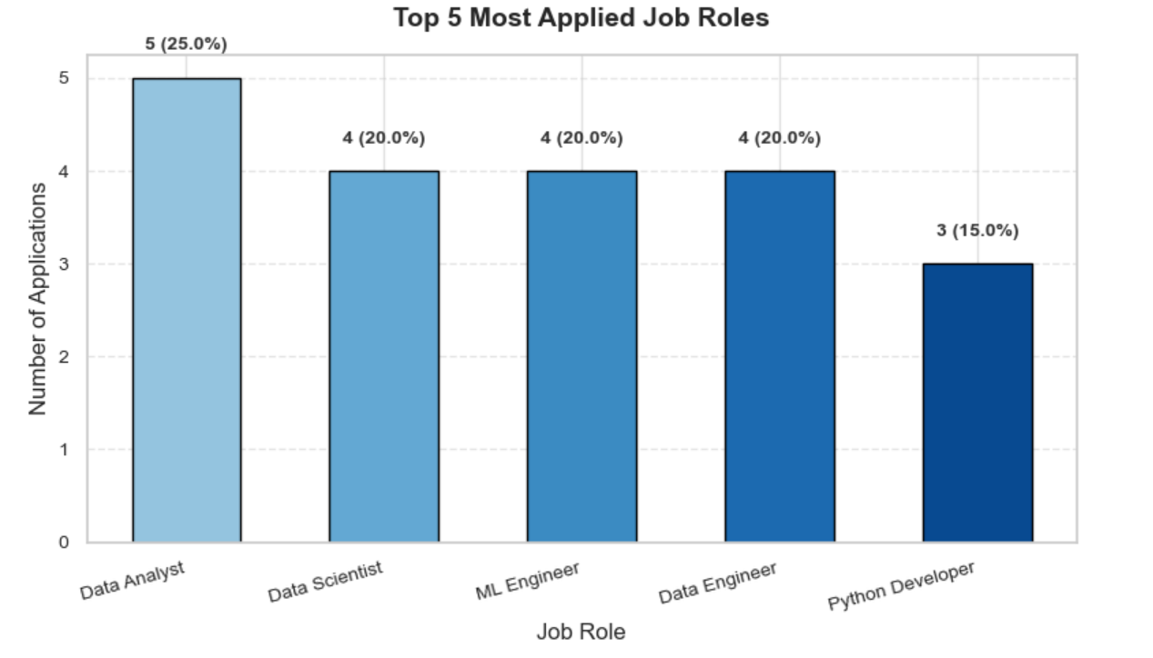
SQL Query: Top 5 most applied job roles
select job_role,count(*) as Number_of_application
from applications
group by job_role
order by Number_of_application desc limit 5;
Key Finding : Data Analyst and AI Engineer roles are the most sought-after.
Applied
Interview
Rejected
Offer
Key Insight: 45 applications remain in progress, while 28 rejections indicate competitive screening processes requiring strategic focus.

Slide 11
Strategic Insights & Key Findings
Seasonal Trends
Company Selection Strategy
Most applications were submitted between September and October, showing a clear hiring cycle. Aligning future applications during these active months can increase interview chances and recruiter responses.
Large organizations such as Google and Amazon show higher rejection rates, while mid-size or startup firms offer better response ratios. Targeting balanced company types can improve overall success rates.
Application Performance Trend
Role Market Demand
Tushar shows the highest selection ratio (around 18%), mainly from focused AI and Data roles. Applicants with diversified but strategic choices, like Rohit, also perform well—suggesting that quality targeting beats volume
AI Engineer and Data Analyst roles dominate total applications (about 60%), proving they are the most competitive and in-demand fields. Prioritizing interview preparation in these roles could increase final selections.

Slide 12
Recommendations & Next Steps
Diversify Application Targets
Don’t rely too much on large firms — they show high rejection rates. Include mid-sized and startup companies that have faster response times and better acceptance ratios.
Align Applications with Hiring Seasons
Application volume peaks in September–October, suggesting stronger recruiter activity. Submitting applications in these months can improve visibility and callback rates.
Focus on High-Demand Roles
Positions like Data Analyst and AI Engineer make up most applications and selections. Strengthen skills, certifications, and projects around these roles to stay competitive.
Track and Learn from Interview Feedback
Use interview notes and outcomes to spot recurring weaknesses — whether in SQL, communication, or project clarity — and work on improving them before the next round.
Implement Monthly Tracking
Automate tracking of new applications and interview updates through SQL + Python scripts. Use dashboards to monitor trends and measure progress each month.

Slide 13
Conclusion
This project turned raw job data into actionable insights.
  Using SQL and Python, I identified trends that reveal how timing, company choice, and
  skills impact results.
It’s a step toward smarter applications —
and a reminder that data can guide career growth as much as effort does.

