Slide 1
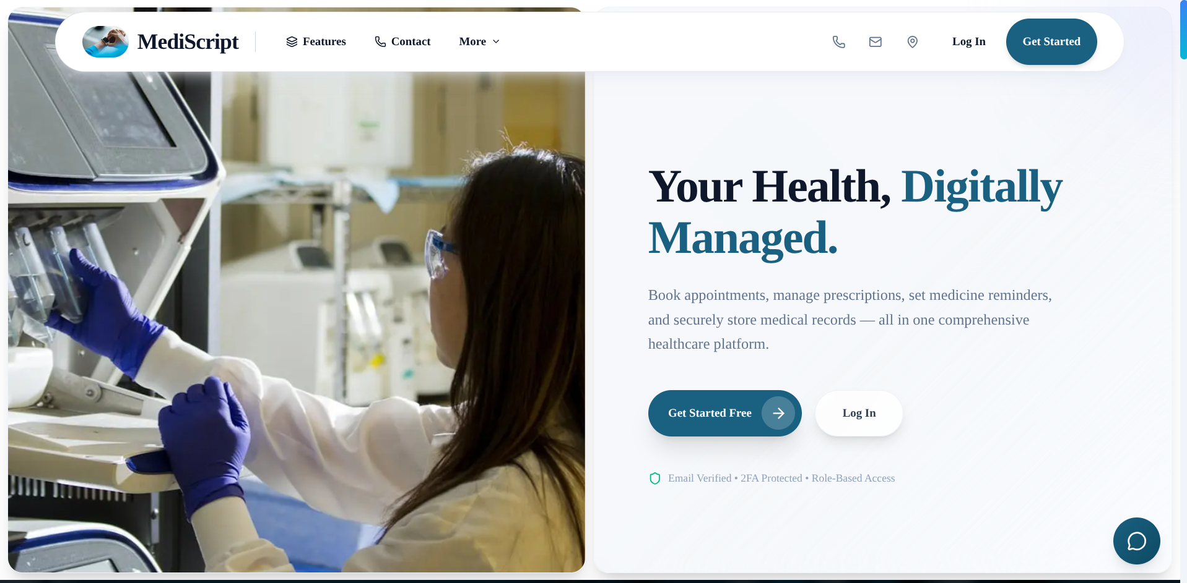
MediScript-E
A Secure Digital Healthcare Platform
Software Engineering Course Project
Tushar Barua
CSE — USTC, Chittagong
2024–2025
🌐 mediscript-e.vercel.app

Slide 2
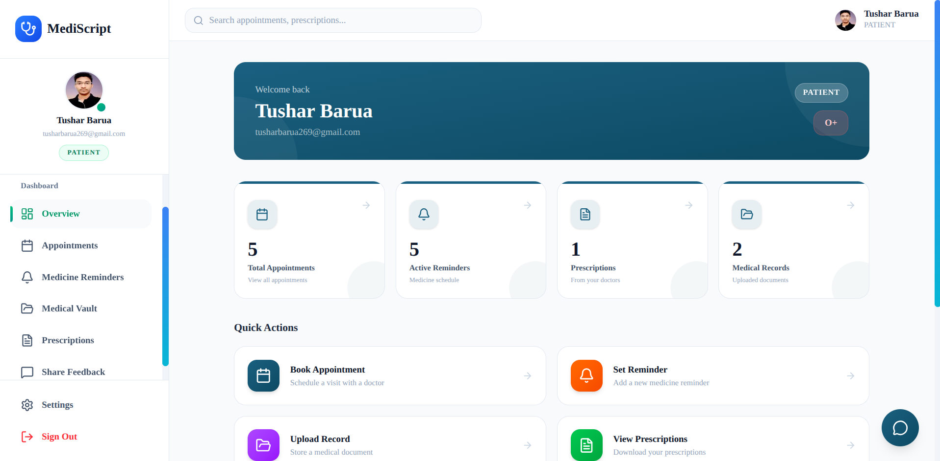
Abstract
IEEE — Project Overview
What is MediScript-E?
• Full-stack digital healthcare platform
• Connects Patients, Doctors, and Administrators
• Built following complete SDLC methodology
• Digitizes the entire patient-doctor workflow
Core Purpose
• Digitize patient-doctor workflow end-to-end
• Secure medical data in the cloud
• Automate medicine reminders via email
Built with: Next.js · TypeScript · PostgreSQL · Vercel
MediScript-E | Tushar Barua | CSE, USTC

Slide 3
Presentation Outline
What We'll Cover Today
1
Related Work
IEEE
8
Tech Stack
SDLC Phase 3
2
Problem Statement
SDLC Phase 1
9
Auth & Security
SDLC Phase 3
3
Proposed Solution
SDLC Phase 1
10
Core Features
SDLC Phase 3
4
Requirements Analysis
SDLC Phase 1
11
Testing
SDLC Phase 4
5
Use Cases & Actors
SDLC Phase 1
12
Results & Deployment
SDLC Phase 5
6
System Architecture
SDLC Phase 2
13
Challenges & Conclusion
IEEE
7
Database Design
SDLC Phase 2
MediScript-E | Tushar Barua | CSE, USTC

Slide 4
Related Work
IEEE — Existing Systems & Gap Analysis
Platform | Primary Focus | What It Lacks (Combined)
Practo (India) | Doctor discovery & appointment booking | No unified: reminders + vault + AI chatbot + open access
Zocdoc (USA) | Online appointment scheduling | No unified: e-prescriptions + 2FA + AI + free open platform
HealthTap (USA) | AI symptom checker + doctor chat | No unified: appointment booking + RBAC + prescription PDF
Manual / Paper-based | Traditional in-person healthcare | No digitization at all — records lost, no reminders
The Gap
• Each platform solves one problem — none combines all features in a single free, open system
• No existing free platform offers: booking + e-prescription + reminders + vault + AI chatbot + 2FA + RBAC
• MediScript-E fills this gap — unified, secure, role-based, and production-deployed
MediScript-E | Tushar Barua | CSE, USTC

Slide 5
Problem Statement
Phase 1 — Requirements Analysis
Pain Point | Reality
Prescriptions | Lost, damaged, inaccessible
Appointments | Phone calls & physical visits required
Medical Records | Scattered across multiple hospitals
Medicine Schedule | No reminders — often forgotten
Data Security | No role-based access control
"Healthcare data is fragmented, insecure, and inaccessible when needed most."
MediScript-E | Tushar Barua | CSE, USTC

Slide 6
Proposed Solution
Phase 1 — Requirements Analysis
One Platform. Three Roles. Complete Workflow.
Role | Key Capabilities
👤 Patient | Book appointments · View prescriptions · Set reminders · Upload records
👨‍⚕️ Doctor | Manage appointments · Issue digital prescriptions · Archive records
🛡️ Admin | Monitor platform · Manage users · View all appointments
Result:
End-to-end digital healthcare — from booking to prescription to secure storage.
25+
9
3
5
100%
API Endpoints
DB Models
User Roles
Core Features
Live on Vercel
MediScript-E | Tushar Barua | CSE, USTC

Slide 7
Requirements Analysis
Phase 1 — Functional & Non-Functional
Functional Requirements
Non-Functional Requirements
• FR1: Register & login with email verification
• FR2: Book appointments with available doctors
• FR3: View & download prescriptions as PDF
• FR4: Set medicine reminders — automated email alerts
• FR5: Upload & manage medical records (cloud)
• FR6: Doctor manages appointments & prescriptions
• FR7: Admin monitors users & platform stats
NFR | Requirement
Security | 2FA, RBAC, bcrypt, JWT
Performance | Serverless, connection pooling
Scalability | Vercel + Supabase managed infra
Usability | Responsive, mobile-friendly UI
Reliability | Token expiry, cascade delete
Maintainability | TypeScript, Prisma ORM
MediScript-E | Tushar Barua | CSE, USTC

Slide 8
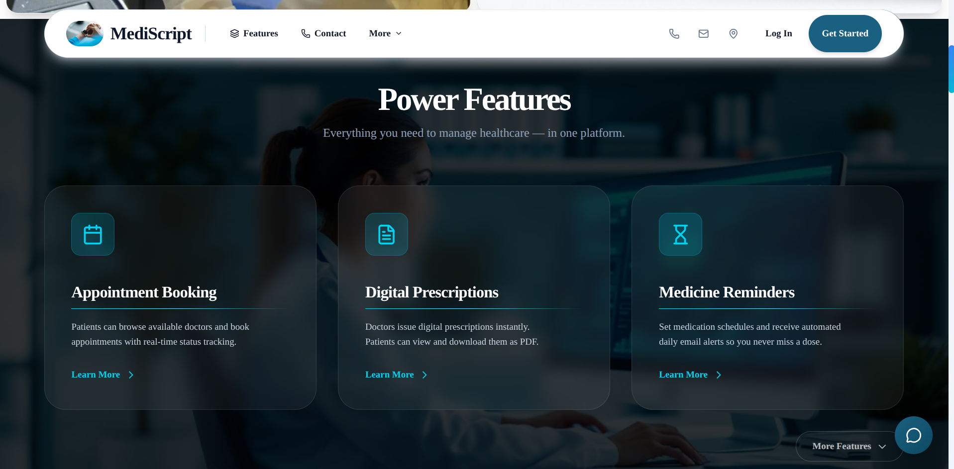
Use Cases & Actors
Phase 1 — Requirements Analysis
Actors
Key Use Cases
👤 Patient
👨⚕️ Doctor
🛡️ Admin
⚙️ Cron System (automated)
🔗 OAuth Provider (Google / GitHub)
UC1: Register → Verify Email → Login
UC2: Patient books appointment
UC3: Doctor confirms & issues prescription
UC4: Patient downloads prescription PDF
UC5: Patient sets reminder → receives email
UC6: Admin manages users & monitors platform
Appointment Flow
PENDING → CONFIRMED → COMPLETED | CANCELLED
MediScript-E | Tushar Barua | CSE, USTC

Slide 9
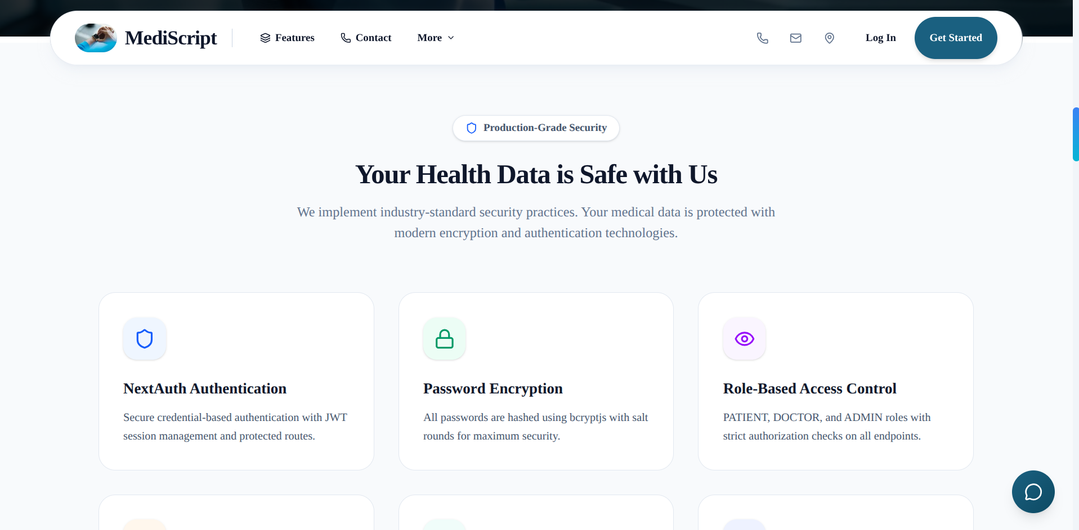
System Architecture
Phase 2 — System Design
PRESENTATION TIER
Next.js App Router · React 19 · TypeScript
↓
APPLICATION TIER
Next.js Serverless API Routes · NextAuth.js · Prisma ORM
↓
DATA TIER
PostgreSQL (Supabase) · Supabase Storage
External Services
Groq API (Llama 3.1) · Nodemailer (Gmail SMTP) · Google & GitHub OAuth · GitHub Actions (Cron)
MediScript-E | Tushar Barua | CSE, USTC

Slide 10
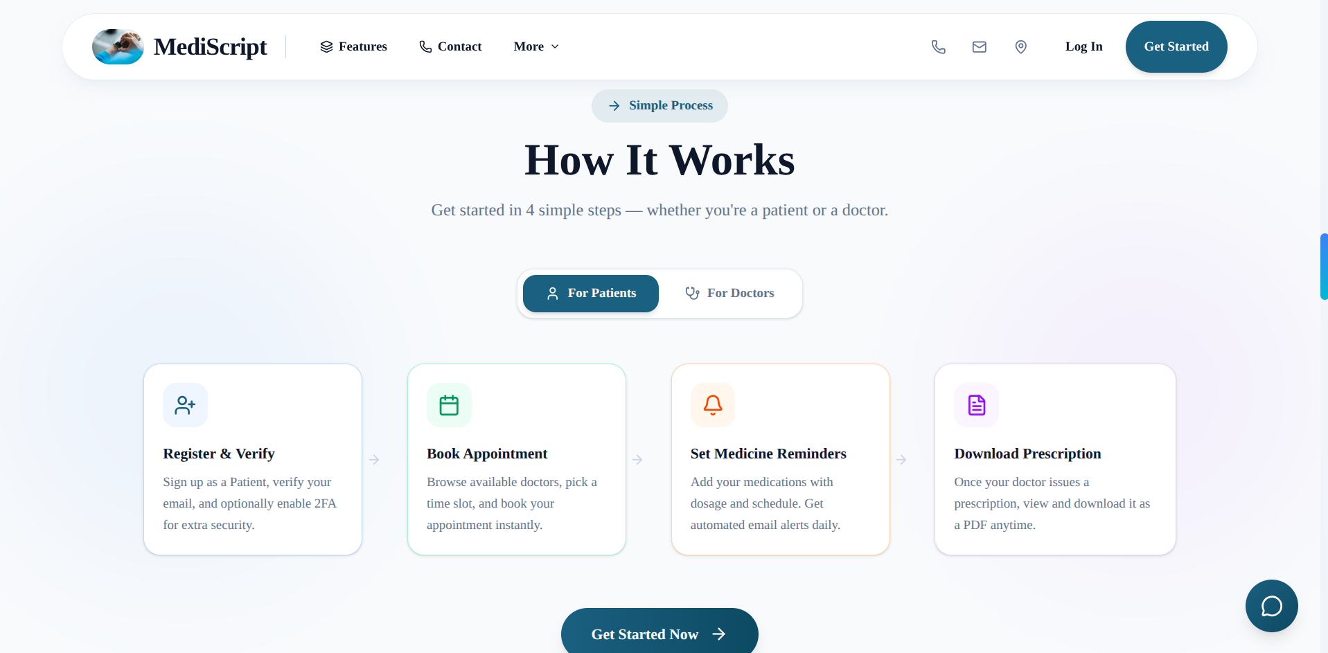
Database Design
Phase 2 — System Design
Schema Overview — 9 Models · 3 Roles · Cascade Delete
User
├── DoctorProfile → Appointment[ ] · Prescription[ ]
└── PatientProfile → Appointment[ ] · Prescription[ ]
MedicalVault[ ] · MedicineReminder[ ]
ContactMessage (standalone)
Testimonial (standalone)
Key Design Decisions
• Soft archive on prescriptions (archivedByDoctor flag)
• OTP stored temporarily — cleared after verification
• Cascade delete — no orphan records on user deletion
MediScript-E | Tushar Barua | CSE, USTC

Slide 11
Tech Stack
Phase 3 — Implementation
Layer | Technology | Purpose
Framework | Next.js 16 (App Router) | Full-stack web framework
Language | TypeScript 5 | Type safety across codebase
Styling | Tailwind CSS 4 + Framer Motion | UI & animations
Auth | NextAuth.js 4 | JWT sessions + OAuth
ORM | Prisma 7 | Type-safe DB queries
Database | PostgreSQL via Supabase | Managed relational DB
Storage | Supabase Storage | Medical file uploads
Email | Nodemailer (Gmail SMTP) | Verification, OTP, reminders
AI | Groq SDK — Llama 3.1 8B | MediBot chatbot
Deployment | Vercel | Serverless hosting + CI/CD
MediScript-E | Tushar Barua | CSE, USTC

Slide 12
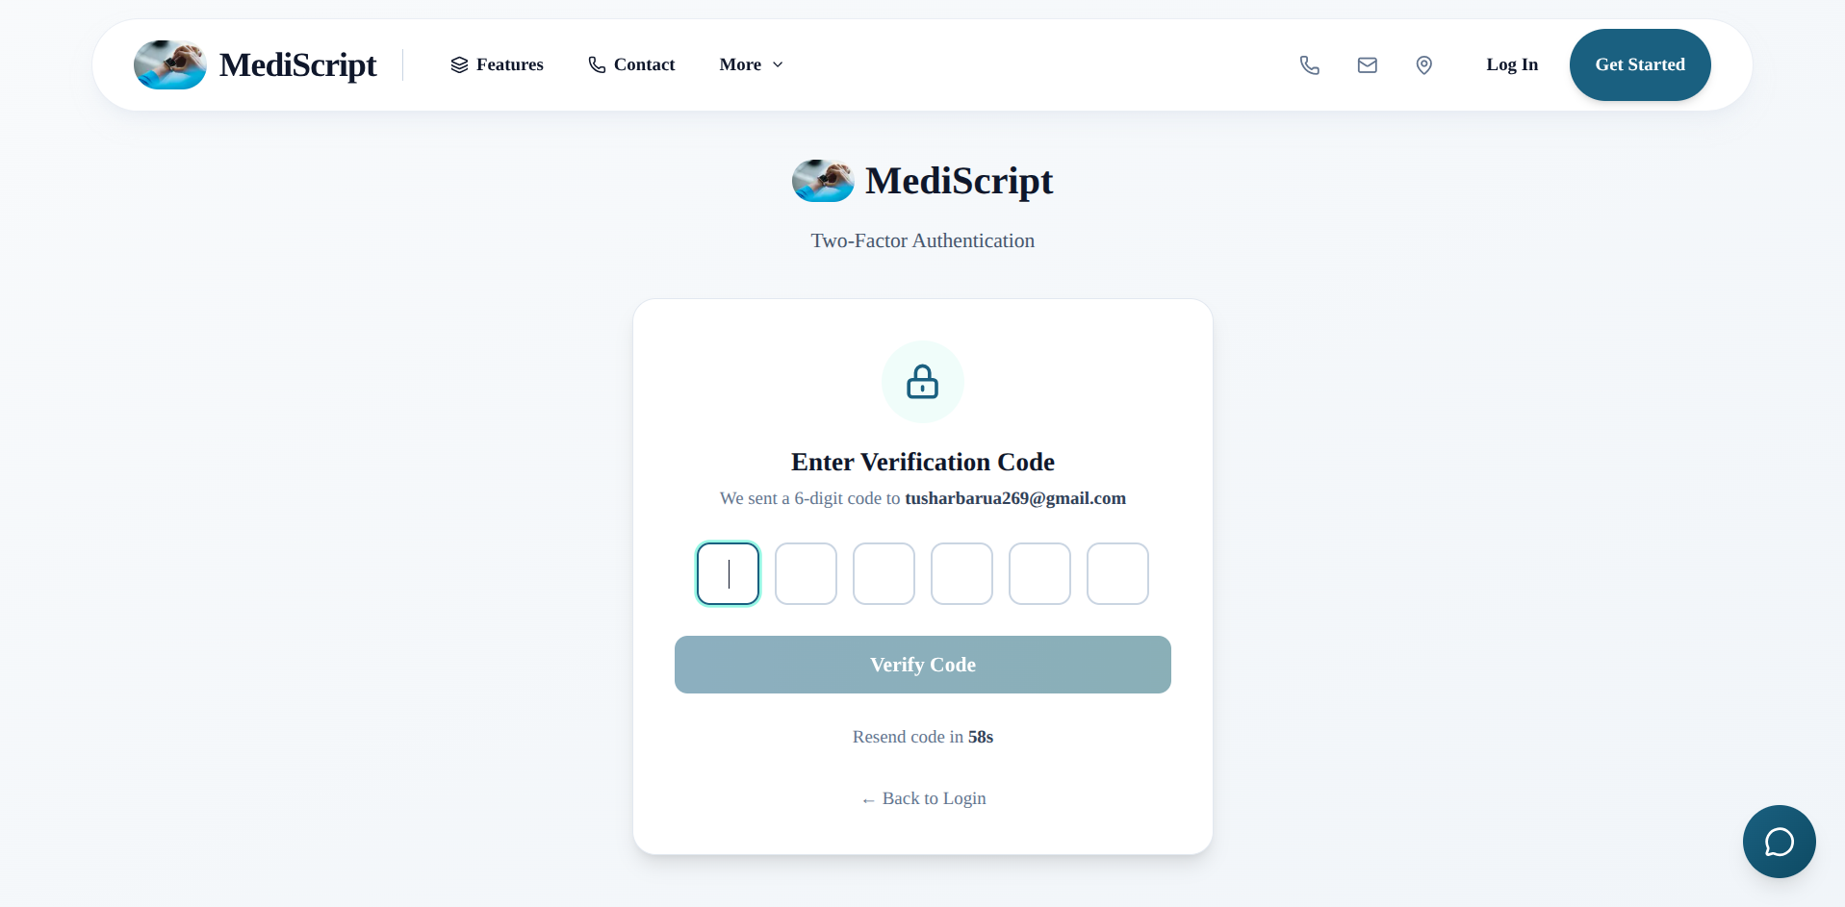
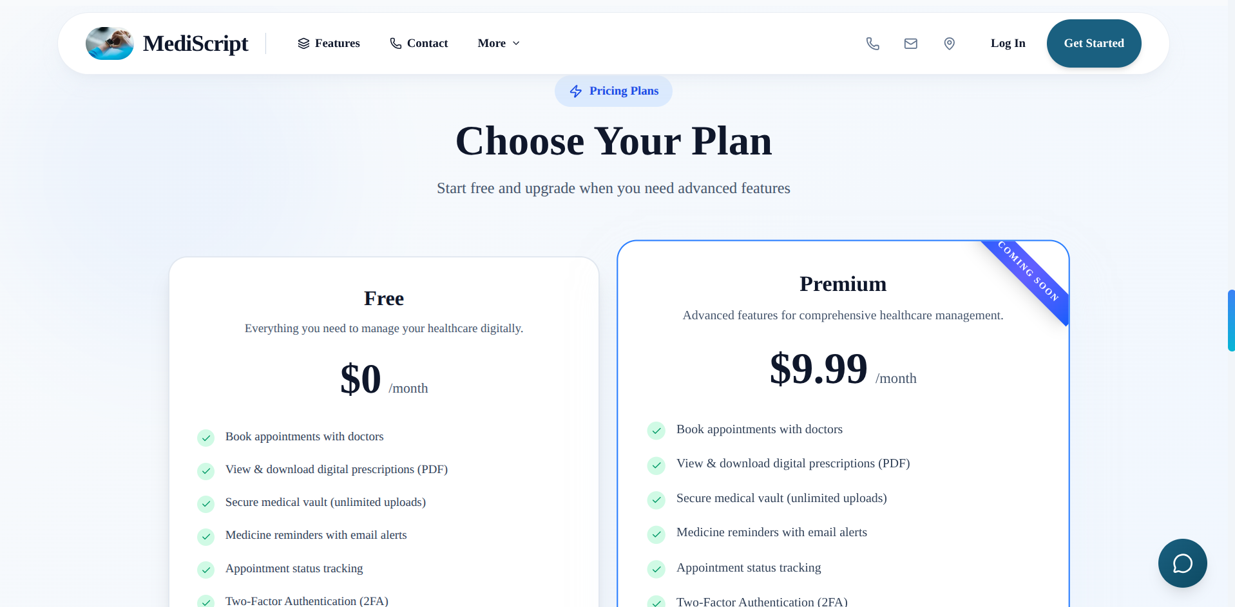
Authentication & Security
Phase 3 — Implementation
1
Email Verification
crypto token · 24h expiry · account inactive until verified
2
Password Hashing
bcryptjs · 10 salt rounds
3
Two-Factor Auth (2FA)
email OTP · 6 digits · 10 min expiry · optional per user
4
OAuth Login
Google & GitHub · auto email-verified · profile auto-created
5
JWT Sessions
30-day expiry · role stored in token
6
RBAC
every API route checks role + ownership on PATCH/DELETE
MediScript-E | Tushar Barua | CSE, USTC

Slide 13
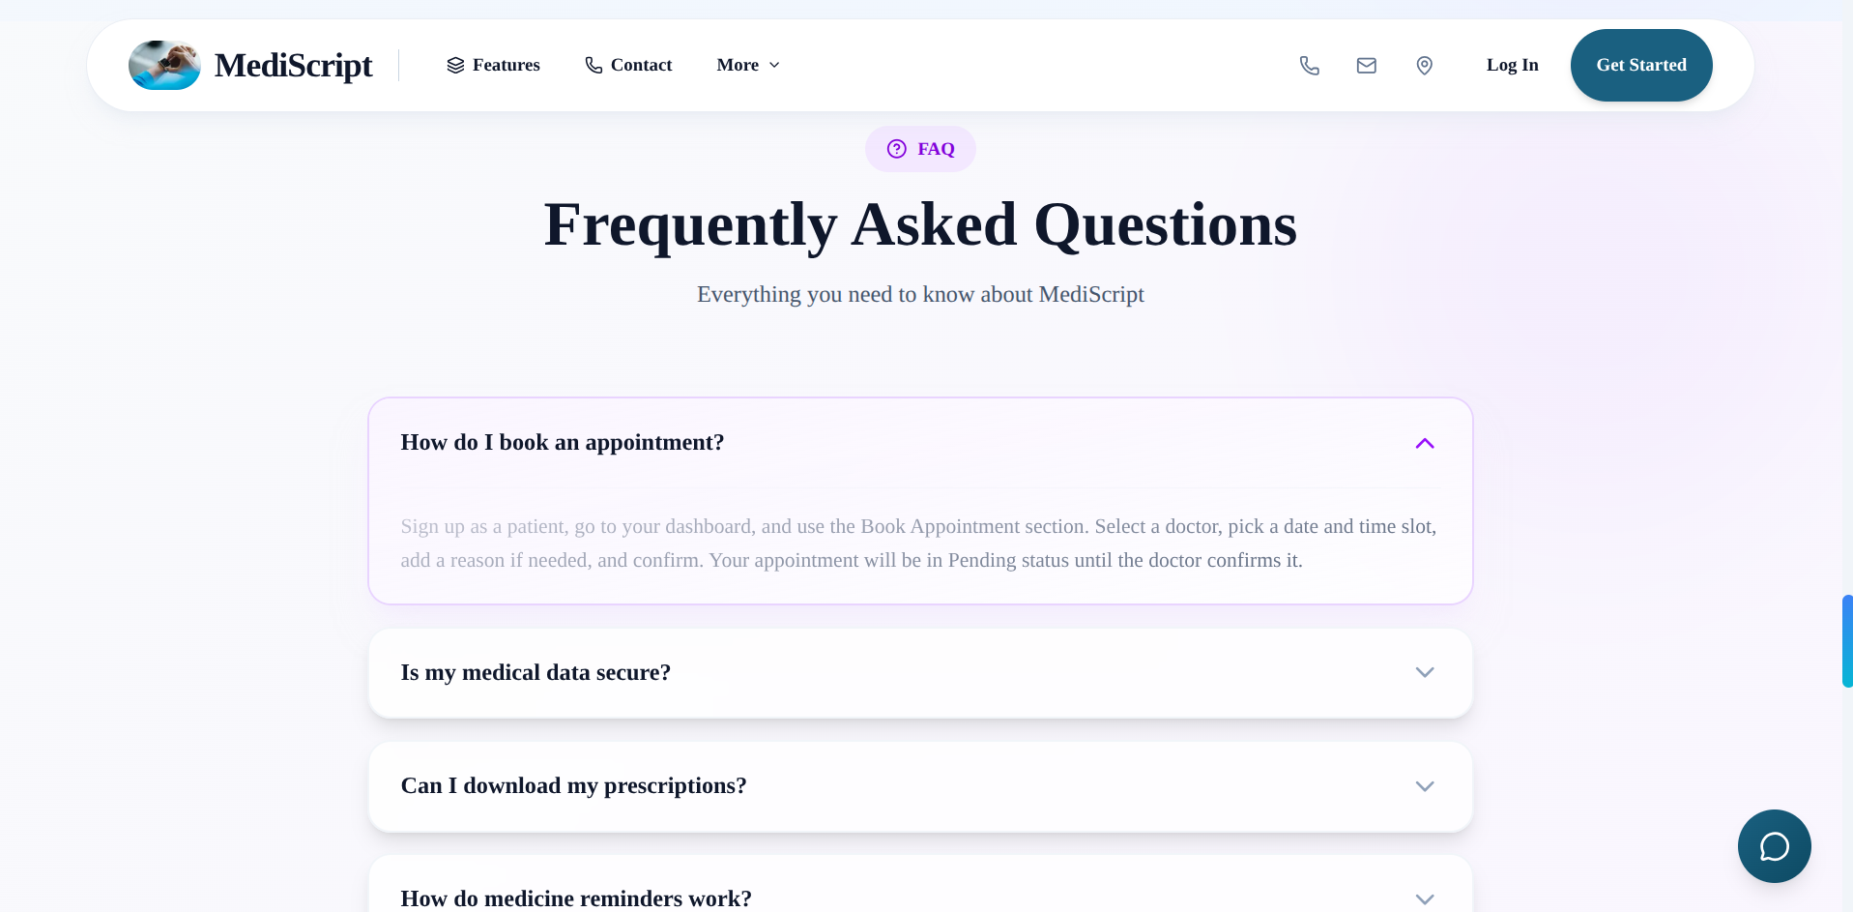
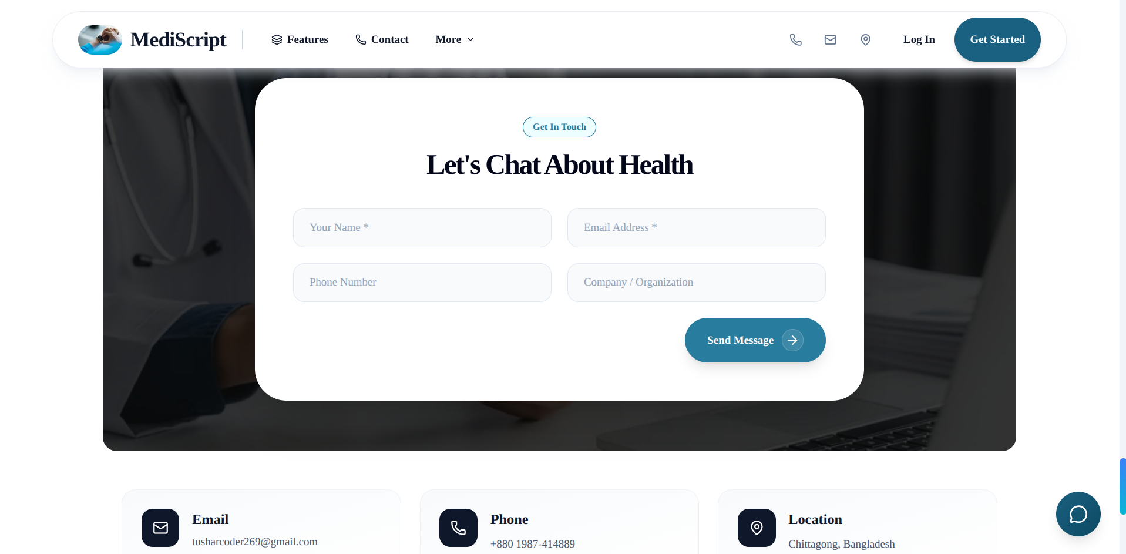
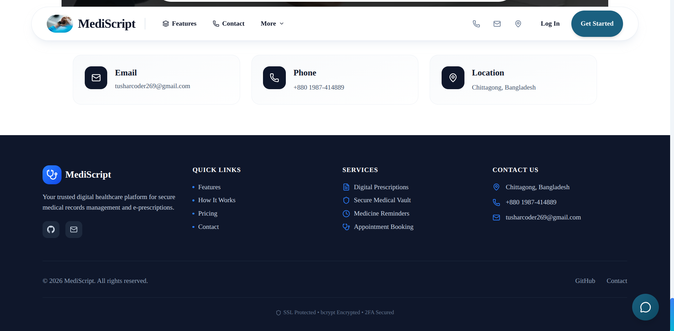
Patient Features
Phase 3 — Implementation
📅
Appointment Booking
📄
E-Prescription
Select doctor → pick date & time → confirm booking
View diagnosis + medications → download as PDF
💊
Medicine Reminders
🗂️
Medical Vault
Set schedule → receive automated email alerts daily
Upload reports → stored securely in Supabase cloud
MediScript-E | Tushar Barua | CSE, USTC

Slide 14
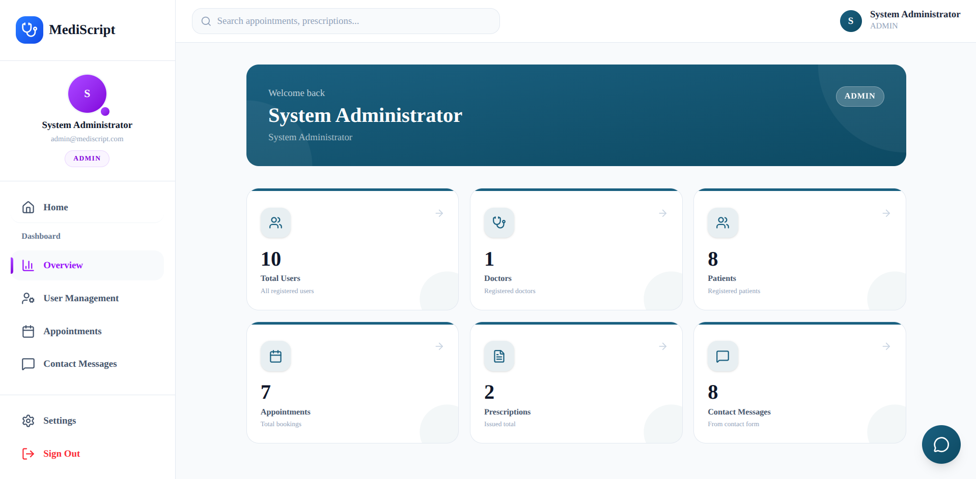
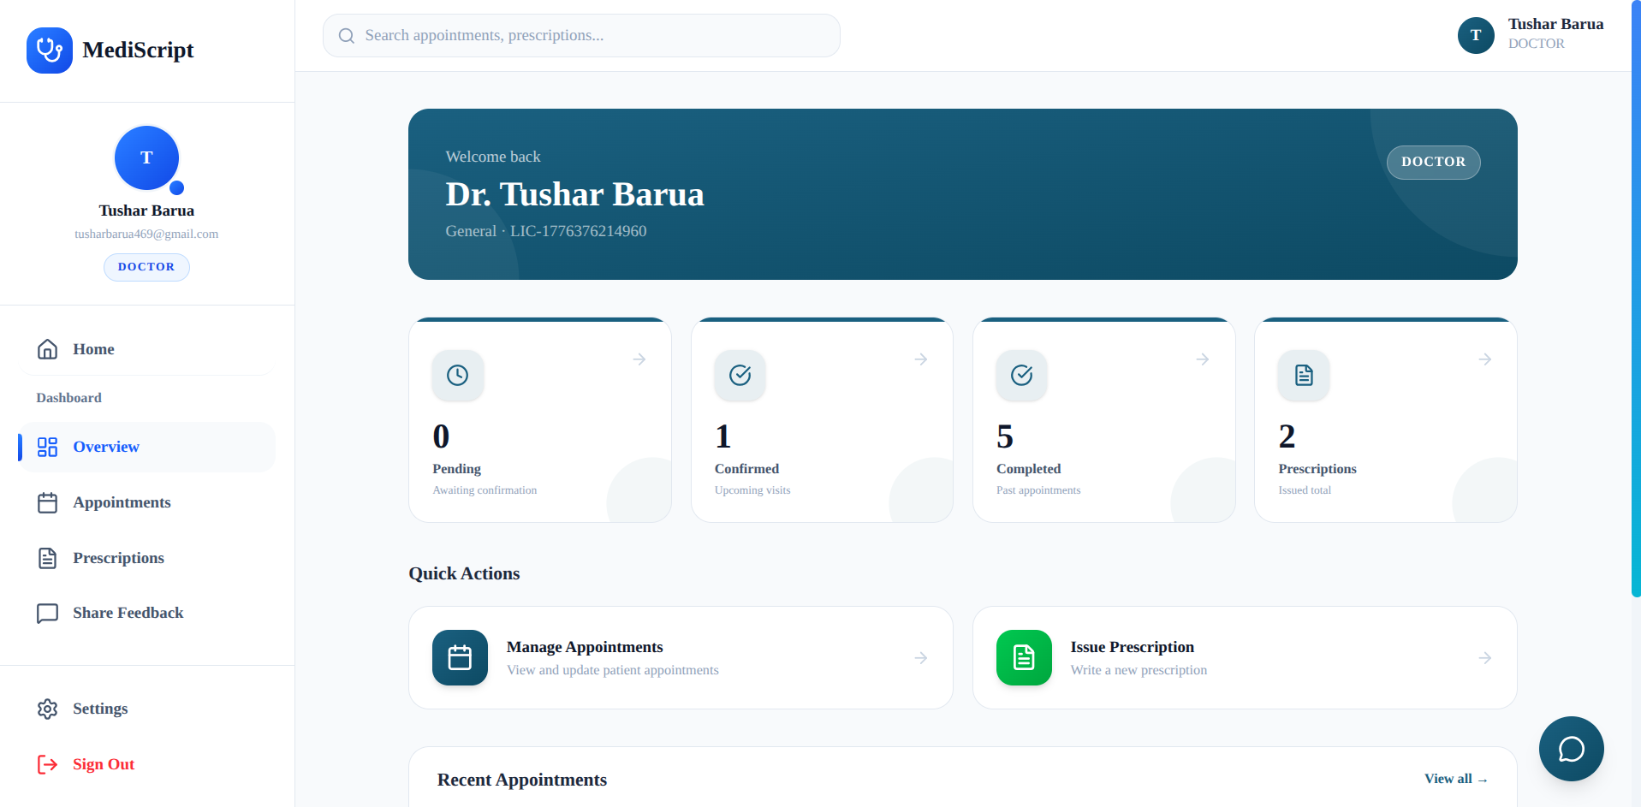
Doctor & Admin Features
Phase 3 — Implementation
👨⚕️ Doctor
🛡️ Admin
• Confirm / cancel / complete appointments
• Issue prescriptions → appointment auto-completed
• Edit, archive, delete prescriptions
• See patient blood group on prescription form
• Real-time platform statistics
• Delete users — cascade removes all data
• Monitor all appointments & contact messages
MediScript-E | Tushar Barua | CSE, USTC

Slide 15
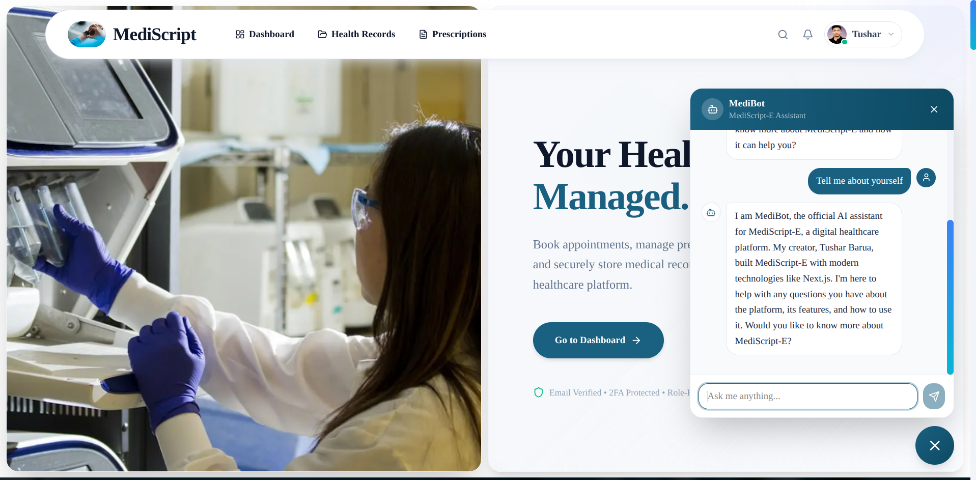
MediBot & Global Search
Phase 3 — Special Features
🤖 MediBot — AI Chatbot
🔍 Global Search
• Powered by Groq — Llama 3.1 8B Instant
• Answers platform-related questions
• Available globally on all pages
• Responds in Bangla if user writes in Bangla
• Max 512 tokens — concise responses
• Trigger: navbar icon or Ctrl+K
• Debounced — 300ms delay
Role | Can Search
Guest | Doctors only
Patient | Doctors · own appointments · prescriptions
Doctor | Patients · own appointments · prescriptions
Admin | All users · appointments · contacts
MediScript-E | Tushar Barua | CSE, USTC

Slide 16
Testing
Phase 4 — Testing & Validation
Testing Approach: Manual + Integration Testing
Test Area | Coverage | Result
Auth flows (register, login, 2FA, OAuth) | All auth paths tested end-to-end | ✅ Pass
Appointment lifecycle | PENDING → CONFIRMED → COMPLETED | ✅ Pass
Prescription CRUD | Create, edit, archive, delete | ✅ Pass
Medicine reminder + email delivery | Cron trigger → email received | ✅ Pass
Medical vault upload/delete | Upload, rename, delete verified | ✅ Pass
Security & authorization | Unauthorized access → 401/403 verified | ✅ Pass
Edge cases | Past date, duplicate email, expired OTP | ✅ Pass
MediScript-E | Tushar Barua | CSE, USTC

Slide 17
Results & Evaluation
Phase 5 — What Was Delivered
✓
Email Verification (24h token)
✓
Medical Vault (cloud storage)
✓
Two-Factor Authentication (2FA)
✓
AI Chatbot — MediBot (Groq Llama 3.1)
✓
Google & GitHub OAuth
✓
Global Search (role-aware, Ctrl+K)
✓
Appointment Booking & Management
✓
Admin Dashboard & User Management
✓
Digital Prescriptions + PDF Download
✓
Responsive UI — mobile + desktop
✓
Automated Medicine Reminders (email)
✓
Production Deployment — Live on Vercel
All SDLC phases completed · All requirements met · Live on Vercel
MediScript-E | Tushar Barua | CSE, USTC

Slide 18
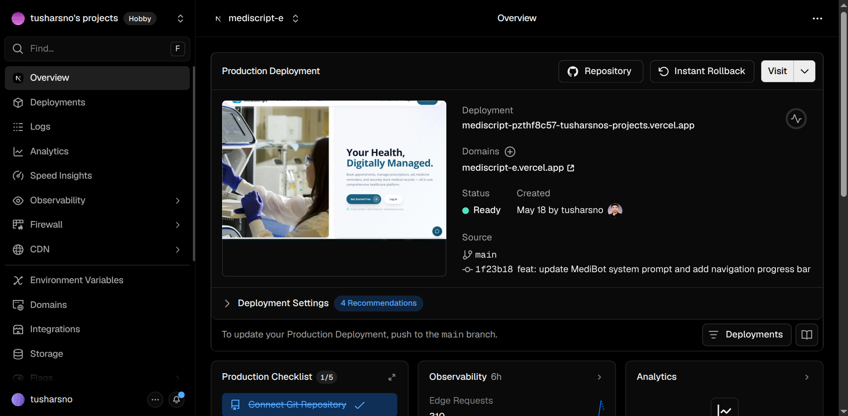
Deployment
Phase 5 — Deployment
1
Push to GitHub (main branch)
↓
2
Vercel detects push → triggers build
↓
3
Next.js build (pnpm build)
↓
4
Serverless functions deployed globally
↓
5
Live at: mediscript-e.vercel.app ✅
Key Config
• Database: Supabase PostgreSQL + PgBouncer pooling
• Cron: GitHub Actions — every 5 min → reminder emails
• 10 environment variables configured on Vercel
MediScript-E | Tushar Barua | CSE, USTC

Slide 19
Challenges & Solutions
Real Problems — Real Fixes
# | Challenge | Solution
1 | 2FA re-auth after OTP verification | Magic token + DB OTP null check before session creation
2 | Supabase SSL failure on Vercel | sslmode=no-verify + PgBouncer pooler URL
3 | OAuth users have no password field | Check user.password === '' before allowing update
4 | Medicine reminder time zone mismatch | Convert server time to Bangladesh Standard Time (UTC+6)
5 | Prisma connection exhaustion in serverless | Singleton pattern via globalThis.prismaGlobal
6 | Cascade delete — foreign key constraint errors | Manual delete in correct dependency order
7 | Stale JWT after profile name update | Force window.location.reload() after save
MediScript-E | Tushar Barua | CSE, USTC

Slide 20
Future Enhancements
What's Next for MediScript-E
⚡ Short Term
🚀 Medium Term
🌐 Long Term
• Real-time notifications (WebSockets)
• Doctor availability calendar
• Patient-doctor rating system
• Push notifications (PWA)
• Video consultation (WebRTC)
• Prescription QR code for pharmacies
• Mobile app (React Native)
• Multi-language support (Bangla)
• AI symptom checker
• Payment gateway for telemedicine
• HIPAA / GDPR compliance
• National health record integration
MediScript-E | Tushar Barua | CSE, USTC

Slide 21
Conclusion
SDLC Complete — Results & Takeaway
SDLC Phases: Requirements → Design → Implementation → Testing → Deployment ✅
What Was Achieved
✓
Secure auth — Email Verification, 2FA, OAuth, RBAC
✓
Complete patient-doctor workflow — booking to prescription
✓
Automated medicine reminder system (cron + email)
✓
Secure cloud-based medical record storage
✓
AI-powered chatbot assistant (MediBot — Groq Llama 3.1)
✓
Deployed and live on Vercel — production ready
"Structured Software Engineering methodology turns ideas into maintainable,
scalable, and secure real-world applications."
MediScript-E | Tushar Barua | CSE, USTC

Slide 22
Thank You
🎬 PLAY VIDEO MediScript-E Demo
MediScript-E — Your Health, Digitally Managed.
Tushar Barua
Computer Science & Engineering · USTC, Chittagong
📧 tusharcoder269@gmail.com
🔗 github.com/tusharsno
🌐 mediscript-e.vercel.app
Open for Questions & Discussion
MediScript-E | Tushar Barua | CSE, USTC

